Slide 1
Content Advanced Features
Notes:
1

Slide 2
Node Types
2
Notes:
2

Slide 3
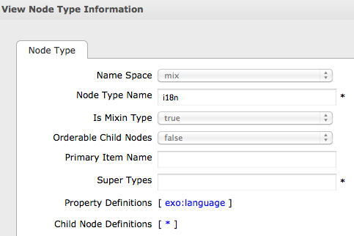
JCR – Node Types
A node type defines the properties and the possible child nodes of a nodes.
A node type must be either“primary”or“mixin”:
Primary node type: Each node is defined by exactly one primary node type.
Mixin node type: Each node can integrate properties of 0 or several mixin node types. (For java experts: Mixins are often compared to java interfaces.)
Notes:
3
3

Slide 4
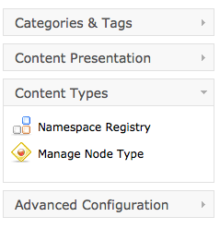
Node Type
Namespace, NodeType and Templates
There are many different nodetypes for a JCR.
A nodetype defines the properties and possible child nodes.
A nodetype can inherit from other nodetypes.
The nodetype then inherits property and child node definitions.
Notes:
4
4

Slide 5
Namespace
Namespace
Each nodetype and property belongs to a namespace.
The namespace helps to avoid name conflicts. (When different organizations uses the same name.)
A namespace is a prefix, defined a URL. (Similar to xml.)
The namespaces are managed in a namespace registry.
Do not hesitate to create your own namespace(s) for your nodetypes and properties.
Notes:
5
5

Slide 6
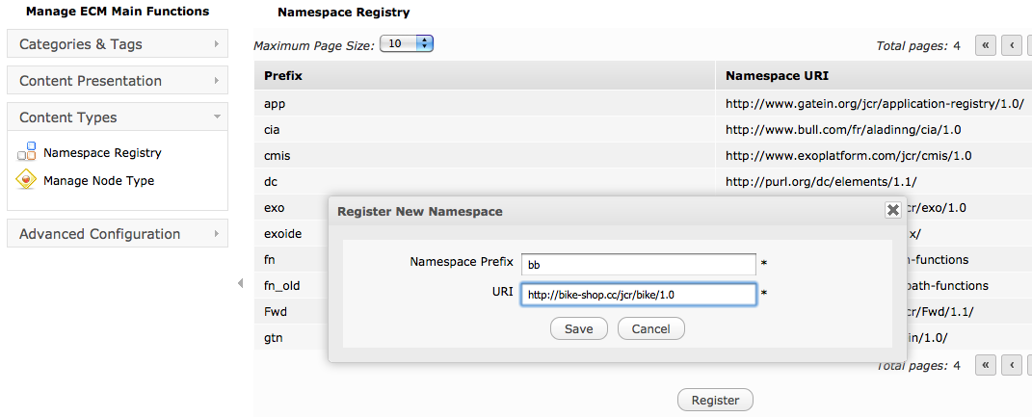
Namespace
Notes:
6
6

Slide 7
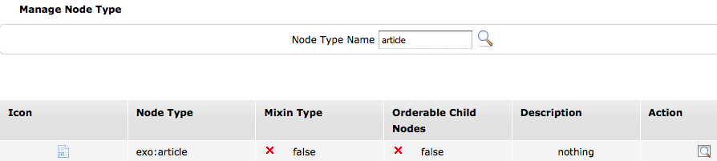
Node Type
Notes:
7
7

Slide 8
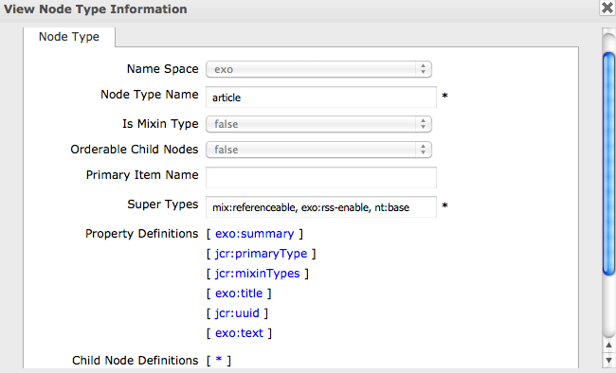
Node Type
Notes:
8
8

Slide 9
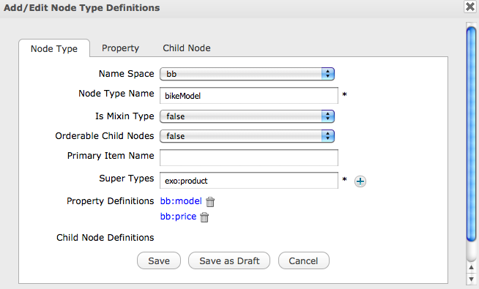
Node Type
Notes:
9
9

Slide 10
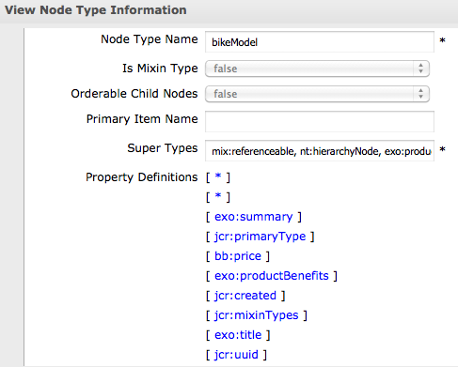
Node Type
Notes:
10
10

Slide 11
Document Types
11
Notes:
11

Slide 12
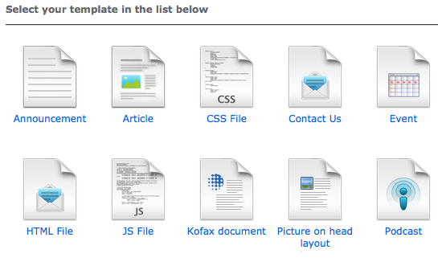
Document Type
Document types are node types for which you created a dialog and a view template.
Document type dialog templates appear in the “Add Content” dialog of the site explorer.
Notes:
12
12

Slide 13
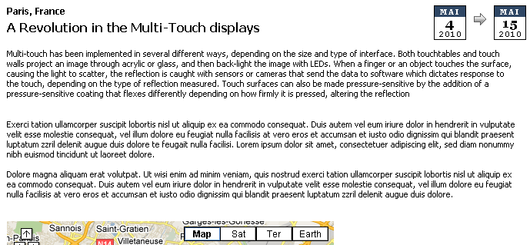
Document Type
The view of a document type is used for showing the content.
Notes:
13
13

Slide 14
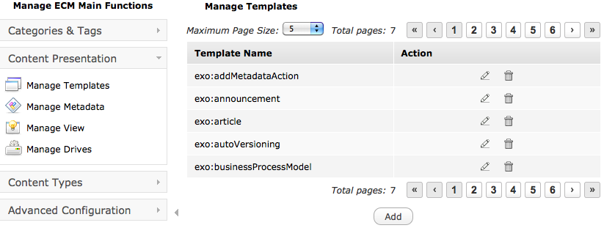
Document Type
You can modify current templates or create new ones.
Notes:
14
14

Slide 15

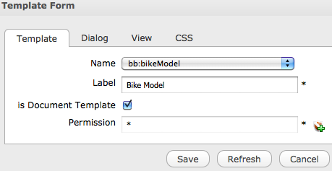
Document Type
You can modify current templates or create new ones.
Notes:
15
15

Slide 16
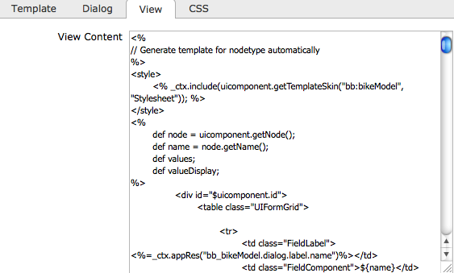
Document Type
The dialog and view templates are written in groovy template language.
Notes:
16
16

Slide 17
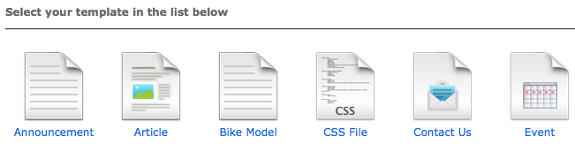
Document Type
The dialog is now in the template list.
Notes:
17
17

Slide 18
Exercise: Document Type
New node type “BikeModel”
Create a namespace “bb”
Create a node type “bikeModel” that inherits from “exo:product”. Do not save yet! Add the string property “model“ and the double property “price” to the bikeModel node type. Now, save the node type. After saving you cannot modify the node type anymore!
Open the manage templates interface, Click on “Add”. Choose the node type “bikeModel” and create a view and a dialog – they will be generated automatically.
Open the site explorer, drive “Sites Management” your new document type.

Slide 19
Locks – Unlocks
19
Notes:
19

Slide 20
Locks
When modifying a content, then the node is locked for other users automatically by the Content Explorer.
The locked node is marked by a very small lock.
Behind this, there is a locking mechanism. If necessary, an administrator can unlock nodes manually.

Slide 21
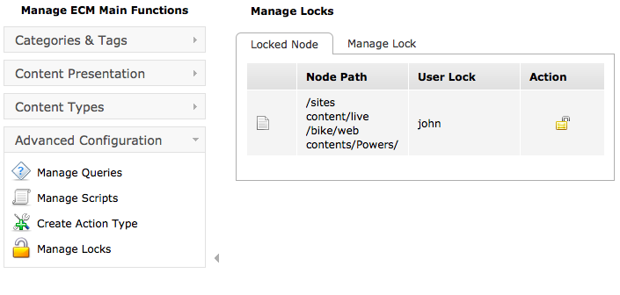
Unlock
Behind this, there is a locking mechanism. If necessary, an administrator can unlock nodes manually.

Slide 22
Export – Import
22
Notes:
22

Slide 23

Export - Import
You can export a node. This export the node and all its descendants to an xml file.
You import the exported file to another node or another installation of eXo, also for transferring between from Pre-Prod and Production systems.

Slide 24
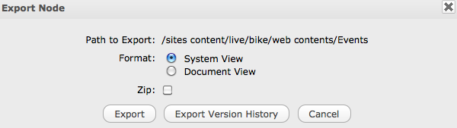
Export - Import
When exporting you can choose between two different xml formats (they are explained in eXo Developer course).

Slide 25
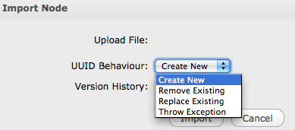
Export - Import
When Importing you may have conflicts of UUID which by definition have to be unique. PLF-2970

Slide 26
Exercise: Export - Import
Open the folder: /bike/web contents/Events
Export this node.
Scrutinize the exported file.
Delete this node and test it.
Import the node to the same parent node and test again.

Slide 27
Actions
27
Notes:
27

Slide 28
Triggers – Actions
You can link an action to any node.
Action Types:
Business Process: Workflow integration with Bonita or JBPM,
Groovy Script: A java implementation.
The action can be triggered when
A node is added, deleted,
A property is added, deleted or read,
the scheduler triggers the action,
or right-click by the user.
Actions are node types
You can find them in the node type list. Furthermore each action has a dialog template.

Slide 29
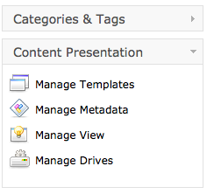
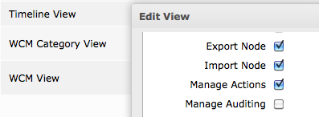


Actions

Slide 30
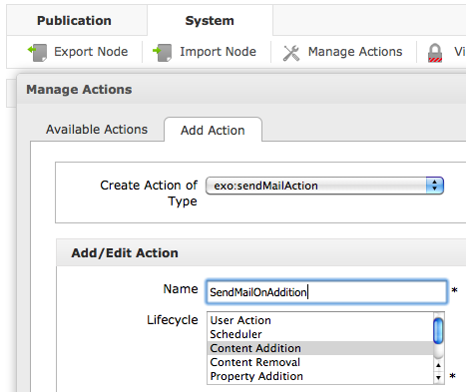
Actions

Slide 31
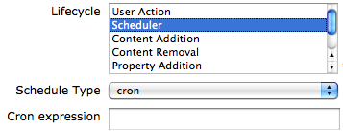
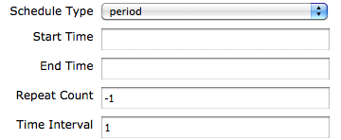
Scheduled Actions
Schedule Types:
Cron: A cron expression can define any period, repetitions, weekdays etc. – a little bit cryptic.
Period: Start and End time, number of repetitions and a time interval.

Slide 32
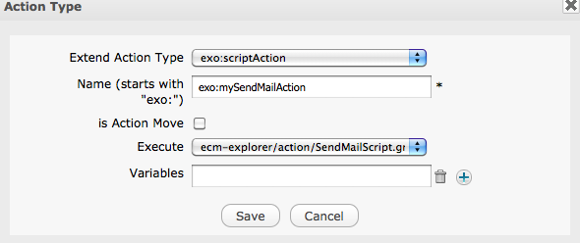
Actions

Slide 33
Content Advanced Features
Notes:
33

