Slide 1
Chromattic
Notes:
1

Slide 2
Table of Content
Chromattic – JCR comparison
Concept
Benefits
Property Mapping
How-To
Exercise
Notes:
2

Slide 3
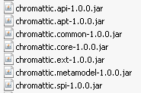
Chromattic
What
An object mapping framework
…for Java Content Repository as back end storage
Like Hibernate for relational data bases
http://code.google.com/p/chromattic/
Notes:
3

Slide 4
Chromattic - JCR Comparison
4
Notes:
4

Slide 5
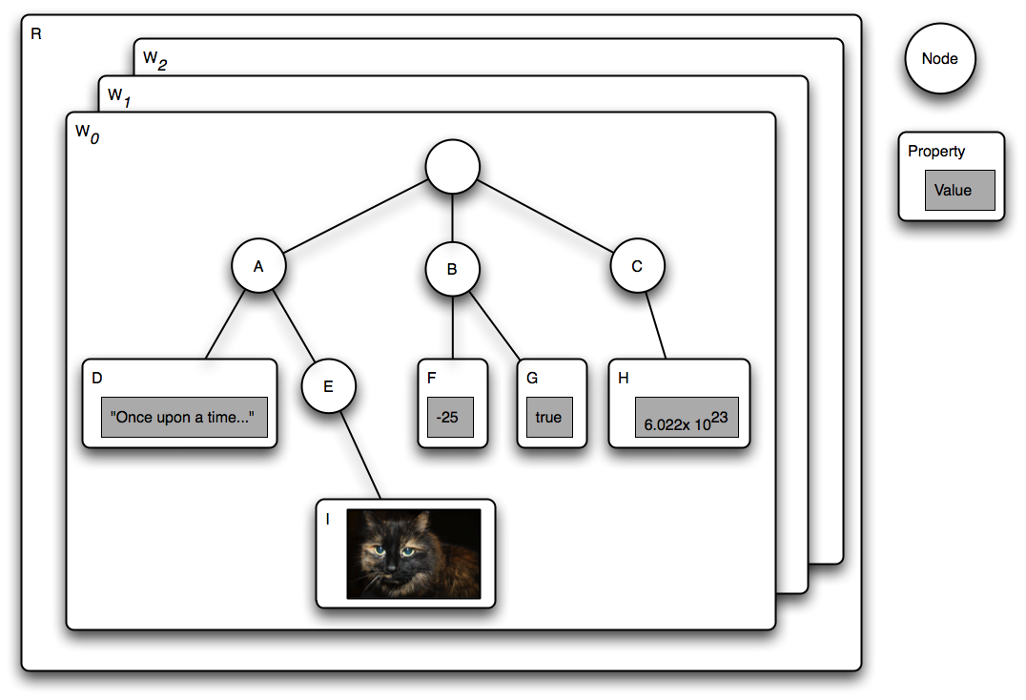
JCR
Notes:
5

Slide 6
JCR – Chromattic Comparison
JCR defines a set of base node types for modeling a file system
nt:hierarchyNode: a super type for file and folder, its purpose is mainly to define a common node type for children of a folder
nt:resource: a node type for modeling a resource, basically it's data
nt:file: a node type for a file, it contains data via a jcr:content child node of type nt:resource
nt:folder: a node type for a folder with children of type nt:hierarchynode
The following examples list the content of a directory structure and we have two versions, one using the native JCR API and one using Chromattic objects mapped onto the same node types.
Notes:
6

Slide 7
JCR Way
public void print(Node node) throws RepositoryException {
String typeName = node.getPrimaryType().getName();
if (typeName.equals(“nt:file”)) {
Node content = node.getNode(“jcr:content”);
String mimeType = “”;
if (content.hasProperty(“mimeType”)
mimeType = content.getProperty(“mimeType”).getString();
System.out.println(“File” + node.getName() + “:” + mimeType);
} else if (typeName.equals(“nt:folder)) {
System.out.println(“Folder “ + node.getName());
Iterator i = node.getNodes();
while (i.hasNext()) {
Node child = (Node)i.next();
print(node);
} else {
throw new IllegalArgumentException(“print should not be called with the node type ” + typeName);
}
}
Notes:
7

Slide 8
JCR Way – Not type safe
public void print(Node node) throws RepositoryException {
String typeName = node.getPrimaryType().getName();
if (typeName.equals(“nt:file”)) {
Node content = node.getNode(“jcr:content”);
String mimeType = “”;
if (content.hasProperty(“mimeType”)
mimeType = content.getProperty(“mimeType”).getString();
System.out.println(“File” + node.getName() + “:” + mimeType);
} else if (typeName.equals(“nt:folder)) {
System.out.println(“Folder “ + node.getName());
Iterator<?> i = node.getNodes();
while (i.hasNext()) {
Node child = (Node)i.next();
print(node);
} else {
throw new IllegalArgumentException(“print should not be called with the node type ” + typeName);
}
}
Notes:
8

Slide 9
Chromattic Way – provides type safety
public void print(File file) {
if (file instanceof Document) {
String mimeType = file.getContent().getMimeType();
System.out.println(“File “ + file.getName() + “ “ + mimeType;
else {
Folder folder = (Folder)file;
System.out.println(“Folder “ + folder.getName();
for (File child : folder.getChildren())
print(child);
}
}
Notes:
9

Slide 10
Benefits
10
Notes:
10

Slide 11
Benefits
Keywords
Provides a type safe object model for JCR
Use Java 5 annotation
Enable development of rich models
Integrates well with Java language with the use of Java Collection and Generics
Advanced features like support for JCR multiple inheritance
Integrates at the Java compiler level via the Java Annotation Processor Tools (APT)
Generation of node type definitions
Notes:
11

Slide 12
Benefits
Details
Object oriented programming
Add any method you need
Methods are invoked with an appropriate node type, enforced during the compilation.
Productivity
Code completion
Refactoring
Less errors due to typos etc.
Notes:
12

Slide 13
Concept
13
Notes:
13

Slide 14
Concept
Chromattic Builder
build()
Chromattic
open()
Chromattic Session
Chromattic classes
Meta Model
Objects
Java
classes
Node type defs
JCR
Notes:
14

Slide 15
Object Lifecycle
ChromatticSession provides support for interacting with objects life cycle.
Chromattic Session
create()
persist()
Transient
insert()
Persistent
destroy()
Removed
Notes:
15

Slide 16
Class Generation
Uses APT (Annotation Processor Tool)
File.java
APT
File_Chromattic. java
Compiler
File.class
File_Chromattic. class
Class loading
Class<File>
<<extends>>
Class<File_Chromattic>
Notes:
16

Slide 17
Property Mapping
17
Notes:
17

Slide 18
Property mapping
Java types are mapped to JCR property types
String as JCR String
Integer/int/Long/long as JCR Long
Boolean/boolean as JCR Boolean
Float/float/Double/double as JCR Double
java.util.Date as JCR Calendar
InputStream as JCR Binary
Java enum type mapped to JCR String type

Slide 19
Multivalued property mapping
JCR types can be multivalued and are mapped either to native array type or java.util.List java type
@Property
int[] getIntArray();
@Property
Integer[] getIntegerArray();
@Property
List<Integer> getIntegerList();

Slide 20
Relationship types
Four kinds of relationship
Hierarchic: the default one
Reference and path provides support for JCR references
Embedded enables mapping for super type and mixin

Slide 21
Collection mapping
Unordered collection
Collection<File> getChildren()
Ordered collection based on JCR node order
List<File> getChildren()
Associative collection
Map<String, File> getChildren()

Slide 22
JCR multiple inheritance support
@MixinType(name=“votes”)
public abstract class Votes {
public abstract int getVoteCount();
public abstract void setVoteCount(int count);
}
@PrimaryType(name=“nt:file”)
public abstract class Document {
@OneToOne(type = RelationshipType.EMBEDDED)
@Owner
public abstract Votes getVotes();
}

Slide 23
Parameter type and generics inheritance
public abstract class Container<T> {
@OneToMany
public abstract Collection<T> getChildren();
}
@PrimaryType(name=“nt:folder”)
public abstract class Directory extends Container<File> {
}
@PrimaryType(name=“identities”)
public abstract class IdentityContainer<I extends IdentityObject> extends Container<I> {
}

Slide 24
Eventing
The session provides eventing for state changes
Entity life cycle changes
State changes (properties)
Enables dependency injection integration
public class InjectingListener implements LifeCycleListener {
public created(Object o) {
if (o instanceof FrameworkObject) {
((FrameworkObject)o).setFramework(framework);
}
}
…
}

Slide 25
Chromattic HowTo
25
Notes:
25

Slide 26
How-to
Example
org.chromattic.docs.reference.gettingstarted.Page class - an object representation of a web page.
The property name is the web page name and is mapped to the JCR node name.
The property title is the page title and is mapped to the JCR title node property of type STRING.
The property content is the page content and is mapped to the JCR content node property of type STRING.
Hint: Create an abstract bean class, Chromattic will implement this class
Use annotations for the mapping
Notes:
26

Slide 27
How-to
@PrimaryType(name = "gs:page")
public abstract class Page {
@Name
public abstract String getName();
@Property(name = "title")
public abstract String getTitle();
public abstract void setTitle(String title);
@Property(name = "content")
public abstract String getContent();
public abstract void setContent(String content);
}
Notes:
27

Slide 28
How-to
Bootstrap:
ChromatticBuilder builder = ChromatticBuilder.create();
builder.add(Page.class);
Chromattic chromattic = builder.build();
Session:
ChromatticSession session = chromattic.openSession();
try
{
Page page = session.insert(Page.class, "index");
page.setTitle("Hello Page");
page.setContent("Hello World");
session.save();
}
finally { session.close(); }
Notes:
28

Slide 29
How-to
Build:
Uses APT (Annotation Processor Tool)
Needs a Chromattic APT jar on the class path
Does not modify existing classes, but takes the existing classes and adds new classes.
Maven dependency entry:
<dependency>
<groupId>org.chromattic</groupId>
<artifactId>chromattic.api</artifactId>
</dependency>
Notes:
29

Slide 30
Multiple Values
Uses a List <?>
<propertyDefinition autoCreated="false" mandatory="false" multiple="true" name="tags"> </propertyDefinition>
/**
* Returns the list of the page tags.
*
* @return the list of tags
*/
@Property(name = "tags")
public abstract List<String> getTags();
Notes:
30

Slide 31
Parent-Child Relation
One to One relation.
Parent and child is „mappedby“ have a „MappedBy“ and an „OneToOne“ annotation.
The parent is „owner“ of the child.
Code of the site object:
@Owner
@OneToOne
@MappedBy("root")
public abstract Page getRootPage();
public abstract void setRootPage(Page root);
Code of the Root object:
@OneToOne
@MappedBy("root")
public abstract WebSite getSite();
Access code:
Page root = session.create(Page.class);
site.setRootPage(root);
assertEquals(site, root.getSite());
session.save();
Notes:
31

Slide 32
Exercise: Chromattic
In the data folder, create node types (upper right corner) for cmtc files.
In the logic folder, deploy the PhoneBookRestService.grs REST service.
In the UI folder, you need change value of variable "serverUrl" (by default it set to "http://localhost:8080/IDE/rest/shop") on your domain name in PhoneBookGadget.xml.
Now you can now test the PhoneBookGadget.xml.
To deploy your gadget in your iGoogle dashboard. Get the URL of the gadget from the View menu, removing "/private" from the URL.
Notes:
32

Slide 33
Chromattic
Notes:
33

