Slide 1
eXo Extended Services

Slide 2
eXo Knowledge

Slide 3
eXo Forum Adminstrator
RolesRulesPlugin :
Defines who is administrator (of all portlet instances in all sites)
Definition by login, group or membership
Example:
...webapps\portal\WEB-INF\conf\ks\ks-plugins-configuration.xml :
<value-param>
<name>role</name>
<value>ADMIN</value> <!--only ADMIN is possible here -->
</value-param>
<values-param>
<name>rules</name>
<value>root</value>
<value>*:/platform/administrators</value>
<value>manager:/platform/users</value>
...

Slide 4
eXo Forum
Contact Provider Component:
When opening the user profile, the data can be provided by different ways.
...webapps\ks-extension\WEB-INF\ks-extension\ks\profile-configuration.xml
<component>
<key>org.exoplatform.ks.common.user.ContactProvider</key>
<type>org.exoplatform.ks.common.user.DefaultContactProvider</type>
</component>
Alternatives providers:
  CSContactProvider
  PersonalProfileContactProvider
  BusinessProfileContactProvider
  Detailed wiki article: http://wiki.exoplatform.org/xwiki/bin/view/KS/Profile+Provider+Configuration

Slide 5
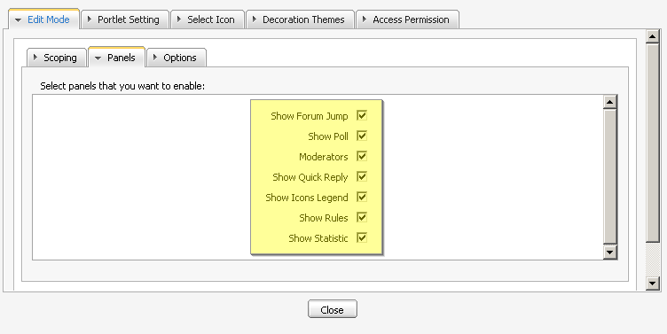
eXo Forum
Composition of the Forum Portlet:
The forum portlet contains smaller portlets, you can choose to show those small interfaces in the forum settings:
Show Forum, Jump, Show Poll, Moderators, Show Quick Reply, Show Icons Legend, Show Rules, Show Statistic
The forum portlet
accesses in fact the
UIComponent of each
portlet.

Slide 6
eXo Forum
Forum real world project:
Get a idea of the goal structure before you start
What categories and which names for theses categories?
Which forums in each category and their names?
Who will be a moderator of each single category?
For each forum, which email addresses shall be notified at new each new topic or new message?
Which forums shall be moderated?
Which groups have write and view access to each forum?
Do you want to have all forums in on portlet instance or in several instances?

Slide 7
eXo FAQ
FAQ:
RolesRulesPlugin
ContactProvider
Modify the template in the portlet’s setting
http://wiki.exoplatform.org/xwiki/bin/view/KS/Initialization+FAQ+Plugin+Configuration

Slide 8
Exercise
Create a custom extension redefining:
  RolesRulesPlugin (...webapps\portal\WEB-INF\conf\ks\ks-plugins-configuration.xml)
  The contact provider (...webapps\ks-extension\WEB-INF\ks-extension\ks\profile-configuration.xml)
  Replace the UI Compoment by your custom component: ...\webapps\forum\templates\forum\webui\popup\UIQuickReplyForm.gtmpl

Slide 9
eXo Collaboration

Slide 10
eXo Contacts
Contacts Listener
By default (cs-extension) there is a listener that creates an address book for each user group.
http://svn.exoplatform.org/projects/cs/trunk/extension/webapp/src/main/webapp/WEB-INF/cs-extension/cs/contact/contact-service-configuration.xml
3 listeners for creating:
  The user fiche and the permission to the user to modify its fiche (org.exoplatform.contact.service.impl.NewUserListener)
  The group address book – if it did not exist – and adds the user to this book (NewMembershipListener).
  synchronizes the user fiche whenever the root modifies the user profile in staff management – or any other modification of the user’s details. (UpdateUserProfileListener)

Slide 11
eXo Contacts
Make group address books visible
By default the user only sees those group address books to those he belongs to.
With this configuration you can make other groups visible.
<component>
<key>org.exoplatform.contact.service.ContactService</key>
<type>org.exoplatform.contact.service.impl.ContactServiceImpl</type>
<init-params>
<values-param>
<name>UserCanSeeAllGroupAddressBooks</name>
<description>User can see all GroupAddressBooks or only GroupAddressBooks that the user has at least one membership</description>
<value>false</value>
</values-param>
<values-param>
<name>NonPublicGroups</name>
<description>Groups that shouldn't be displayed in broadcast list. Wildcards may be used in groups name</description>
<!--value>/platform/*</value>
<value>/platform/guests</value-->
</values-param> </init-params> </component>

Slide 12
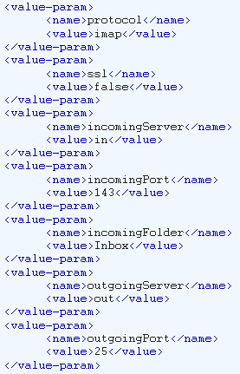
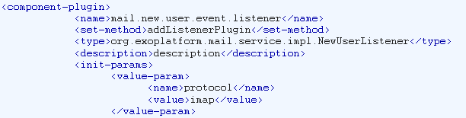
eXo Mail
NewUserListener
org.exoplatform.mail.service.impl.NewUserListener

Slide 13
Exercises – eXo Collaboration
Analyse the contact listeners …/webapp/WEB-INF/cs-extension/cs/contact/contact-service-configuration.xml
Make all address books visible: org.exoplatform.contact.service.ContactService
Modify the parameters of: org.exoplatform.mail.service.impl.NewUserListener

Slide 14
eXo Social

Slide 15
Social
Add a button to the activity stream
Custom activity types
Custom UI view for the activity types

Slide 16
Social
Lifecycles:
http://svn.exoplatform.org/projects/social/branches/1.0.x/component/exosocial/src/main/java/conf/portal/configuration.xml
Other stuff: http://svn.exoplatform.org/projects/social/branches/1.0.x/component/people/src/main/java/conf/portal/configuration.xml
Space:
also configuration.xml

Slide 17
Social
OpenSocial
eXo Social implements open social protocols

Slide 18
Social
OAuth
Authentification without sending login and password.
Authentification credentials between servers that trust each other.
They send login and a token between the servers (3-lag)

Slide 19
eXo Extended Services

