Slide 1
CRaSH
Notes:
1

Slide 2
CRaSH Introduction
2
Notes:
2

Slide 3
CRaSH
What
A shell for Java Content Repository
Considers the JCR tree as its file system
Basic administration
http://code.google.com/p/crsh
Notes:
3

Slide 4
CRaSH
How
Written as a Groovy script
Easy to add new commands
Found in WEB-INF/groovy/commands
Annotated with Args4j
Describe switches and arguments
You can extend the language
Notes:
4

Slide 5
CRaSH
Telnet
SSH
Connectors
Shell Engine
JCR
Connector
SCP
Commands
Args4j
Groovy
Notes:
5

Slide 6
Groovy integration: property access
// Iterate over the properties
Node.eachProperty({ property -> out.print(property.name);};
// This code
def foo = null;
if (node.hasProperty(‘foo)) {
foo = node.getProperty(‘foo’).getString();
}
// Can be replaced by
foo = node.foo;
//
foo = node[‘foo’];

Slide 7
Groovy integration: node child access
// Iterates over the children
def count = 0;
node.each({ node -> count++; })
// This code
def foo = null;
If (node.hasNode(‘foo’) {
foo = node.getNode(‘foo);
}
// can be replaced by
foo = node.foo;
// Or
foo = node[‘foo’];

Slide 8
Documentation
http://crsh.googlecode.com
http://crsh.googlecode.com/svn/doc/1.0.0-beta9/index.html

Slide 9
CRaSH HowTo
9
Notes:
9

Slide 10
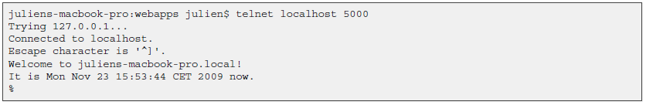
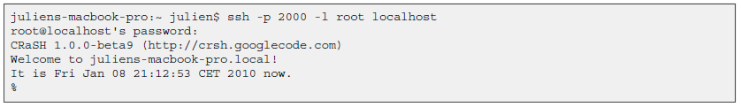
CRaSH How-to
Steps
Copy the crsh.war to a server running eXo Portal 2.5 or GateIn.
Telnet connection is done on port 5000
SSH connection is done on port 2000 with the password crash :
Notes:
10

Slide 11
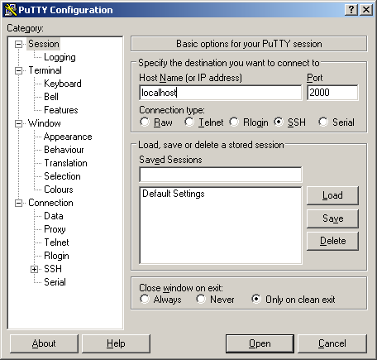
CRaSH How-to
PuTTY:
Notes:
11

Slide 12
CRaSH Commands
Commands
Connect to the container “portal” to the workspace “portal-system”
Like Unix ls, cp, mv, rm
SQL select command
Notes:
12

Slide 13
CRaSH Commands
Export
It is possible to export a node. The node type is nt:file. The file is in the root folder of the same workspace. Then it is possible to access the file from webdav.
Import, the other way around
Notes:
13

Slide 14
SCP Export and Import
Export
The following command will export the node /gadgets in the repository portal-system of the portal container portal:
scp -P 2000 root@localhost:portal:portal-system:/production/app:gadgets .
The node will be exported as app_gadgets.xml.
Note that the portal container name is used: “portal”. If you do omit it, then the root container will be used. The exported file format use the JCR system view.
Import
scp -P 2000 gadgets.xml root@localhost:portal:portal-system/production/app:gadgets
Notes:
14

Slide 15
Exercise: CRaSH
Connect to CRaSH by ssh (port 2000) or telnet (port 5000)
Type in your shell: connect -c portal -u root -p gtn collaboration
Test the commands: ls, cd, mv, rm,
Export and import a node. Is it document or system view? Import the node 5 times. What happens?
Add a mix:versionable mixin to an existing node. (syntax: addmixin . mix:versionable)
Test 5 different select use cases as seen in http://wiki.exoplatform.org/xwiki/bin/view/JCR/JCR+Query+Usecases.
Export and import using SCP
For experts: Create a new command and test it
Documentation: http://crsh.googlecode.com/svn/doc/1.0.0-beta18/html/index.html
Notes:
15

Slide 16
CRaSH
Notes:
16

