Slide 1
CRaSH
Notes:
1

Slide 2
CRaSH Introduction
2
Notes:
2

Slide 3
CRaSH
What
A shell for Java Content Repository
Considers the JCR tree as its file system
Basic administration
http://code.google.com/p/crsh
Notes:
3

Slide 4
CRaSH
How
Written as a Groovy script
Easy to add new commands
Found in WEB-INF/groovy/commands
Annotated with Args4j
Describe switches and arguments
You can extend the language
Notes:
4

Slide 5
CRaSH
Telnet
SSH
Connectors
Shell Engine
JCR
Connector
SCP
Commands
Args4j
Groovy
Notes:
5

Slide 6
Groovy integration: property access
// Iterate over the properties
Node.eachProperty({ property -> out.print(property.name);};
// This code
def foo = null;
if (node.hasProperty(‘foo)) {
foo = node.getProperty(‘foo’).getString();
}
// Can be replaced by
foo = node.foo;
//
foo = node[‘foo’];

Slide 7
Groovy integration: node child access
// Iterates over the children
def count = 0;
node.each({ node -> count++; })
// This code
def foo = null;
If (node.hasNode(‘foo’) {
foo = node.getNode(‘foo);
}
// can be replaced by
foo = node.foo;
// Or
foo = node[‘foo’];

Slide 8
Documentation
http://crsh.googlecode.com
http://crsh.googlecode.com/svn/doc/1.0.0-beta9/index.html

Slide 9
CRaSH HowTo
9
Notes:
9

Slide 10
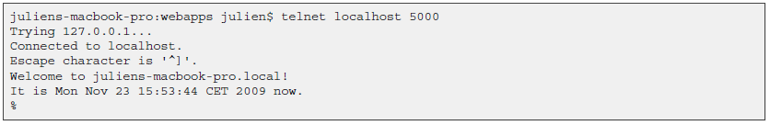
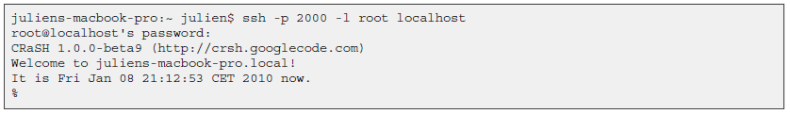
CRaSH How-to
Steps
Copy the crsh.war to a server running eXo Portal 2.5 or GateIn.
Telnet connection is done on port 5000
SSH connection is done on port 2000 with the password crash :
Notes:
10

Slide 11
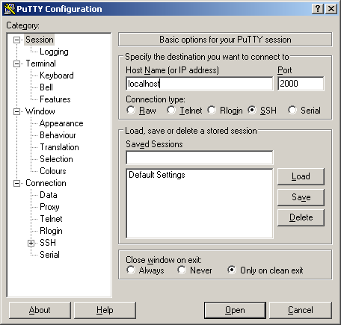
CRaSH How-to
PuTTY:
Notes:
11

Slide 12
CRaSH Commands
Commands
Connect to the container “portal” to the workspace “portal-system”
Like Unix ls, cp, mv, rm
SQL select command
Notes:
12

Slide 13
CRaSH Commands
Export
It is possible to export a node. The node type is nt:file. The file is in the root folder of the same workspace. Then it is possible to access the file from webdav.
Import, the other way around
Notes:
13

Slide 14
Exercise: CRaSH
Stop eXo. Copy crsh.war to your webapps. Start eXo.
Connect to CRaSH by ssh or telnet
Type in your shell: connect -c portal -u root collaboration
Test the commands: ls, cd, mv, rm,
Export and import a node. Is it document or system view? Import the node 5 times. What happens?
Add a mix:i18n mixin to an existing node. (syntax: addmixin . mix:versionable)
Test 20 different select use cases as seen in http://wiki.exoplatform.org/xwiki/bin/view/JCR/JCR+Query+Usecases.
Create a new command: http://code.google.com/p/crsh/wiki/Extension
Notes:
14

Slide 15
CRaSH
Notes:
15

