Slide 1
eXo Knowledge

Slide 2
eXo Knowledge
What?
  Suite of collaborative applications oriented to knowledge sharing.
  On-line discussions and user generated content (Forum)
  Collaborative FAQ for business knowledge ?expertise? (Answers), like Yahoo Answers, Stackoverflow, in France: Developpez.com.
And precisely:
  Forum : A full featured message boards application that holds on-line discussions and posts user generated content.
  Answers : A questions/answers application to help finding solutions
  FAQ : An Answers-based application to publish questions/answers in public FAQs

Slide 3
eXo Knowledge
User level distinction
Guests: Non-identified users, can view but cannot contribute
Users: Identified users that have login
Moderators: Responsible for one forum or one eXo Answers category
Administrator: Manages everything, special administration interface, can ban users, can convert users to moderators. Always responsible for whole application.
Role Matrices on the wiki,
  http://wiki.exoplatform.com/xwiki/bin/view/KS/Forum+Features
  http://wiki.exoplatform.com/xwiki/bin/view/KS/FAQ+Features

Slide 4
eXo Forum

Slide 5
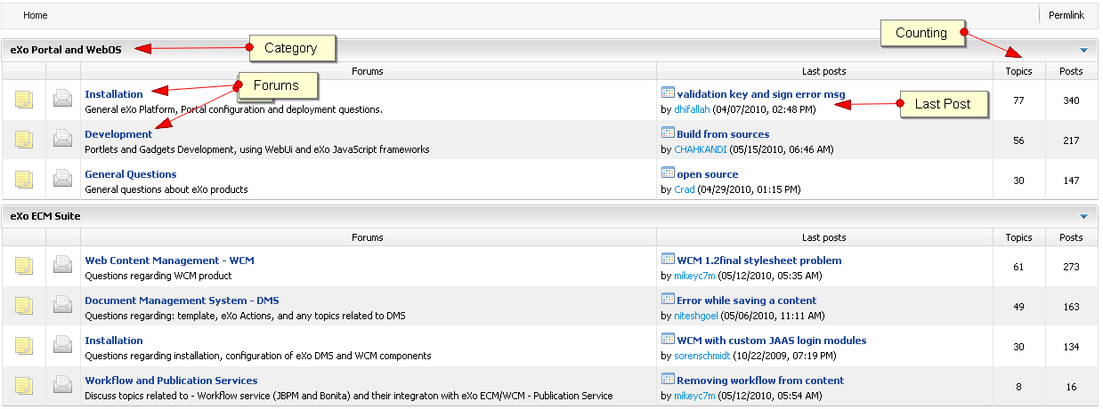
eXo Forum
Forum structure:
Several categories
  One or more forums in each category

Slide 6
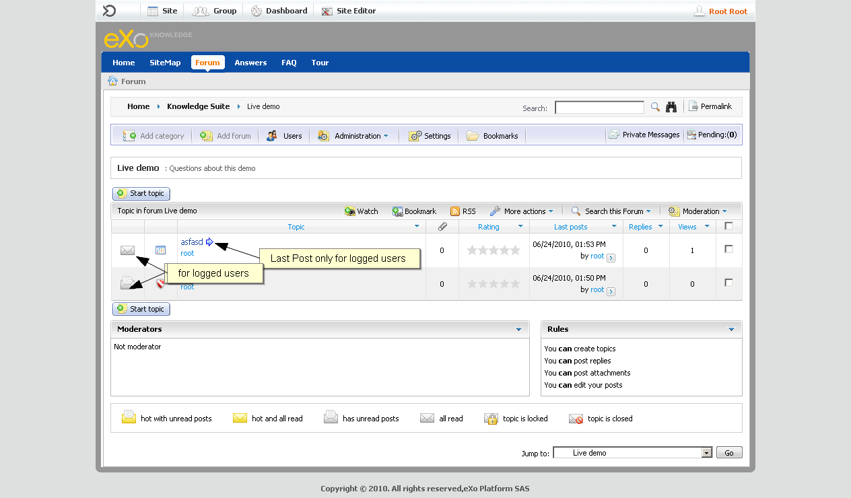
eXo Forum
Forum structure:
Several categories
  One or more forums in each category

Slide 7
eXo Forum
RSS:
RSS Feeds for categories, forums, and topics
No RSS for restricted forums

Slide 8
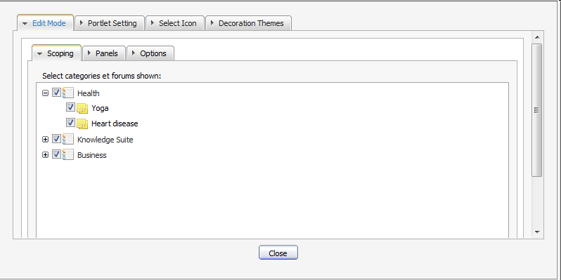
eXo Forum – Forum Portlet Edit Mode
Scoping Settings:
Allows to define a reduced scope of the visible forums

Slide 9
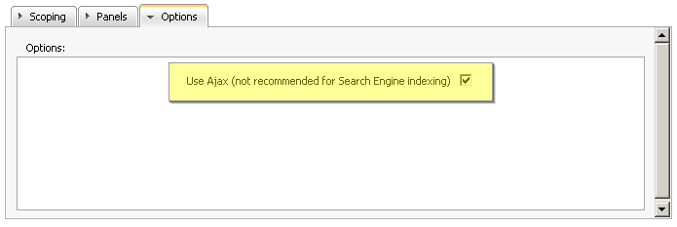
eXo Forum – Forum Portlet Edit Mode
Ajax Settings:
      Ajax: The page is only partially reloaded, the URL does not change, the back button does not work, search engines cannot index the forum
      No Ajax: Page is reloaded completely, the URL changes, the back button works, search engine friendly.

Slide 10
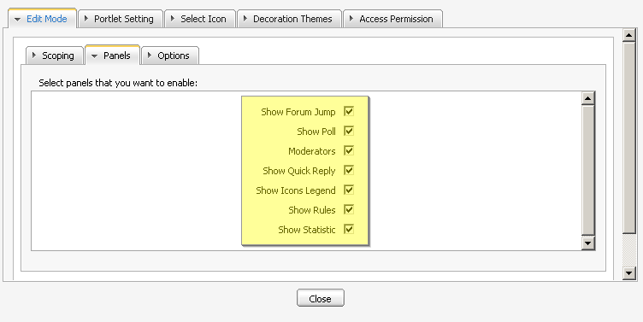
eXo Forum – Forum Portlet Edit Mode
Panels setting:
In the settings, you can choose which panels you wish to show: Show Forum, Jump, Show Poll, Moderators, Show Quick Reply, Show Icons Legend, Show Rules,Show Statistic

Slide 11
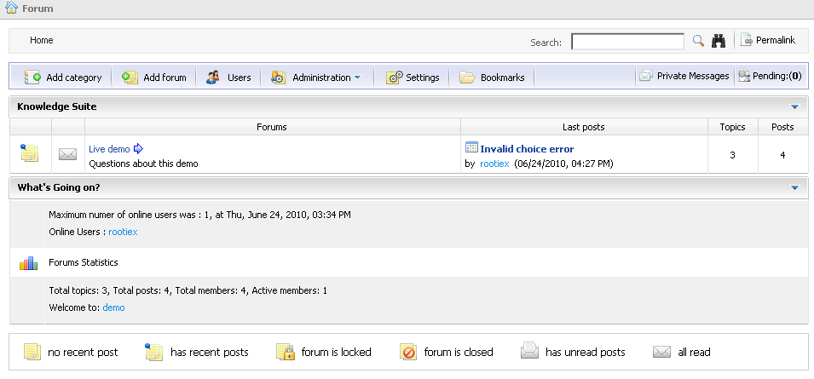
eXo Forum – Forum Portlet Edit Mode
All panels:

Slide 12
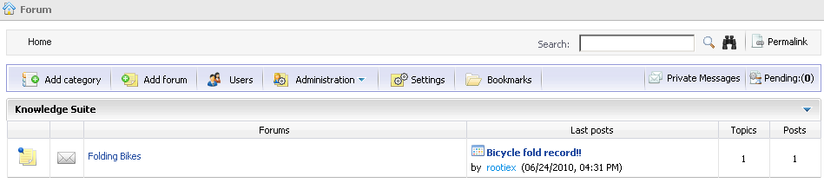
eXo Forum – Forum Portlet Edit Mode
Without any panels:
All panels unchecked:

Slide 13
eXo Forum
Multiple Instances:
      You can create several instances of the forum portlet.
      All instances share the same users, moderators and administrators.
      But you can define different settings in the Edit Mode.
      That means different scopes or different panels.
      This way you can create – for example – a forum page for only one special forum or a category, using a reduced panel selection.

Slide 14
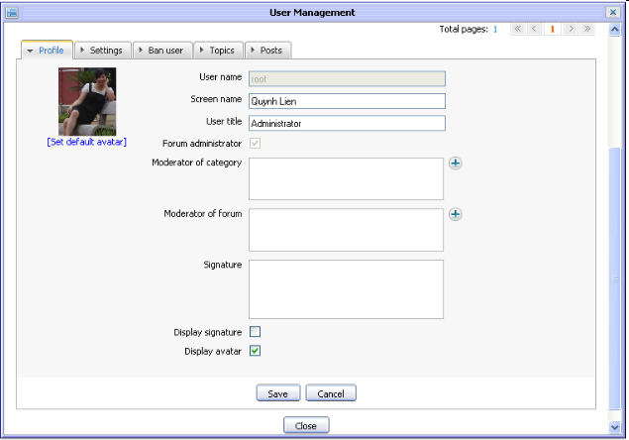
eXo Forum
User Management

Slide 15
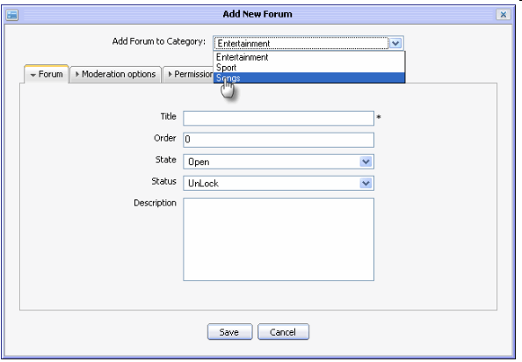
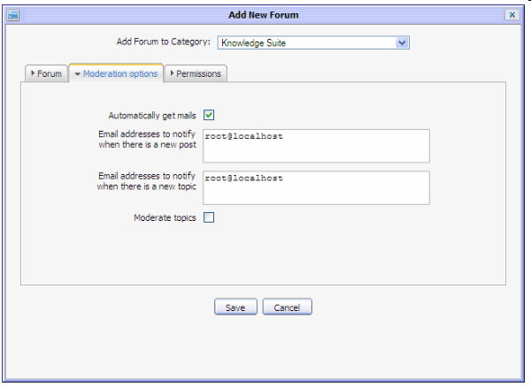
eXo Forum
Forum Administration:
Add categories
Email alerts

Slide 16
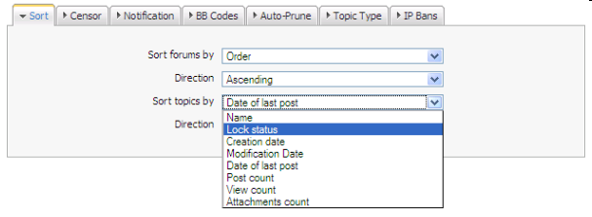
eXo Forum
Forum Administration:
Sort
Censor keywords
Notification message definition
BB Codes
Auto-Prune
Topic Type
IP Bans

Slide 17
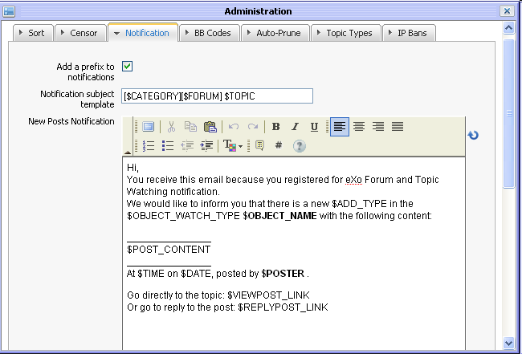
eXo Forum
Forum Administration:
Sort
Censor keywords
Notification message definition
BB Codes
Auto-Prune
Topic Type
IP Bans

Slide 18
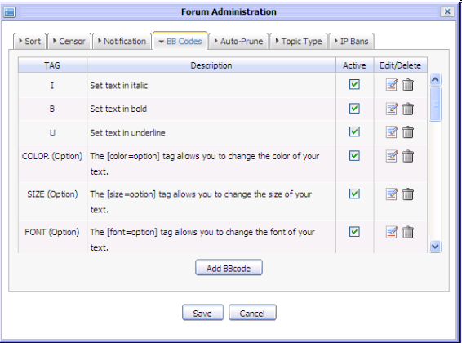
eXo Forum
Forum Administration:
Sort
Censor keywords
Notification
BB Codes
Auto-Prune
Topic Type
IP Bans

Slide 19
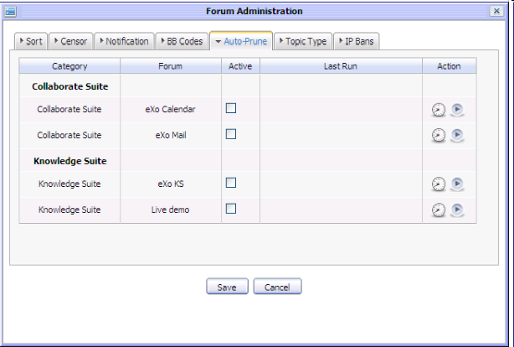
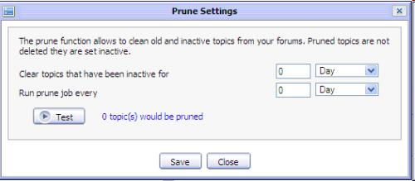
eXo Forum
Forum Administration:
Sort
Censor keywords
Notification
BB Codes
Auto-Prune of old topics
Topic Type
IP Bans

Slide 20
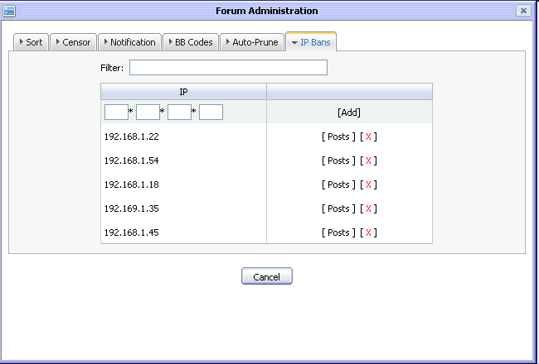
eXo Forum
Forum Administration:
Sort
Censor keywords
Notification
BB Codes
Auto-Prune
Topic Type
IP Bans

Slide 21

eXo Forum
Forum Administration:

Slide 22
eXo Forum
Tag with suggestions of other tags entered by any user:

Slide 23
eXo Answers

Slide 24
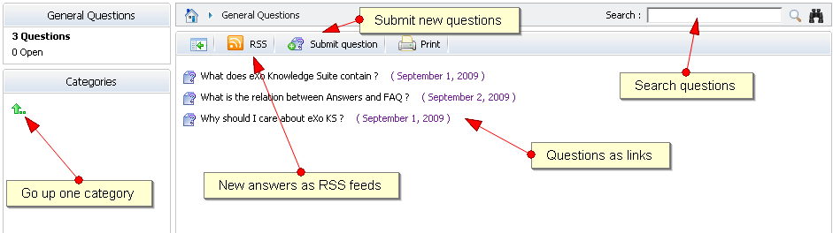
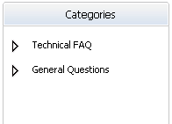
eXo Answers
Answers:
Several categories and subcategories
Formerly called FAQ

Slide 25
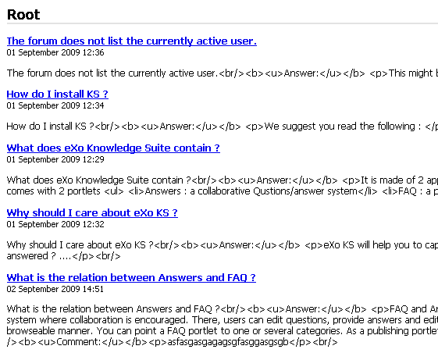
eXo Answers
Answers as RSS Feed

Slide 26
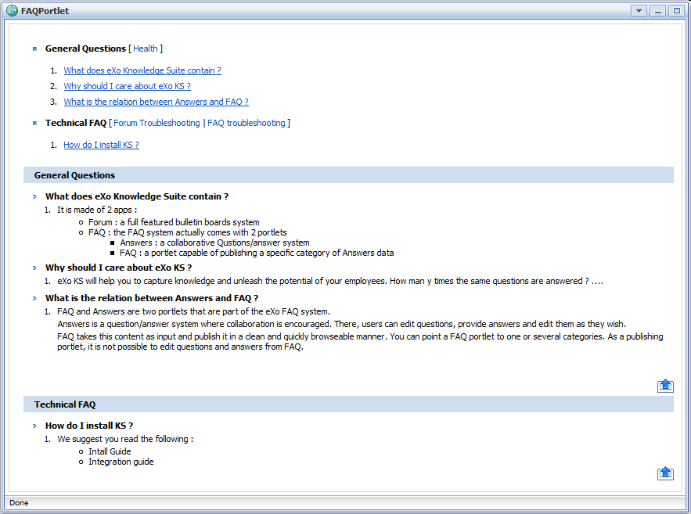
eXo Answers
FAQ Portlet
  Visible
  Approved question
  At least one approved answer

Slide 27

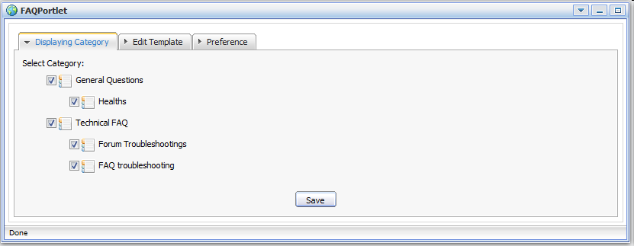
eXo Answers
FAQ Portlet – Edit Mode

Slide 28
eXo Knowledge Exercise
eXo Answers
Create an eXo Answers structure and fill it with questions and answers using several users.
Relate a question to other questions.
Approve some questions and make them appear in the FAQ portlet.

Slide 29
eXo Knowledge Exercise
eXo Forum
Create forum categories and several forums
Decide who should be a moderator
Subscribe to a complete category or forum, provide your personal email address
Fill in the forum with some topic
Upload an attachment to some discussions
Use the administrator settings

Slide 30
eXo Knowledge Suite
Q & A

