Slide 1
eXo Collaboration

Slide 2
eXo Collaboration
What?
  Provides a rich Web 2.0 browser-base interface with a suite of collaborative applications targeted at team work coordination and information sharing.
And precisely:
  AddressBook : is an integrated address book and contacts manager. It not only handles private and public contacts in your organization but also keep precious information such as address, telephone, fax, etc. Furthermore, we also support VCard format, import/export in order to consolidate your existing contacts into a single place.
  Calendar : A personal and shared agenda.
  Mail : is a full featured email client.
  Chat: An effective and convenient way to communicate in real time.

Slide 3
eXo AddressBook

Slide 4
eXo AddressBook
What?
  An integrated address book and contacts manager
  Handles private and public contacts in the organization
  Keeps information such as address, telephone, fax, etc.
  Supports VCard format
  Import/export in order to consolidate the existing contacts into a single place.

Slide 5
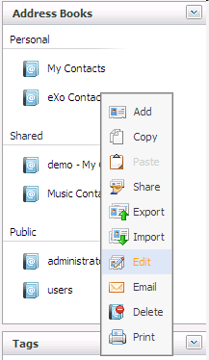
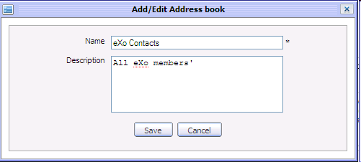
eXo AddressBook
Edit Address Books

Slide 6
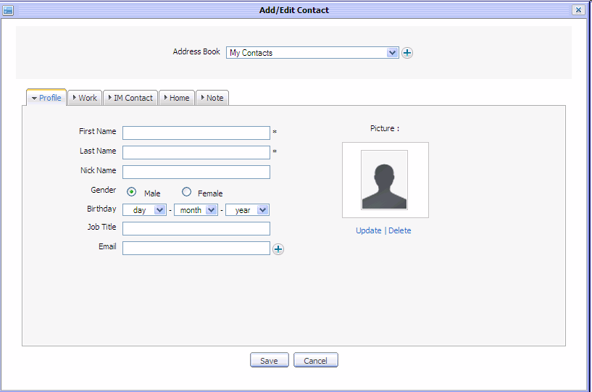
eXo AddressBook
Edit Contacts

Slide 7
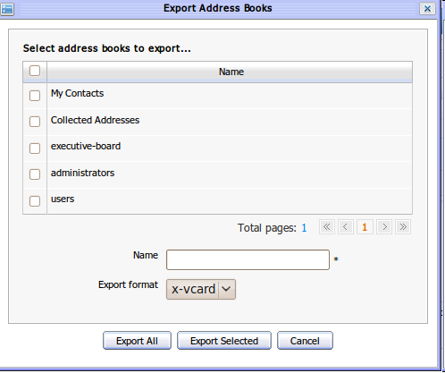
eXo AddressBook
Export Address Books
X-vcard format

Slide 8
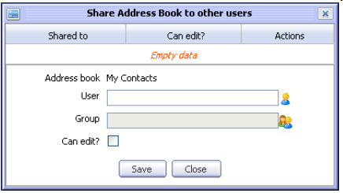
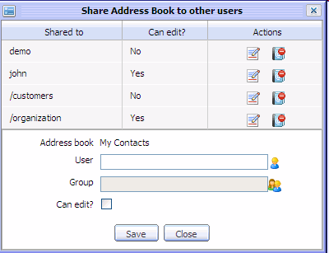
eXo AddressBook
Share Address Books

Slide 9
eXo AddressBook
Collected Addresses
  All email addresses that have been used in “To, CC and CCO” and that are not already in another address book.
  The idea is that the user moves the collected addresses to the other address books.

Slide 10
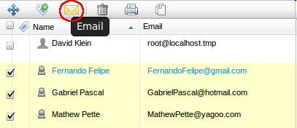
eXo AddressBook
Send Mail from the contacts list

Slide 11
eXo Calendar

Slide 12
eXo Calendar
What?
  Personal and shared agendas
  Helps to schedule the user’s time, a group’s time and to coordinat
  Manages shared and public agendas in the organization
  Facilitates iCal support that helps to easily exchange event/task information with other applications
  Tasks (for individual users) and Events (several users can participate)

Slide 13
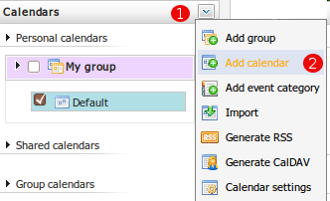
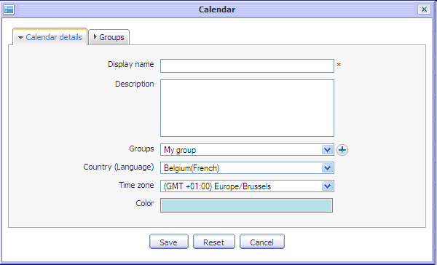
eXo Calendar
Add Calendar

Slide 14
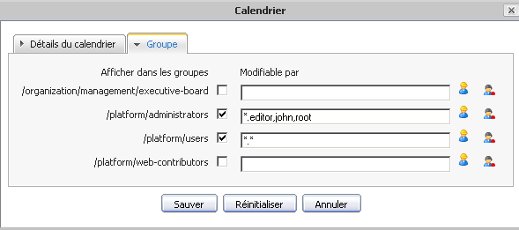
eXo Calendar
Add a calendar for a user group, or several user groups
Fine tune the edit rights by user or groups memberships

Slide 15
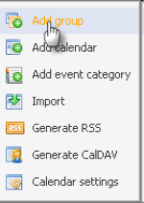
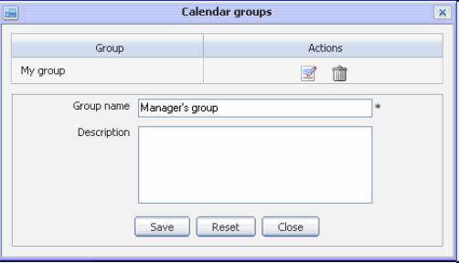
eXo Calendar
Manage Calendar Groups
Calendar groups give a structure to the user’s personal calendars

Slide 16

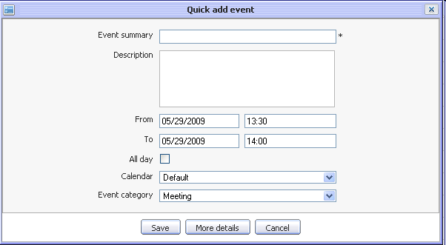
eXo Calendar
Events
Can added to
any calendar
Can be in any category

Slide 17
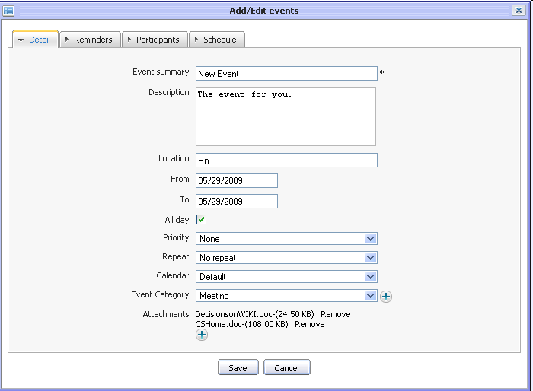
eXo Calendar
Events

Slide 18
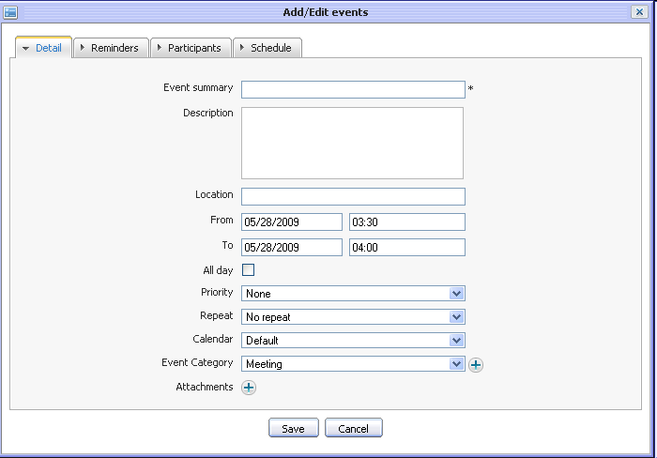
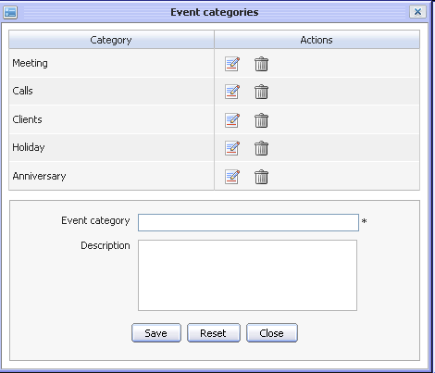
eXo Calendar
Events

Slide 19
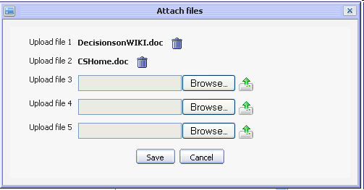
eXo Calendar
Event attachments

Slide 20
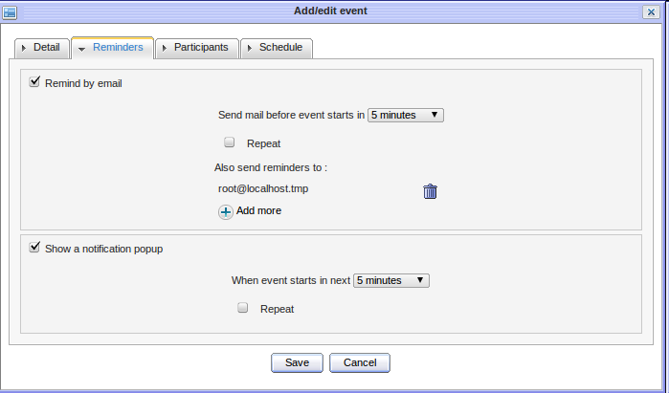
eXo Calendar
Event Reminders

Slide 21
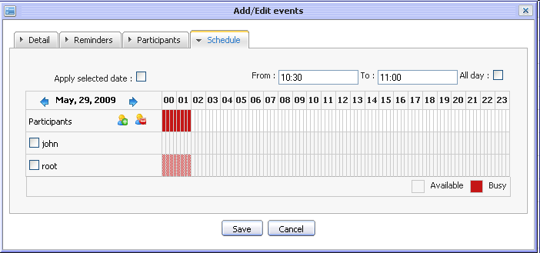
eXo Calendar
Event Schedules

Slide 22
eXo Calendar
Task differences to event
Delegate and status

Slide 23
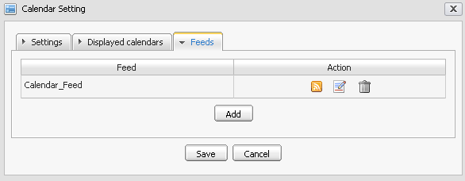
eXo Calendar
RSS Feed
Limited to last 100 events
Configuration of this limit in CalendarService

Slide 24
eXo Calendar
iCal

Slide 25
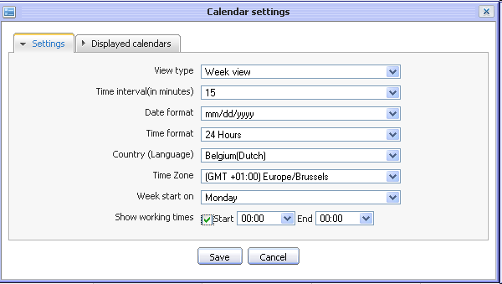
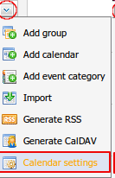
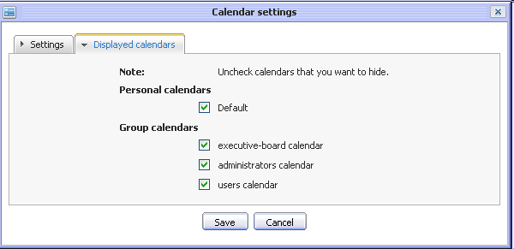
eXo Calendar
Calendar Settings

Slide 26
eXo Collaboration
Exercise eXo Calendar
Create a new calendar
Share it with a friend
Create group calendar
Create a calendar for several groups
Create several events in each calendar and invite colleagues
Use the scheduler in order to manage the event
Create a group calendar called “Meeting Room 1” and share it with all users.
Sign in as a different user and verify which calendars you can see and which ones you can also modify.

Slide 27
eXo Mail

Slide 28
eXo Mail
What?
  A web base email client
  eXo Mail is a web based application that allows you to send, receive, view your mails through Internet without actually downloading it to your computer
  eXo Mail is smoothly integrated with other Collaboration Suite modules such as Address Book and Calendar.

Slide 29
eXo Mail
Protocols
  Uses the protocols imap and pop3.
  Can be connected to any mail server which provides imap and pop3 protocol.

Slide 30
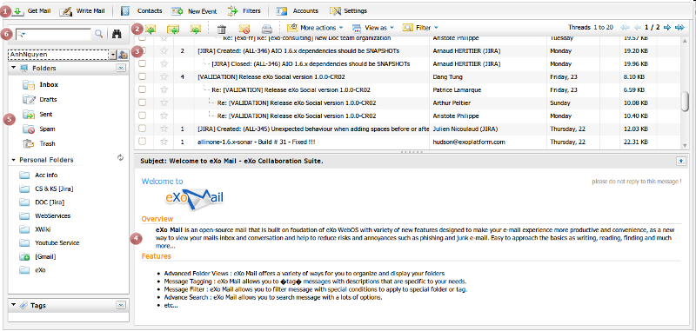
eXo Mail

Slide 31
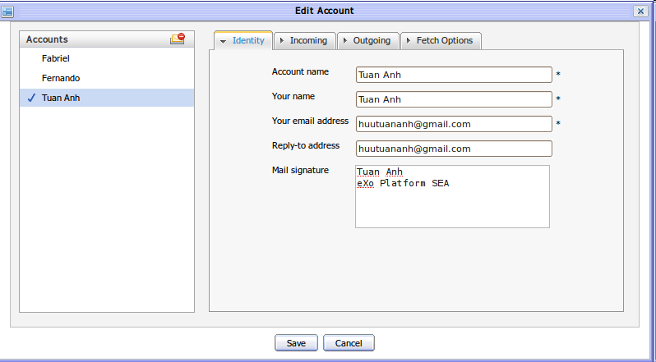
eXo Mail
Manage Accounts

Slide 32
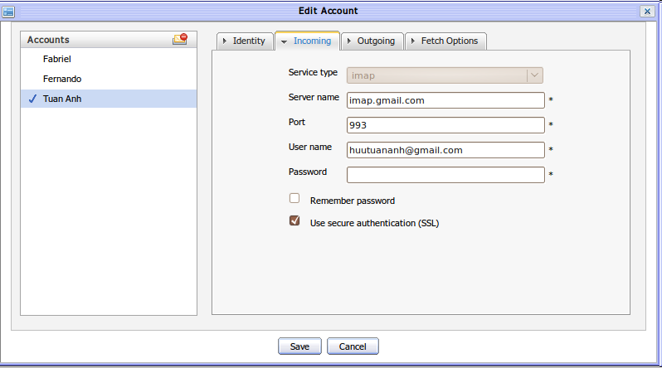
eXo Mail
Manage Accounts

Slide 33
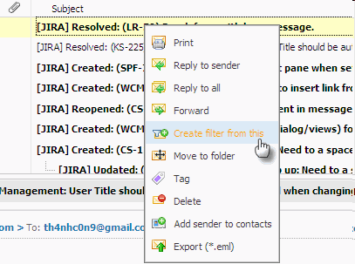
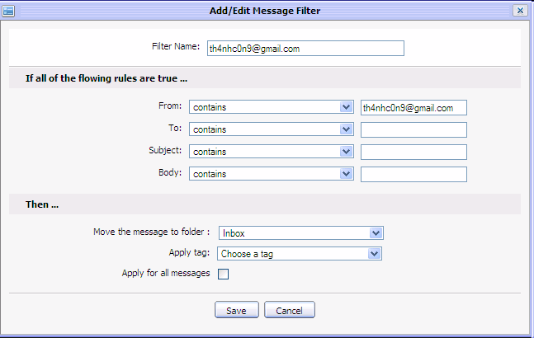
eXo Mail
Manage Filters

Slide 34
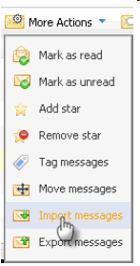
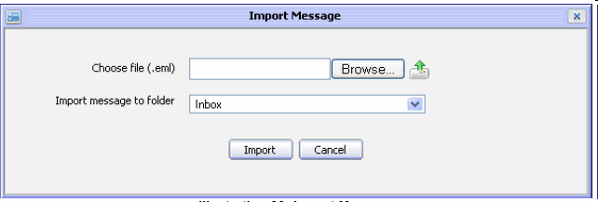
eXo Mail
Export and Import
EML format

Slide 35
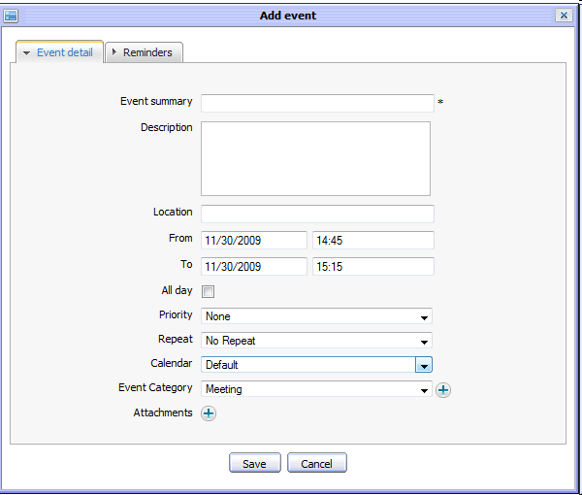

eXo Mail
Add Event
In eXo Calendar

Slide 36
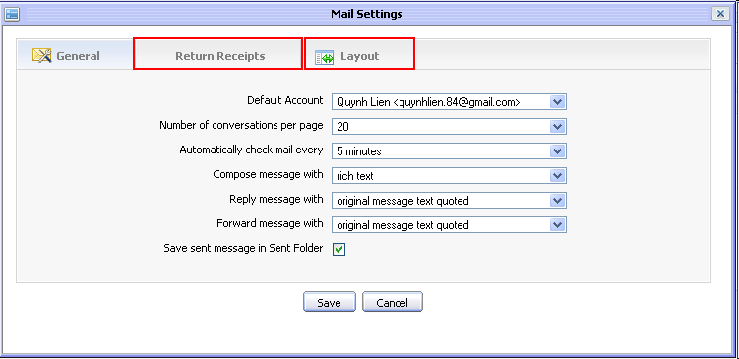
eXo Mail
Settings

Slide 37
eXo Collaboration
Exercise for eXo Mail
Open eXo Mail
Configure the eXo Mail client so that it connects to your email account
Connect to the server
And write an email to “soren.schmidt@exoplatform.com”
Add a subfolder “exo” in your account
Add a filter that puts all emails from “exoplatform” to the subfolder “exo”

Slide 38
eXo Chat

Slide 39
eXo Chat
What?
  Exchange electronic messages with one or more other computer users in real time
  People in online chat sessions type messages to others using their keyboards
  The message then appears on the screens of all participants.

Slide 40
eXo Chat
How?
  Extensible Messaging and Presence Protocol (XMPP),
  XMPP is an open XML-based protocol originally aimed at near-real-time, extensible instant messaging (IM) and presence information (e.g. buddy lists).
  eXo Chat is a chat solution based on an XMPP server (OpenFire)

Slide 41
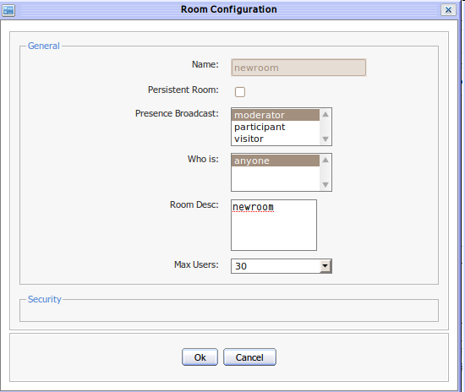
eXo Chat
Room Config

Slide 42
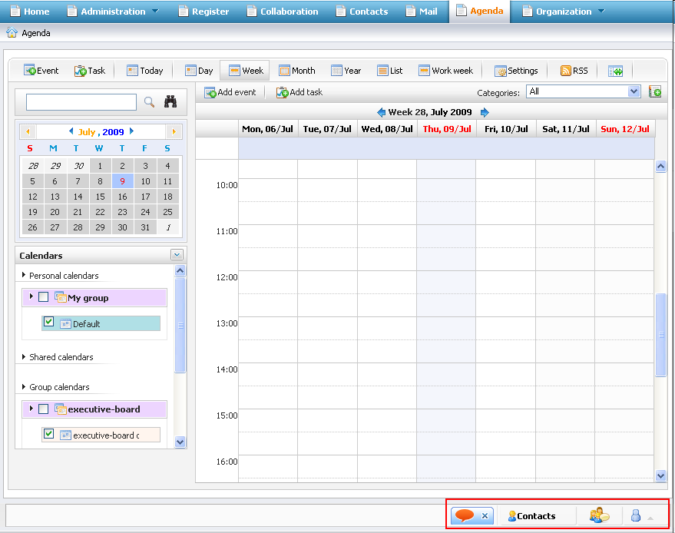
eXo Chat
Chat Bar
The Chat Bar is located
at the bottom

Slide 43
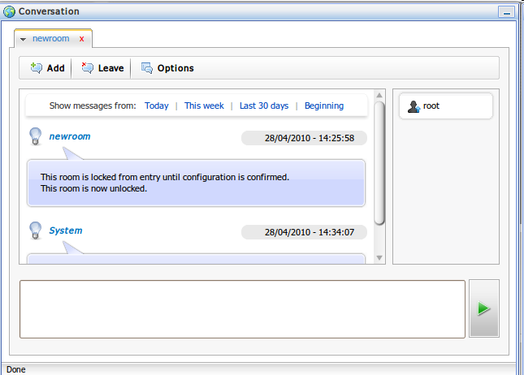
eXo Chat
Conversation

Slide 44
eXo Collaboration
Q & A

