Slide 1
CRaSH
Common Reusable Shell

Slide 2
Overview and Architecture
Configuration
Commands
Exercises

Slide 3
Overview and Architecture

Slide 4
Overview
A shell for Java Content Repository
Considers the JCR tree as its file system
Basic administration
http://code.google.com/p/crsh
http://crsh.googlecode.com
http://crsh.googlecode.com/svn/doc/1.0.0-beta25/index.html

Slide 5

Architecture
A webapp included in eXo Platform
Written as a Groovy script
Easy to add new commands
Found in WEB-INF/groovy/commands
Annotated with Args4j
Describe arguments
You can extend the language

Slide 6
Architecture
Telnet
SSH
Connectors
Shell Engine
JCR
Connector
SCP
Commands
Args4j
Groovy

Slide 7
Groovy Integration
// Iteration over the properties
node.eachProperty({ property -> out.print(property.name);});
// Traditional Property Access
def foo = null;
if (node.hasProperty(‘foo’)) {
foo = node.getProperty(‘foo’).getString();
}
// Groovy Property Access
foo = node.foo;
//
foo = node[‘foo’];

Slide 8
Groovy Integration
// Iterates over the children
def count = 0;
node.each({ node -> count++; })
// Traditional Property Access
def foo = null;
if (node.hasNode(‘foo’)) {
foo = node.getNode(‘foo’);
}
// Groovy Access
foo = node.foo;
// Or
foo = node[‘foo’];

Slide 9
Configuration
WebApp

Slide 10
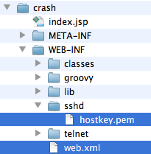
Configuration Overview
All configuration in /WEB-INF/web.xml
The SSH server key is stored in /WEB-INF/sshd/hostkey.pem

Slide 11

Configuration
Telnet connection is configured for the port 5000, SSH on port 2000
To remove the telnet access, remove or comment the listeners from web.xml

Slide 12

SSH Server Key Configuration
Default Key
The key can be changed by replacing the file WEB-INF/sshd/hostkey.pem.
External Key
Configure the server to use an external file by using the ssh.keypath parameter in web.xml. Uncomment the XML section and change the path to the key file.

Slide 13
CRaSH Commands
Like Unix

Slide 14
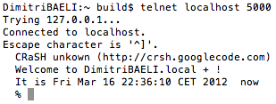

Connection
Telnet connection is done on port 5000
SSH connection is done on port 2000 with the password crash

Slide 15
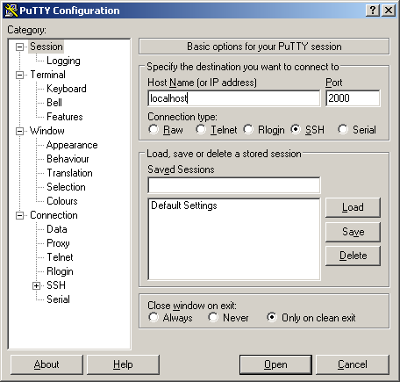
Putty

Slide 16
Commands
Connect to the workspace “portal-system”
Like Unix ls, cp, mv, rm, pwd
ls lists not only folder contents but also details of a single node.
SQL select command for queries on the JCR (-o for offset and -l for length)
Disconnect using the “bye” command

Slide 17
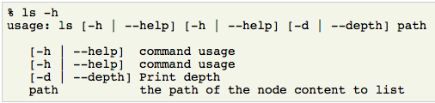
Help
--help -h : Lists the command options. Try “cd -h” or “mv -h”

Slide 18
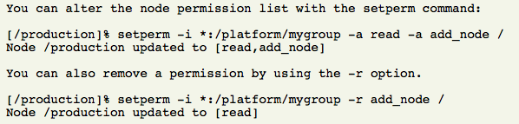
Permission Commands
Rights: read, add_node, set_property, remove
Example of permissions, listing role:group and the right : [*:/platform/administrators read,*:/platform/administrators add_node,*:/platform/administrators set_property,*:/platform/administrators remove]
setperm: Modify the permissions for any node

Slide 19
Session Commands
You are working in a CRaSH session,
The changes you do in the session are not visible outside of your CRaSH session!
Commit !
Saves the changes you did in the current session.
A node can be provided to save the state of the this nodes and its descendants only.
Rollback:
In order to rollback the changes of the current session.
A node can be provided to rollback the state of the this nodes and its descendants only.

Slide 20
Operators
“|” Pipe Operator
Streams a command output stream to a command input stream
Example: select * from exo:article | addmixin mix:referenceable
“+” Distributor Operator
Merges (“distributes”) two streams into one stream
“+” after the pipe
select * from nt:unstructured | setperm -i any -a read + setperm -i any -a write
“+” before the pipe
select * from nt:file + select * from nt:folder | addmixin mix:votable

Slide 21
SCP Export and Import
Export the node /gadgets in the repository portal-system as app_gadgets.xml
scp -P 2000 root@localhost:portal:portal-system:/production/app:gadgets .
The node will be exported as app_gadgets.xml.
The “:portal:” necessary, also the “:/” and the “ .”
The exported file format use the JCR system view.
Import the same file
scp -P 2000 app_gadgets.xml root@localhost:portal:portal-system/production/app:gadgets
For Windows: pscp -scp -P 2000 root@localhost:portal…

Slide 22
CRaSH Exercises

Slide 23
Exercise: cRaSH commands
Connect to CRaSH
ssh (port 2000) or telnet (port 5000) (ssh password: “crash”)
connect -c portal -u root -p gtn collaboration
ws login -c portal -u root -p gtn collaboration (future versions)
Test the commands: ls, cd, mv, rm, pwd
Use double codes for node names with blanks: ls “Sites Content”
Add a mix:versionable mixin to an existing node
syntax: addmixin . mix:versionable
Test 5 different select use cases.
Extra: Create a new command and test it

Slide 24
Exercise: Crash SCP
Create a new site called “mysite”
The configuration of your site is in the workspace portal-system at the path: /production/mop:workspace/mop:portalsites/mop:mysite
Make an SCP export of your site and import using SCP it on a different server
Export: scp -P 2000 root@localhost:portal:portal-system:/production/mop:workspace/mop:portalsites/mop:mysite . (←< the “ .” is important)
Import
scp -P 2000 mop_mysite.xml root@localhost:portal:portal-system:/production/mop:workspace/mop:portalsites
Extra:
Also export/import the content of mysite (articles etc.) : workspace collaboration, path /sites content/live/mysite

Slide 25
CRaSH
Common Reusable Shell

