Slide 1
eXo Features
Social, Knowledge and Collaboration

Slide 2
Table of Content
Social Features
Activity Stream
Spaces
Connections
Knowledge Features
Forum
Poll
Wiki
Collaboration Features
Calendar

Slide 3
Social Features
Facebook for the company intranet
Each employee has a profile
Employees can connect (a.k.a. friends)
Each employee has her or his activity stream
Spaces
Like groups where employees work together in a project
Special forum
Special wiki
Shared documents in the DMS
Shared calendar
Customizable with new applications
eXo Intranet uses eXo Social

Slide 4
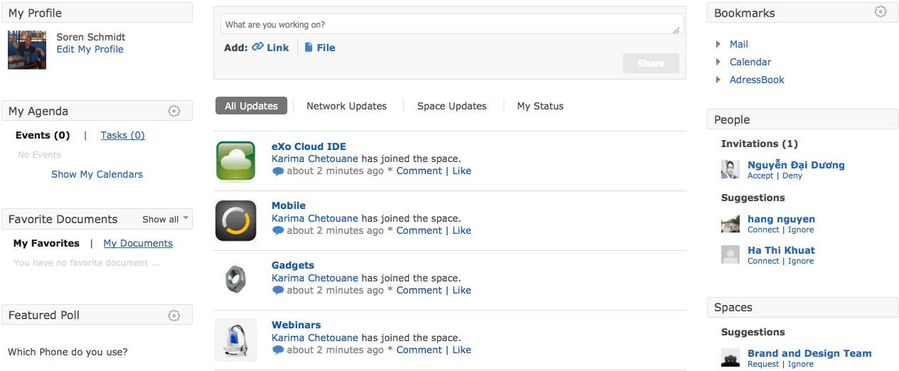
Main Page Overview

Slide 5
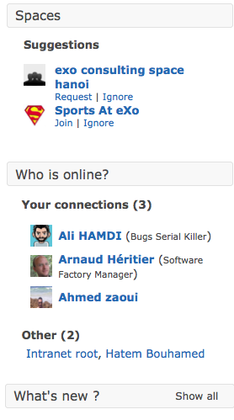
Gadgets
Placed anywhere
Easy to develop
Easy to deploy
Direct access to applications

Slide 6
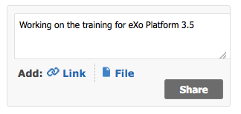

Activity Streams
Each user has an activity stream.
Text messages
Files from the DMS
Comments
Forum entries
Connections
Events triggered by eXo applications
Events triggered by other systems
Custom event types

Slide 7

Pushed Entries
Pushed from other applications
Developer Info
Rest API
Java API

Slide 8

Custom Entries
Different activity types
Customizable
Extensible
Neat integration
One-Click operations for “Open” or “View Changes”

Slide 9
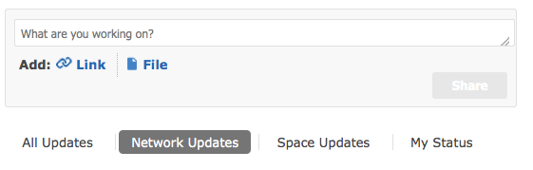
ENTRY Filter
Own entries
Network entries
Space entries
All Entries

Slide 10
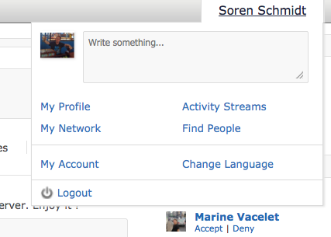
Enhanced Profile Menu
Including an activity interface

Slide 11
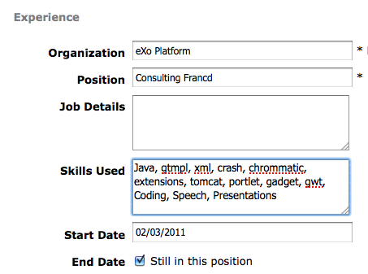
Profile
Avatar picture
Contact details
Experiences

Slide 12
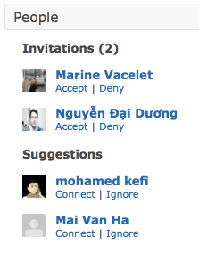
Connect to other users
Connect = Friend
Invite
Accept or Deny
Suggestions
Updates of connections appear on the network activity stream.

Slide 13
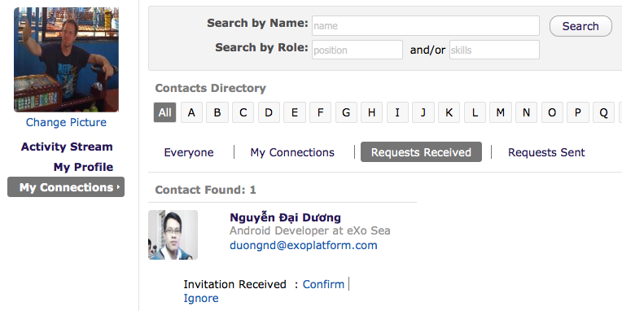
Manage Connections
Browse
Search by name
Search by role or skill
Invite
Confirm

Slide 14
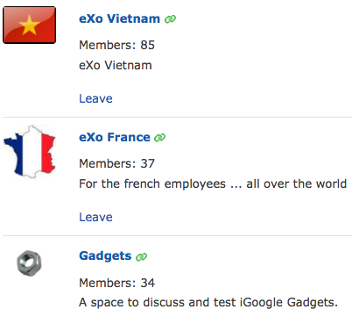
Spaces
Group, interests or project
Anyone can create a space
Technically a space is a user group like other groups in eXo

Slide 15
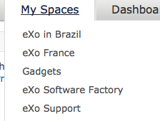

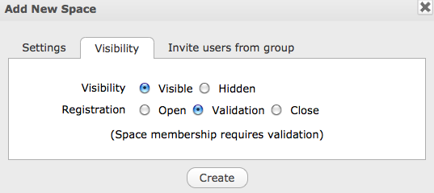
Spaces
Listed in the menu
Visible or Hidden
Free registration
By validation
By invitation

Slide 16
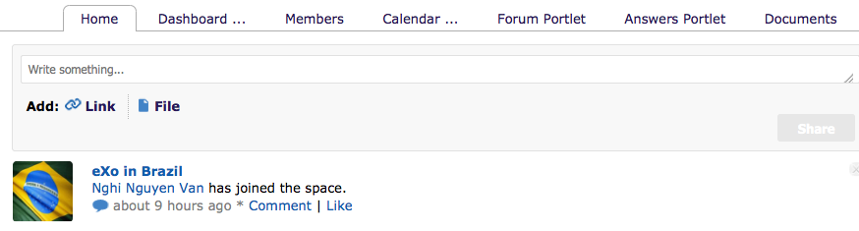
Space Navigation
Shared activity stream
Dashboard, Calendar, Forum, Documents
Customizable

Slide 17
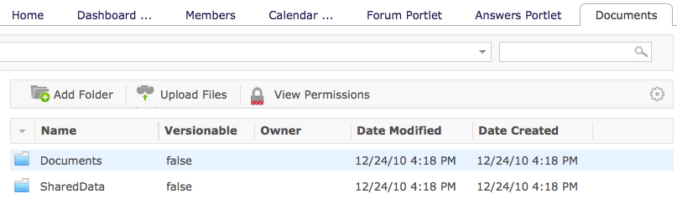
Space DMS
Shared documents
Only space members
Simple interface
Reserved node in the JCR

Slide 18
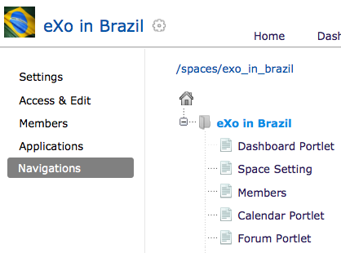
Space Settings
Settings by Space leader
Like a group site
Own navigations, pages, and layout
Manage Members
Improve navigations
Add applications

Slide 19
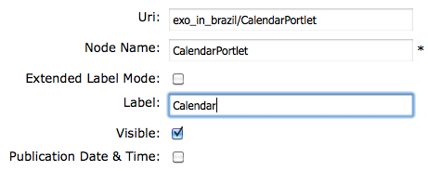
Space Navigation
Like a group navigation
Correction the label “Calendar Portlet” in “Calendar”

Slide 20
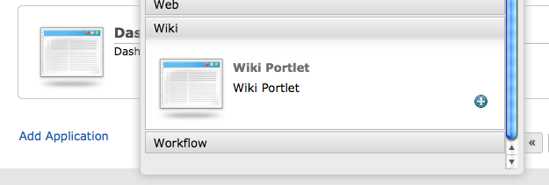
New Applications
Adding a Wiki Portlet
A new page containing a wiki

Slide 21
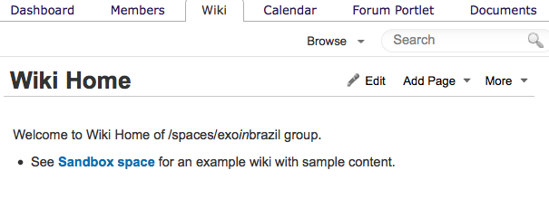
Space Wiki
Added in 4 clicks
Working out of the box
Dedicated wiki
Access by members

Slide 22
Exercise – eXo Social
Work together on one server if possible
Connect to other users, invite them
Modify your profile, upload an avatar
Write something in the activity stream
Create a space “Technical Hints”
Visible, Open
and a space “Finance Team”
Invisible, Invitation
Invite other users to the “Finance Team”
Upload a space document
Create a calendar event
Use the space activity stream, point to the uploaded document
Add a new application to your space (Wiki)
Accept invitations from other users or spaces
Observe your activity streams

Slide 23
Social Features

