Slide 1
Web Content Management

Slide 2
WCM Introduction

Slide 3
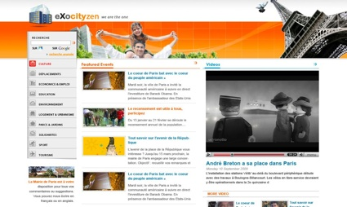
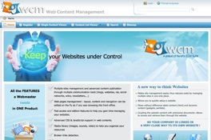
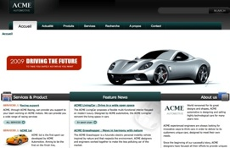
eXo WCM
Overview

Slide 4
Content
Content
A chunk of information that is stored on the server.
Can be shown in different portlets at different locations of WCM.
Examples:
  PDF Document
  Site Artifact (Banner, Footer). Site artifacts are not indexed for search.
  Articles, News, Events, etc.
  Any document stored on the server.

Slide 5
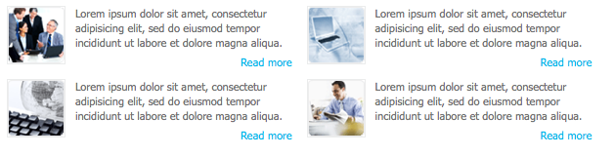
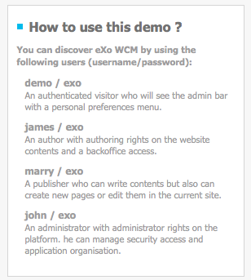
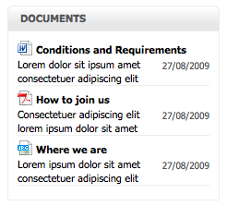
eXo WCM
WCM Content List Portlets

Slide 6
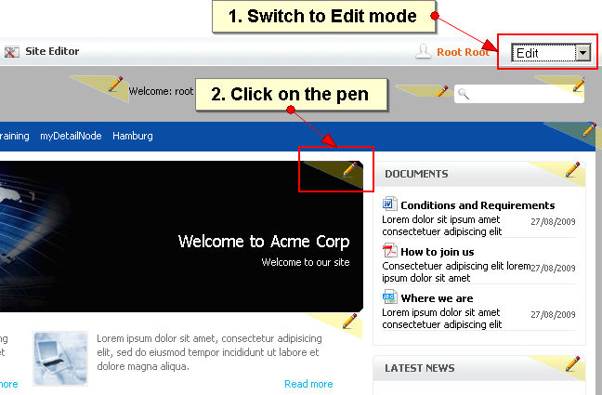
Inline Editing
  Edit Current Page Content
  Switch between Edit to Publishing mode
  Edit the portlet and its content using the “Pen icon”

Slide 7
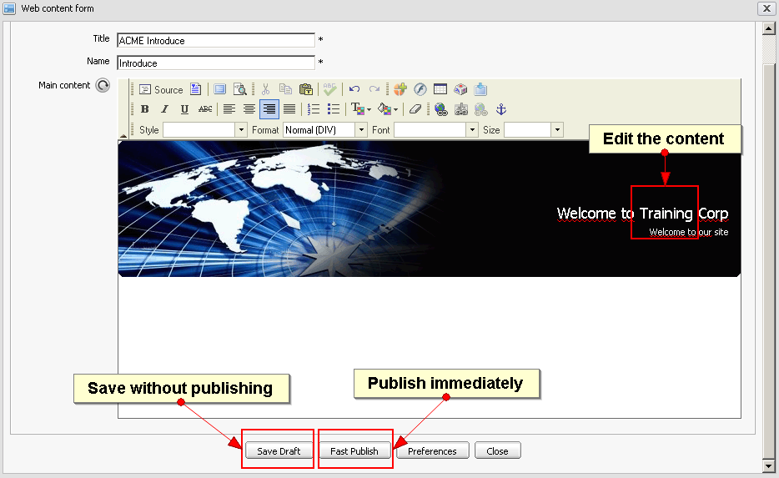
Fast Publication
  Publishes the modification immediately

Slide 8
Draft
  Save the modifications without publishing it.
  The state of the modifications is “draft”.
  The public still sees in the last published version.
  Updates are visible in “Edit” mode but not in “published” mode
  In “Edit” mode, non-published documents are marked as “Draft”.
  “Draft” and “Published” correspond to two states in the “Publication Lifecycle”.

Slide 9
Content Detail Portlet
  Formerly known as Single Content Viewer (SCV)
  Shows a single content in the portlet.

Slide 10
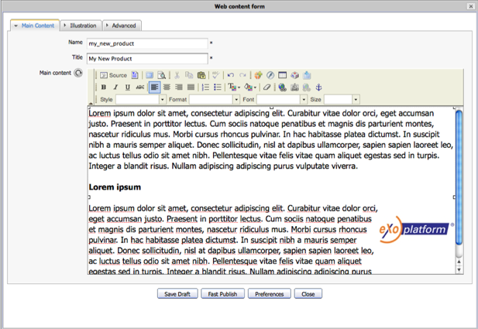
Content Detail Portlet
Editing
Tabs
Document Title
FCK Toolbar
Content

Slide 11

FCK Editor
Full Screen Editing
Link to DMS
HTML Source

Slide 12
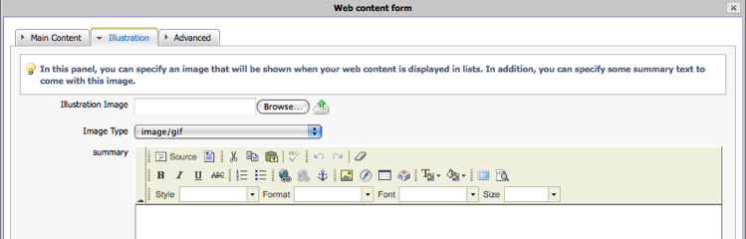
Content Detail Portlet
Editing
  Prepare the information for list viewer
  Set Image and/or Summary

Slide 13
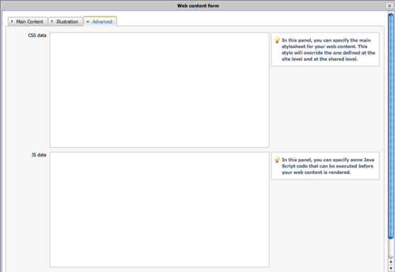
Content Detail Portlet

Slide 14
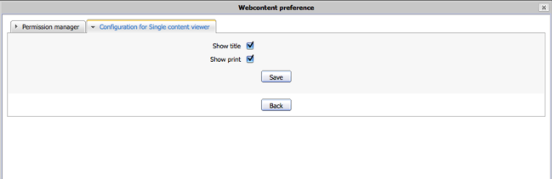
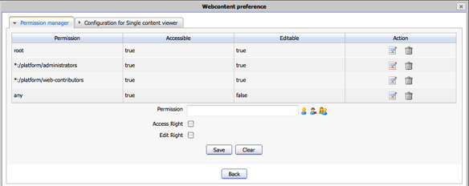
Content Detail Portlet
Select options
of the view
Manage
permissions

Slide 15
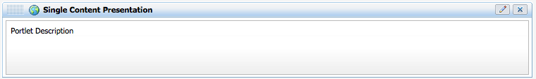
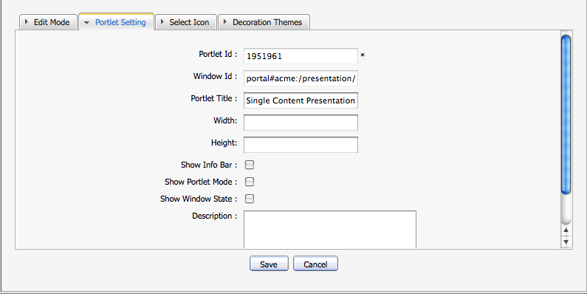
Content Detail Portlet
Portlet Options
Hide portlet
decoration

Slide 16
Exercise 1: Content Detail
Fast Publish
Login as root. Open the Acme site. (http://wcm:8080/ecmdemo/public/acme/)
Switch to Edit mode.
Modify the homepage portlet and click on “Fast Publish”. Switch to “Published” mode.
Modify it again and click on “Save Draft”. Click on “Published” and see the difference.
New Page
Create a new page, place a single content viewer.
Select a content from the acme news drive.

Slide 17
Content List Portlet

Slide 18
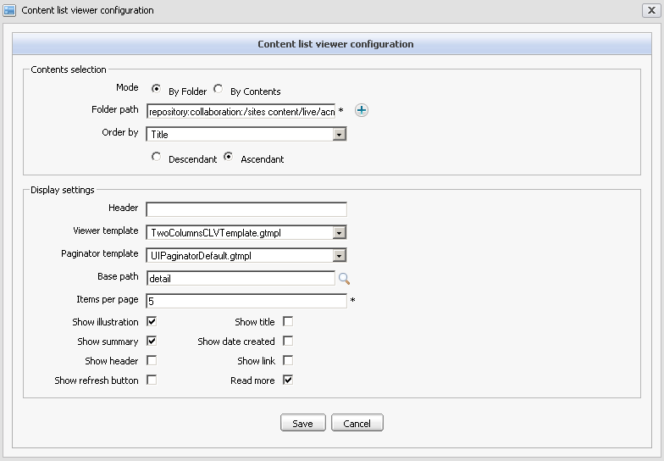
Content List
Show the content as list from a folder
Select folder from any folder (content, taxonomy, ...)
Choose a viewer and a paginator template
Select display options
  Title
  Header
  Summary
  Date
  Image
  Link

Slide 19
Content List
Show the content as list from a folder
Select folder from any drive (content, taxonomy, ...)
Choose a viewer and a paginator template
Select display options
  Title
  Header
  Summary
  Date
  Image
  Link

Slide 20
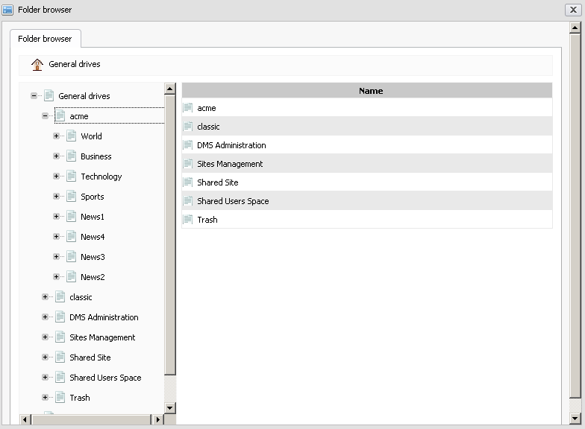
Content List
Choose a folder
Can be a category
folder

Slide 21
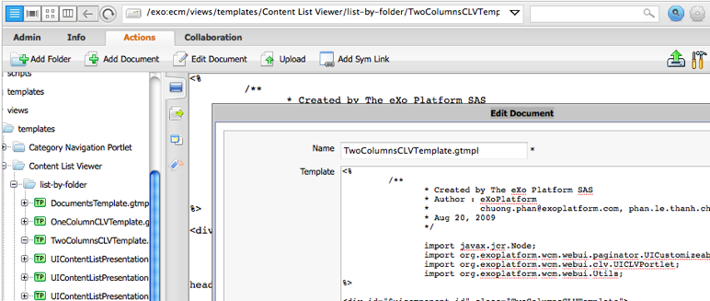
Content List
  The Content List templates are located in:
  /exo:ecm/views/templates/Content List Viewer/list-by-folder
  You can customize them online, wait until you have learned more about DMS.

Slide 22
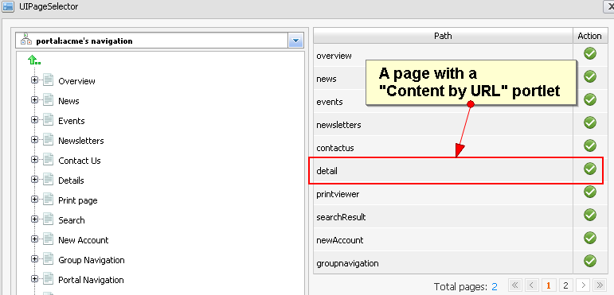
Content List
  The “Base Path” should better be called “Detail Page”.
  You can choose any page but you should take one with a “Content by URL” Portlet.
  The “Content by URL” interprets the URL and show a single content.

Slide 23
Exercise 2a: Content List
Content List
Login as root. Go to acme site.
Create a new page or reuse the page of exercise 1.
Put 2 columns.
Drag a Content List portlet to the left column.
  Choose the template “OneColumnCLVTemplate.gtmpl” .
  Choose the folder “acme”
  Content by URL
  Go to the site management, click on “Edit Navigation” and create a new page containing a “Content by URL” portlet. The navigation node shall not be “visible”.
  From your Content List point to that page instead of “details”. Test it.

Slide 24
Exercise 2b: Content List
Content List and Details on the same page
  Take your Content List page and add a “Content by URL” page on the same page in the right column.
  Open the Content List Portlet and make “Base Path” point to the same page.

Slide 25
Taxonomy

Slide 26
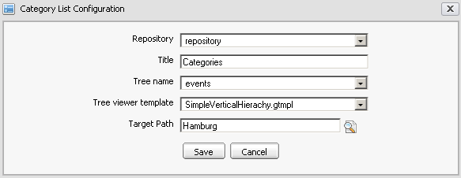
Category Portlets
Category Navigation Portlet
Categories are organized in a taxonomy tree.
There are several taxonomy trees.
You can show the categories in a special Category Navigation portlet
  In that portlet you choose the tree and the target path.
  The target path should point to a “Category Content” portlet.

Slide 27
Category Portlets

Slide 28
Category Portlets
Category Navigation Portlet
Categories are organized in a taxonomy tree.
There are several taxonomy trees.
You can create your own trees and use it freely.
Each tree is a hierarchy of categories and subcategories etc.
A document can be in zero, one or several categories.

Slide 29
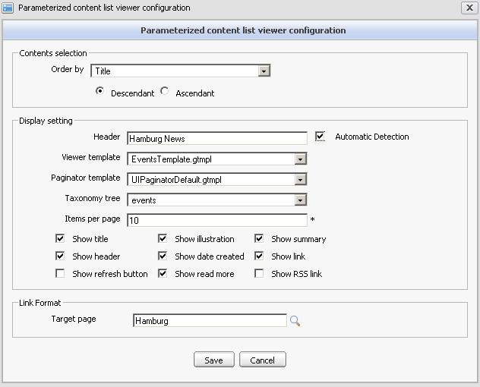
Category Portlets
Category Content
Shows the contents of a category in a list.
You can choose the taxonomy tree and a target path.
The target path should point at a page containing a “Content by URL” portlet.

Slide 30
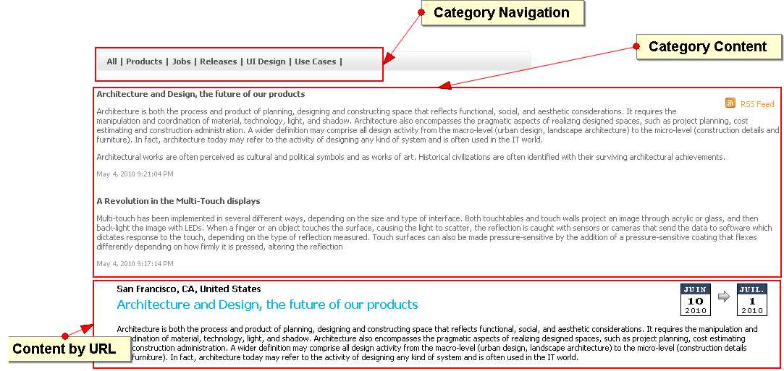
Category Portlets
Category portlets combined in the event page

Slide 31
Exercise 3: Category Portlets
Combined Category Page
Login as root. Go to acme site.
Create a new page.
Put 3 rows.
Drag a Category Navigation Portlet, a Category Content Portlet and a Content by URL Portlet.
  Choose “*event*” wherever you see it.
  Make the Category Navigation Portlet and the Category Content Portlet point at the same page.
  Click on “Events” and compare it with your new page.

Slide 32
Newsletters

Slide 33

Newsletters
Newsletter Portlets
There are two portlets:
  Back Office: For the administrators and moderators called “Newsletter Manager”
  Front Office: For the public called “Newsletter”

Slide 34
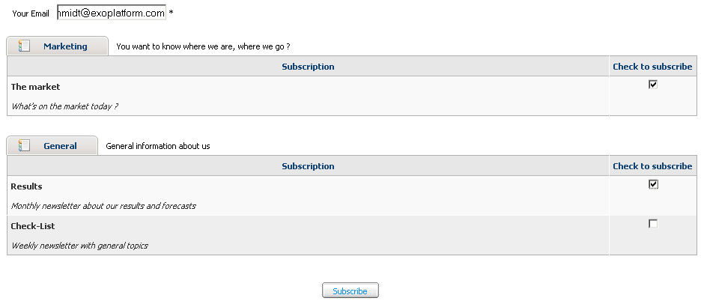
Newsletters
Newsletter Portlet
Subscribe to any newsletter by email.
No management of internal newsletters.

Slide 35
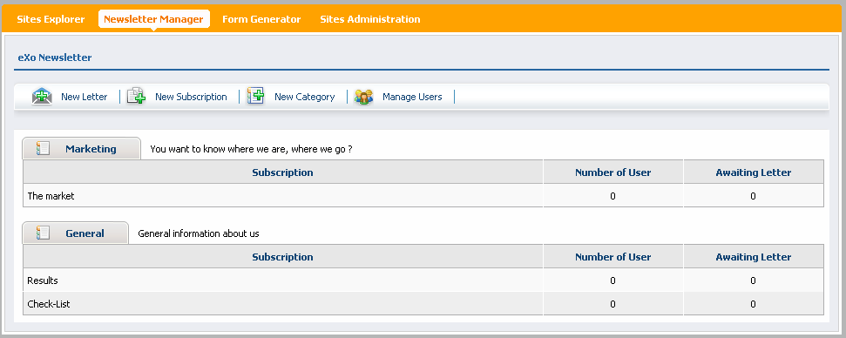
Newsletters
Newsletter Manager
Manage all newsletters, categories, subscriptions and users.

Slide 36
Newsletters
Newsletter Manager
Each category contains several subscriptions.
For each subscription you send letters.
Each subscription has one or more responsible authors (“redactor”), who can create and send the letters.

Slide 37
Exercise: Newsletter
Create a new newsletter category “training”.
Create a new subscription “training news”.
Make “john” moderator of the category and the subscription.
Subscribe with your email address.
Create a newsletter in the “training news”.
Send the newsletter.
Verify your inbox.

Slide 38
WCM

