Slide 1
Customizations

Slide 2
User Access Control List
Group Creation
Portal Data Import Strategies
Creating a Custom Site

Slide 3
Internationalization
Skins

Slide 4
User ACL
User Access Control List

Slide 5
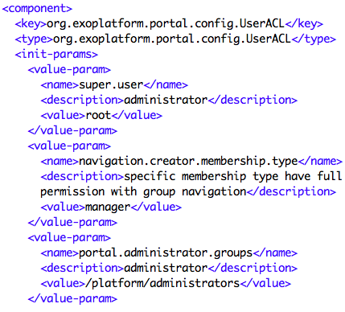
User Access Control List
…\webapps\portal\WEB-INF\conf\portal\portal-configuration.xml
User ACL
Super.user
Navigation creator role
Administrator group

Slide 6
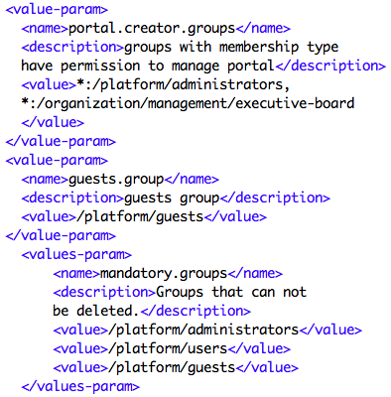
User Access Control List
User ACL
Portal creator groups
Guests group
Mandatory groups

Slide 7
Group Creation

Slide 8
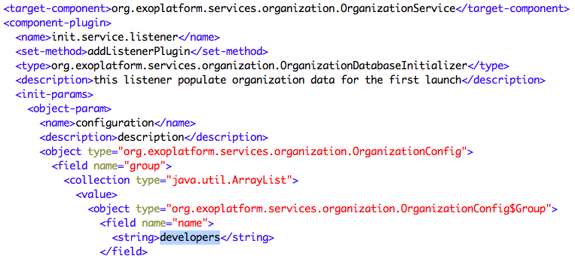
Create a new Group
webapps/platform-extension/WEB-INF/conf/organization/organization-configuration.xml

Slide 9
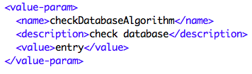
Database Check
checkDatabaseAlgorithm
initialization parameter determines how the database update is performed.
entry
means that each user, group and membership listed in the configuration is checked each time GateIn 3.2 is started. If the entry does not exist in the database yet, it is created.
empty
If the checkDatabaseAlgorithm parameter value is set to empty, the configuration data will be updated to the database only if the database is empty.

Slide 10
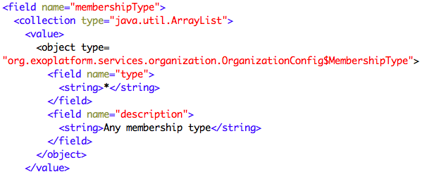
Users and Memberships
Users and memberships are created using the same addListenerPlugin for the OrganizationService

Slide 11
Portal Data Import Strategies
Conserve or overwrite

Slide 12
Import Modes
In an extension, you create new portals (sites) and also import new data into existing portals.
There are 4 types of import modes
Conserve
Insert
Merge
Rewrite
Examples for navigation data

Slide 13
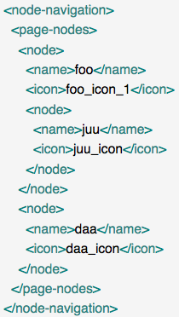
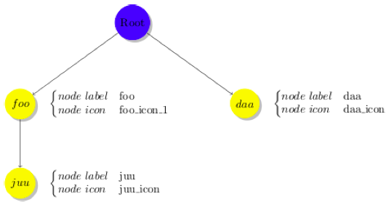
Import Example
First Import

Slide 14
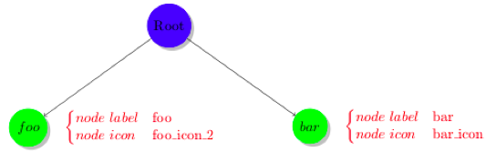
Second Import
A navigation with two subnodes
The node “foo” does already exist.
The node “bar” is a new node.

Slide 15
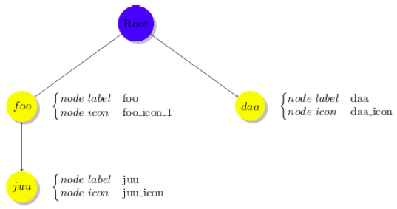
Conserve Strategy
With the CONSERVE mode, data are only imported when they do not exist.

Slide 16
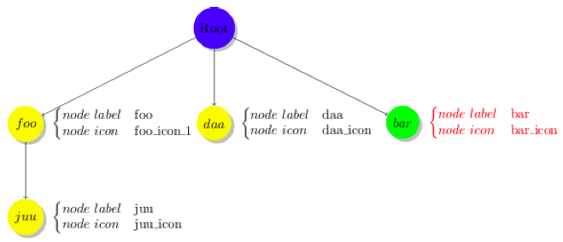
Insert Strategy
If a node does not exist, the importer will add new nodes to the navigation tree.

Slide 17
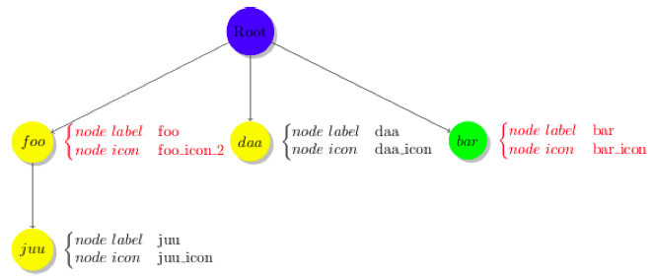
Merge Import
Import data when it does not exist, update data when it exists.

Slide 18
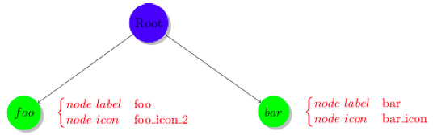
Overwrite Strategy
Everything will be destroyed and replaced with new data.

Slide 19
Creating a Custom Site
Based on the Intranet sample site

Slide 20
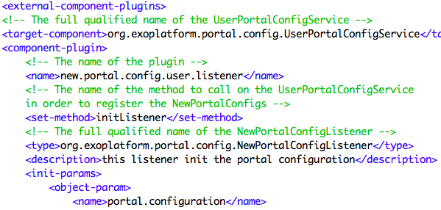
Creating A custom site
webapps/acme-intranet/WEB-INF/conf/office-extension/portal/portal-configuration.xml
UserPortalConfigService --> initListener

Slide 21
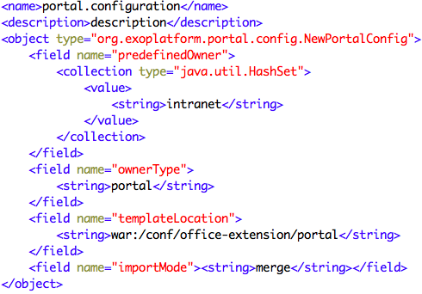
Creating A custom site
Creating the intranet portal (site)

Slide 22
Custom Site Parameters
ownerType
Defines the type of portal navigation. It may be a portal, group or user.
predefinedOwner
Defines the navigation owner, the system looks for the configuration files in a folder with this name, if there is no suitable folder, a default portal will be created whose name is the value of predefinedOwner .
templateLocation
The path that contains all portal configuration files.

Slide 23
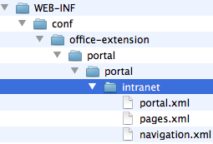
Folder Structure
The portal configuration files are searched in the path {templateLocation}/{ownerType}/{predefinedOwner}.
All navigations are defined in the navigation.xml file.
Pages are defined in pages.xml.
Portal configuration is defined in {ownerType}.xml.

Slide 24
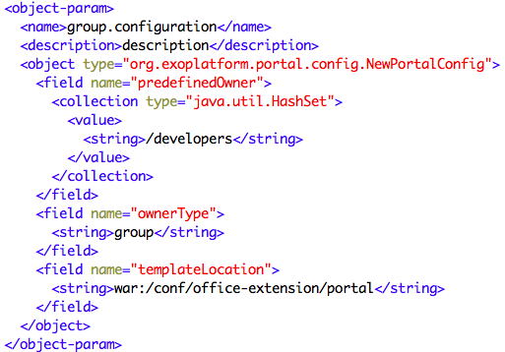
Creating a Group Site
Developers group

Slide 25
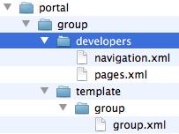
Group Site Folder Structure
Developers group with navigation and pages
Redefining the template for groups
The group template is valid for all new groups without a portal configuration (portal layout).

Slide 26
Exercise: Custom Site
Create an extension that creates a custom site “bike”
Add navigation nodes, pages and a common layout.
Add resource bundles for the new site
Extra: Create a group site

Slide 27
Internationalization
Multilingual Sites

Slide 28

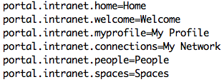

Internationalization
Internationalization
Multilingual Intranets and web sites
Also abbreviated as i18n
Key-Value pairs are stored in .properties or .xml files
On file per language, identified by the language iso 639 code

Slide 29
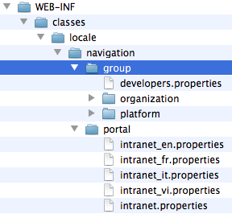
Internationalization Files
3 kinds of properties:
General portal keys, accessible from anywhere
navigation node keys, tightly bound to a navigation separated by user, group and general portals
Portlet resource bundles, only accessible in portlet code
The files are stored as resources on the classpath of a webapp : WEB-INF/conf/classes/locale

Slide 30
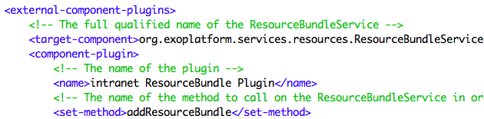
Resource Bundle Service
You have to configure the ResourceBundleService in order to add new resource bundles.
Example: webapps/acme-intranet/WEB-INF/conf/office-extension/portal/resource-bundle-configuration.xml

Slide 31
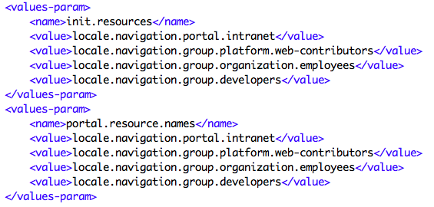
Resource Bundle service
init.resources
initiates resources related to portal, group, user resource bundle.
portal.resource.names defines
all resources that belong to the Portal Resource Bundle.
These resources are merged into a single resource bundle which is accessible from anywhere

Slide 32
Exercise: Internationalization
Copy the empty extension and create from that your custom i18n-extension.
Correct wrong translations
In your custom extension, override a *.properties file in order to correct some translations. Override the file …\webapps\acme-website\WEB-INF\classes\locale\navigation\group\platform\web-contributors_en.xml
Translations for the bike site
Provide …\webapps\bike-extension\WEB-INF\classes\locale\navigation\portal\bike_en.xml for new navigation nodes.
Extra: Group navigation nodes
For the group “platform/training” create some navigation nodes with some pages. Use a key for the navigation node labels (#myTrainingGroupPage).

Slide 33
Skins
CSS

Slide 34
Skin Types
Portal Skin
All portlet skins are merged together and cached – for performance reasons.
Portlet Skins
Included when a specific portlet is deployed on a page.
Unified Look-and-Feel
Portlet Specification CSS Classes: CSS classes included in the portal skin, allowing all portlets to follow a unified look-and-feel.
eXo specified Portlet Skins, allowing a more customizable look-and-feel.

Slide 35
Default Skin
By default, there is only only one skin called “Default”
All webapps can add css files to the “Default” skin.
Defined in WEB-INF/gatein-resources.xml

Slide 36
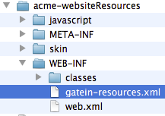

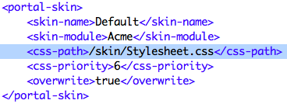
Skin definition
Example: acme-websiteResources

Slide 37
Skin Definition
Resulting link in any page of the server.
The link id matches the skin-module.
All stylesheets of this module are merged together.
The position matches the css-priortiy
“lt” means left-to-right (alternative would be “rt” for right-to-left)

Slide 38
Custom Skin
Create a custom skin called “bikeSkin”
Webapp ingredients:
Extension
web.xml with a ResourceRequestFilter
gatein-resources.xml
Stylesheet.css

Slide 39
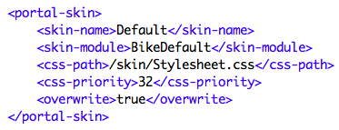
Gatein-Resources
gatein-resources.xml contains a reference to new css rules with a high priority.

Slide 40
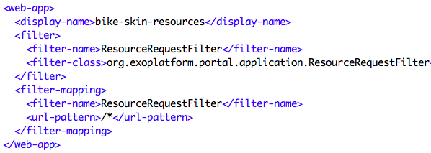
Web XML for SKins
Web xml contains a ResourceRequestFilter

Slide 41
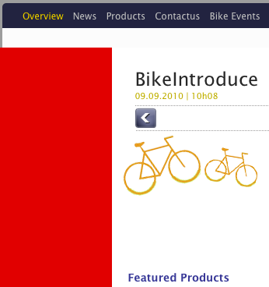
Result Screenshot

Slide 42
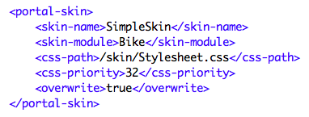
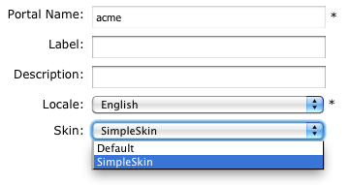
New Skin Example
New skin example

Slide 43
Exercise: Skin
Test the skin project
Deploy the config (activation) jar to tomcat/lib
Deploy the war to tomcat/webapps
Whenever you redeploy, delete the webapp folder.

Slide 44
Customizations

