Slide 1
Portal Introduction
Portal Elements and Organization ModeL

Slide 2
Discovery

Slide 3
Why a portal ?
Improvement of productivity
Single Entry Point
Single Sign-On
Application Integration
Resources leverage
Centralized User Management
Simplified Administration and Deployment

Slide 4
Why eXo Platform ?
Respect for Standards
Professional Open Source
Integrated and Extensible
Customer-driven innovation (ex: cloud IDE, web OS)
Flexible Roadmap

Slide 5
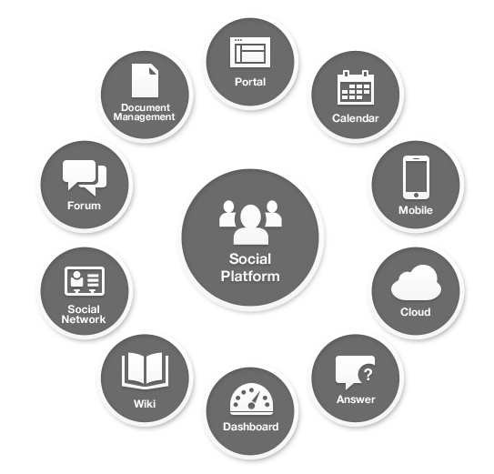
Enterprise Portal

Slide 6
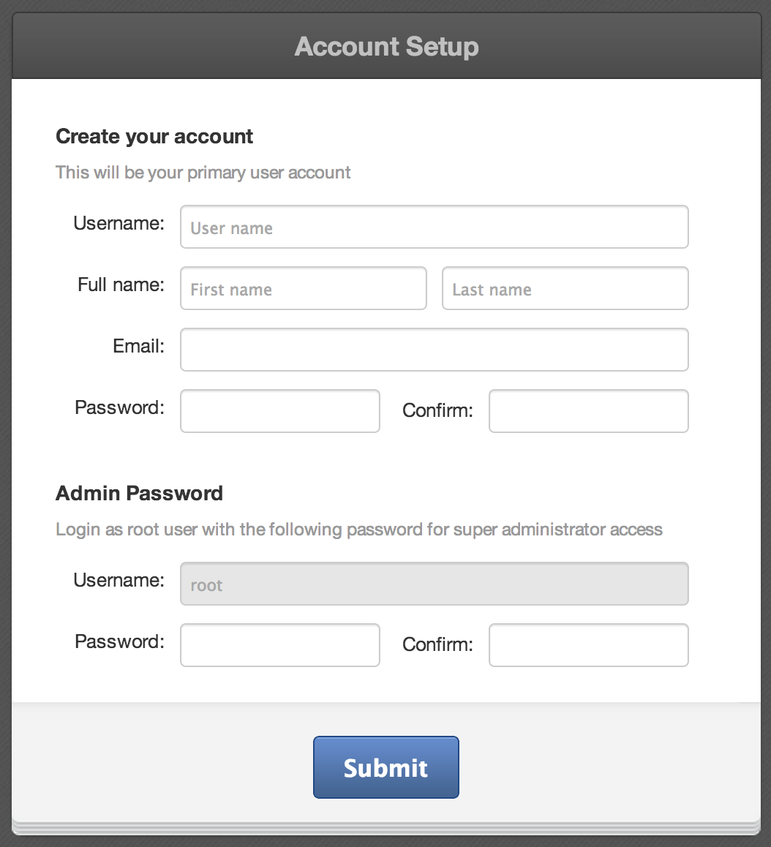
Setup
Open the this address: http://localhost:8080
Forwards to the default portal: http://localhost:8080/portal /intranet/

Slide 7
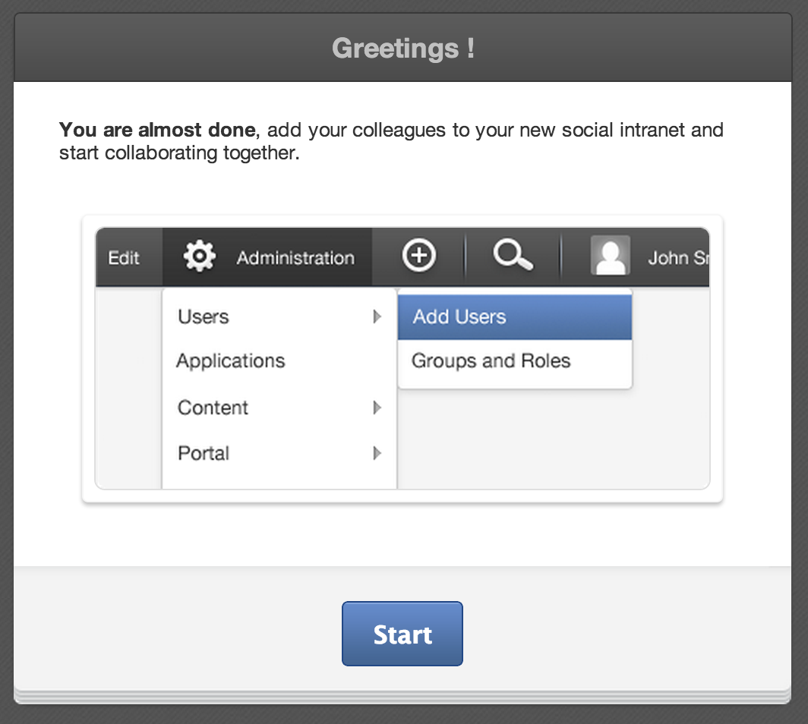
eXo Platform Landing Page

Slide 8
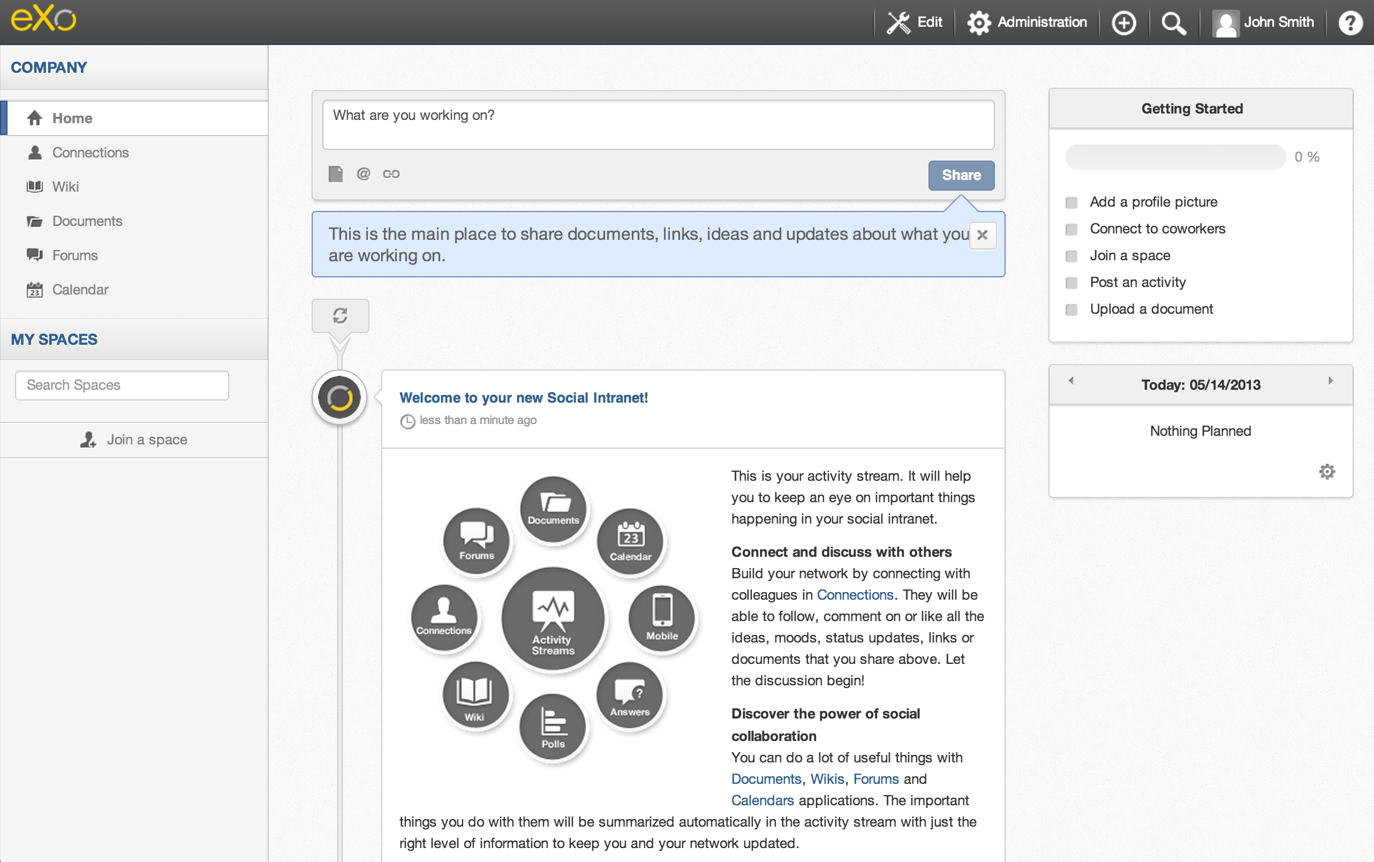
eXo Platform Social Intranet

Slide 9
eXo Platform Social Intranet
Admin Bar
Navigation
Applications

Slide 10
Admin Tool Bar for Authenticated Users

Slide 11
Admin Tool Bar : Administrator View
Logo : link to Homepage
Edit : pages, sites, navigation, SEO
Administration : administration of applications
+ : quick add content
Search : unified search
User name with account and language preferences
Help : contextual Help Center

Slide 12
Admin Tool Bar : Standard User View
Logo : link to Homepage
No Edit menu
No Administration menu
+ : quick add content
Search : unified search
User name with account and language preferences
Help : contextual Help Center

Slide 13
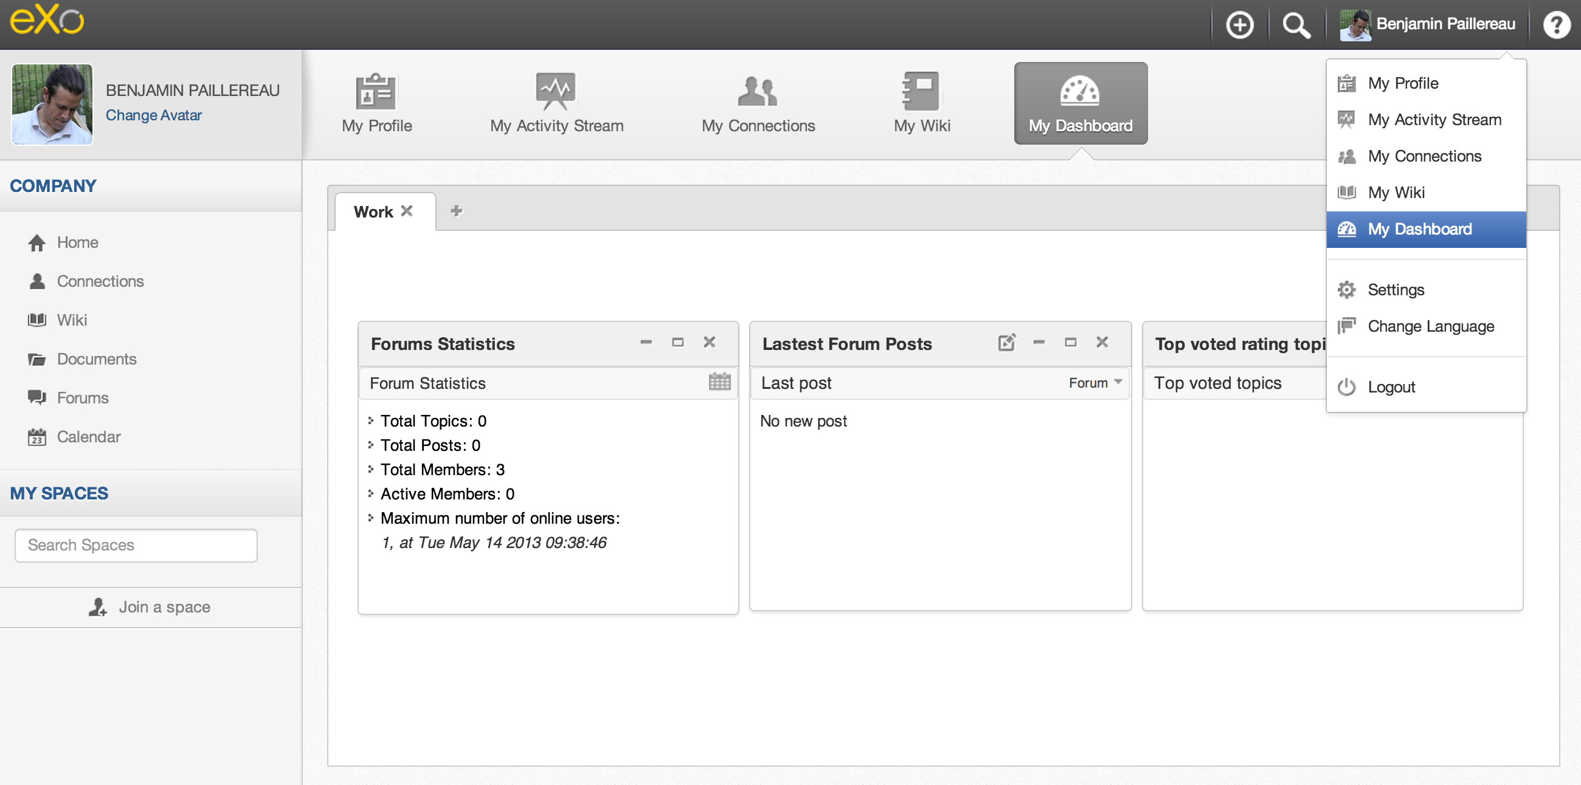
Personal Space and Dashboard
Personal Gadgets, which are private to each user.

Slide 14
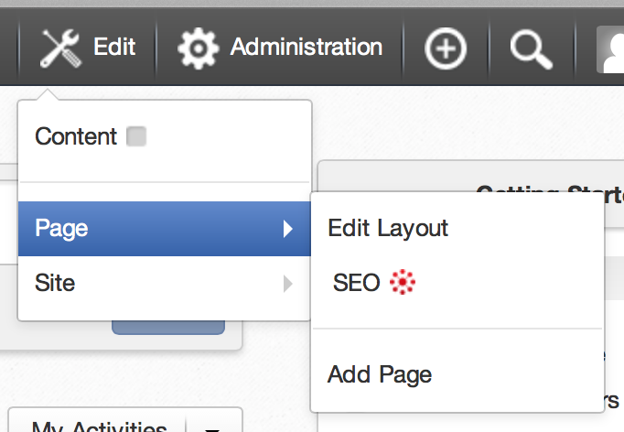
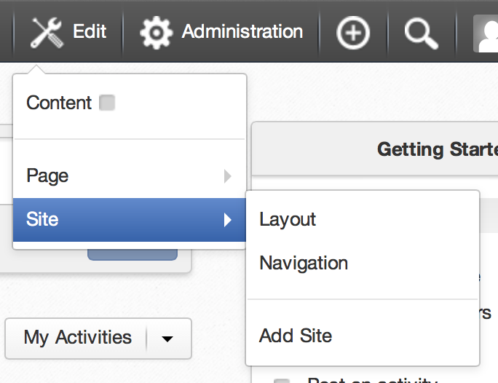
Admin Tool Bar - Editor
Add/Edit Page and SEO
Edit Site Layout

Slide 15
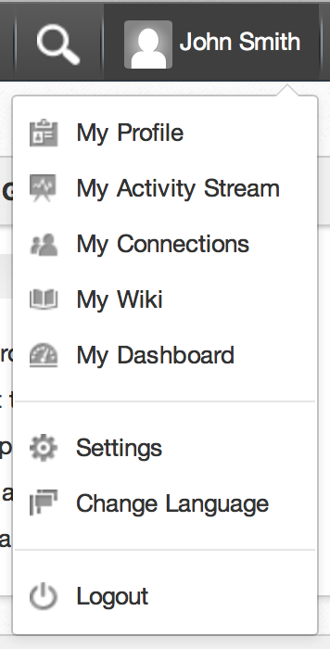
Admin Tool Bar
By clicking on the user name you can
Modify some user data
Access to his personal space
Change the user language preference
Log out

Slide 16
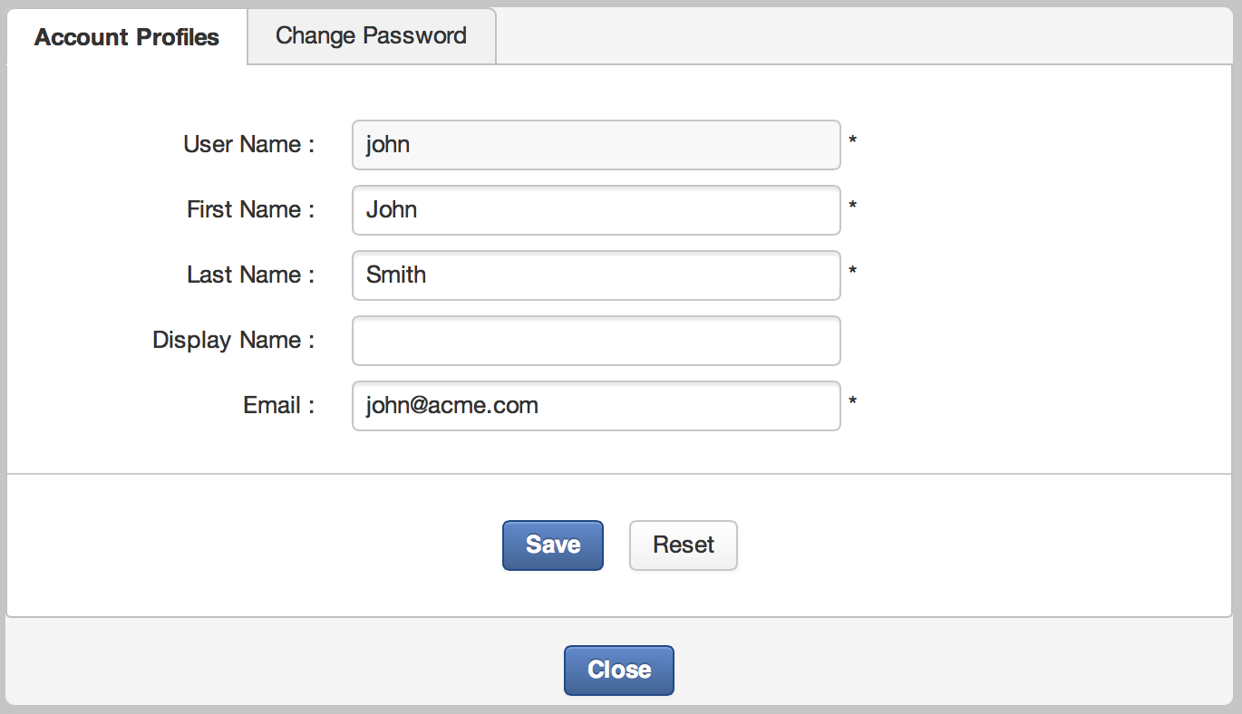
User Account

Slide 17
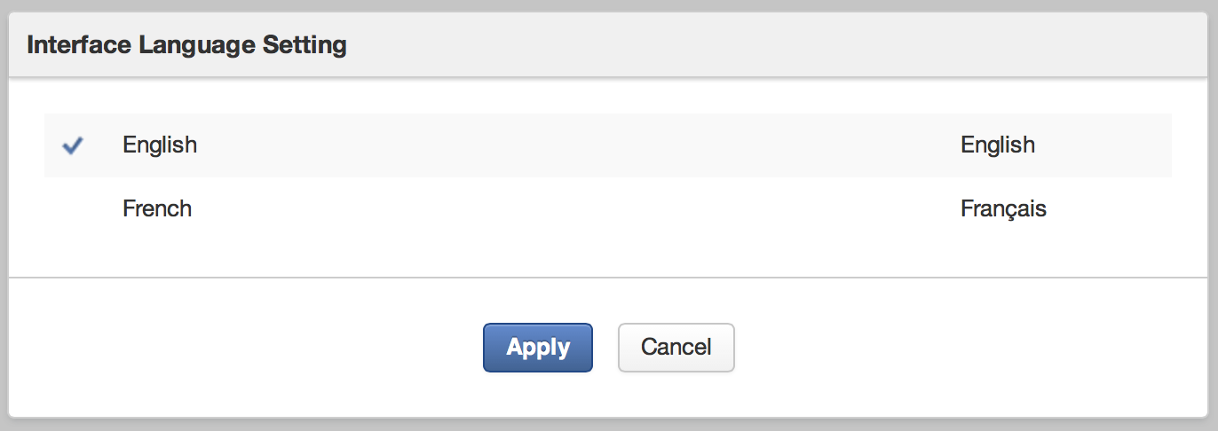
Languages Preferences
eXo Platform is available in French and English
Anonymous / public site:
the language choice is stored in temporary session.
After login: The choice is stored in the user preferences.

Slide 18
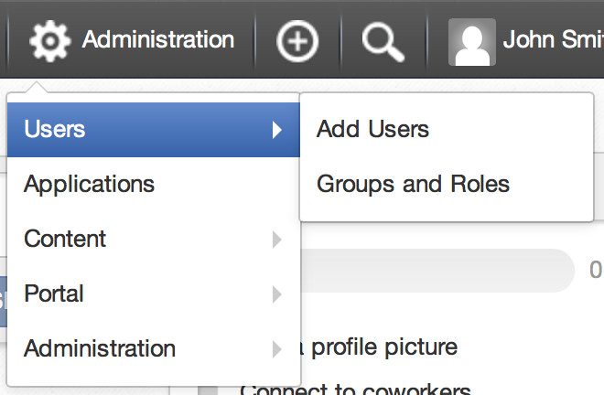
Platform Settings
eXo’s internal applications are available and top right corner.
You have access to settings, administration and monitoring tools.
The choice of applications depend on the user profile. Different users have access to different applications.

Slide 19
Gadgets Personal Dashboard

Slide 20
Gadgets
Live user interface
Accessible in Dashboards, WebOS or using a Gadget Wrapper (later more about this)
Many implementations : Google Gadget standard in GateIn
Embeddable chunk of HTML and Javascript, defined in a standard XML file.

Slide 21
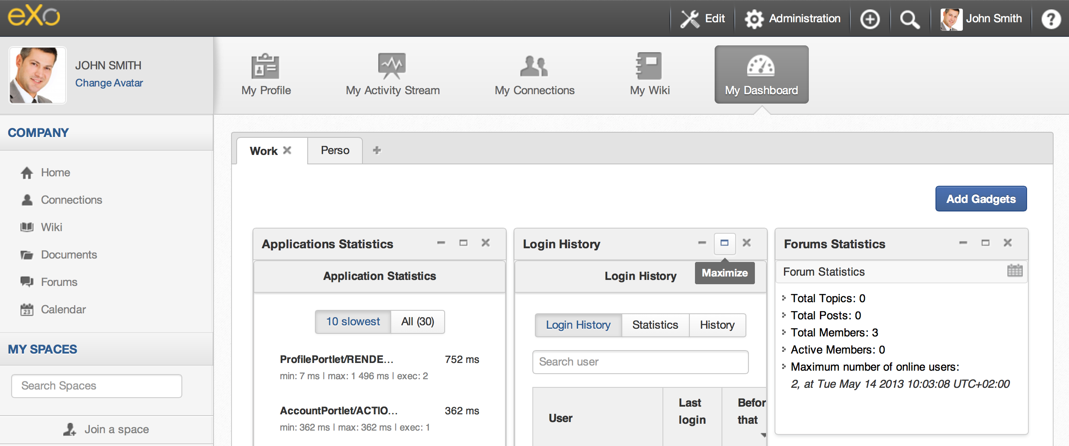
Personal Dashboard
Personal Dashboard of John Smith
Double click to edit a tab’s name
Add gadgets from the Gadgets Directory
Minimize, maximize, delete

Slide 22
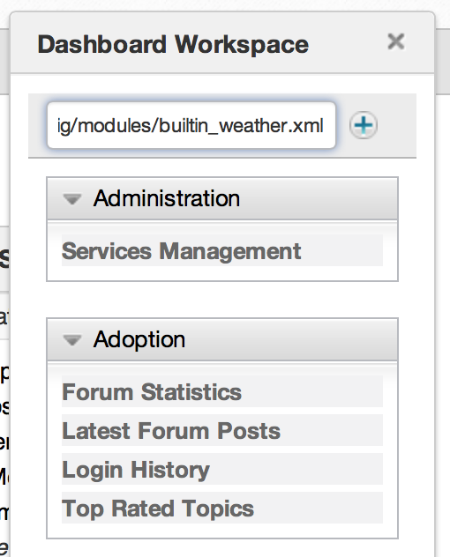
External Gadgets
External gadgets are stored on other servers. You need an Internet connection.
You need to enter or copy a complete URL which points to an XML file.
Enter the gadget URL
Then click on +

Slide 23
Exercices

Slide 24
Exercise 0 : Start and Play
Requirement:
Java SDK 6 or Java SDK 7 (eXo Platform 3.5 was Java 6 only)

Slide 25
Exercise 0 : Start and Play
Start the portal
Create a directory $TRAINING_HOME and unzip platform-4.0.0.zip
Search for the binary subfolder:
...\platform-4.0.0
In command line, launch:
Linux / Mac OS : ./start_eXo.sh
Windows : start_eXo
Wait
Watch the startup messages.
The startup is finished when you see “INFO: Server startup in 71219 ms”.
Open this page in a browser: http://localhost:8080

Slide 26
Exercise 0 : Start and Play
How to stop eXo Platform
To stop the server, simply type Ctrl+C from the console
You can also use : ./stop_eXo.sh stop
To re-init and get the default configuration (starting from scratch):
Unzip again in order to get a fresh eXo installation.

Slide 27
Exercise 0 : Start and Play
Settings
Open http://localhost:8080
Create the Administrator account (john)
Log in as John
Change the language for John
Change his email address
Open Administration > Users > Add Users
Create the user Mary

Slide 28
Exercise 0 : Start and Play
Dashboard
Log in as “mary” (password: gtngtn)
Create two dashboards tabs with different names and drag gadgets to it
Log in as “john” (password: gtngtn)
Verify that his dashboard is empty (remember that the dashboard is personal)
Create a dashboard for John
Add an external gadget to the dashboard: http://shazingo.com/lig/lg/142002.xml
If not otherwise stated, in all following exercises of this training use “john”.

Slide 29
Organizational Model Users, Groups and Roles

Slide 30
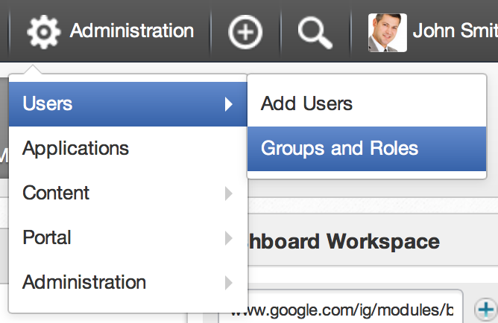
Organisational Model
Components
Users
Groups
Memberships
Authentication and Authorization
Generalized model for the platform
By default: Database storage (Hibernate)
Possible: Directory storage (LDAP), Microsoft Active Directory, or a custom system.

Slide 31
Organisational Model - Memberships
Membership are identical with roles: manager, validator, editor.
Membership are shared among all groups.
When a user is added to a group she or he must be assigned with a membership to that group.
The asterisk “*” stands for “all memberships”.

Slide 32
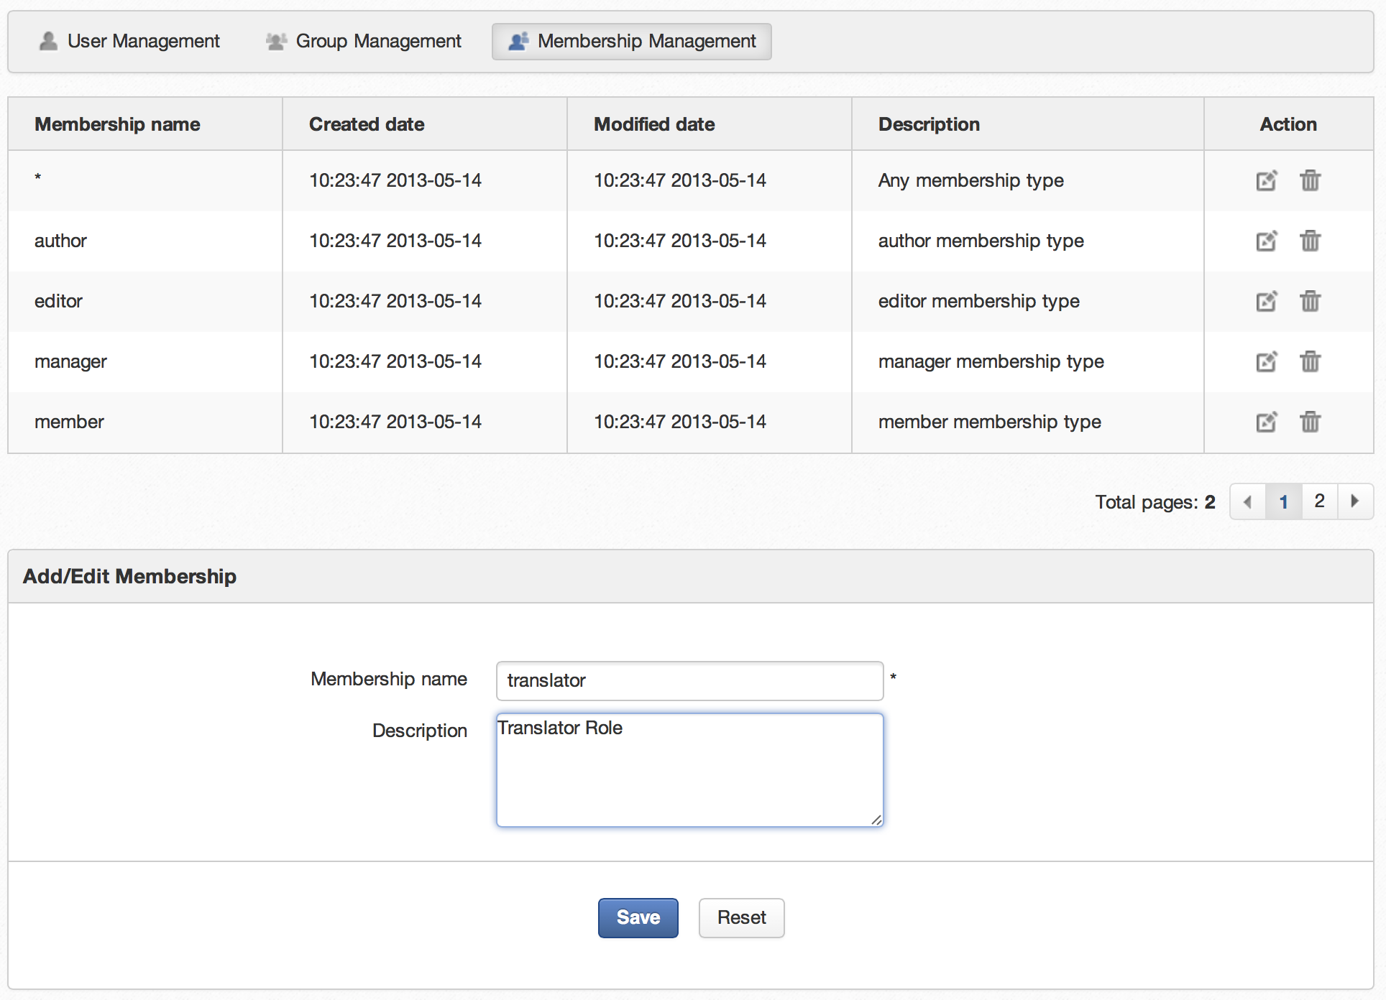
Organisational Model - Memberships
Add or modify memberships tab
Modify or delete memberships
Add new membership

Slide 33
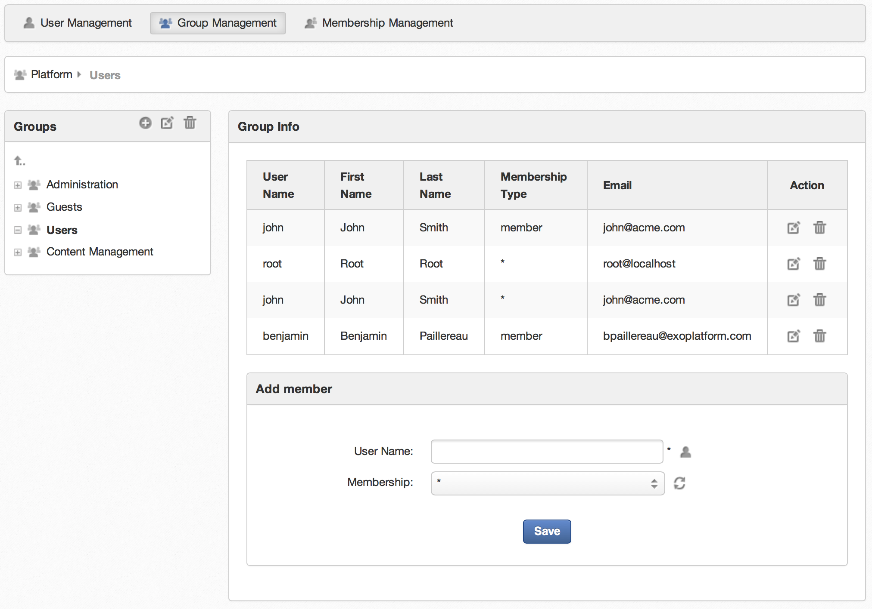
Organisational Model – Groups
Groups are organized in hierarchy, but there is no inheritance.
A user can be several times in the same group with different memberships.
Add subgroup, modify or delete groups
Edit or delete a user’s membership
Add or edit a membership
Current group

Slide 34
General Remarks
Name = ID
Every time you see a field asking for a group, membership or user name, you should think of an ID. Therefore, names cannot be modified. For end users, there is sometimes a second field called „label“ which is used for the interface. You will see this usage of the „name“ field in other areas of eXo.
Case Sensitivity
Everything is case sensitive: user, group and membership name.
Membership Type manager
This is the role of the manager of each group. Each group has to have one member with a role. The administrator who creates a group is automatically added to that group with the membership type “manager”.

Slide 35
Exercise : Memberships
Create a new member
Login as John.
Open the application “’Add Users” (Administration > Users)
Create a user called “elena”.
Manage users and groups
Open “Groups and roles” (Administration > Users)
Search for the user “Elena”. Is she already member of a group?
Create a new membership type “translator”.
Create a new subgroup in platform called “bike”.
Add Elena to the new group with the new membership type.
Add Elena a second time to that group user the “manager” membership type.

Slide 36
Portal Introduction
Portal Elements and Organization ModeL
Questions and Answers

