Slide 1
Customizations and Extensions
Notes:
1

Slide 2
Table of Contents
Folder Structure
Service Configuration
Central Properties Configuration
Configuration Profiles
Portal Container
Extension Mechanism
Configuration Priorities
External Configuration
Notes:
2

Slide 3
Folder Structure
3
Notes:
3
3

Slide 4
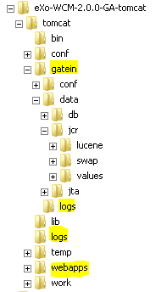
Folder Structure
About
Application configuration files
GateIn configuration files
Temp files
Data files
Log files
WebApps
WebApp structure
Notes:
4
4

Slide 5
Folder Structure
Folder Explanations
Data/jcr/lucene: index Lucene
Data/jcr/values: database values for each workspace
Notes:
5
5

Slide 6
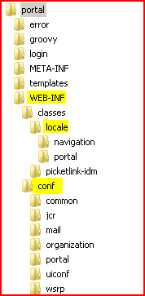
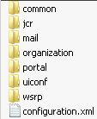
Folder Structure
WebApp
WEB-INF/classes/locale
WEB-INF/conf
WEB-INF/conf/configuration.xml
Notes:
6
6

Slide 7
Service Configuration
7
Notes:
7
7

Slide 8
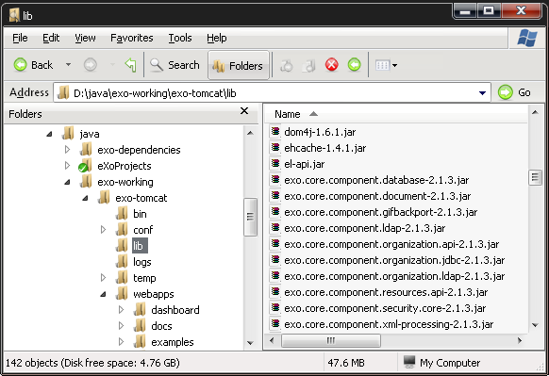
Service Configuration – Introduction
Nearly everything could be considered a service!
Look into the lib folder:
Notes:
8
8

Slide 9
Services
In that lib folder you find services for databases, caching, ldap and ftp:
exo.core.component.database-x.y.z.jar
exo.kernel.component.cache-x.y.z.jar
exo.core.component.organization.ldap-x.y.z.jar
exo.jcr.component.ftp-x.y.z.jar
Of course, there are many more services, in fact a lot of the jar files are services.
A service can have a configuration. This default configuration is delivered in the jar file.
The default configuration is in the jar file in the /conf or /conf/portal directory. in a file named configuration.xml.
In order to reduce hidden configurations, eXo does not use default configurations.
Notes:
9
9

Slide 10
SOA Keywords
All eXo services are built around the eXo.
Services are also refered to as „Components“.
Called the service management layer.
All services are glued together by the eXo Container using dependcy injection.
The eXo Container is responsible for loading services.
The life-cycle of a service is handled by the eXo Container.
The same service can have several different implementations, but only one can be used during runtime.
The eXo Container has the role of the dependency provider.
The consumer of a services does not call directly a service.
The consumer accesses the services through the eXo Container.
The eXo Container provides a reference to an implementation of the requested service
Notes:
10
10

Slide 11
Services
Interface – Implementation
It's important to get the idea that you separate the interface and implementation for a service. That is a good concept to reduce dependencies on specific implementations. Any service in eXo is defined by a java interface and may have many different implementations. The service implementation is then injected by a container into the application.
Singleton
Each service has to be implemented as a singleton, which means that each service is created only once - in one single instance.
Service = Component
A service and a component can safely be considered to be the same thing.
Notes:
11
11

Slide 12
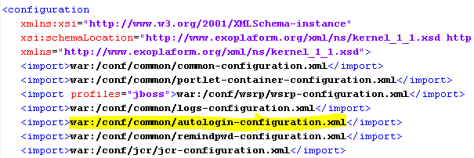
Service Configuration
To declare a service, you must add an xml configuration file in a specific place.
This file can be in the jar file, in a webapp or in the external configuration.
Each webapp can add or modify configurations.
The configuration start point is …\webapps\portal\WEB-INF\conf\configuration.xml, there you normally import other configuration files:
Notes:
12
12

Slide 13
Import Configuration
Import Configurations from other files:
war: Imports from a webapp in the /WEB-INF folder.
jar or classpath: Uses the classloader, you can use this prefix in the default configuration for importing an other configuration file which is accessible by the classloader.
Notes:
13
13

Slide 14

Service Configuration
The registration of a service within the container is done with the <component> element.
You have to define a service at least one time, otherwise the service is not known by the container.
You see here the interface (defined by <key>) and the implementation (defined by <type>):
Notes:
14
14

Slide 15

Service Configuration
For example, open the exo-ecms-core-services-x.y.z.jar file; inside this jar open /conf/portal/configuration.xml. You will see:
Each component has a key which matches the qualified java interface name (org.exoplatform.services.cms.CmsService).
The specific implementation class of the component (CmsServiceImpl) is defined in the <type> tag.
If a service does not have a separate interface, the <type> will be used as the key in the container. This is the case of ContentInitializerService.
Notes:
15
15

Slide 16
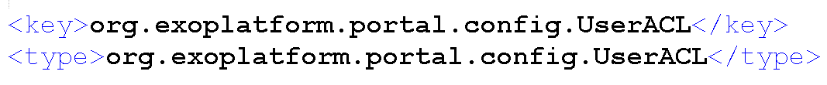
Service Configuration – Single Implementation
The UserACL service has the same <key> and <type>.
This corresponds to the special case of a single implementation.
The developer may decide not to create an interface if there will not be more than one implementation of the service.
Notes:
16
16

Slide 17
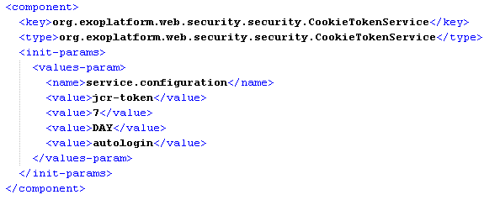
Services Configuration
Look into …\webapps\portal\WEB-INF\conf\common\autologin-configuration, there you define a component (=service).
Notes:
17
17

Slide 18
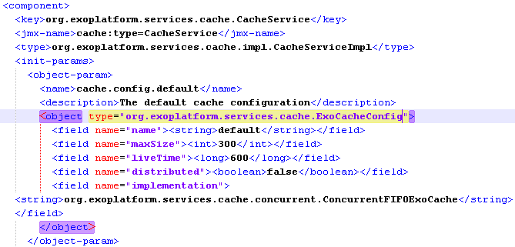
Services Configuration
The configurations can be simple, but there can be complex configurations
The cache service (common-configuration.xml) is configured using the object org.exoplatform.services.cache.ExoCacheConfig:
Notes:
18
18

Slide 19
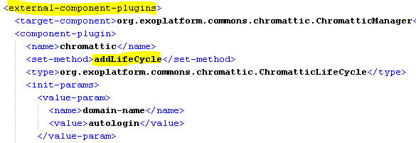
Services Configuration
Modifications of a service are done by plugins. The plugins call a methods of a service (…\webapps\portal\WEB-INF\conf\portal\autologin-configuration) :
Notes:
19
19

Slide 20
Central Properties Configuration
20
Notes:
20
20

Slide 21
Configuration Folder
Central Configuration folder
...\tomcat\gatein\conf\
In this folder (and subfolders) you can override any (previous/default) configuration. Later more about this.
Also called “external configuration”.
Documentation: http://www.jboss.org/exojcr/
Notes:
21
21

Slide 22
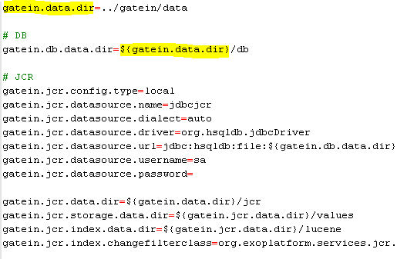
Configuration.properties
The file ...\tomcat\gatein\conf\configuration.properties makes the most common configurations easily accessible
Notes:
22
22

Slide 23
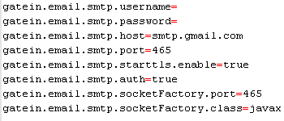
Configuration
Email service properties in ...\tomcat\gatein\conf\configuration.properties
Notes:
23
23

Slide 24
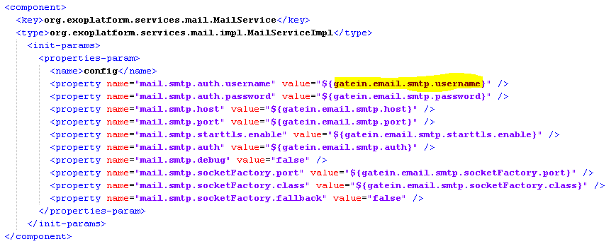
Configuration
Email service properties used in ...\webapps\portal\WEB-INF\conf\mail\portal-mail-configuration.xml\tomcat\gatein\conf\configuration.properties
Notes:
24
24

Slide 25
Exercise: Common Properties
Central Configuration file
Stop eXo Platform
Open ...\tomcat\gatein\conf\configuration.properties
Modify gatein.data.dir in order to point to a different folder
Restart eXo.
What happens?
Extra: If you have a database available, modify the datasources in configuration.properties and configure the datasources in tomcat/conf/server.xml depending on your database.
Notes:
25
25

Slide 26
Configuration Profiles
26
Notes:
26
26

Slide 27


Configuration Profiles
Configuration profiles are restrictions.
Only if a profile is activated the configuration is taken into account. Otherwise the configuration is ignored.
The profile restrictions can be at any level of the configuration.
Notes:
27
27

Slide 28


Configuration Profiles
Several profiles can be listed by a comma separated list: “profile1, profile2”.
Profiles are used for clustering configuration.
Notes:
28
28

Slide 29
Configuration Profiles
Profile activation is done by a java environment settings.
The example run eXo with the profiles profile1 and profile2
In gatein.sh (or bat) modify it that you use: “-Dexo.profiles=profile1,profile2”.
Notes:
29
29

Slide 30
Exercise: Configuration Profile
Open the documentation and find out about the different profiles. Example for collaboration and knowledge.
What is the difference of the profiles „all“ and „default“?
How to include workflows?
Which profiles you have to choose in order to exclude „WCM“ and „Collaboration“?
Notes:
30
30

Slide 31
Portal Container
31
Notes:
31
31

Slide 32
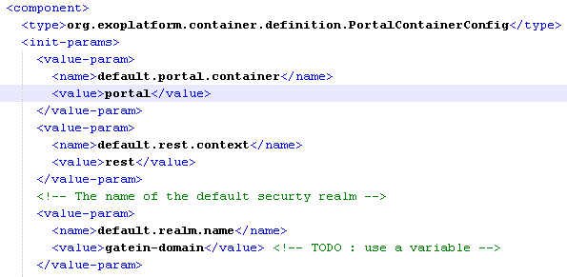
Portal Container Definition
The portal container is defined in a jar file defining the component PortalContainerConfig. You define the name, the rest context and the realm (examples: …/tomcat/lib/exo.platform.extension.config-3.0.0-GA.jar – do not modify this file!)
Notes:
32

Slide 33


Portal Container URL
The name of the portal is part of the URL:
http://localhost:8080/portal/public/default/
Also the rest service context is defined: http://localhost:8080/portal/rest/jcr/repository/collaboration/
Notes:
33

Slide 34
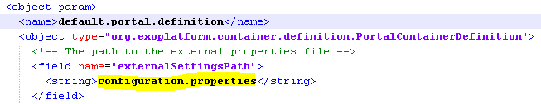
Properties File
You also define the name of the properties file.
Notes:
34

Slide 35
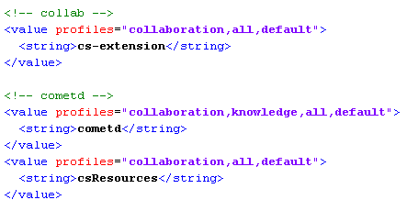
Portal Container WebApps
You also define a long list of webapps that are part of the Portal Container.
Note that you can restrict the participation of webapps by using configuration profiles.
The first webapp has the lowest priority, The last webapp has the highest priority.
Notes:
35

Slide 36
Exercise: Portal Container
Open tomcat/lib/exo.platform.extension.config-3.0.0-GA.jar, unzip this file and analyze the configuration in …/platform/configuration.xml
In next chapter we learn how to add our custom webapp to this list.
Notes:
36

Slide 37
Extension Mechanism
37
Notes:
37
37

Slide 38
Problem
You should never modify the source code of the delivery of eXo Platform.
At each delivery of a new version you might have to re-do your modifcation.
This is not good practice.
And it‘s not allowed if you subscribe for support.
Solution: It‘s a lot better to plug your modifications from outside the source code
Listen carefully everthing about the Extension Mechanism.
It‘s a very important feature of eXo Platform.
Notes:
38
38

Slide 39
Extension Mechanism
Goals:
Define the priority of the war files
Define the priority of configurations that are in the war files.
Allow to override javascript, skin, and template files in a customized war. That means calling the http://my-host/portal/any-file accesses in fact a file in any war that is not obligatory in the portal war.
Resources searched on the class path do also respect the same priorities
Notes:
39
39

Slide 40
Extension Mechanism
Extension Mechanism
Attention: The Extension Mechanism only concerns the priority and the order of these resources but not the order the application server loads the war.
There is a war called „starter.war“ that manages this mecanism. This war file must be loaded in last position. In tomcat in order to load a war in last position, you must unzip it (the other war files must stay in the war format).
Notes:
40
40

Slide 41
Extension Mechanism
Unified Servlet Context (PortalContainerContext)
Examples:
1. You can overload the standard configurations by placing a different configuration in your customized war.
2. The resource http://localhost:8080/portal/css/my-skin.css can be located in the portal war file, but also in any other war file that you have defined, called for example „customizedWar“.
Notes:
41
41

Slide 42
Unified Classloader
Unified Classloader
Managed by the Unified Servlet Context
Only for resources, not for java classes.
Each time a resource is loaded (from the classpath), all libs in the war files of the unified servlet context classload are accessible.
The parent classloader of the application server (tomcat/lib) remains the parent classloader.
Notes:
42
42

Slide 43
Extension Mechanism
Extension
Customize eXo Platform
User Interface
Menu
Graphical style
ECM Templates
JSPs
Configuration
Services
Portlets
Notes:
43
43

Slide 44
Extension Mechanism
Unified Servlet Context
Requirements:
Create your own war file containing all customizations.
In the web.xml declare the listener: PortalContainerConfigOwner
Add the custom war file to the Unified Servlet Context by configuring the org.exoplatform.container.definition.PortalContainerConfig component. This component has to be configured in the RootContainer. For that you add a special configuration jar file to the lib folder.
In order to load your customExtension war before the starter.war create a customExtension.xml file in conf/catalina/localhost/
Notes:
44
44

Slide 45
Activation Jar
Activation Jar
Requirements:
Create a folder „conf“ and create in that folder a „configuration.xml“.
The configuration xml contains a single external-component-plugin that adds a war to the PortalContainerConfig component.
Notes:
45
45

Slide 46
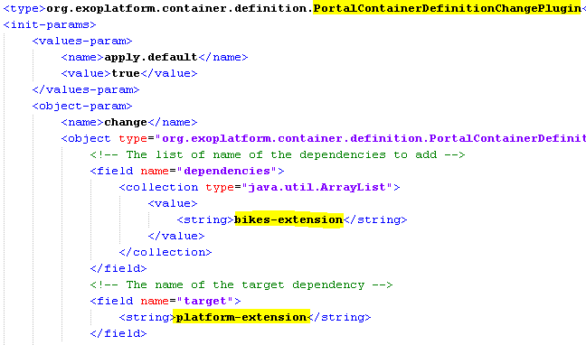
Configuration Jar
Notes:
46
46

Slide 47
Extension Mechanism
eXo Services (=Knowledge, Collaboration)
For each eXo Extended Service (Marketing term!) there are one or several extension wars. These wars contain all necessary configurations and built-in components/services for the eXo Extended Service.
You must not touch these war files!
For your own configuration there is a file ...\gatein\conf for the most common configurations
... And a you are invited to create your own extension war file
Notes:
47
47

Slide 48
Admin Tool Bar Config
The original configuration of the Admin Tool Bar is in …\tomcat6-bundle\webapps\platform-extension\WEB-INF\conf\portal\portal\sharedlayout.xml
You can override it in your custom war. Place your customization in your-custom-war\WEB-INF\conf\portal\portal\sharedlayout.xml
In “sharedlayout.xml“ you will find the definition of several portlets, in fact each entry in the Admin Tool Bar is a small portlet. The file configures the order of these entries in the tool bar.
Furthermore, there is a place holder for the site: <site-body/>
Notes:
48
48

Slide 49
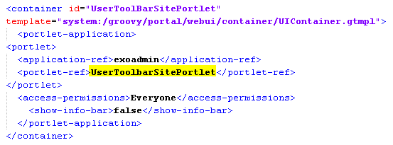
Admin Tool Bar Config
Notes:
49
49

Slide 50
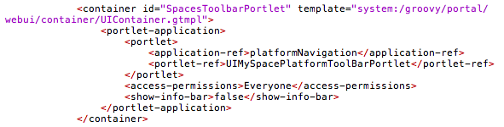
Admin Tool Bar Config
Notes:
50
50

Slide 51
Exercise : How to use Maven offline
Replace a configuration file
Open a shell
Open the project file “…/exercises/custom-extension/1-project“
Execute “mvn clean” in the shell – there will be errors (if you are online), otherwise there will be downloads, you should stop the execution after the first download)
Copy maven-repository.zip to §HOME/$username/.m2/
Delete the existing folder named “repository”
Unzip maven-repository.zip
Execute “mvn clean” in the shell – no more errors, because the deliverd repository is used
Notes:
51
51

Slide 52
Exercise – Custom Extension: 1/3
Open exercise …/custom-extension/
Change the order of the portlets in the Admin Tool Bar …/1-project\war\src\main\webapp\WEB-INF\conf\portal\portal\sharedLayout.xml
In order to be faster, integrate exercises the next two exercises before compiling and starting eXo
Notes:
52
52

Slide 53
Exercise – Custom Extension: 2/3
Override a jsp file
In the same project folder: …/custom-extension/1-project/war/src/main/webapp
Create your own version of the jsp file …webapp\portal\login\jsp\login.jsp
You have to copy login.jsp to the exact same position in your bike-extension.
Notes:
53
53

Slide 54
Exercise – Custom Extension: 3/3
Add a language in a configuration file
Copy ...tomcat\webapps\portal\WEB-INF\conf\common\locales-config.xml to exact …src\main\webapp\WEB-INF\conf\common\locales-config.xml
Add Afrikaans language (“af“) to locales-config.xml
Open …\exercises/custom-extension/1-project and execute “mvn clean install”
Take a clean tomcat of eXo Platform. Take a clean tomcat of eXo Platform. Copy the compiled war (…\ 1-project\war\target\bike-extension.war) to the webapps folder.
Copy the compiled jar (…\1-project\config\target) file to the tomcat/lib folder
Start eXo. Click on change language and you should see Afrikaans in the list.
Notes:
54
54

Slide 55
Extra-Exercise: Rename the extension
All your extensions are called “bike-extension”. Let‘s rename it to “kiwi-extension“.
Make a copy of folder …/exercises/custom-extension/2-solution, name the copy “kiwi-extension“.
Replace “bike-extension” by “kiwi-extension” in:
myExtensionProject\war\pom.xml
myExtensionProject\war\src\main\webapp\WEB-INF\web.xml
myExtensionProject\config\src\main\resources\conf\configuration.xml
Execute mvn clean install and try it on a clean eXo Platform
Notes:
55
55

Slide 56
Configuration Priorities
56
Notes:
56
56

Slide 57
Configuration Priorities
Root Container:
Default configuration in jar files: …/conf/configuration.xml
External Configuration: …\tomcat\gatein\conf\configuration.xml
The Portal Container inherits the Root Container configuration
Portal Container Configuration:
Default configuration in jar files: …/conf/portal/configuration.xml
Webapp configuration: /WEB-INF/conf/configuration.xml
External Configuration: …\tomcat\gatein\conf\portal/<portal-name>/configuration.xml
Notes:
57
57

Slide 58
External Configuration
58
Notes:
58
58

Slide 59
Configuration Folder
Central Configuration folder
...\tomcat\gatein\conf\
In this folder (and subfolders) you can override any (previous/default) configuration.
Also called “external configuration”.
You can do both:
Replacing configuration files by using the exact same path and name.
Import new configurations (use a different path and name for the file!)
Notes:
59
59

Slide 60
External Configuration
For the root container:
…\tomcat\gatein\conf\configuration.xml
For eXo Platform there is one import in the root container configuration. The configuration is imported from a jar file:
For portal containers:
…\tomcat\gatein\conf\portal\portal\configuration.xml
Overriding configuration files: …\tomcat\gatein\conf\portal\portal\any-conf-file
Notes:
60
60

Slide 61
Customizations and Extensions
Notes:
61

