Slide 1
eXo Social

Slide 2
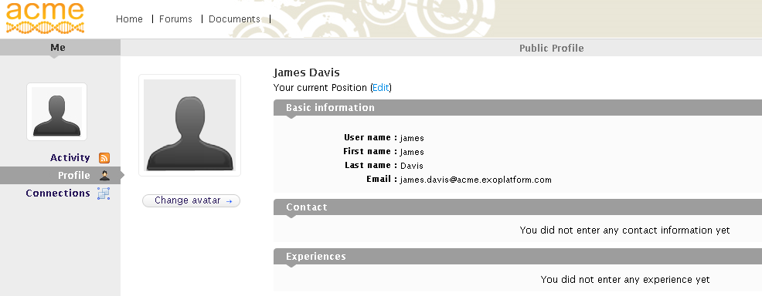
eXo Social
Advanced User and Community Management
  People
  Spaces
  People: Portal’s users in a social network
  People Directory of your organization or society

Slide 3
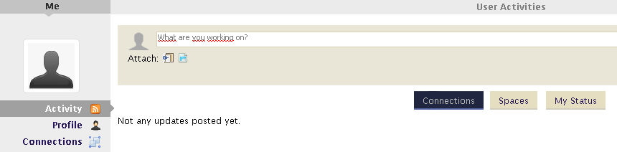
eXo Social
Improving Information Sharing
Advanced User and Community Management
  Delegated Management of membership
Enterprise Social Networking using OpenSocial

Slide 4
Open Social
A de-facto standard created by Google
  A set of common application programming interfaces (APIs) for web-based social network applications.
  Create social applications (Gadgets)
  Formerly eXo supported a proprietary standard called “widgets” which have been replaced by Gadgets.
  Gadgets can be games, mini applications, news feeds, maps or any content.

Slide 5
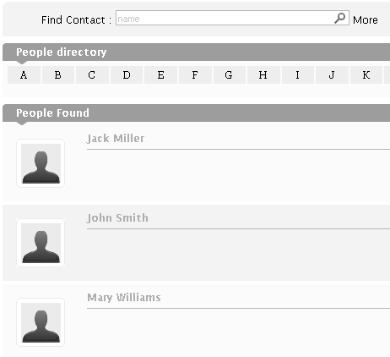
eXo Social
Three parts
People
  That is a user directory
Spaces
  That is a group for collaboration
Dashboard
  That part is Open Social

Slide 6
People
Directory
  Browse profiles of people in the enterprise or organization
  Invite people to connect
  This connection can be accepted or not
Connections
  See all accepted connections
  See her or his profile
  Her or his activities
  Her or his other connections

Slide 7
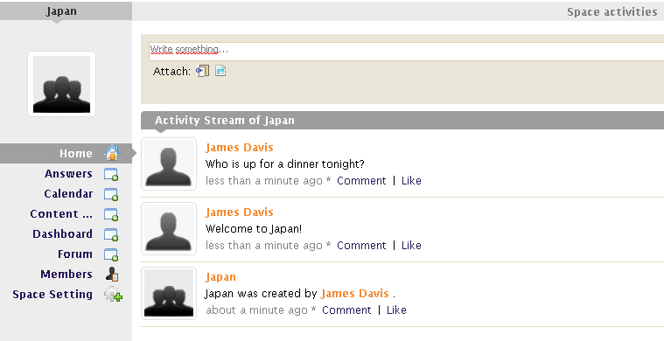
Spaces
Spaces (a.k.a. Group)
  Create a group of people around a subject
  Write Comments, plug RSS, plug Jira
  Visible or hidden spaces
  Registration is open, after validation or by invitations only.
  Bound to a group. You can choose a group of your people directory, but only those groups where you are a manager of the group.

Slide 8
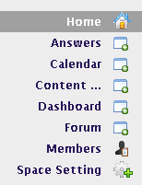
Spaces
Space Calendar
  A shared calendar of the space members
Answers
  A common Answers application for the space
Space Content Explorer
  A dedicated place for the space members
Space Dashboard
  Common integration any Open Social application
  (Gadgets)
Space Forum
  Discussion among the members of the space
Space Members
  Browse the members of a space

Slide 9
Dashboard
Open Social
  Add a gadgets
  Arrange gadgets on the dashboard
  Configure preferences

Slide 10
Gadgets
Gadgets
  Formerly eXo supported a proprietary standard called “widgets” which have been replaced by Gadgets.
  Gadgets can be games, mini applications, news feeds, maps or any content.
  Definition in an XML file
Examples
  Open http://www.google.com/ig/directory?synd=open
  Click on “Add to your Webpage” and then “Get the code”
  Browse the code and copy the URL concerning the xml file, example: http://www.donalobrien.net/apps/google/currency.xml

Slide 11
Gadgets
Hello World Gadget
  <?xml version="1.0" encoding="UTF-8" ?>
  <Module>
  <ModulePrefs title=“Hello World Gadget" />
  <Content type="html">
  <![CDATA[
  Hello, world!
  ]]>
  </Content>
  </Module>

Slide 12
Exercises Open Social -1/2
(The best is to work together on one server.)
Go to Social Intranet
Log in as Jack
Upload an avatar for Jack
Add some activities
Add an activity with a photo
Create the space “Madagaskar” (open, visible), upload a space photo
Create the space “Japan” (validation, visible), upload a space photo
Add Connections to john, mary and james.
Browse to the space applications Answers, Content, Calendar and Forum and make some entries.

Slide 13
Exercises Open Social -2/2
Go to Social Intranet
Log in as John
Upload an avatar for John
Add some activities
Confirm the connection with Jack (do you see his activities?)
Create the space “Miama” (open, visible), see if you can bound his space to a group, upload a space photo
Join all available spaces. Go to the applications to find the entries Jack created. React on the entries of Jack.
Add Connections to james, mary and root.
If time: Login in as mary and do the same
Login as jack again and look out for the pending requests for his space “Japan”.

