Slide 1
Advanced Portlets
Notes:
1

Slide 2
Table of Content
Portlet Communication
Examples in Labs
Notes:
2

Slide 3
Portlet Communication
3
Notes:
3
3

Slide 4
Object sharing between portlets
How do we exchange information between portlets ?
The JSR 286 adds :
Portlet session
Public render parameter

Slide 5
Portlets & Sessions
Info sharing in the same web application
Accessible from :
portletRequest.getPortletSession();
Attributes stored at 2 levels :
Request.setAttribute(name, value, PortletSession.APPLICATION_SCOPE);
Request.setAttribute(name, value, PortletSession.PORTLET_SCOPE);

Slide 6
Public Parameters
Simply share infos between portlets, in different possible applications
Easier lifecycle than Events
But limited to String sharing
For example :
portletRequest.getParameter()
portletRequest.setRenderParameter()

Slide 7
Public Parameters
<portlet-app ... version="2.0">
<portlet>
<description xml:lang="EN">Public Parameter Consumer 003</description>
<portlet-name>PublicParamterConsumer-003</portlet-name>
...
<supported-public-render-parameter>country</supported-public-render-parameter>
</portlet>
<public-render-parameter>
<identifier>country</identifier>
<name>country</name>
</public-render-parameter>
</portlet-app>

Slide 8
Coordination: IPC Events
IPC: Inter Portlet Communication
Data sharing between portlets
The object has to be serializable and implements java.io.Serializable

Slide 9
Coordination: IPC Event Configuration
<portlet-app ... version="2.0">
<event-definition>
<name>addressBookInfo</name>
<value-type>org.exoplatform.training.AddressBookEntry</value-type>
</event-definition>
<portlet>
<description xml:lang="EN">Address Book Form 005</description>
<portlet-name>AddressBookForm-005</portlet-name>
....
<supported-publishing-event>
<name>addressBookInfo</name>
</supported-publishing-event>
</portlet>
<portlet>
<description xml:lang="EN">Address Book List 005</description>
<portlet-name>AddressBookList-005</portlet-name>
<portlet-class>
org.exoplatform.training.AddressBookListPortlet
</portlet-class> ....
<supported-processing-event>
<name>addressBookInfo</name>
</supported-processing-event>
</portlet>

Slide 10
Coordination: IPC Event Code
Serializable event 1. Event producer
public void processAction(ActionRequest request, ActionResponse response) ... {
try {
AddressBookEntry entry = new AddressBookEntry();
entry.setFirstName( request.getParameter("firstName") );
...
response.setEvent("addressBookInfo", entry);
} catch (Exception e) {
e.printStackTrace();
}
}
2. Consumer
public void processEvent(EventRequest request, EventResponse response) ... {
// get the event from the request
AddressBookEntry event = (AddressBookEntry) request.getEvent().getValue();
// Put the event in some parameter
request.setAttribute("event", event);
}

Slide 11
Portlet & Resources
Used to serve :
Resources for AJAX application
Binary resources : images, PDF, etc.
Portlet has a complete control on the response sent to the client
Portlet must implement
serveResource(ResourceRequest, ResourceResponse)

Slide 12
Exercises
12
Notes:
12
12

Slide 13
Exercises
Create a HelloWorld Portlet
Add the preference management
Add a public parameter
Test portlet caching
Create 2 portlets using IPC events
Use PortletSession

Slide 14
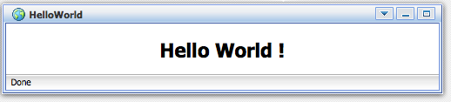
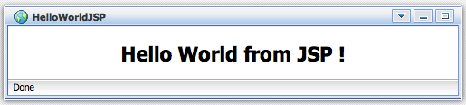
Lab-001: Simple Portlet
Create HelloWorld Portlet
Implement the portlet (with or without a dispatcher)
Configure the portlet and the web application
Deploy the WAR
Import the portlet using the application registry
Show the portlet

Slide 15
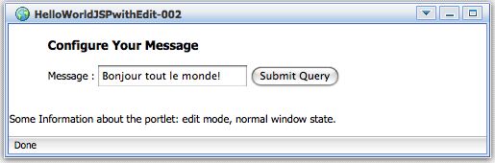
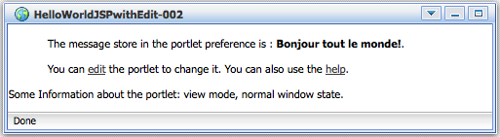
Lab-002: Preferences
Add the preference management
Form in EDIT mode
Show a message en VIEW mode

Slide 16
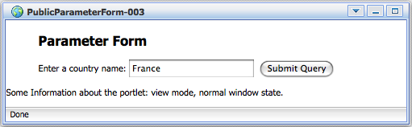
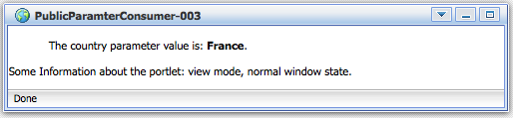
Lab-003: Public Parameter
Create a public parameter
Interchange data between 2 portlets
Test the portlet with a parameter you enter in a form.

Slide 17
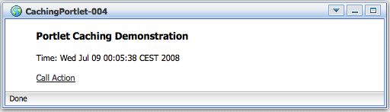
Lab-004: Caching
Test Portlet Caching
Configure a portlet with and without caching
Call ProcessAction

Slide 18
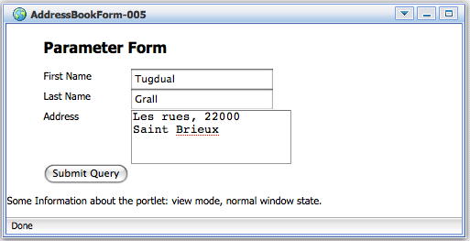
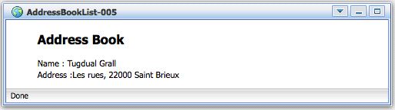
Lab-005: IPC
Inter Portlet Communication
Create an event (Java Class)
Exchange this event between 2 portlets

Slide 19
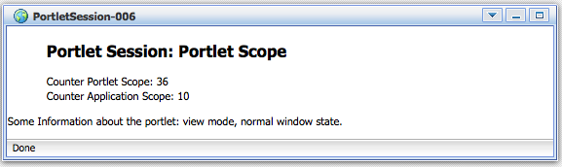
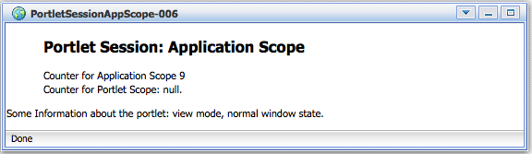
Lab-006: PortletSession
Create 2 portlets using PortletSession
Each portlet store its object in different scopes
36

Slide 20
Advanced Portlets
Notes:
20

