Slide 1
eXo Knowledge

Slide 2
eXo Knowledge
What?
  Suite of collaborative applications oriented to knowledge sharing.
  On-line discussions and user generated content (Forum)
  Collaborative FAQ for business knowledge ?expertise? (Answers), like Yahoo Answers, Stackoverflow, in France: Developpez.com.
And precisely:
  Forum : A full featured message boards application that holds on-line discussions and posts user generated content.
  Answers : A questions/answers application to help finding solutions
  FAQ : An Answers-based application to publish questions/answers in public FAQs

Slide 3
eXo Knowledge
User level distinction
Guests: Non-identified users, can view but cannot contribute
Users: Identified users that have login
Moderators: Responsible for one forum or one eXo Answers category
Administrator: Manages everything, special administration interface, can ban users, can convert users to moderators. Always responsible for whole application.
Role Matrices on the wiki,
  http://wiki.exoplatform.com/xwiki/bin/view/KS/Forum+Features
  http://wiki.exoplatform.com/xwiki/bin/view/KS/FAQ+Features

Slide 4
eXo Forum

Slide 5
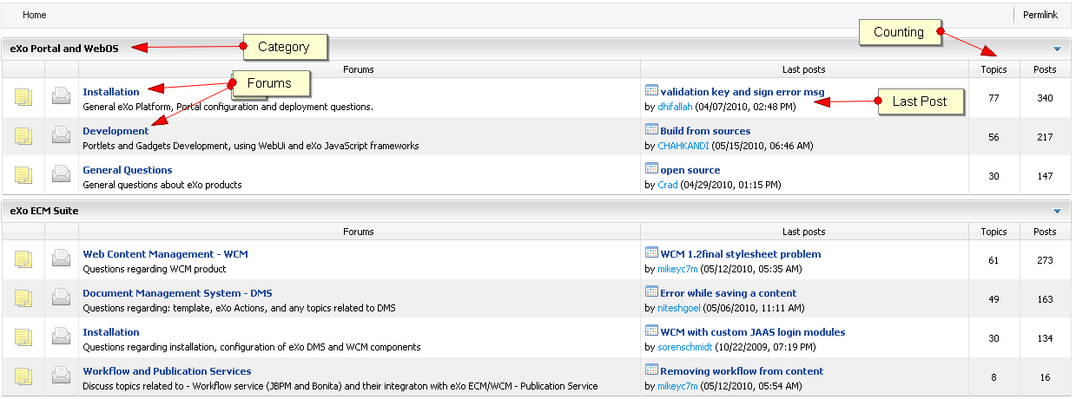
eXo Forum
Forum structure:
Several categories
  One or more forums in each category

Slide 6
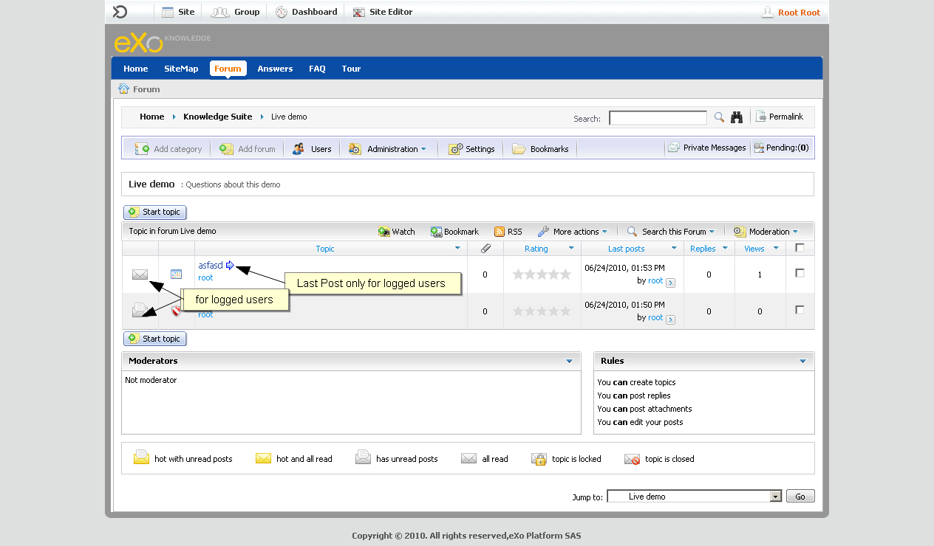
eXo Forum
Forum structure:
Several categories
  One or more forums in each category

Slide 7

eXo Forum
Tag with suggestions of other tags entered by any user:

Slide 8
eXo Forum
RSS:
RSS Feeds for categories, forums, and topics
No RSS for restricted forums

Slide 9
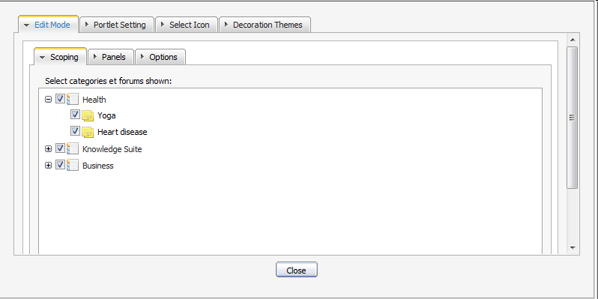
eXo Forum – Forum Portlet Edit Mode
Scoping Settings:
Allows to define a reduced scope of the visible forums

Slide 10
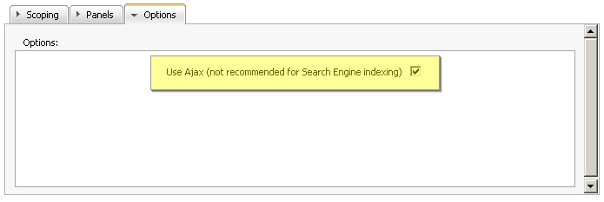
eXo Forum – Forum Portlet Edit Mode
Ajax Settings:
      Ajax: The page is only partially reloaded, the URL does not change, the back button does not work, search engines cannot index the forum
      No Ajax: Page is reloaded completely, the URL changes, the back button works, search engine friendly.

Slide 11
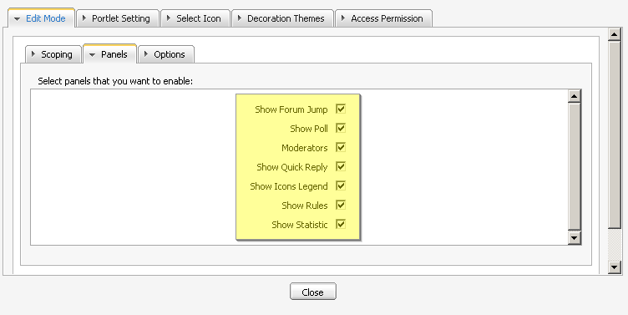
eXo Forum – Forum Portlet Edit Mode
Panels setting:
In the settings, you can choose which panels you wish to show: Show Forum, Jump, Show Poll, Moderators, Show Quick Reply, Show Icons Legend, Show Rules,Show Statistic

Slide 12
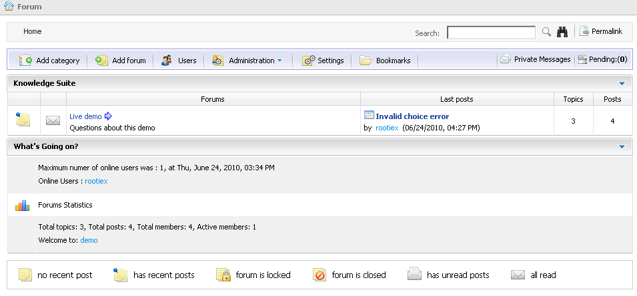
eXo Forum – Forum Portlet Edit Mode
All panels:

Slide 13
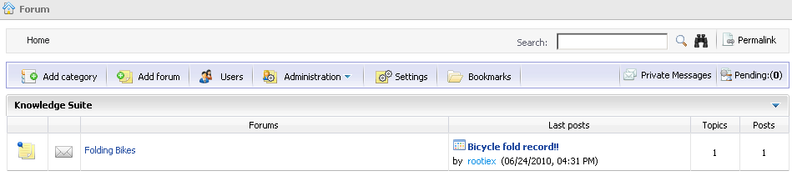
eXo Forum – Forum Portlet Edit Mode
Without any panels:
All panels unchecked:

Slide 14
eXo Forum
Multiple Instances:
      You can create several instances of the forum portlet.
      All instances share the same users, moderators and administrators.
      But you can define different settings in the Edit Mode.
      That means different scopes or different panels.
      This way you can create – for example – a forum page for only one special forum or a category, using a reduced panel selection.

Slide 15
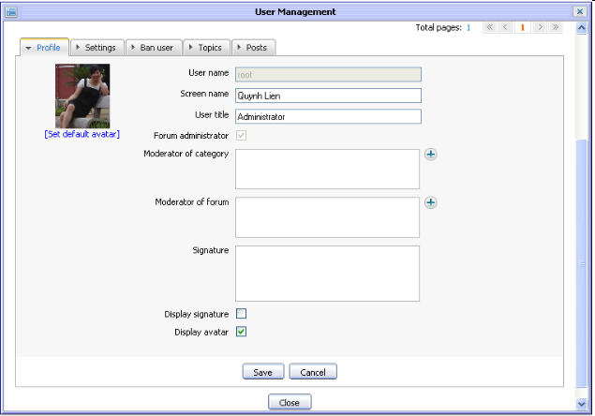
eXo Forum
User Management

Slide 16
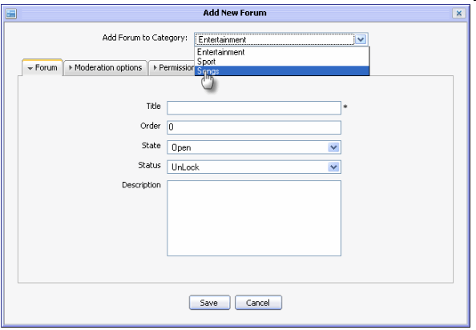
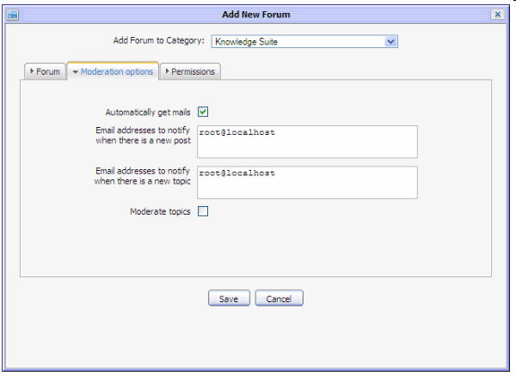
eXo Forum
Forum Administration:
Add categories
Email alerts

Slide 17
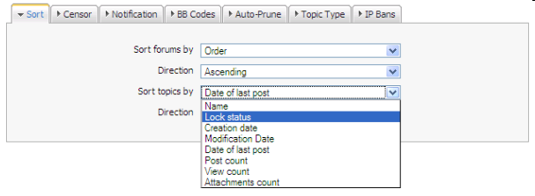
eXo Forum
Forum Administration:
Sort
Censor keywords
Notification message definition
BB Codes
Auto-Prune
Topic Type
IP Bans

Slide 18
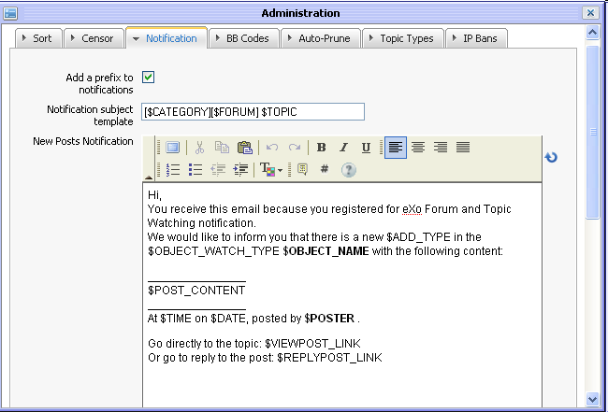
eXo Forum
Forum Administration:
Sort
Censor keywords
Notification message definition
BB Codes
Auto-Prune
Topic Type
IP Bans

Slide 19
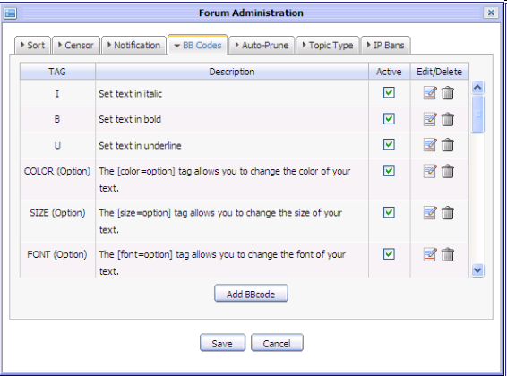
eXo Forum
Forum Administration:
Sort
Censor keywords
Notification
BB Codes
Auto-Prune
Topic Type
IP Bans

Slide 20
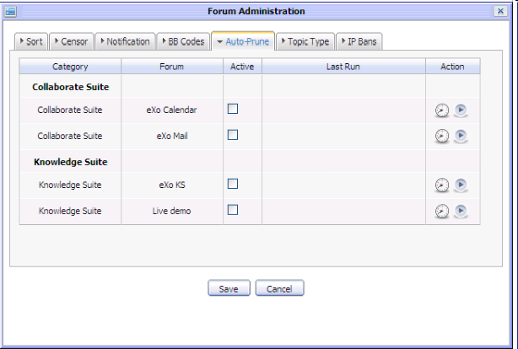
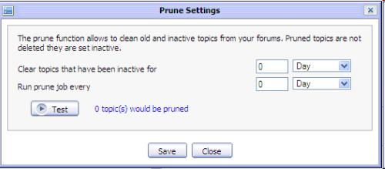
eXo Forum
Forum Administration:
Sort
Censor keywords
Notification
BB Codes
Auto-Prune of old topics
Topic Type
IP Bans

Slide 21
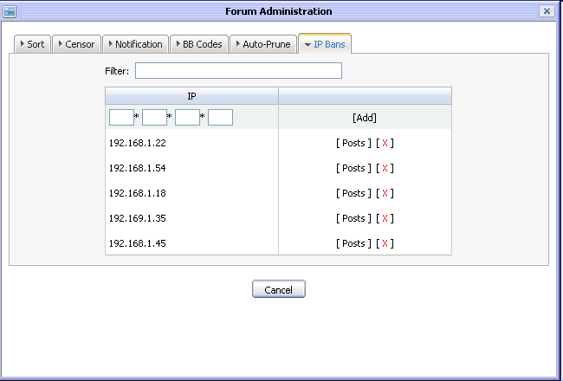
eXo Forum
Forum Administration:
Sort
Censor keywords
Notification
BB Codes
Auto-Prune
Topic Type
IP Bans

Slide 22
Exercises – eXo Forum (15 min)
Login as root –> Make john a moderator of forums
Create a category “Latina” and a forum “Argentina”, make Mary the moderator
Create a new page called LatinaNews with a forum application
Only show the forum “Latina”, do not use Ajax
Show the panels: Show Forum, Jump, Moderators, Show Icons Legend, Show Rules
Use the forum, verify if the URLs are permanent
Modify the notification messages
Modify the email address of John to your email address
Watch the Argentina forum
Write a post to Argentina forum and verify your inbox
Create a new topic, attach an attachment

Slide 23
eXo Answers

Slide 24
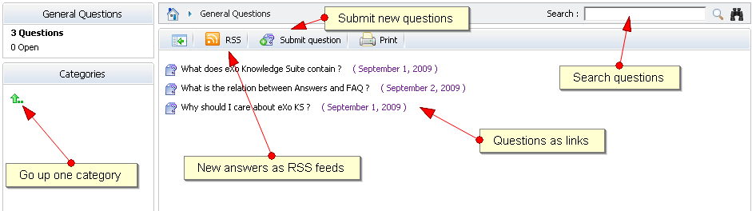
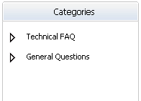
eXo Answers
Answers:
Several categories and subcategories
Formerly called FAQ

Slide 25
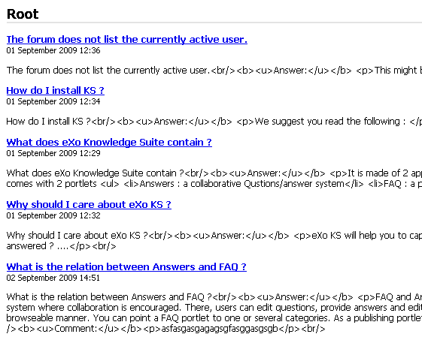
eXo Answers
Answers as RSS Feed

Slide 26
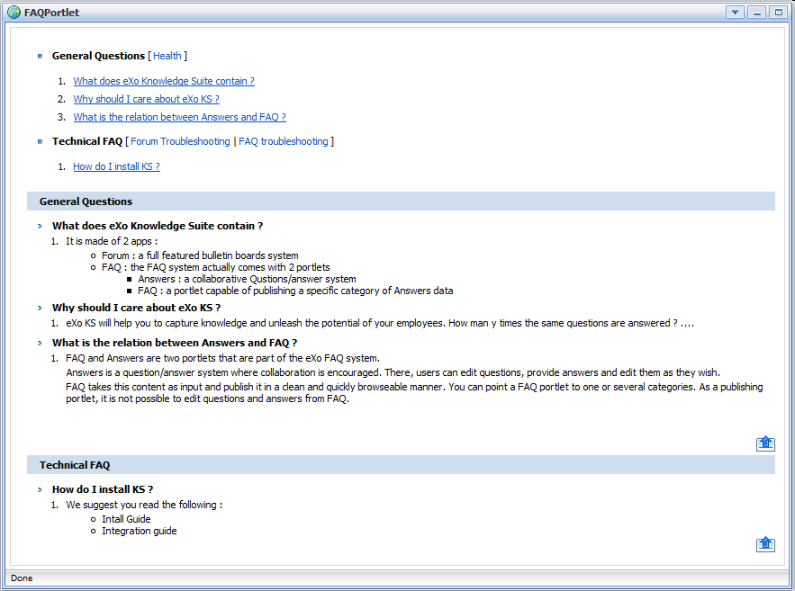
eXo Answers
FAQ Portlet
Visible
Approved question
At least one approved answer

Slide 27

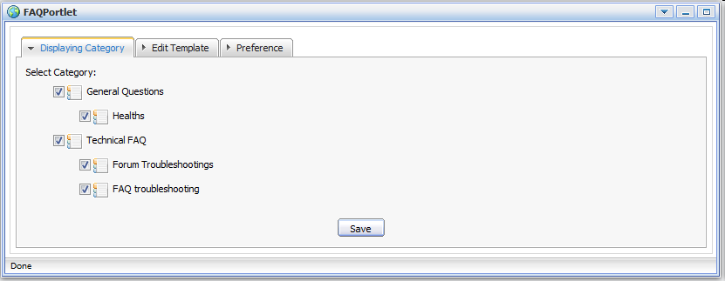
eXo Answers
FAQ Portlet – Edit Mode

Slide 28
Exercise – eXo Knowledge
eXo Answers
Create an eXo Answers structure Africa –> Tunisia and Africa –> Kongo
Make Mary the moderator
Fill it with questions and answers using several users.
Relate a question to other questions.
Approve some questions (That is Mary’s task)
Create a new page called AfricaFAQ containing the FAQ portlet
Make the Africa category appear in the new page.
Open the RSS feed of Tunisia.

Slide 29
eXo Knowledge Suite
Q & A

