Slide 1
Portal Configuration
& Customization

Slide 2
Folder Structure

Slide 3
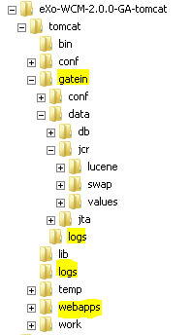
Folder Structure
About
Application configuration files
GateIn configuration files
Temp files
Data files
Log files
WebApps
WebApp structure

Slide 4
Folder Structure
Folder Explanations
Data/jcr/lucene: index Lucene
Data/jcr/values: database values for each workspace

Slide 5
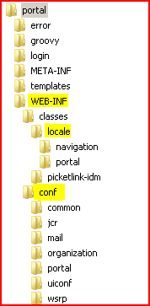
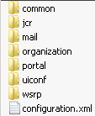
Folder Structure
WebApp
WEB-INF/classes/locale
WEB-INF/conf
WEB-INF/conf/configuration.xml

Slide 6
Services

Slide 7
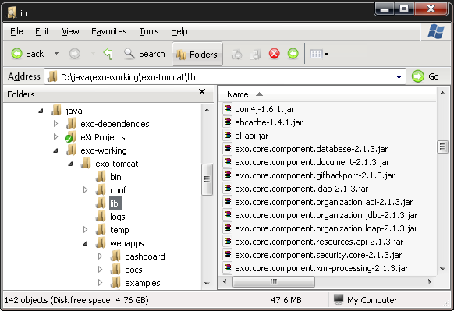
Introduction
Nearly everything could be considered a service!
Look into the lib folder:

Slide 8
Services
In that lib folder you find services for databases, caching, ldap and ftp:
    exo.core.component.database-x.y.z.jar
    exo.kernel.component.cache-x.y.z.jar
    exo.core.component.organization.ldap-x.y.z.jar
    exo.jcr.component.ftp-x.y.z.jar
Of course, there are many more services, in fact a lot of the jar files are services.
A service can have a configuration. This default configuration is delivered in the jar file.
The default configuration is in the jar file in the /conf or /conf/portal directory. in a file named configuration.xml.
In order to reduce hidden configurations, eXo does not use default configurations.

Slide 9
SOA Keywords
All eXo services are built around the eXo.
Services are also refered to as „Components“.
Called the service management layer.
All services are glued together by the eXo Container using dependcy injection.
The eXo Container is responsible for loading services.
The life-cycle of a service is handled by the eXo Container.
The same service can have several different implementations, but only one can be used during runtime.
The eXo Container has the role of the dependency provider.
The consumer of a services does not call directly a service.
The consumer accesses the services through the eXo Container.
The eXo Container provides a reference to an implementation of the requested service

Slide 10
Services
Interface – Implementation
It's important to get the idea that you separate the interface and implementation for a service. That is a good concept to reduce dependencies on specific implementations. Any service in eXo is defined by a java interface and may have many different implementations. The service implementation is then injected by a container into the application.
Singleton
Each service has to be implemented as a singleton, which means that each service is created only once - in one single instance.
Service = Component
A service and a component can safely be considered to be the same thing.

Slide 11
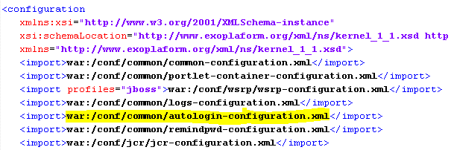
Service Configuration
To declare a service, you must add an xml configuration file in a specific place.
This file can be in the jar file, in a webapp or in the external configuration.
Each webapp can add or modify configurations.
The configuration start point is …\webapps\portal\WEB-INF\conf\configuration.xml, there you normally import other configuration files:

Slide 12
Import Configuration
Import Configurations from other files:
war: Imports from a webapp in the /WEB-INF folder.
jar or classpath: Uses the classloader, you can use this prefix in the default configuration for importing an other configuration file which is accessible by the classloader.

Slide 13

Service Configuration
The registration of a service within the container is done with the <component> element.
You have to define a service at least one time, otherwise the service is not known by the container.
You see here the interface (defined by <key>) and the implementation (defined by <type>):

Slide 14

Service Configuration
For example, open the exo-ecms-core-services-x.y.z.jar file; inside this jar open /conf/portal/configuration.xml. You will see:
Each component has a key which matches the qualified java interface name (org.exoplatform.services.cms.CmsService).
The specific implementation class of the component (CmsServiceImpl) is defined in the <type> tag.
If a service does not have a separate interface, the <type> will be used as the key in the container. This is the case of ContentInitializerService.

Slide 15
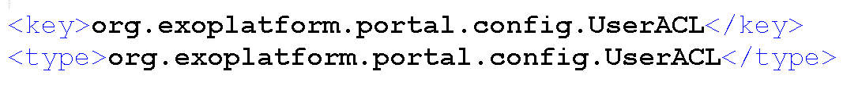
Service Configuration – Single Implementation
The UserACL service has the same <key> and <type>.
This corresponds to the special case of a single implementation.
The developer may decide not to create an interface if there will not be more than one implementation of the service.

Slide 16
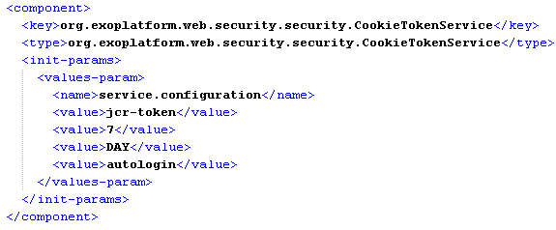
Services Configuration
Look into …\webapps\portal\WEB-INF\conf\common\autologin-configuration, there you define a component (=service).

Slide 17
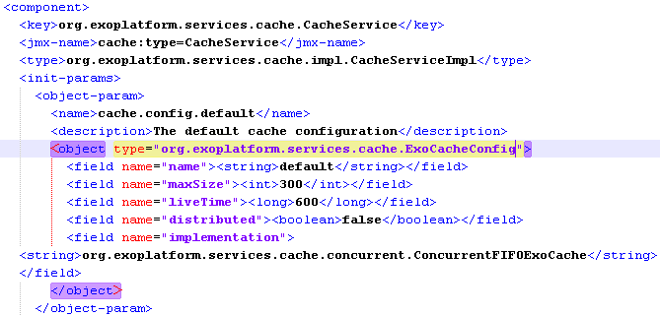
Services Configuration
The configurations can be simple, but there can be complex configurations
The cache service (common-configuration.xml) is configured using the object org.exoplatform.services.cache.ExoCacheConfig:

Slide 18
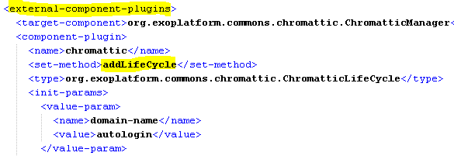
Services Configuration
Modifications of a service are done by plugins. The plugins call a methods of a service (…\webapps\portal\WEB-INF\conf\portal\autologin-configuration) :

Slide 19
Exercise 1: Service Configuration
Stop eXo Platform
Open ...\webapps\portal\WEB-INF\conf\common\autologin-configuration.xml
Modify the time of the cookie token service to 2 days.
Restart eXo.
Look into other configuration files.
Attention: This is just an exercise! Normally you should NOT modify configurations or code this way. Stay tuned until we talk about the extension mechanism.

Slide 20
Central Properties Configuration

Slide 21
Configuration Folder
Central Configuration folder
...\tomcat\gatein\conf\
In this folder (and subfolders) you can override any (previous/default) configuration. Later more about this.
Also called “external configuration”.
Documentation: http://www.jboss.org/exojcr/

Slide 22
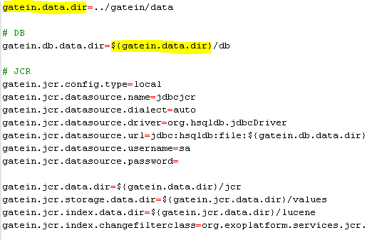
Configuration.properties
The file ...\tomcat\gatein\conf\configuration.properties makes the most common configurations easily accessible

Slide 23
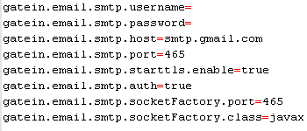
Configuration
Email service properties in ...\tomcat\gatein\conf\configuration.properties

Slide 24
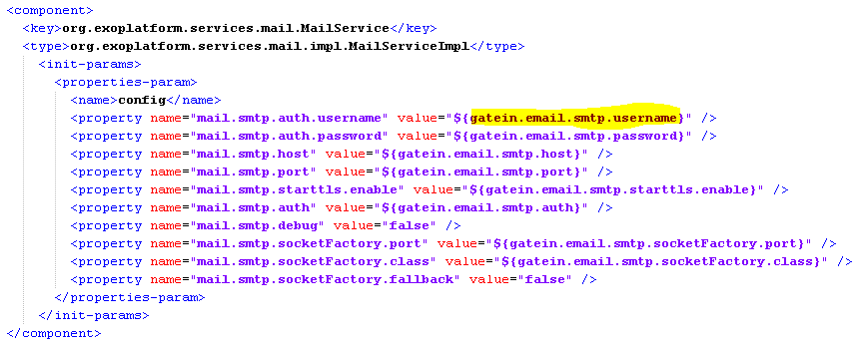
Configuration
Email service properties used in ...\webapps\portal\WEB-INF\conf\mail\portal-mail-configuration.xml\tomcat\gatein\conf\configuration.properties

Slide 25
Exercise 3: Common Properties
Central Configuration file
Stop eXo Platform
Open ...\tomcat\gatein\conf\configuration.properties
Modify gatein.data.dir in order to point to a different folder
Restart eXo.
What happens? (eXo Platform starts with an empty database?)
Verify that the new data is stored in a different folder

Slide 26
Configuration Profiles

Slide 27


Configuration Profiles
Configuration profiles are restrictions.
Only if a profile is activated the configuration is taken into account.
The profile restrictions can be at any level of the configuration.

Slide 28


Configuration Profiles
Several profiles can be listed by a comma separated list: “profile1, profile2”.

Slide 29
Configuration Profiles
Profile activation is done by a java environment settings.
The example run eXo with the profiles profile1 and profile2
sh gatein.sh -Dexo.profiles=profile1,profile2”.

Slide 30
Exercise 4: Configuration Profile
Start a fresh (freshly unzipped) eXo Platform using the profiles knowledge and collaboration. (If you start eXo without defining a profile, all profiles are included.)
Do you see any differences?
Hint: sh gatein.sh -Dexo.profiles=knowledge,collaboration”.

Slide 31
Portal Container

Slide 32
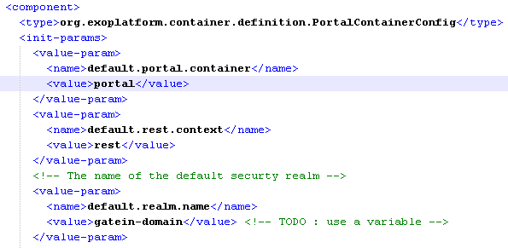
Portal Container Definition
The portal container is defined in a jar file defining the component PortalContainerConfig. You define the name, the rest context and the realm (examples: …/tomcat/lib/exo.platform.extension.config-3.0.0-GA.jar – do not modify this file!)

Slide 33


Portal Container URL
The name of the portal is part of the URL:
http://localhost:8080/portal/public/default/
Also the rest service context is defined: http://localhost:8080/portal/rest/jcr/repository/collaboration/

Slide 34
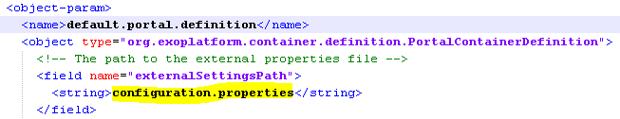
Properties File
You also define the name of the properties file.

Slide 35
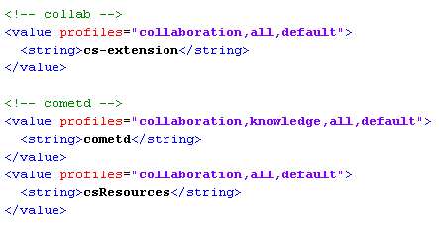
Portal Container WebApps
You also define a long list of webapps that are part of the Portal Container.
Note that you can restrict the participation of webapps by using configuration profiles.
The first webapp has the lowest priority, The last webapp has the highest priority.

Slide 36
Exercise 4: Portal Container
Open tomcat/lib/exo.platform.extension.config-3.0.0-GA.jar and analyze the configuration in …/platform/configuration.xml
In next chapter we learn how to add our custom webapp to this list.

Slide 37
Extension Mechanism

Slide 38
Problem
You should never modify the source code of the delivery of eXo Platform.
At each delivery of a new version you might have to re-do your modifcation.
This is not good practice.
And it‘s not allowed if you subscribe for support.
Solution: It‘s a lot better to plug your modifications from outside the source code
Listen carefully everthing about the Extension Mechanism.
It‘s a very important feature of eXo Platform.

Slide 39
Extension Mechanism
Goals:
  Define the priority of the war files
  Define the priority of configurations that are in the war files.
  Allow to override javascript, skin, and template files in a customized war. That means calling the http://my-host/portal/any-file accesses in fact a file in any war that is not obligatory in the portal war.
  Resources searched on the class path do also respect the same priorities

Slide 40
Extension Mechanism
Extension Mechanism
Attention: The Extension Mechanism only concerns the priority and the order of these resources but not the order the application server loads the war.
There is a war called „starter.war“ that manages this mecanism. This war file must be loaded in last position. In tomcat in order to load a war in last position, you must unzip it (the other war files must stay in the war format).

Slide 41
Extension Mechanism
Unified Servlet Context (PortalContainerContext)
Examples:
  1. You can overload the standard configurations by placing a different configuration in your customized war.
  2. The resource http://localhost:8080/portal/css/my-skin.css can be located in the portal war file, but also in any other war file that you have defined, called for example „customizedWar“.

Slide 42
Unified Classloader
Unified Classloader
Managed by the Unified Servlet Context
Only for resources, not for java classes.
Each time a resource is loaded (from the classpath), all libs in the war files of the unified servlet context classload are accessible.
The parent classloader of the application server (tomcat/lib) remains the parent classloader.

Slide 43
Extension Mechanism
Extension
Customize eXo Platform
  User Interface
  Menu
  Graphical style
  ECM Templates
  JSPs
  Configuration
  Services
  Portlets

Slide 44
Extension Mechanism
Unified Servlet Context
Requirements:
Create your own war file containing all customizations.
In the web.xml declare the listener: PortalContainerConfigOwner
Add the custom war file to the Unified Servlet Context by configuring the org.exoplatform.container.definition.PortalContainerConfig component. This component has to be configured in the RootContainer. For that you add a special configuration jar file to the lib folder.

Slide 45
Configuration Jar
Configuration Jar
Requirements:
Create a folder „conf“ and create in that folder a „configuration.xml“.
The configuration xml contains a single external-component-plugin that adds a war to the PortalContainerConfig component.

Slide 46
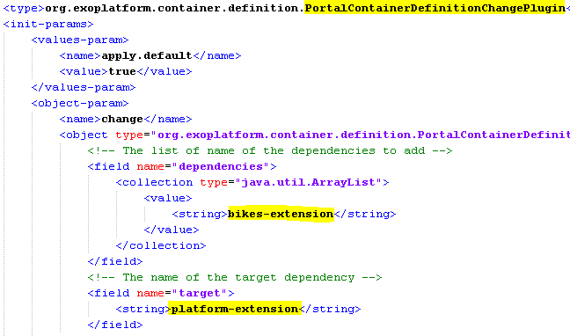
Configuration Jar

Slide 47
Extension Mechanism
eXo Services (=Knowledge, Collaboration)
For each eXo Extended Service (Marketing term!) there are one or several extension wars. These wars contain all necessary configurations and built-in components/services for the eXo Extended Service.
You must not touch these war files!
For your own configuration there is a file ...\gatein\conf for the most common configurations
... And a you are invited to create your own extension war file

Slide 48
XPI
XPI
  eXo Public Interface
  Public API Java
  Possible Configurations
  Customization by Extensions
Developers are not authorized to modify eXo code and artifacts (jar, war, ear) – otherwise there is no support.
Example : cs-extension.war (do not touch these war files!)
Customization: in gatein/conf/portal/portal/configuration.xml or in a custom extension (recommended way)

Slide 49
Admin Tool Bar Config
  The original configuration of the Admin Tool Bar is in …\tomcat6-bundle\webapps\portal\WEB-INF\conf\portal\portal\sharedlayout.xml
  You can override it in your custom war. Place your customization in your-custom-war\WEB-INF\conf\portal\portal\sharedlayout.xml
  In “sharedlayout.xml” you will find the definition of several portlets, in fact each entry in the Admin Tool Bar is a small portlet. The file configures the order of these entries in the tool bar.
  Furthermore, there is a place holder for the site: <site-body/>

Slide 50
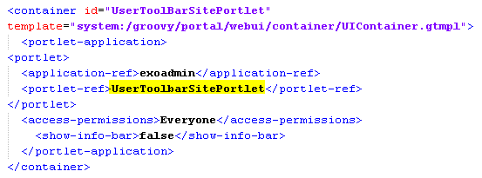
Admin Tool Bar Config

Slide 51
Admin Tool Bar Config

Slide 52
Exercise 10: Redefine the Admin Tool Bar
  Open exercise …\210-configuration\exercise-210-configuration-10-sharedLayout
  Change the order of the portlets in the Admin Tool Bar
  …/1-project\war\src\main\webapp\WEB-INF\conf\portal\portal\sharedLayout.xml
  Open …\210-configuration\exercise-210-configuration-10-sharedLayout\1-project and execute “mvn clean install”
  Take a clean tomcat of eXo Platform. Copy the compiled war (…\ 1-project\war\target\bike-extension.war) to the webapps folder.
  Copy the compiled jar (…\1-project\config\target) file to the tomcat/lib folder
  Start eXo

Slide 53
Exercise 12: Override jsp
  Create your own extension called bike-extension.war
  Create your own version of the jsp file
  …webapps\portal\login\jsp\login.jsp
  in that extension.
  Open …\210-configuration\exercise-210-configuration-12-jsp\1-project and execute “mvn clean install”
  Copy the compiled war to the webapps folder.
  You reuse the running tomcat of exercise 10: no need to modify the jar, no need to restart tomcat.

Slide 54
Exercise 14: Override Configuration File
Replace a configuration file
Make a copy of the folder “exercise-all-empty-project” and call the copy “bike-extension”
Copy
...tomcat\webapps\portal\WEB-INF\conf\common\locales-config.xml
to
bike-extension\1-project\war\src\main\webapp\WEB-INF\conf\common\locales-config.xml
Add Afrikaans language (“af”) to locales-config.xml
Take a clean tomcat of eXo Platform. Copy the jar and war files.
Start eXo.
Click on change language and you should see Afrikaans in the list.

Slide 55
Exercise 15: Rename the extension
All your extensions are called “bike-extension”. Let’s rename it to “kiwi-extension”.
Make a copy of folder …\210-configuration\exercise-210-configuration-10-sharedLayout\2-solution, name the copy “myExtensionProject”
Replace “bike-extension” by “kiwi-extension”:
  myExtensionProject\war\pom.xml
  myExtensionProject\war\src\main\webapp\WEB-INF\web.xml
  myExtensionProject\config\src\main\resources\conf\configuration.xml
Execute mvn clean install and try it on a clean eXo Platform

Slide 56
Configuration Priorities

Slide 57
Configuration Priorities
  Root Container:
  Default configuration in jar files: …/conf/configuration.xml
  External Configuration: …\tomcat\gatein\conf\configuration.xml
  The Portal Containers inherit the Root Container configuration
  Portal Container Configuration:
  Default configuration in jar files: …/conf/portal/configuration.xml
  Webapp configuration: /WEB-INF/conf/configuration.xml
  External Configuration: …\tomcat\gatein\conf\portal/<portal-name>/configuration.xml

Slide 58
External Configuration

Slide 59
Configuration Folder
Central Configuration folder
...\tomcat\gatein\conf\
In this folder (and subfolders) you can override any (previous/default) configuration.
Also called “external configuration”.
You can do both:
  Replacing configuration files by using the exact same path and name.
  Import new configurations (use a different path and name for the file!)

Slide 60
External Configuration
For the root container:
…\tomcat\gatein\conf\configuration.xml
For eXo Platform there is one import in the root container configuration. The configuration is imported from a jar file:
For portal containers:
…\tomcat\gatein\conf\portal\portal\configuration.xml
Overriding configuration files:
…\tomcat\gatein\conf\portal\portal\any-conf-file

Slide 61
Exercise 20: External Configuration
Replace a configuration
Copy
...tomcat\webapps\portal\WEB-INF\conf\common\locales-config.xml
to
...\tomcat\gatein\conf\portal\portal\custom\bike-locales-config.xml
In the copied file, delete all language but leave only English and French
Create a file ...\tomcat\gatein\conf\portal\portal\custom\my-custom-locales-def.xml
Copy the configuration of LocaleConfigService from …\webapps\portal\WEB-INF\conf\common\common-configuration.xml
Add a file...\tomcat\gatein\conf\portal\portal\configuration.xml with an import that points to my-custom-locales-def.xml
Restart eXo.
Click on change language and check.

Slide 62
Portal Configuration
& Customization

