Slide 1
eXo Content for Developers
Notes:
1

Slide 2
Table of Content
Document Types
Document Template Syntax
Mixins
Interceptors
Content List Portlet Templates
Action Scripts and Dialogs
Notes:
2

Slide 3
Document Types
Notes:
3

Slide 4
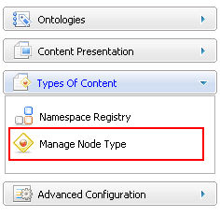
Node Type
Namespace, NodeType and Templates
There are many different nodetypes for a JCR.
A nodetype defines the properties and possible child nodes.
A nodetype can inherit from other nodetypes.
The nodetype then inherits property and child node definitions.
Notes:
4
4

Slide 5
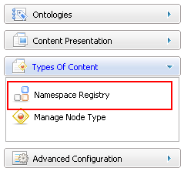
Namespace
Namespace
Each nodetype and property belongs to a namespace.
The namespace helps to avoid name conflicts. (When different organizations uses the same name.)
A namespace is a prefix, defined a URL. (Similar to xml.)
The namespaces are managed in a namespace registry.
Do not hesitate to create your own namespace(s) for your nodetypes and properties.
Notes:
5
5

Slide 6
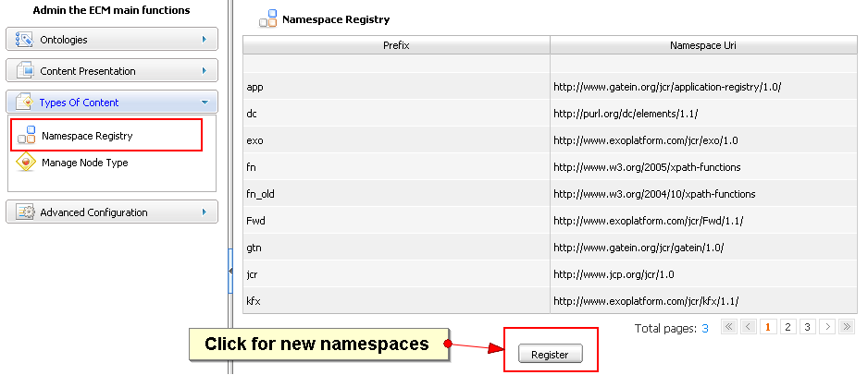
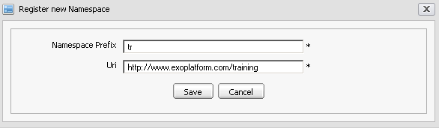
Namespace
Notes:
6
6

Slide 7
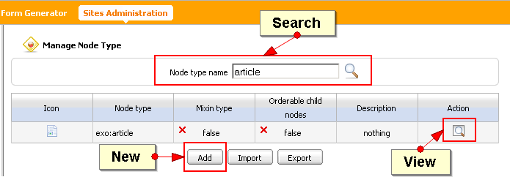
Node Type
Notes:
7
7

Slide 8
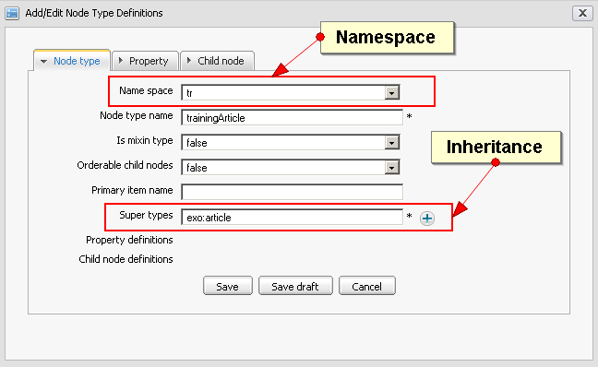
Node Type
Notes:
8
8

Slide 9
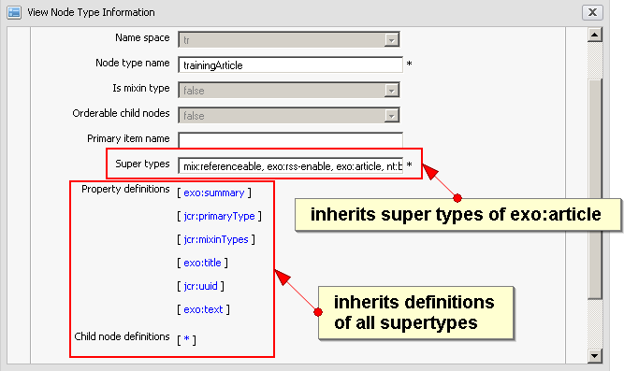
Node Type
Notes:
9
9

Slide 10
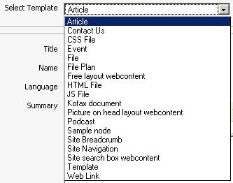
Document Type
Document types are node types for which you created a dialog and a view template.
Document type dialog templates appear in the“Add Document”dialog of the site explorer.
Notes:
10
10

Slide 11
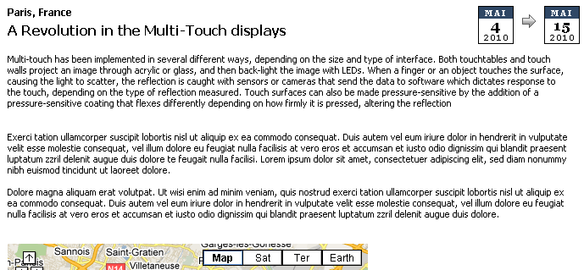
Document Type
The view of a document type is used for rendering the content.
Notes:
11
11

Slide 12
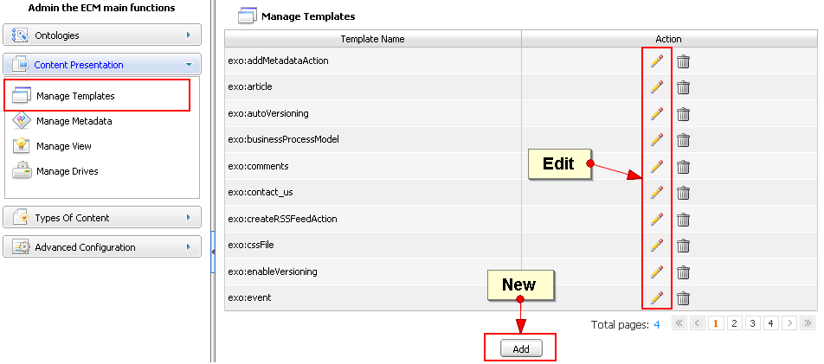
Document Type
You can modify current templates or create new ones.
Notes:
12
12

Slide 13
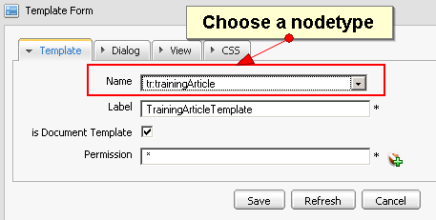
Document Type
You can modify current templates or create new templates.
Notes:
13
13

Slide 14
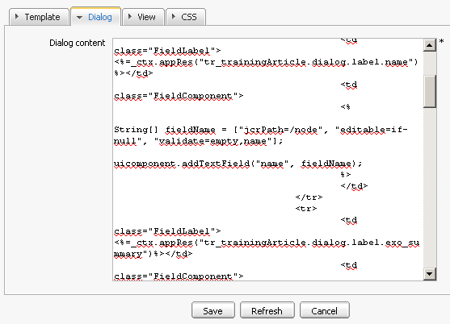
Document Type
The dialog and view templates are written in groovy template language.
Notes:
14
14

Slide 15
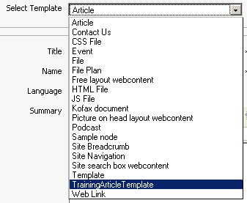
Document Type
The dialog is now in the template list.
Notes:
15
15

Slide 16
Exercise: Document Type
Bike Article
Create a namespace ”tr” assigned to „http://exotraining.com“
Create a node type “bikeArticle“ that inherits from “exo:article”. Do not save yet! Add the text property “model“ and the number property “price“ to the bike article. Now, save the node type.
Open the manage templates interface, Click on “Add”. Choose the node type “bikeArticle” . The view and the dialog template are generated automatically. Save.
Open the site explorer, drive “Sites Management” – path “acme/web contents” – and test your new document type.
Extra: Copy and paste the view and dialog template of exo:article.

Slide 17
Document Template Syntax
Notes:
17

Slide 18
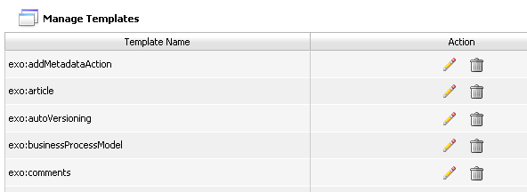
Groovy Templates
Groovy : script language for the JVM
http://groovy.codehaus.org
Java compliant syntax
GTMPL : equivalent of Java with JSP but with Groovy
No taglibs
18

Slide 19
Groovy templates
Scriptlets :
<%String portalURI = Util.getPortalRequestContext().getPortalURI();%>
<%=variable %> ou $variable
<a href=”<%=portalURI%>”>
<href="$portalURI">
Implicit objects:
uicomponent : UIComponent linked to this template
_ctx : Binding context WebuiBindingContext
19

Slide 20
Groovy Template
Get the label from a resource bundle
<%=_ctx.appRes("key.from.resourcebundle") %>
You can access the public methods of the UIComponent class
GTMPL Documentation :
http://groovy.codehaus.org/Groovy+Templates
20

Slide 21
View Templates
View Template for a specific NodeType
File Explorer = UIDocumentInfo
Content Browser : UIDocumentDetail
ECMViewComponent:
public Node getNode()‏
public List<Node> getRelations()‏
public List<Node> getAttachments()‏
public String getRssLink()‏
public String getLanguage()
public Object getComponentInstanceOfType(String className)
public String getImage(Node node)‏
public String getPortalName()‏
public String getRepository()‏
public String getWorkspaceName()‏
public List<Node> getComments()
public String getDownloadLink(Node node)‏
21

Slide 22
View Templates
<%
def node = uicomponent.getNode() ;
SimpleDateFormat dateFormat = new SimpleDateFormat() ;
%>
<div class="SampleBG">
<label class="text"><%=_ctx.appRes("Sample.view.label.date")%>: </label>
<span class="text">
<%if(node.hasProperty("exo:date")) {
dateFormat.applyPattern("MMMMM dd yyyy") ;
%>
<%=dateFormat.format(node.getProperty("exo:date").getDate().getTime())%>
<%}%>
</span>
</div>
<% if (node.hasNode("exo:image")) {
imgSrc = uicomponent.getImage(node) ;
%>
<div style= "width: 95%; height: 160px ; text-align: center; padding: 5px;">
<image src="$imgSrc" width="250" height="150"/>
</div>
<% } %>
22

Slide 23
Dialog Templates
Form directive (mandatory):
<% uiform.begin() %>
...
<% uiform.end() %>
Form action buttons (mandatory):
<% for(action in uicomponent.getActions()) {
String link = uicomponent.event(action) ;
%>
<a href="$link" >$action</a>
<%}%>
23

Slide 24
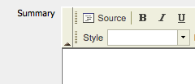
Dialog Templates
Input fields:
Many types : Text, Wysiwyg, Upload, Select,...
1 input = 1 node property
With a common model:
addXYZField(String name, String label, String [] arguments)
Example: addTextField("title", "Titre",["jcrPath=/node/exo:title"])‏
24

Slide 25
Node Input
The node name is mandatory
String nameArgs[] = ["jcrPath=/node", "mixintype=mix:votable", "editable=if-null", "validate=name,empty"];
uicomponent.addTextField("name", nameArgs )
jcrPath : /node represents the target jcr node
mixintype : mixin list to apply on this node
editable : readonly/rw input. Possible values: true, false, if-null
validate : Validators : name, email, number, empty, datetime or customized validators
nodetype : the target node type
25

Slide 26
Text Input
String [ ] titleArgs = ["jcrPath=/node/exo:title", "validate=empty"];
uicomponent.addTextField("title", titleArgs) ;
jcrPath : The target path
editable : true|false|if-not-null
defaultValue : Predefined value
multiValues=true : is it a multi-values input
type=password : for password inputs
26

Slide 27
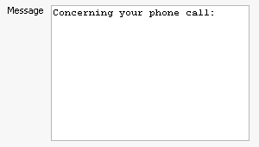
Textarea Input
String [ ] messageArgs = ["jcrPath=/node/exo:message", "validate=empty"];
uicomponent.addTextAreaField(“message", messageArgs) ;
jcrPath : path
editable : true|false|if-not-null
validate : name|email|number|empty|datetime or other
defaultValues : predefined value
multiValues=true : is it multi-valued ?
27

Slide 28
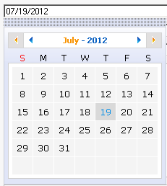
Calendar Input
String [] dateArgs = ["jcrPath=/node/exo:date", "validate=datetime"];
uicomponent.addCalendarField("date", dateArgs) ;
jcrPath : path
editable : true|false|if-not-null
validate : datetime or other
multivalue=true : is it multi-valued ?
visible : true|false
options=displaytime : Manage time
defaultValues : predefined value (MM/dd/yyyy) by default.
28

Slide 29

Upload Input
String [ ] imageArgs = ["jcrPath=/node/exo:image/jcr:data"];
uicomponent.addUploadField("image", imageArgs);
jcrPath : path
multivalue=true : is it multi-valued ?
Example : exo:image is a node nt:resource :
<nodeType name="exo:sample"...
<childNodeDefinition name="exo:image" defaultPrimaryType="nt:resource"...
<nodeType name="nt:resource" primaryItemName="jcr:data" ...
<propertyDefinition name="jcr:data" requiredType="Binary"...
<propertyDefinition name="jcr:encoding" requiredType="String"...
<propertyDefinition name="jcr:lastModified" requiredType="Date"...
29

Slide 30

Select Input
String [ ] langArgs = ["jcrPath=/node/exo:language", "options=en,fr,es,de"];
uicomponent.addSelectBoxField(“language", langArgs) ;
jcrPath : path
editable : true|false|if-not-null
defaultValues : Predefined value
multiValues=true : is it multi-valued ?
options : Value list
script : groovy script to provide the list
scriptParams : groovy script parameters
30

Slide 31
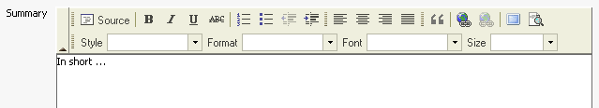
HTML Text Input
String [] summaryArgs = ["jcrPath=/node/exo:summary", "options=basic"];
uicomponent.addWYSIWYGField("summary", summaryArgs);
jcrPath : path
validate : name | empty or other Validator class
defaultValues : predefined value
multivalue=true : is it multi-valued ?
options=basic|full : basic editor or full editor
31

Slide 32
Hidden Input
Often used to create sub nodes
String[ ] resource = ["jcrPath=/node/exo:image", "nodetype=nt:resource", "visible=false"] ;
uicomponent.addHiddenField("resource", resource) ;
jcrPath : /node path
nodetype : node type
mixintype : mixin list
editable : readonly or read-write: Possible values: true,false,if-null
validate : validators
defaultValues : Predefined values.
32

Slide 33

Selector Action
Text filled with a value selector widget:
jcrPath : Path of the property we wish to create
editable : true|false|if-not-null
validate : name|email|number|empty|datetime ou FQN Validator class
defaultValues : defaut values
multivalue=true : activates the multiple value interface if the pointed JCR property is multivalue
selectorClass : FQN ComponentSelector class. Component Widget used for the selector. Examples : UIECMPermissionBrowser, UIJCRBrowser
selectorParams : Parameters to pass to the selector
selectorIcon : css style to show the selector icon
33

Slide 34
Exercise 1a – Template (15 min)
Login as root.
Create a form (dialog template) using a Calendar (Format dd/MM/YYYY), Selector Widget, SelectorClass, and upload field and a multivalue input field.
Test your template
Open the Application Registry and import all applications.
Create a new page, open the “fastcontentcreator” category and drag the fast content creator portlet to your page. Open the portlet’s settings and choose your form. Path: /sites content/live/acme/web contents/training
Test the FastContentCreator.
Open the site explorer at /sites content/live/acme/web contents/training and discover how your form is stored.
Open the form’s dialog and analyse the generated code.
34

Slide 35
Mixins
Notes:
35

Slide 36
Mixins
Allows to add properties and/or subnodes to any node.
You have to add code for the mixin in the node‘s dialog template.
Example: The mixin “i18n” defines the “exo:language” property. This property is added to the exo:article dialog:
String[] fieldName = ["jcrPath=/node", "mixintype=mix:i18n"] ;
uicomponent.addTextField("name", fieldName) ;
...
String[] fieldLang = ["jcrPath=/node/exo:language", "options=en,fr,es,de", lang] ;
uicomponent.addSelectBoxField("lang", fieldLang) ;
Remark: You can create a template for a mixin and integrate it in a view template – for an example search for mix:votable in the exo:article view template: <% _ctx.include(uicomponent.getViewTemplate("mix:votable", "view1")); %>
36

Slide 37
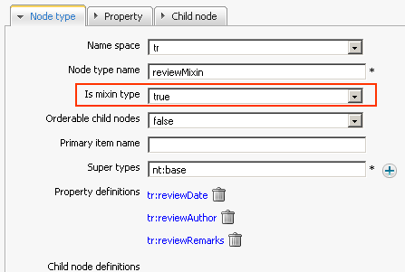
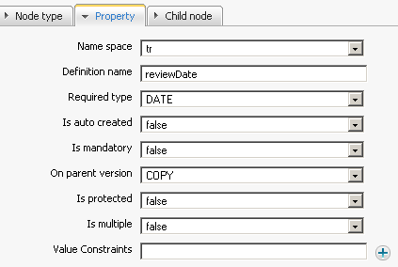
Exercise – Mixins 1/2
Your boss asks you to add three fields to the bikeArticle form: → reviewDate (Calendar Widget), reviewAuthor (input field)
You cannot modify the bikeArticle node type anymore. In that moment the mixins come into your mind.
Create the mixin node type “reviewMixin” for these properties. Choose “true” for the “mixin” type.
37

Slide 38
Exercise – Mixins 2/2
Integrate this mixin in your flashNews dialog template.
In the dialog template, add the mixins name in to the list of mixins: "mixintype=mix:i18n, reviewMixin”).
Add the input elements for the “reviewMixin” properties: reviewDate and reviewAuthor”.
38

Slide 39
Content List Portlet Template
Notes:
39

Slide 40
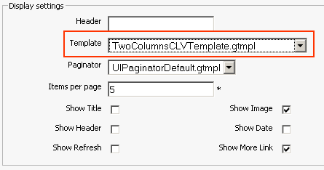
Content List Template
The Content List portlet offers a number of prepared templates.
For projects you can create custom templates, they will then appear in the select box of the portlet settings.
The templates are coded in groovy template (gtmpl) – similar to java.
Notes:
40
40

Slide 41
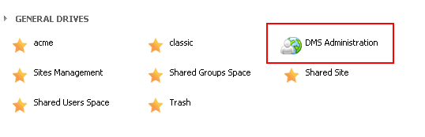
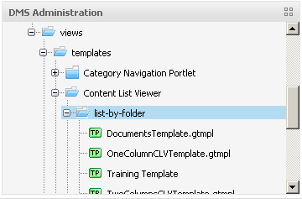
List Template
Access by the site explorer:
Login as john. Open the Acme site.
Open the Site Explorer
Open the DMS Administration drive and then /exo:ecm/views/templates/content-list-viewer/list/list-by-folder
Notes:
41
41

Slide 42
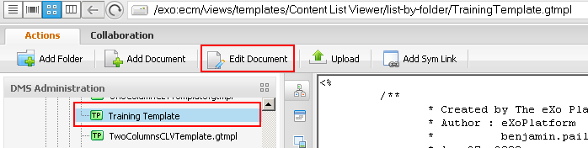
List Template
Modify the new template
Copy the ContentListViewerDefault and call the copy BikeTemplate.gtmpl
Add a test text like “TEEEESSSSTT” behind the first <div> of the BikeTemplate.gtmpl in order to if the modification works.
Notes:
42
42

Slide 43
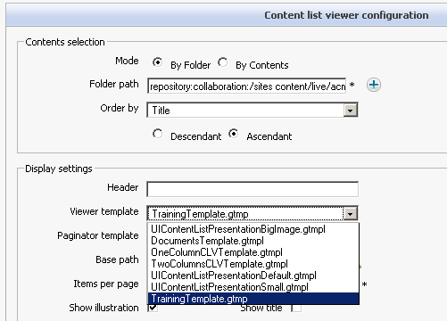
Mini-Exercise: List Template
List Template
Copy and paste the ContentListViewerDefault and rename it to your BikeTemplate
Modify the BikeTemplate
Use the bike template in a Content List portlet
Notes:
43
43

Slide 44
Exercise – Banner Show 1/2
Your boss asks you to create a new document type called “Banner” that helps web masters to add a banner with a text. You can provide a link that is opened when clicked on the image.
The text should be placed at a freely x-y-position on the image.
The dialog template should contain the fields: text, image upload, x-position, y-position, link.
The view template shall use these variable and render the image and then the text and the defined position.
First you need to create a nodetype, just import it from the training toolkit.
Then add template for the wcmBanner nodetype, there will be generated templates that are created automatically.
The generated dialog and view template does not do what your boss asks you. Copy/paste the templates from the training toolkit. Do not forget to declare your templates as « Document type ».
Test the banner document type.
44

Slide 45
Exercise – Banner Show 2/2
Your boss asks you to show the banner in a banner show, where the banners are reloaded every n seconds.
Your idea is to create a content list template that takes documents of your banner document type and show them in a carousel way (every n seconds).
Open the content list folder by webdav: http://localhost:8080/ecmdemo/rest-ecmdemo/jcr/repository/dms-system/exo:ecm/views/templates/Content%20List%20Viewer/list-by-folder
Copy the banner list template from the toolkit (banner-carousel.gtmpl).
Create some banners in a folder.
Add a banner list to the homepage of acme pointing to your banner folder and test it.
45

Slide 46
Interceptors
Notes:
46

Slide 47
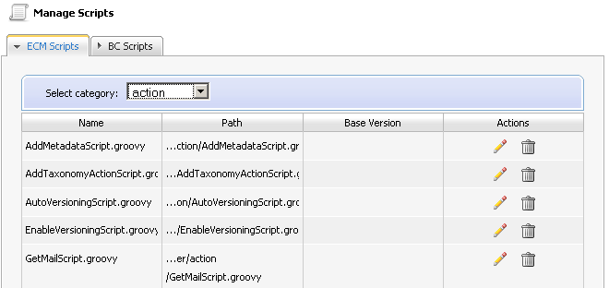
Manage Scripts
Scripts
ECM Scripts
Actions
Interceptors
Widgets
BC Scripts (deprecated)
47

Slide 48
CmsScript Interface
ECM Supports groovy script execution
The script has to implement CmsScript :
import org.exoplatform.services.cms.scripts.CmsScript;
public class PreNodeSaveInterceptor implements CmsScript {
public PreNodeSaveInterceptor() {
}
public void execute(Object context) {
// wrong: String path = (String) context;
println(" Pre Node Save, a good form validator");
}
public void setParams(String[] params) {}
}
Context and params depend on the script type.
48

Slide 49
ECM Script Dependency Injection
Dependency injection (Widget example)
public class FillSelectBoxWithCalendarCategories implements CmsScript {
...
public FillSelectBoxWithCalendarCategories(RepositoryService repositoryService, NodeHierarchyCreator nodeHierarchyCreator) {
repositoryService_ = repositoryService ;
nodeHierarchyCreator_ = nodeHierarchyCreator ;
}
49

Slide 50
Integrate Interceptor Scripts to a dialog template
Executed before node creation:
<% uicomponent.addInterceptor("ecm-explorer/interceptor/MyPreInterceptor.groovy", "prev"); %>
Executed after node creation:
<% uicomponent.addInterceptor("ecm-explorer/interceptor/MyPostInterceptor.groovy”, "post"); %>
Possible Parameters:
context = node.getPath()‏
params[0] = repository
50

Slide 51
Exercise – Interceptor
For the event template you need a validation that the start date is prior to the end date.
Use a prenodesave interceptor that verifies this condition. If negative a message exception has to be triggered and the data has not to be stored.
Upload a the interceptor script from the toolkit.
Assign the interceptor to the dialog template of exo:event. Add this code at the beginning of the template: <% uicomponent.addInterceptor("ecm-explorer/interceptor/DateOrderPreNodeSaveInterceptor.groovy”,"prev");%>
Test it.
51

Slide 52
Action Scripts and Dialogs
Notes:
52

Slide 53
Triggers – Actions
You can link an action to any node.
Action Types:
Business Process: Workflow integration with Bonita or JBPM,
Groovy Script: A java implementation.
The action can be triggered when
A node is added, deleted or read,
A property is added, deleted or read,
or the scheduler triggers the action.
Actions are node types
You can find them in the node type list.

Slide 54
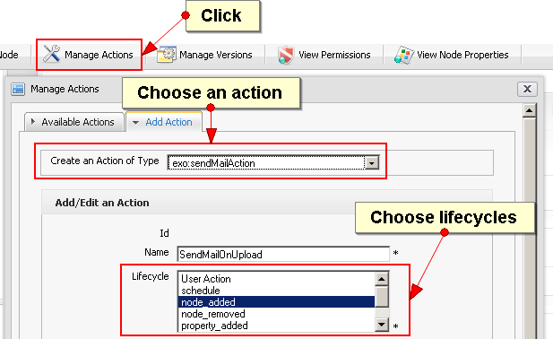
Actions

Slide 55
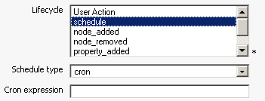
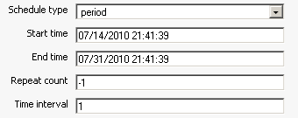
Scheduled Actions
Schedule Types:
Cron: A cron expression can define any period, repetitions, weekdays etc.
Period: Start and End time, number of repetitions and a time interval.

Slide 56
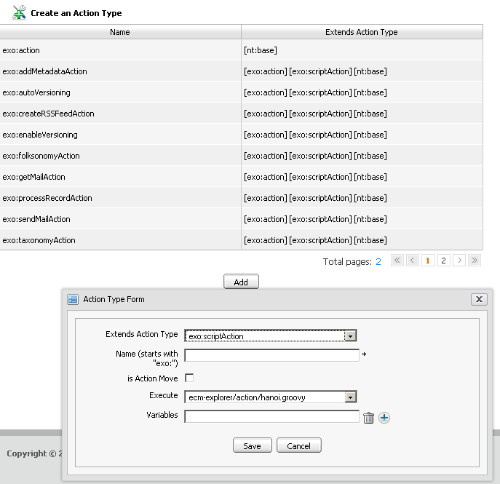
Manage Scripts
Actions
Can be applied on folders
Uses an ECM Script
Action Types: script/workflow
Variables to be used in the action
56

Slide 57
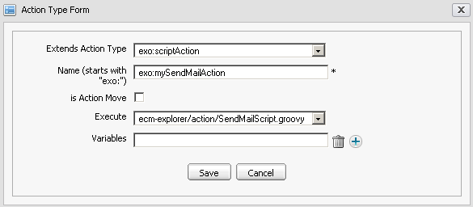
Actions

Slide 58
Actions Scripts
For ECM Actions with the «script» type
Parameters
context : Properties map
params : n/a
Common variables :
Map variables = (Map) context;
String nodePath = (String) variables.get("nodePath") ;
String workspace = (String) variables.get("srcWorkspace");
String actionName = (String) variables.get("actionName");
Node actionNode = (Node) variables.get("actionNode");
58

Slide 59
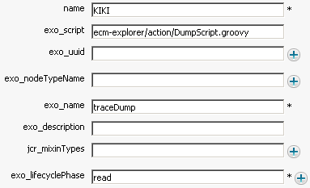
Exercise – Action Dump
Open the Site Administration, then the Manage Scripts Interface.
Create a new action script. Copy the DumpScript code from the toolkit, call the script « DumpScript ».
Create a new Action Type using the DumpScript. Call the action « exo:dumpScriptAction ».
Open the manage template interface and create a dialog for the DumpScript. Do not check the document type checkbox.
The generated template is not nice but usable. In the Lifecycle field type « read », which enables a right-click triggering of an action.
Open the site explorer and assign the action to any node, then right click, trigger the action and see the log traces.
59

Slide 60
Exercise – Action Dump Example Output
srcWorkspace = collaboration
exo:script = ecm-explorer/action/DumpScript.groovy
exo:lastModifier = root
nodePath = /sites content/live/acme/documents
actionName = dumpScript
jcr:uuid = a2a68cd7a9fe066b00310525a0b6af4b
exo:name = dumpScript
repository = repository
initiator = root
exo:title = dumpScript
document-type = nt:unstructured
exo:index = 1000
exo:lastModifiedDate = 2010-10-12T18:54:05.539-04:00
actionNode = org.exoplatform.services.jcr.impl.core.NodeImpl@1b0048a
exo:dateModified = 2010-10-12T18:54:05.532-04:00
exo:owner = root
exo:dateCreated = 2010-10-12T18:54:05.531-04:00
srcPath = /sites content/live/acme/documents
action node properties
jcr:primaryType=exo:dumpScriptAction
jcr:mixinTypes=exo:sortable
exo:modify
exo:owneable
exo:datetime
mix:referenceable
exo:rss-enable
jcr:uuid=a2a68cd7a9fe066b00310525a0b6af4b
exo:dateCreated=2010-10-12T18:54:05.531-04:00
exo:dateModified=2010-10-12T18:54:05.532-04:00
exo:index=1000
exo:isDeep=true
exo:lastModifiedDate=2010-10-12T18:54:05.539-04:00
exo:lastModifier=root
exo:lifecyclePhase=read
exo:name=dumpScript
exo:nodeTypeName=exo:owner=root
exo:roles=*:/platform/users
exo:script=ecm-explorer/action/DumpScript.groovy
exo:title=dumpScript
exo:uuid=
60

Slide 61
eXo Content for Developers
Notes:
61

