Slide 1
eXo SysAdmin Training
JMX Remote Monitoring
Notes:
1

Slide 2
Table of Contents
Introduction JMX & VisualVM
JMX remote configuration
Connecting VisualVM to remote JVM
Using VisualVM
Exercises : JMX Monitoring with JConsole or VisualVM

Slide 3
Introduction JMX & VisualVM
3
Notes:
3

Slide 4
Introduction JMX & VisualVM
JMX is a generic interface created by Sun for retrieving statistics on Java applications.
There are pre-built JMX client applications that exist for gathering these statistics and also APIs for creating custom applications
VisualVM is a GUI application designed for monitoring Java applications. It acts as a client to the JMX interface and can monitor statistics locally or remotely.
By default VisualVM will monitor the VM from which it's launched (locally)
JMX service does not incur any significant overhead.
It’s recommended to launch eXo with JMX in production environments for monitoring.

Slide 5
JMX Remote Configuration
5
Notes:
5

Slide 6
JMX Server Configuration
On Tomcat, modify in the file tomcat/bin/gatein.sh (or gatein.bat) the variable $JAVA_OPTS
- Define a variable JMX_OPTS
JMX_OPTS="-Dcom.sun.management.jmxremote
-Djava.rmi.server.hostname=localhost
-Dcom.sun.management.jmxremote.port=9999
-Dcom.sun.management.jmxremote.authenticate=false
- Dcom.sun.management.jmxremote.ssl=false"
- Set $JAVA_OPTS: JAVA_OPTS="$JAVA_OPTS $JMX_OPTS etc."
On Windows, use %JMX_OPTS% instead of $JMX_OPTS
On JBoss, modify the file $JBOSS/bin/run.conf (instead of gatein.sh)

Slide 7
JMX Configuration Properties
Properties
com.sun.management.jmxremote : indicates that JMX should be activated.
java.rmi.server.hostname : indicates the host
com.sun.management.jmxremote.port : indicates the port (9999).
com.sun.management.jmxremote.ssl=false : disables SSL com.sun.management.jmxremote.authenticate=false : disables authentication
Authentication should be used in production environments, this example configuration should only be used for testing.

Slide 8
JMX Configuration for JBoss
JBoss configuration can be more tricky in some cases.
If it does not work as described, register the JBoss MBeans in the platform MBeanServer:
-Djavax.management.builder.initial= org.jboss.system.server.jmx.MBeanServerBuilderImpl
-Djboss.platform.mbeanserver"

Slide 9
JMX Configuration with Authentication
When you enable authentification, you have to create two files: an access file and a password file.
The password file defines user accounts that can access the monitoring information. The access file defines the permissions of these accounts.
Add these authentication properties in gatein.sh and point to the given files :
-Dcom.sun.management.jmxremote.authenticate=true
-Dcom.sun.management.jmxremote.password.file=tomcat/conf/jmxremote.password
-Dcom.sun.management.jmxremote.access.file=tomcat/conf/jmxremote.access
-Djava.rmi.server.hostname=localhost
-Dcom.sun.management.jmxremote.ssl=false";

Slide 10
JMX Configuration with Authentication
Create a password file (tomcat/conf/jmxremote.password) containing the user accounts with passwords:
guest password admin password
The file above creates two users for JMX connections. Both users, guest and admin, have the password "password ».
Create the access file, in which you assign permissions to each account: (tomcat/conf/jmxremote.access) :
guest readonly admin readwrite
You have to set the read permissions to both files (password file and acces file).

Slide 11
Connecting VisualVM to remote JVM
11
Notes:
11

Slide 12
Connecting VisualVM to remote JVM
Download VisualVm from : http://visualvm.java.net/download.html
VisualVM will monitor the VM from which it's launched (locally)
First create a remote host (via File-> add remote host), by default localhost is already defined as « local »
Add a JMX connection to remote eXo platform server (via File ->add JMX connection)
Add a name and specify the port (9999 for example) used by the JMX
Add a username/password if you are using the authentication
You have now remote JMX access.

Slide 13
Using VisualVM
13
Notes:
13

Slide 14
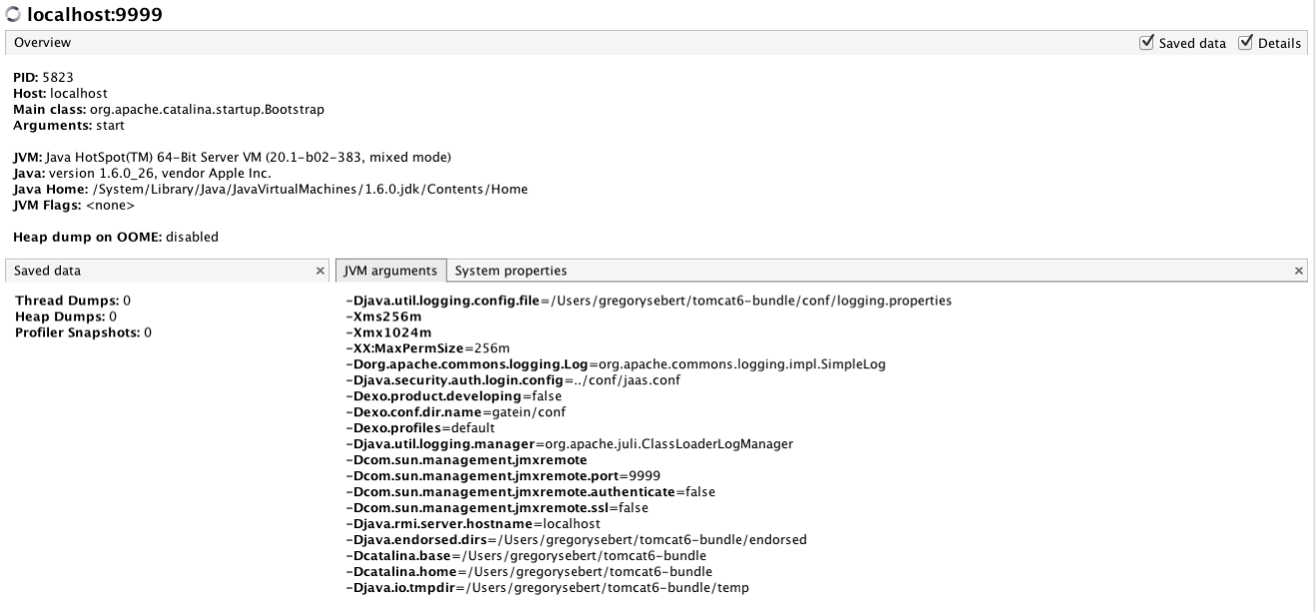
Using VisualVM (Overview tab)
The Overview tab display shows high-level information about the application: its process ID, Java version used to run it, the name of the main class, etc..

Slide 15
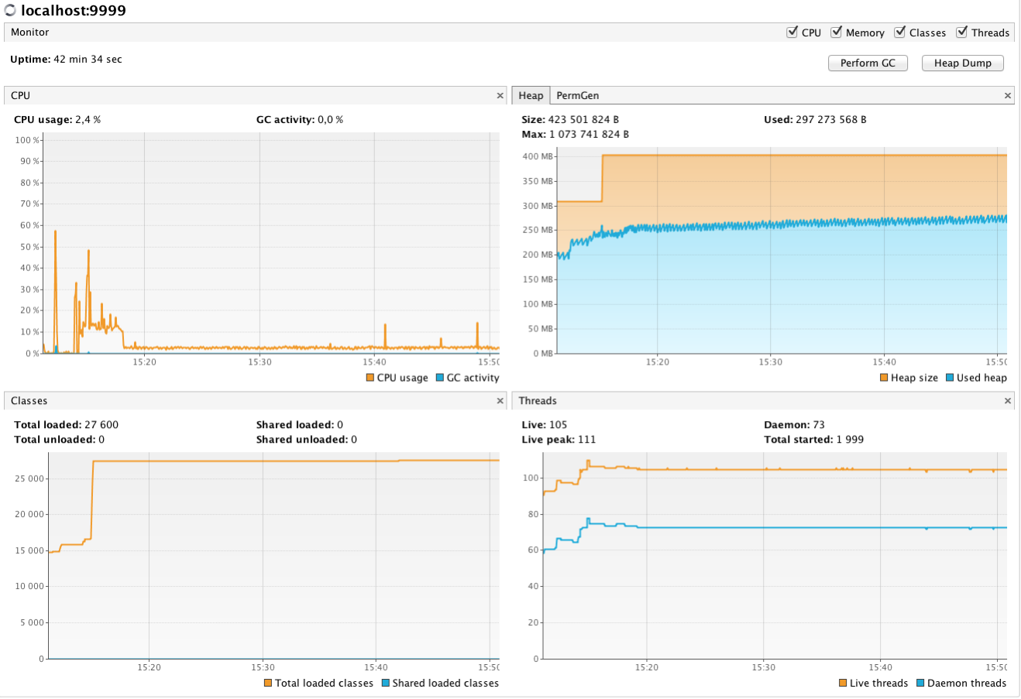
Using VisualVM (Monitor tab)
The Monitor display use full graphs about : CPU, Heap, Permanent Generation, Threads, and Classes
You can also perform GC (garbage collector) or Heap Dump directly from the interface.

Slide 16
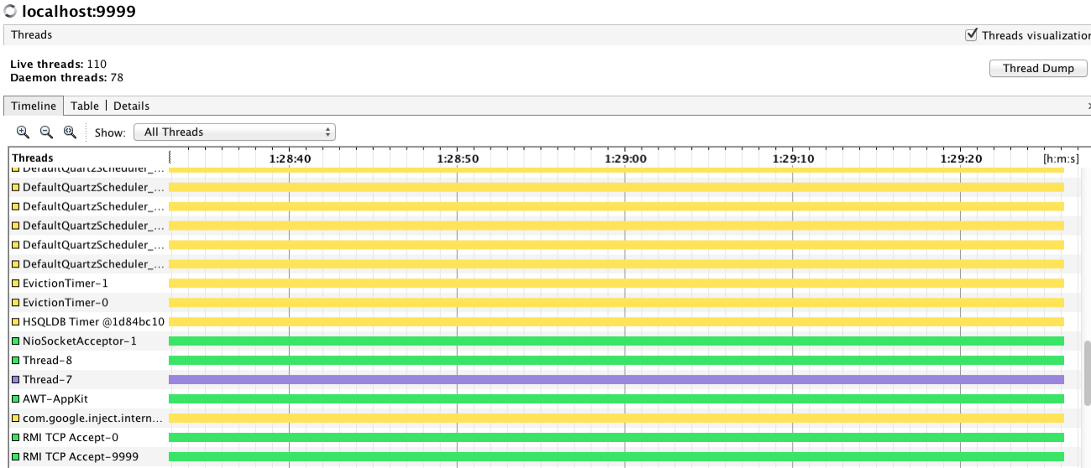
Using VisualVM (Threads tab)
This tab displays a timeline with real-time thread states. Use the buttons in the Timeline toolbar to zoom in/out on the current view.
The drop-down list enables you to select which threads are displayed. You can choose to view all threads, live threads or finished threads.
You can also select a single thread or multiple threads to display a subset of the threads. You can double-click on a thread timeline to open that thread in the Details tab

Slide 17
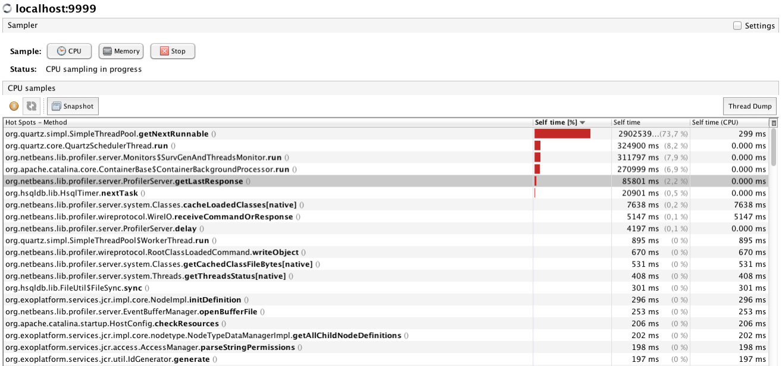
Using VisualVM (Sampler(profiler) tab)
The Sampler tab provides a powerful performance and memory profiler which uses sampling, a technique that allows performance and memory data to be gathered with zero setup and virtually no overhead.

Slide 18
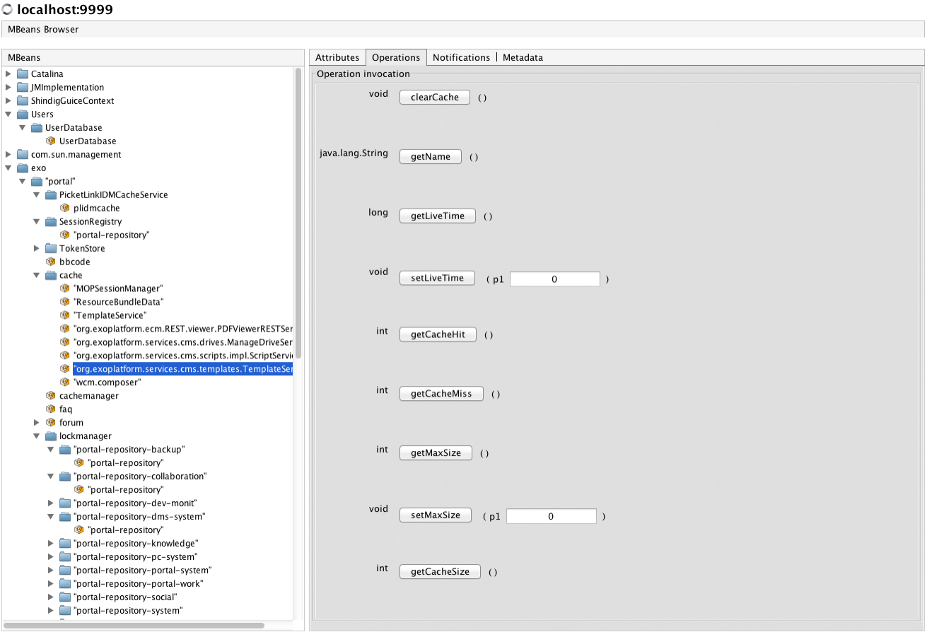
Using VisualVM (MBeans tab)
The MBeans tab displays information about all the MBeans registered with the platform MBean server.
Exo exposes various attributes, operations, notifications, and metadata.
For example, Mbeans tab can be used to manage eXo cache or to retrieve eXo keys attributes :

Slide 19
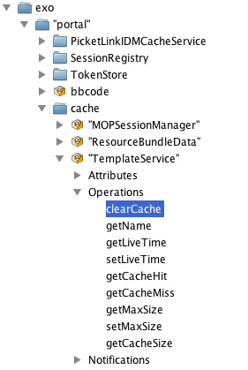
Using VisualVM (Mbeans tab)
Clearing a cache (of groovy templates):

Slide 20
Exercises : VisualVM
20
Notes:
20

Slide 21
Exercises : 1a Connection to JMX
Download VisualVM from : http://visualvm.java.net/download.html
Setup eXo to accept remote conection on port 9999 without authentitication (all the information are in JMX remote configuration (Tomcat) slides)
Start VisualVM
Add a JMX connection to remote eXo platform server (via File ->add JMX connection)
Add a name and specify the port 9999 used by the JMX
You have now remote JMX access.

Slide 22
Exercises : 1b Using VisualVM
Go to overview tab, retrieve the JVM argument and system properties
In the monitor tab, perform a Heap Dump & save it to your machine.
Open this Heap Dump with VisualVM, you can find information about classes, instances etc ....
In the sampler tab, perform a cpu & memory sampling
With the sampler profiler, you can easily identifiy the top cpu & memory consumer.
With the MBeans tab, explore the MBeans exposed by eXo :
Retrieve the portal configuration (in exo->portal->portal->portal.getConfigrationXML())
In the forum MBeans, check if john & root has admin role:
(in exo->portal->forum->hasAdminForumRole(« john »)
Clear the eXo template cache (in exo->portal->cache->TemplateService.clearCache())

Slide 23
Exercises : 2 Connection to JMX with authentitication
Setup eXo to use remote JMX with authentification (All information are in the JMX remote configuration Password Authentication slides).
Create a user adminjmx password adminjmx with read write permission
Create a user guestjmx password guestjmx with read only permission
Restart eXo
Launch VisualVM
Try to connect to jmx, what does occur?
Connect to jmx with user guestjmx, go to Mbeans, go to catalina->engine, and try to stop the engine via the operation tab.
Connect to jmx with user guestjmx, go to Mbeans, go to catalina->engine, and try to stop the engine via the operation tab.
Restart eXo

Slide 24
eXo SysAdmin Training
Notes:
24

