Slide 1
Configuration and Extensions
Basic Customization

Slide 2
Folder Structure
Configuration
Extension Concept
Service Configuration

Slide 3
Folder Structure

Slide 4
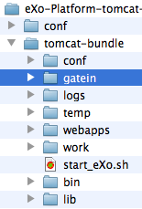
Folder Overview
Standard tomcat, but enhanced
+ jars in tomcat/lib
+ wars in tomcat/webapps
+ declarations in conf/Catalina/
+ modified conf/server.xml
+ modified conf/jaas.config
+ start_eXo file
+ bin/gatein file
+ new gatein folder

Slide 5
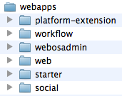
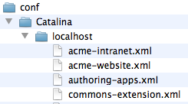
WebApps
About 40 webapps
Several webapps per project
The webapps that are extensions are also declared in conf/Catalina/localhost/

Slide 6
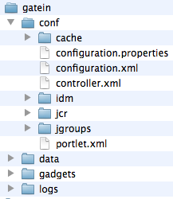
Gatein Folder
Configuration
Data
Index
Logs

Slide 7
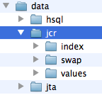
Data Folder
HSQL database
Not for production
Index
Lucene index data
Swap
Temporary data
Values:
Binary Data that is not stored in the database.
jta
Java Transaction API

Slide 8
Configuration
A short Introduction

Slide 9
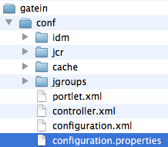
External Configuration
tomcat/gatein/conf/ and subfolders
Highest Priority
tomcat/gatein/conf/configuration.properties for SysAdmin properties

Slide 10
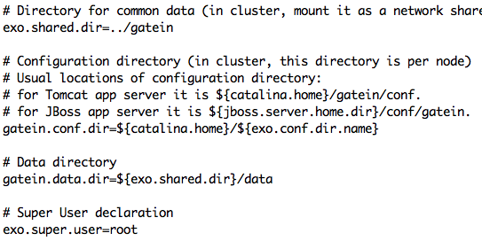
Configuration Properties
tomcat/gatein/conf/configuration.properties

Slide 11
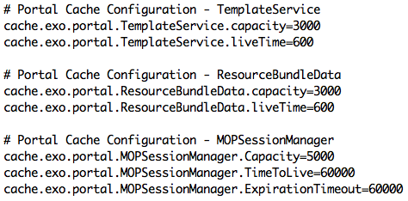
Configuration Properties
Boost eXo and augment the cache liveTimes !
liveTimes are seconds: 600s = 10min

Slide 12

Datasource
The datasource is managed by the application server (tomcat)
eXo accesses the datasources using JNDI lookup
IDM : Identity Management (Organization: Users and Groups)

Slide 13


Datasource
In tomcat/conf/server.xml is the JNDI Resource configuration
Remarks
At the first startup the tables are created.
The provided user has to have permissions for table creation.
After the first startup the permission can be removed.

Slide 14
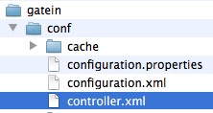
Controller
New concept since eXo Platform 3.5
URL composition
“/portal/” cannot be altered or removed
tomcat/gatein/conf/controller.xml

Slide 15
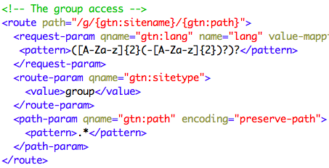
Controller

Slide 16
Exercise: Configuration
Controller
Find where the language is defined in controller.xml
Test out French: http://localhost:8080/portal/fr/acme/
Test out group pages with a “lang” parameter.
Stop the server
Boost eXo Cache
Open tomcat/gatein/conf/configuration.properties
Search for liveTime=600 and set them to 99000
Start the server
Extra: Modify user the page pattern in controller.xml
Extra: If you have a database on hand create, modify tomcat/conf/server.xml in order to point to your database.

Slide 17
Extension Concept
A War + Activation Jar

Slide 18
Reason
Support
Avoids modifying source code in eXo deliveries
No support from eXo for modified code
Advantages
Easy migration to new version
Easy application of patches from eXo support
Clear limit between eXo’s code and customer’s code
Like a PlugIn that you re-apply after each migration

Slide 19
Concept
Allows to customize
HTML, CSS, Javascript, JSP,
Groovy Templates
Configuration
Internationalization
A war file
Contains all customization files
You can overwrite/replace files contained in other wars
Use the exact same path and name
An activation jar
Declares your war as eXo extension.

Slide 20
War Project
Customizations
Put all your customizations in a war file
If you wish to override, use the exact same path and file name
Web.xml
Define the name of your extension in the tag “display-name”.
The name of the war file does NOT matter.
Declare the listener PortalContainerConfigOwner

Slide 21

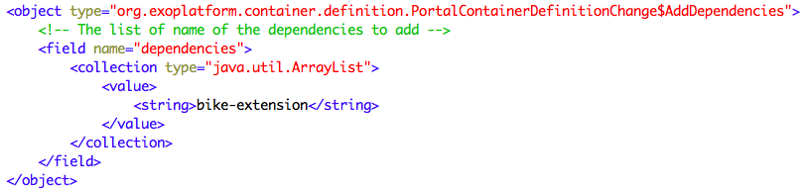
Activation JAR
Configuration.xml
The contains exactly one file in the folder “/conf/”
Name: configuration.xml
Activate the war
Service: org.exoplatform.container.definition.PortalContainerConfig
Point to the name of the extension, defined in the web.xml tag „display-name“

Slide 22
Deployment
Tomcat
Stop tomcat
Copy the jar to tomcat/lib
Copy the war to tomcat/webapps
Tomcat loading order
You extension must be load before the starter.war
To ensure this declare your extension
Declare the bike-extension in tomcat/conf/catalina/localhost/
JBoss
In JBoss create a ear containing the war and jar and deploy it.

Slide 23
Test
Testing
After copying the war and jar you can test the extension.
Restart tomcat
When re-deploying a modified war, stop tomcat, delete the war folder in tomcat/webapps and restart.

Slide 24
Extension Exercise
A War + Activation Jar

Slide 25
Extension Exercise Overview
In this exercise you will
Modify the Admin Tool Bar
Alter the login interface
Add a language
Maven
Go to the folder with pom.xml and execute “mvn clean install”
If you are online maven will download a lot of files.
Alternatively you can use the provided repository.

Slide 26
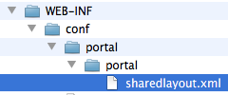
Admin Tool Bar Configuration
Current Admin Tool Bar configuration:
webapps\platform-extension\WEB-INF\conf\portal\portal\sharedlayout.xml
Overriden in your extension:
bike-extension\WEB-INF\conf\portal\portal\sharedlayout.xml
In “sharedlayout.xml“:
definition of several portlets,
each entry in the Admin Tool Bar is a small portlet.
The file configures the order of these entries in the tool bar

Slide 27
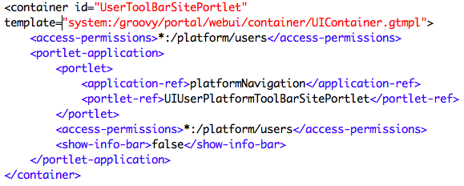
Admin Tool Bar

Slide 28
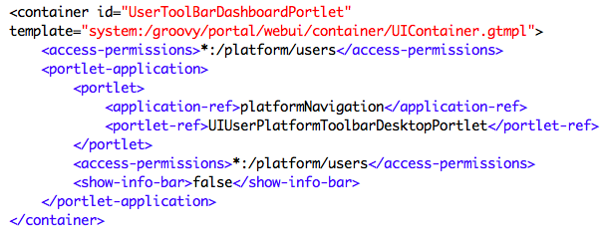
Admin Tool Bar

Slide 29
Maven Offline Repository
Install Maven
Open a shell
Open the project file “…/exercises/custom-extension/1-project“
Execute “mvn clean” in the shell
There will be errors (if you are offline),
If you are online, there will be downloads,
if you wish to work without downloads, you should stop the execution.
Use the prepared Maven repository
Copy maven-repository.zip to §HOME/$username/.m2/
Rename (or delete) the existing folder named “repository”
Unzip maven-repository.zip
Execute “mvn clean” in the shell
No more errors or downloads, because the delivered repository is used

Slide 30
Exercise: Custom Extension 1/3
Open exercise …/custom-extension/
Copy the sharedlayout from the webapps/platform-extension
exercises/custom-extension/1-project/war/src/main/webapp/WEB-INF/conf/portal/portalWEB-INF/conf/portal/portal/sharedlayout.xml
Change the order of the portlets in the Admin Tool Bar
Move the container around the dashboard portlet after the container of the edit portlet.
…/exercises/custom-extension/1-project/war/src/main/webapp/WEB-INF/conf/portal/portal/sharedlayout.xml
In order to be faster, integrate the next two customizations before compiling and starting eXo

Slide 31
Exercise: Custom Extension 2/3
Use the same project folder:
…/custom-extension/1-project/war/src/main/webapp
Create your own version of the jsp file
Copy tomcat/webapps/platform-extension\login\jsp\login.jsp to your project (path: exercises/custom-extension/1-project/war/src/main/webapp/login/jsp)
Add “Welcome to the Bike Shop” to the jsp.
Remember: You have to copy login.jsp to the exact same path in your bike-extension.

Slide 32
Exercise: Custom Extension 3/3
Copy
...tomcat\webapps\portal\WEB-INF\conf\common\locales-config.xml to exact …/exercises/custom-extension/1-project/war/src/main/webapp/WEB-INF/conf/common/locales-config.xml
Add Afrikaans language (“af“) to locales-config.xml

Slide 33
Exercise: Deploy and Test!
Open …/exercises/custom-extension/1-project and execute “mvn clean install”
Copy
Copy the compiled war (…\1-project\war\target\bike-extension.war) to the tomcat/webapps folder.
Copy the compiled jar (…\1-project\config\target) file to the tomcat/lib folder.
Declare the webapp in the tomcat/conf/catalina/localhost/ folder
Start eXo.
Test !
At login you should see the modified login.jsp (http://localhost:8080/portal/private/acme/)
After login you should see modified Admin Tool Bar.
Click on change language and you should see Afrikaans in the list.

Slide 34
Services

Slide 35
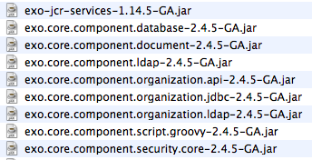
Introduction
Services are java classes with a defined API
Services are deployed to the tomcat/lib folder
A service can have a default configuration
In the jar: /conf/configuration.xml

Slide 36
Service Keywords
Inversion of Control
eXo uses the PicoContainer framework
In PicoContainer services are referenced as “Components”
eXo Container (based on a PicoContainer)
Reads the configuration files and creates exactly one instance of each service (singleton pattern).
The consumer of a service
Does not create an instance (… new myService())
Calls the exoContainer to provide a reference to the requested service

Slide 37
Service Keywords
Interface – Implementation
A service is defined by the java interface
A service can have different implementations
Only one implementation can be used during runtime
The configuration files define which implementation is used
Singleton
Each service is created only once (new myService())
The exoContainer holds the reference to this instance
When requested, the consumer receives the reference

Slide 38
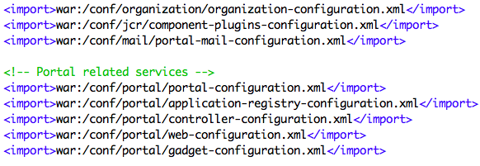
Service Configuration
To declare a service to the eXo Container
you must add an xml configuration to a specific place
jar, webapp or external configuration
eXoContainer reads the files named “configuration.xml”
These files contain very often imports of other configuration files

Slide 39
Configuration Priority
Default configuration inside of jar files
/conf/portal/configuration.xml
Webapp configuration inside of war files
/WEB-INF/conf/configuration.xml
External configuration
/tomcat/gatein/conf/portal/portal/configuration.xml
The external configuration overwrites everything.
The configuration.xml files are read automatically.
A configuration.xml can import other configuration files.

Slide 40
Service Configuration
The registration of a service
done with the <component> elements
You have to define a service, otherwise the service is not known by the eXoContainer.
Interface: defined by <key>
Implementation: defined by <type>
Example
tomcat/webapps/portal/web-inf/conf/mail/portal-mail-configuration.xml

Slide 41
Service REference
A service is always referenced by its interface (<key>), not by the implementation (<type>).

Slide 42
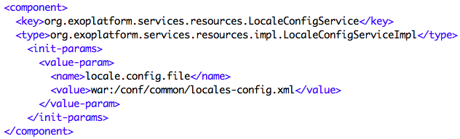
Configuration Parameters
A service can be configured using parameters.
Each services defines the parameters it interpretes.

Slide 43
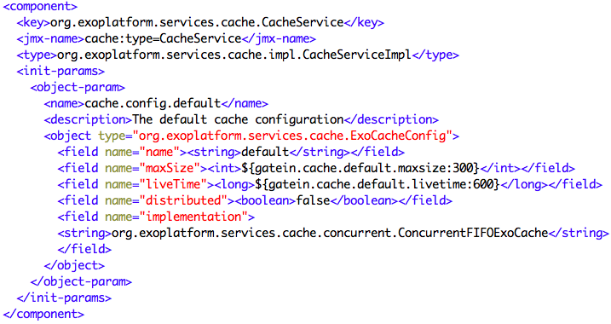
Complex Parameters
Complex Parameters

Slide 44
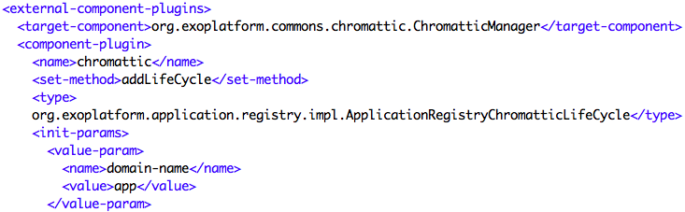
Configuration Plugin
Services can provide plugins
Methods of the service
Allows to add configuration without repeating the other confiugration

Slide 45
Configuration Profiles

Slide 46
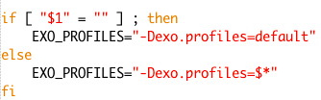
Configuration Profiles
Each profile activates certain configurations.
Java System Variable exo.profiles
Example in start_eXo.sh:
Several profiles can be activated at the same time using a comma.

Slide 47

Configuration Profiles
Any part of the configuration can be added to a profile.
Profile-dependent configuration is only taken into account if the profile is used.
A profile can depend on a list of profiles. In this case, the use of any profile activates the configuration.

Slide 48
Configuration and Extensions
Basic Customization

