Slide 1
eXo Fundamentals Training
Introduction
Sören Schmidt
soren.schmidt@exoplatform.com
Notes:
1

Slide 2

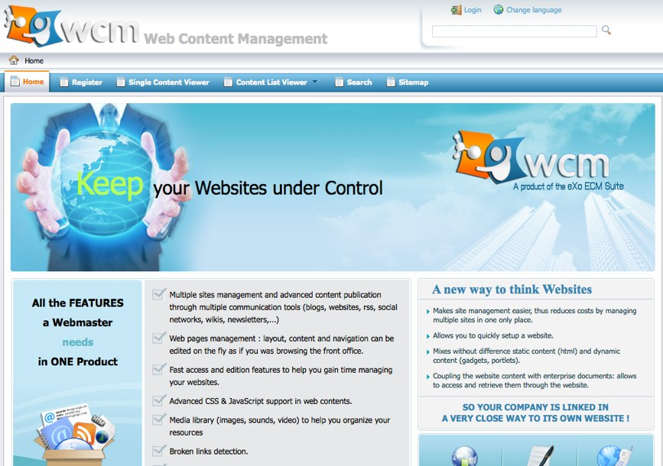

Enterprise Portals
Notes:
2

Slide 3
Objectives
At the end of the eXo Fundamentals Training you should know :
What’s eXo Platform 3.0?
What’s GateIn, eXo Content, eXo Knowledge, eXo Collaboration?
All functional knowledge about these products
Being able to make presentations about these products
Use and administrate these products
No coding!

Slide 4
Agenda
Day 1 | Introduction, eXo Portal/GateIn Presentation, GateIn Front Office and Backoffice, eXo Content Front Office
Day 2 | eXo Content Back Office, eXo Content Features and Customization, eXo Collaboration, eXo Knowledge, eXo Social, Q & A

Slide 5
Training Toolkit
eXo Platform 3.0
Slides
Other Resources:
http://www.exoplatform.com/
http://www.jboss.org/gatein/documentation.html

