Slide 1
Web Content Management
DMS Exercises

Slide 2
Exercise: Site CSS
CSS
Login as root. Open the Acme site.
Open the Site Explorer
Modify the priorities and content of the site css.
Add a new site CSS

Slide 3
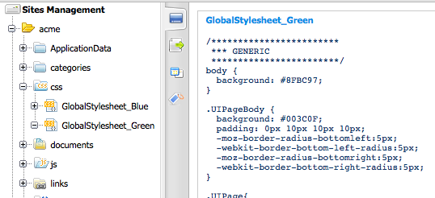
Exercise: Site CSS

Slide 4
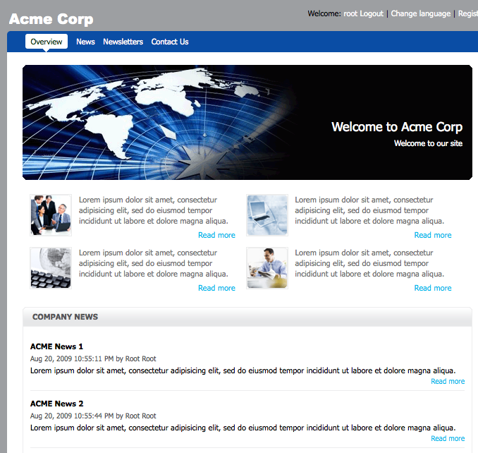
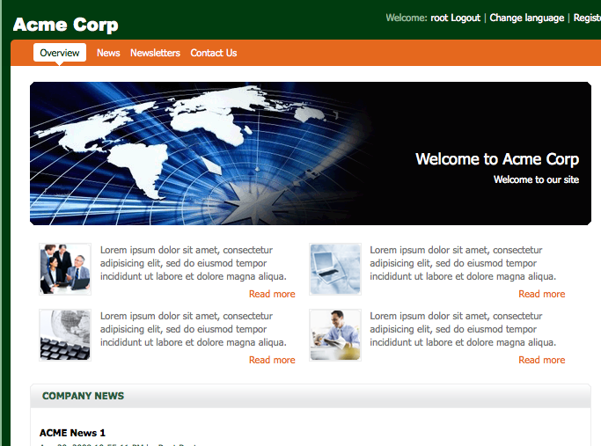

Exercise: Site CSS

Slide 5
Exercise: List Template
Open
Add and edit a template of the Content List portlet.
exo-tomcat/webapps/portal/WEB-INF/conf/wcm/artifacts/application-templates/content-list-viewer/list-by-folder
Copy DocumentsTemplate.gtmpl to FormationTemplate.gtmpl

Slide 6
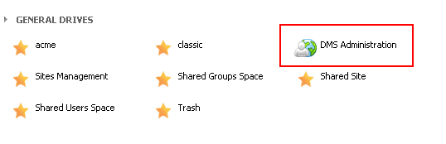
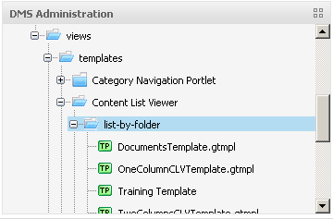
Exercise: List Template
List Template
Login as root. Open the Acme site.
Open the Site Explorer
Open the DMS drive and then
/exo:ecm/views/templates/Content List Viewer/list-by-folder

Slide 7
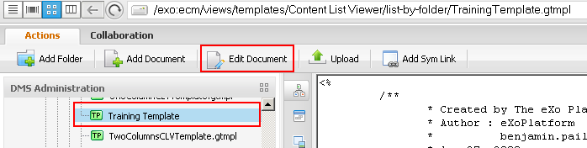
Exercise: List Template
Modify the new template
Copy the DocumentTemplate and call the copy TrainingTemplate.gtmpl
Add a test text like “TEEEESSSSTT” behind the first <div> of the TrainingTemplate.gtmpl in order to if the modification works.

Slide 8
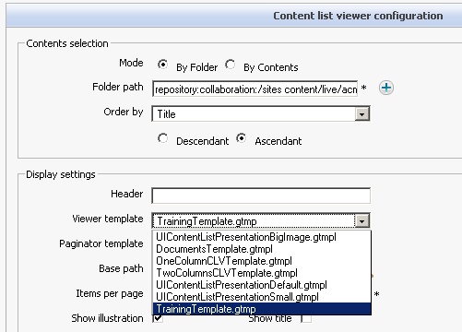
Exercise: List Template
List Template
Use the training template in Content List portlet

Slide 9
Web Content Management
DMS Exercises

