Slide 1
eXo Workflow
Keywords

Slide 2
Workflow
Workflow Introduction
Workflow in eXo
Workflow Development

Slide 3
Workflow Introduction
Workflow : Information flow in an organization
Tasks for defining a business process
Example: Automatic document transmission among people (docuflow)
Workflow Engine: Computer system which allows to execute processes automatically

Slide 4
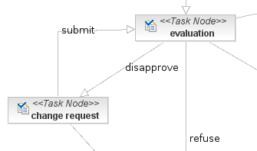
Workflow Introduction
Process definition vs Process instance
Task : unitary activity of a process assigned to a person or a group
The workflow engine orchestrates the information flow among the task using transitions

Slide 5
Workflows in eXo
Pluggable engine: JBPM ou Bonita
Processes: content-validation, payraise, holidays
Application Business Process Controller :
  visualize, fulfill one’s tasks
  start new processes
Application Business Process Administration :
  Process supervision
  upload a new process definition

Slide 6
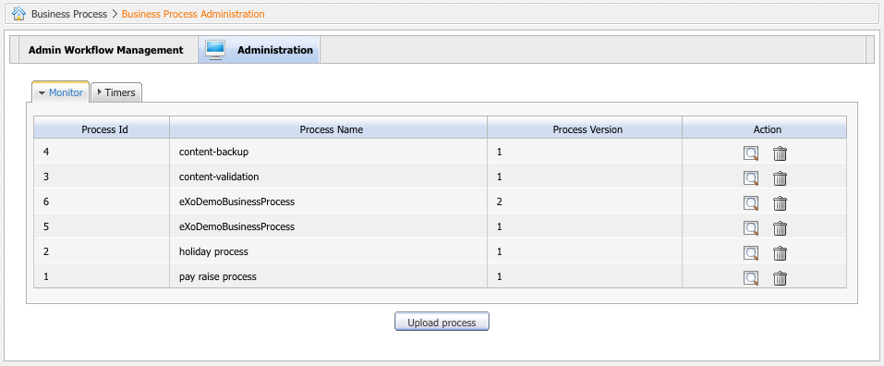
eXo Workflow Applications
Workflow

Slide 7
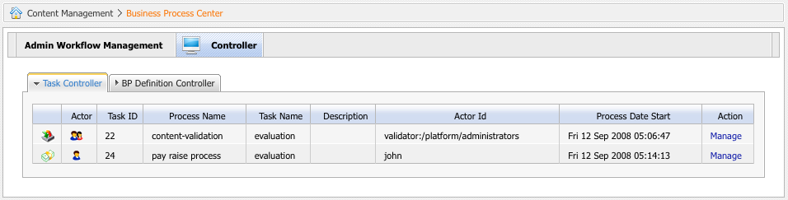
eXo Workflow Applications
Business Process Center
Management of the current processes

Slide 8
eXo Workflow
Keywords

