Slide 1
eXo Fundamentals Training
Portal Elements and Organization Model
Notes:
1

Slide 2
Discovery
2
Notes:
2

Slide 3
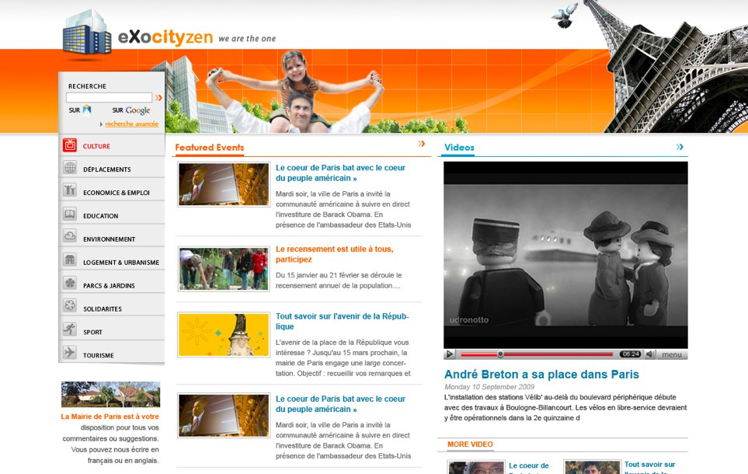
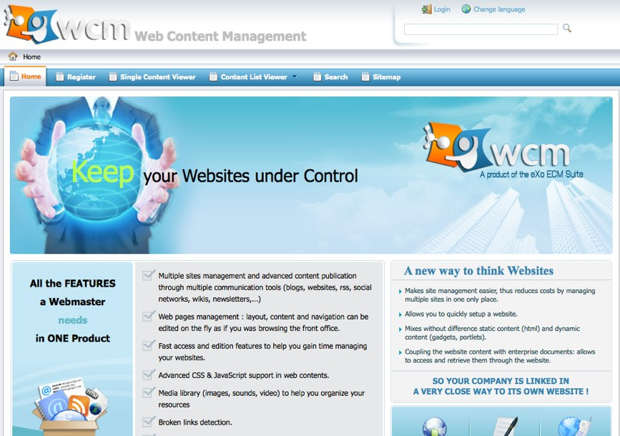

Image Discovery
Notes:
3

Slide 4
Why a portal ?
Improvement of productivity
Single Entry Point
Single Sign-On
Application Integration
Resources leverage
Centralized User Management
Simplified Administration and Deployment

Slide 5
Why eXo Portal ?
Standard Respect
Professional Open Source
Integrated Applicative Suite
eXo innovates (ex: WebOS)
Flexible Roadmap

Slide 6

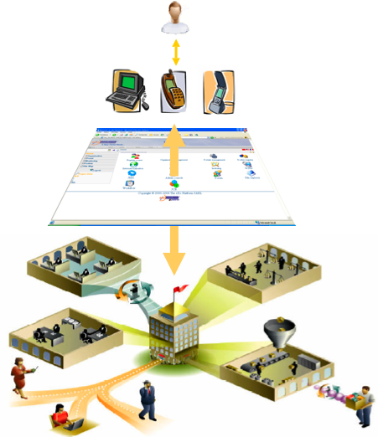
Enterprise Portal
Collaborative
Applications
Workflows
Intranet
Documents

Slide 7
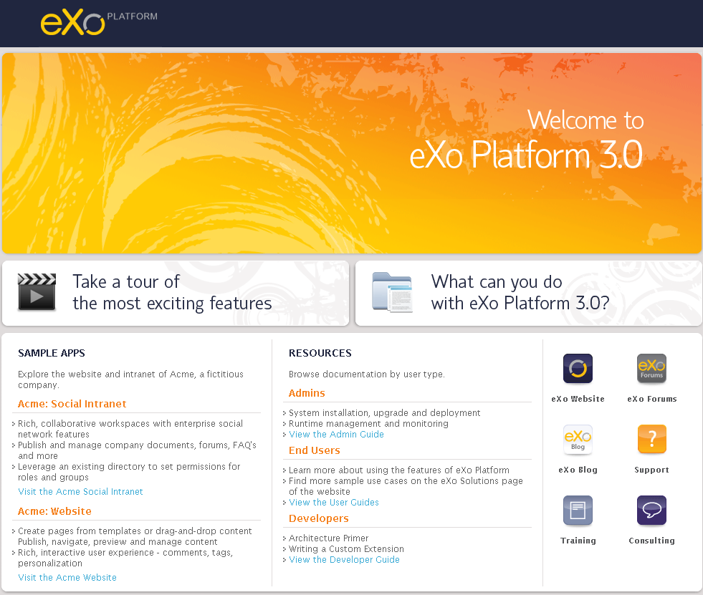
Homepage
Open the this address: http://localhost:8080/portal/
Forwards to the default portal: http://localhost:8080/portal /public/default/
Notes:
7

Slide 8
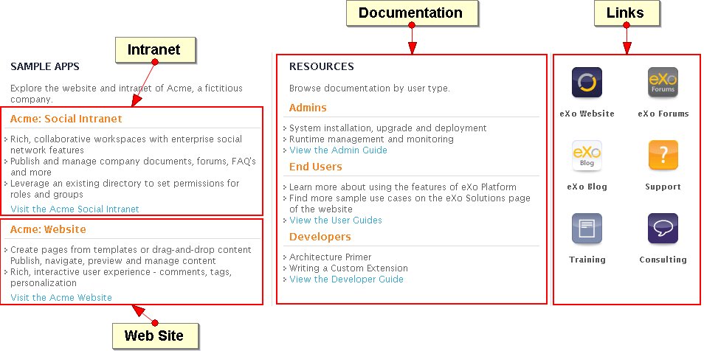
eXo Platform Homepage
Notes:
8

Slide 9
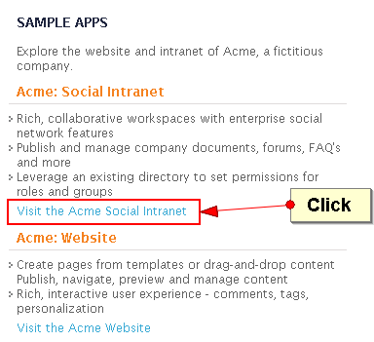
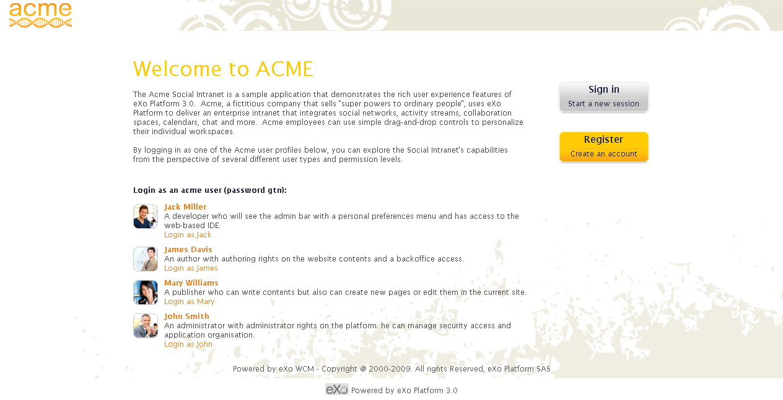
Acme Social Intranet
Notes:
9

Slide 10
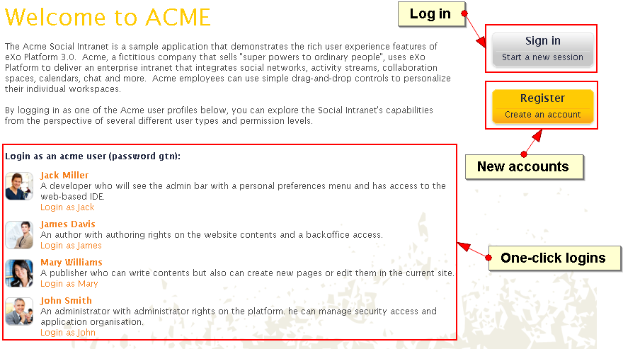
Acme Social Intranet
Notes:
10

Slide 11
Intranet Sample Users
Sample Users:
Jack Miller: A developer who will see the admin bar with a personal preferences menu and has access to the web-based IDE.
James Davis: An author with authoring rights on the website contents and a backoffice access.
Mary Williams: A publisher who can write contents but also can create new pages or edit them in the current site.
John Smith: An administrator with administrator rights on the platform. he can manage security access and application organization.
All passwords are “gtn”.
Notes:
11

Slide 12
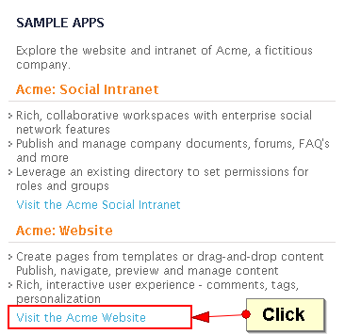
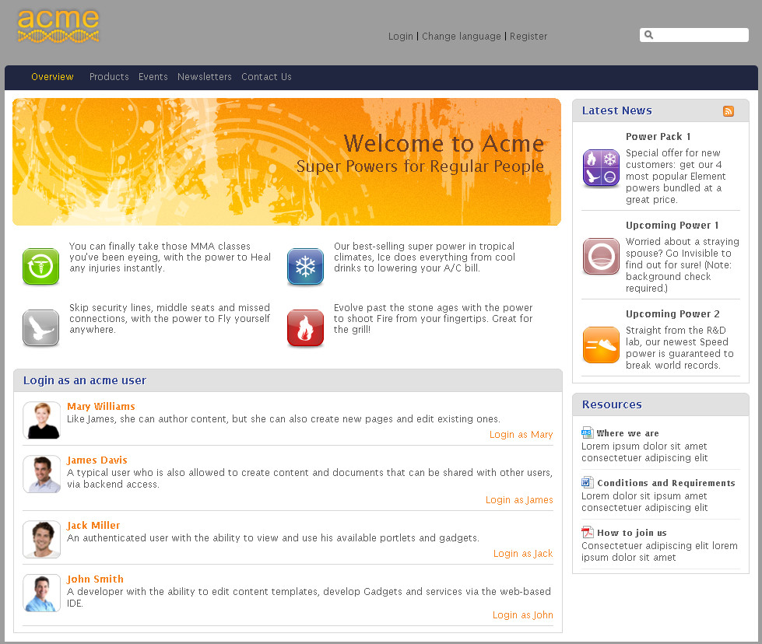
Acme Web Site
Notes:
12

Slide 13
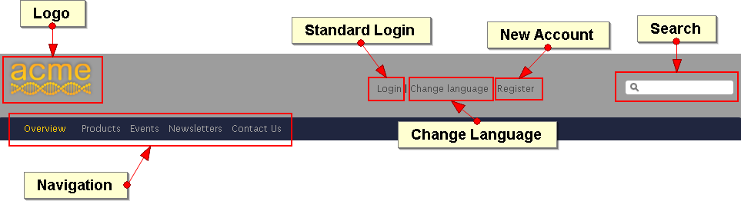
Acme Web Site
Address: http://localhost:8080/portal/public/acme
Notes:
13

Slide 14
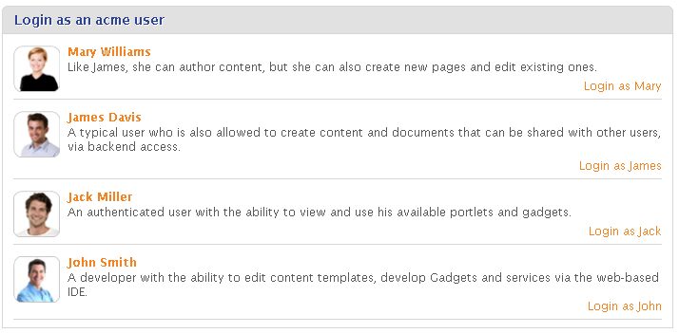
Acme Web Site – Sample Users
Address: http://localhost:8080/portal/public/acme
Notes:
14

Slide 15
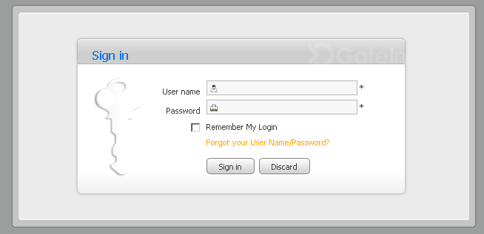
Log in
Notes:
15

Slide 16
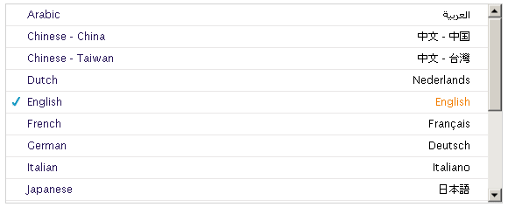
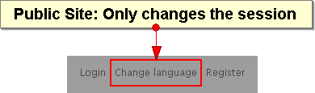
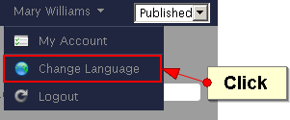
Language Setting
eXo Platform is available in 16 languages
Anonymous / public site: the language choice is stored in the temporary session.
After login: The choice is stored in the user preferences.
Notes:
16

Slide 17
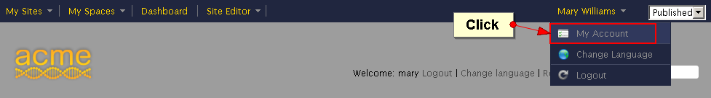
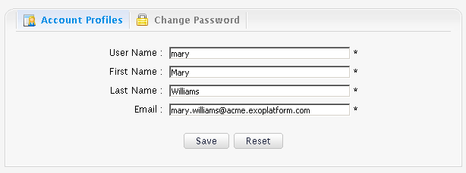
User Account
Notes:
17

Slide 18
Admin Tool Bar
18
Notes:
18

Slide 19
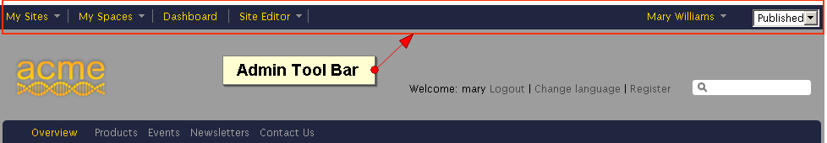
Admin Tool Bar
The Admin Tool Bar contains menu entries for:
Sites
Spaces (Groups) of the current user
Current User (Dashboard)
Site/Group/Dashboard Editor, depending on the current page.
Notes:
19

Slide 20
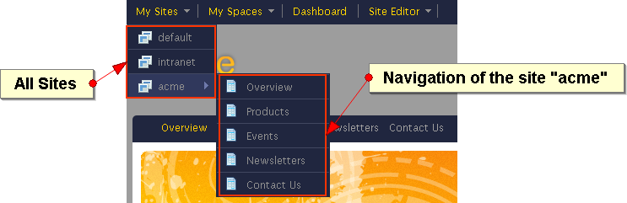
Admin Tool Bar - Sites
Select your site
Notes:
20

Slide 21
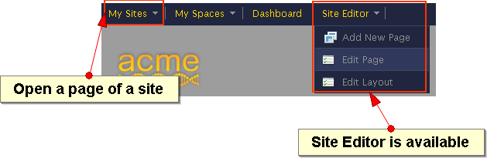
Admin Tool Bar - Sites
Open a page of a site
The Site Editor menu appears at the right
Notes:
21

Slide 22
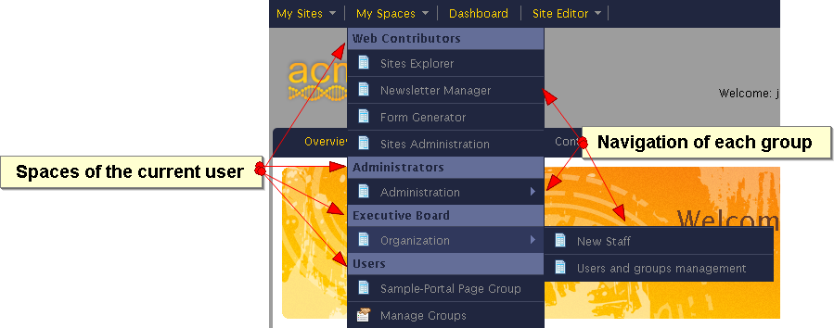
Admin Tool Bar – Space Navigations
Each user sees only the navigations of her or his spaces/groups
Notes:
22

Slide 23
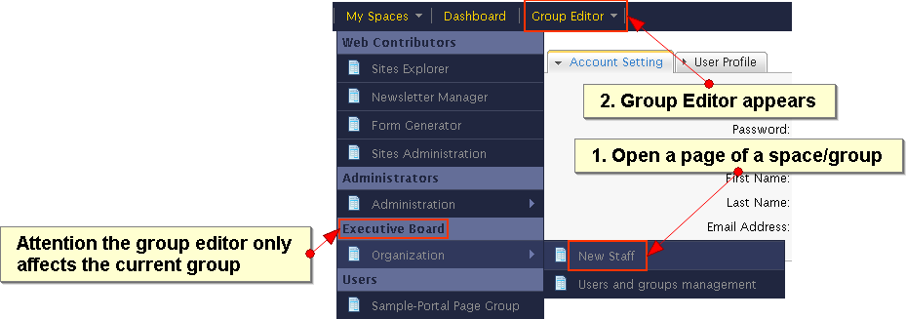
Admin Tool Bar – Group Editor
Group Editor for the groups of the current user
Notes:
23

Slide 24
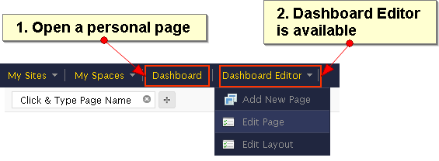
Admin Tool Bar - Dashboard
Current User (Dashboard)
Notes:
24

Slide 25
Admin Tool Bar – Three Editors
Sites
Groups of the current user
Current User (Dashboard)
Notes:
25

Slide 26
Personal Dashboard and Gadgets
26
Notes:
26

Slide 27
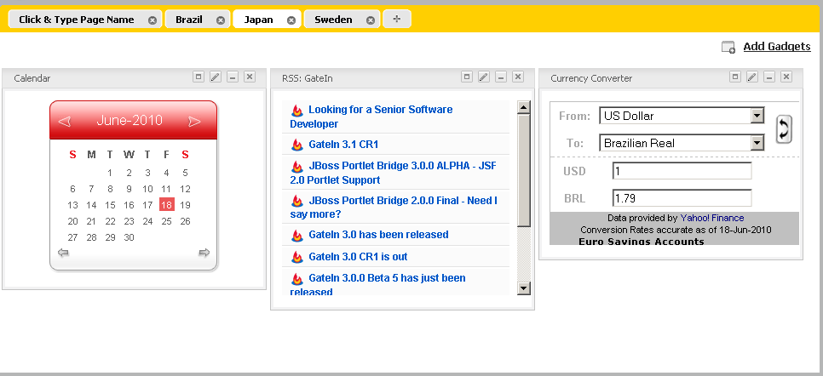
Gadgets
Embeddable chunk of Javascript
Live user interface
Accessible from the Dashboard, WebOS or using a Gadget Wrapper
Many implementations : Google Gadget standard in GateIn
Notes:
27

Slide 28
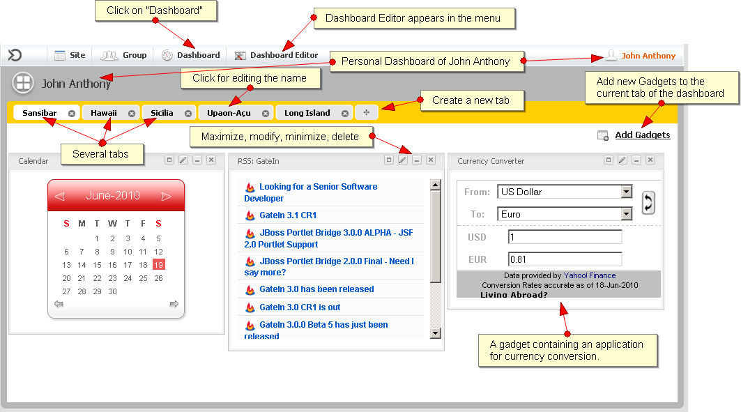
Personal Dashboard
Notes:
28

Slide 29
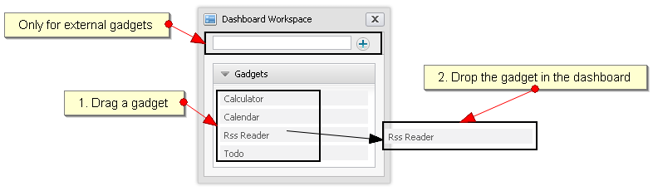
Internal Gadget
Internal gadgets are stored on the eXo server
You can drag it directly to the dashboard
Notes:
29

Slide 30
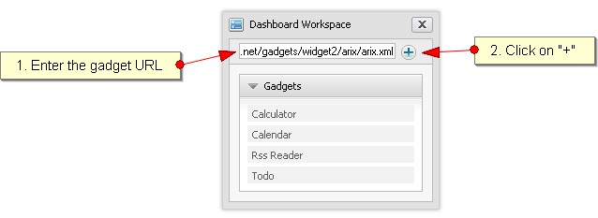
External Gadget
External gadgets are stored on other servers
You need to enter or copy a complete URL
Notes:
30

Slide 31
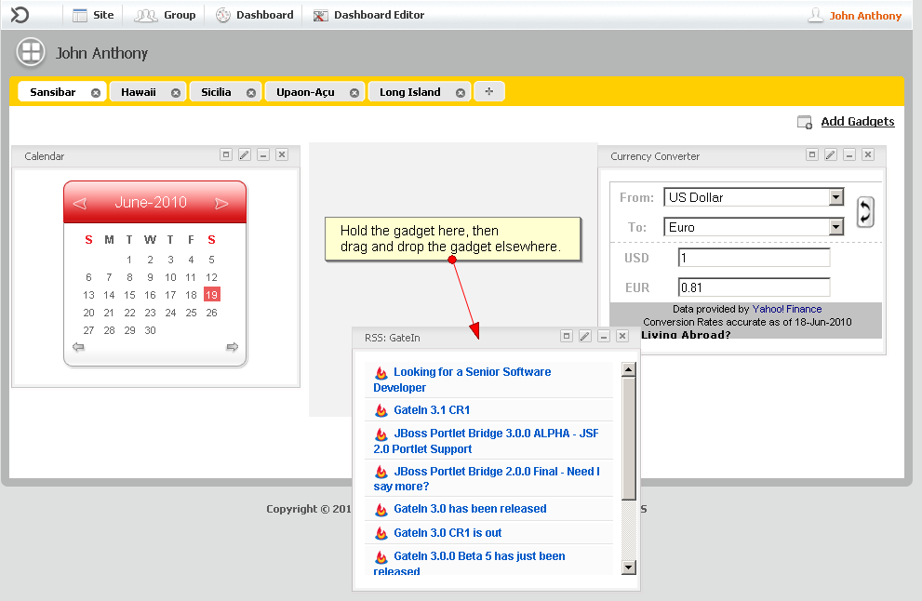
Drag your Gadget
Notes:
31

Slide 32
Exercise 0: Start and Play
Requirement:
Java SDK 6 (For eXo Portal it was Java 5)
Notes:
32

Slide 33
Exercise 0: Start and Play
Start the portal
Create a directory $TRAINING_HOME and unzip eXoPlatform-3.0.0-GA.zip
Search for the binary subfolder:
...\eXoPlatform-3.0.0-GA\bin\tomcat6-bundle\bin
In command line, launch:
Linux / Mac OS : ./gatein.sh run
Windows : gatein run
Wait
Watch the startup messages.
The startup is finished when you see “INFO: Server startup in 71219 ms”.
Start a browser at: http://localhost:8080/portal/
Notes:
33

Slide 34
Exercise 0: Start and Play
Stop the portal
To stop the server , simply type Ctrl+C from the console
You can also use : ./gatein.sh stop
To re-init and get the default configuration, delete :
../eXoPlatform-3.0.0-GA\bin\tomcat6-bundle\gatein\data
../eXoPlatform-3.0.0-GA\bin\tomcat6-bundle\work
../eXoPlatform-3.0.0-GA\bin\tomcat6-bundle\temp
Notes:
34

Slide 35
Exercise 0: Start and Play
Settings
Switch to Acme Website
Before logging in, change the language
Log in as Mary
Change the language for Mary
Change the skin for Mary
Change her email address
Admin Tool Bar
Click on the different menu points and observe how the Admin Tool Bar changes
Notes:
35

Slide 36
Exercise 0: Start and Play
Dashboard
Log in as Mary
Create two dashboards with different names
Log in as John
Verify that his dashboard is empty (remember that the dashboard is personal)
Create a dashboard for John
Add an external gadget to the dashboard: http://shazingo.com/lig/lg/142002.xml
Notes:
36

Slide 37
Organisation Model
37
Notes:
37

Slide 38
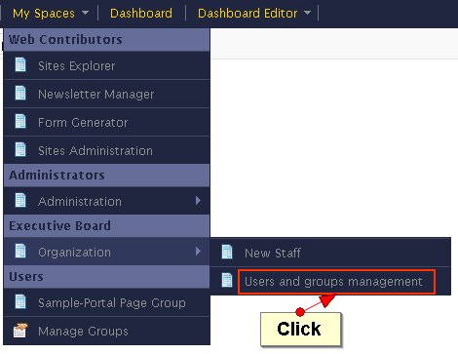
Organisational Model
Components
Users
Groups
Memberships
Authentication and Authorization
Generalized model for the platform
Database storage (Hibernate) or Directory storage (LDAP)
Notes:
38

Slide 39
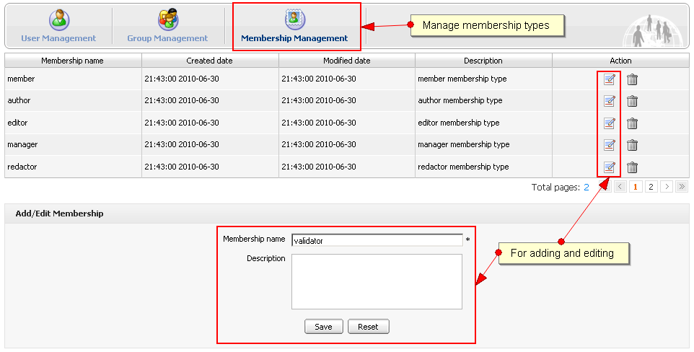
Organisational Model - Memberships
Membership types are similar to roles: manager, validator, editor.
Membership types are shared among all groups.
When a user is added to a group she or he must be assigned with membership type to that group.
The asterisk “*” stands for “all membership types”.
Membership versus “membership type: When a user is assigned to a group with a membership type you say that the user has a “membership”.
Notes:
39

Slide 40
Organisational Model - Memberships
Notes:
40

Slide 41
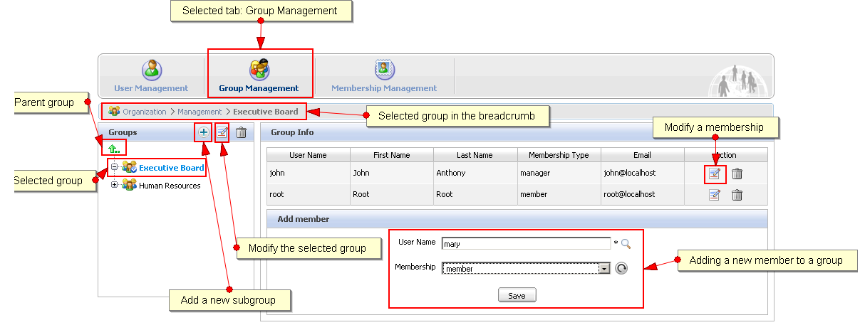
Organisational Model - Groups
Groups are organized in an hierarchy, but there is no inheritance.
A user can be several times in the same group having different memberships.
A user can be in one or several groups
Notes:
41

Slide 42
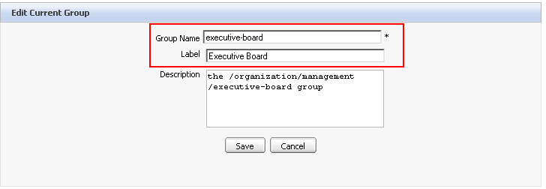
Organisational Model - Groups
Groups have a name. The name is used internally and cannot be modified.
The group label is used for the interfaces and can be modified at will.
Notes:
42

Slide 43
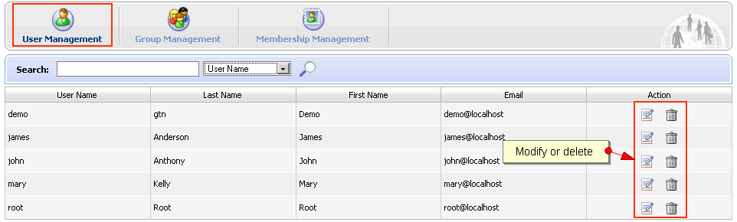
Organisational Model - User
User Management
Notes:
43

Slide 44
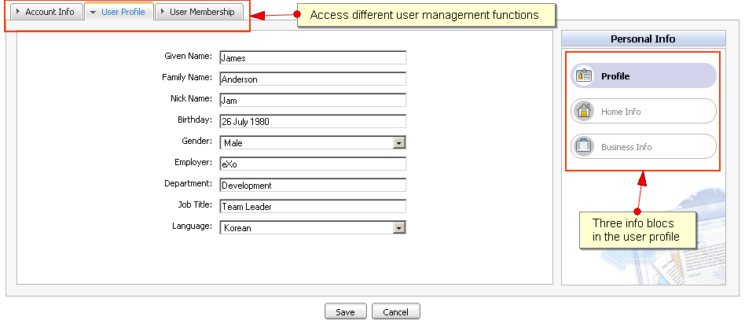
Organisational Model - User
Modify user information, delete memberships
Notes:
44

Slide 45
Memberships: Remarks
Case Sensitivity
Everything is case sensitive: user, group and membership name.
Membership Type manager
This is the role of the manager of each group. Each group has to have one member with role. The administrator who creates a group is automatically added to that group with the membership type “manager”.
Notes:
45

Slide 46
Exercise 1: Memberships
Create a new member
Login as John.
Open the application “’New Staff” (Menu: Group/Organization/New Staff)
Create a user “Elena”.
Manage users and groups
Open “Users and group management” (Menu: Group/Organization)
Search for the user “Elena”. Is she already member of a group?
Create a new membership type “translator”.
Create a new subgroup in platform called “training”.
Add Elena to the new group with the new membership type.
Add Elena a second time to that group user the “manager” membership type.
Notes:
46

Slide 47
eXo Fundamentals Training
Portal Elements and Organization Model
Q & A
Notes:
47

