Slide 1


eXo Platform
The Enterprise Social Platform
Social collaboration Solution
Open Source and Enterprise Ready
Highly extensible platform

Slide 2

Company
eXo began as an open source project in 2002, as the industry's first Java portlet container. The eXo Project catalyzed a portal market dominated by a handful of very large vendors selling six-figure software and lock in. We opened the floodgates to choice in this market, and customers came.
The eXo Project grew into a company in 2003, as a response to customer demand. That customer -- the U.S. Department of Defense -- kicked off a tradition that continues to this day: Building great software in partnership with our customers. We can do this because we release our code in the open. It's how the DoD found us, when we were just university students hacking away, and it's how we choose to do business with our customers.
Today, eXo is a rapidly growing global company, with U.S. headquarters in San Francisco, California, global headquarters in France, and offices in Tunisia, Ukraine, and Vietnam. The company has established technology leadership and proven value by their large European installed base and strategic partnership with Red Hat.

Slide 3
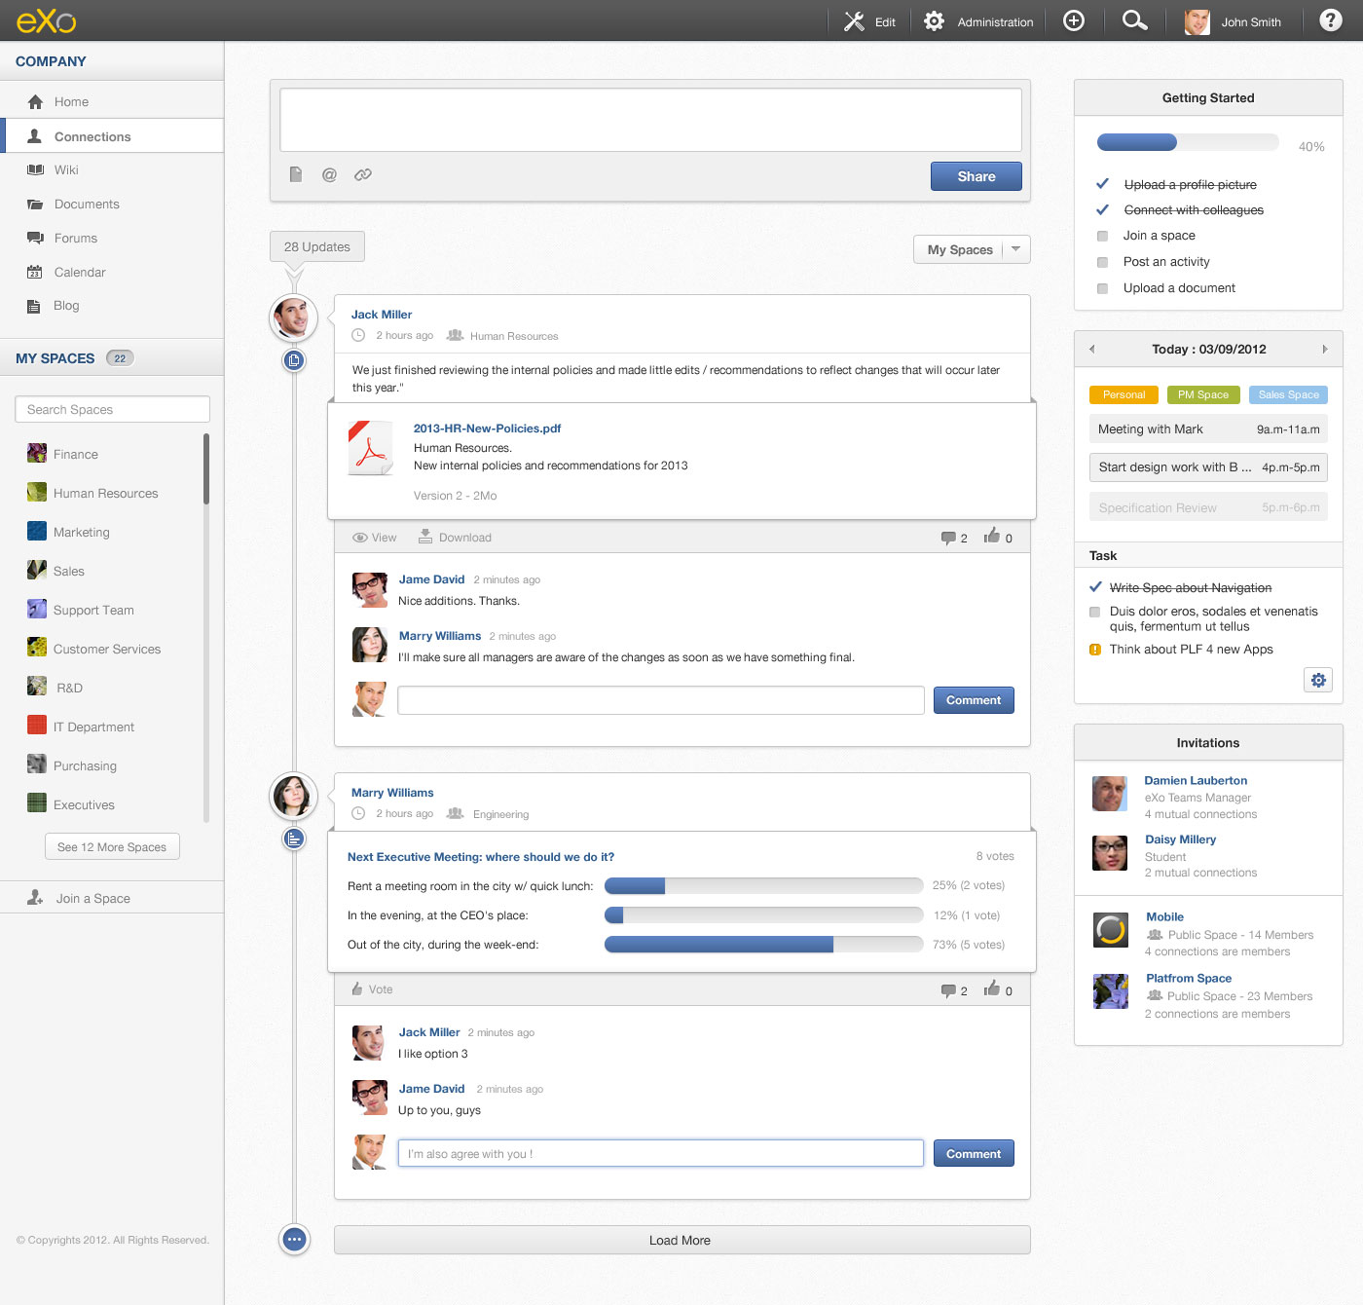
What is eXo Platform?
eXo Platform is an open source social collaboration software solution designed for the Enterprise.
It is full featured, standard based, extensible and has an amazing design.

Slide 4



Why an Enterprise Social Platform
Social is everywhere
Social is enterprise-ready
Social is available

Slide 5
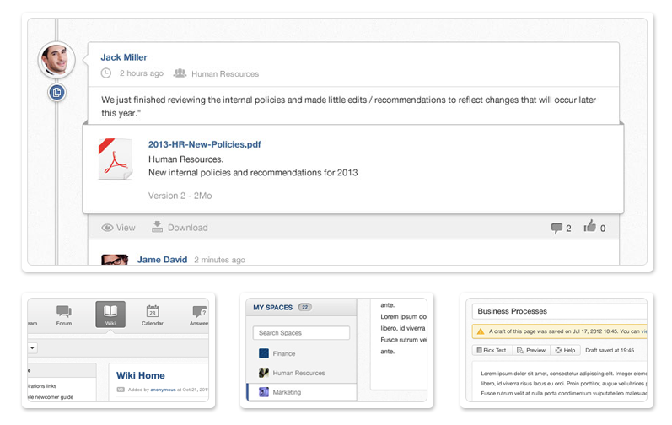
Solution
Build a Social Intranet

Slide 6

Solution
Build Social Websites
v

Slide 7
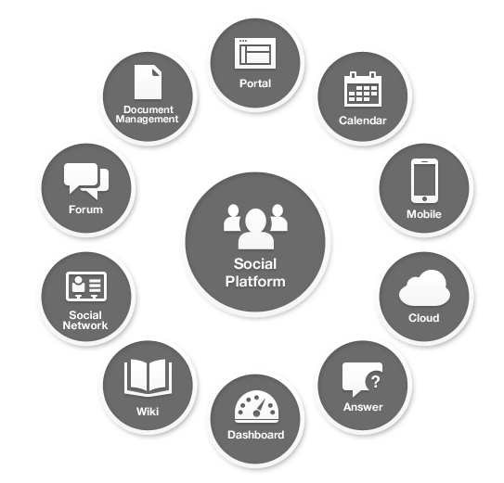
Features
All in a Single Platform
Footer

Slide 8
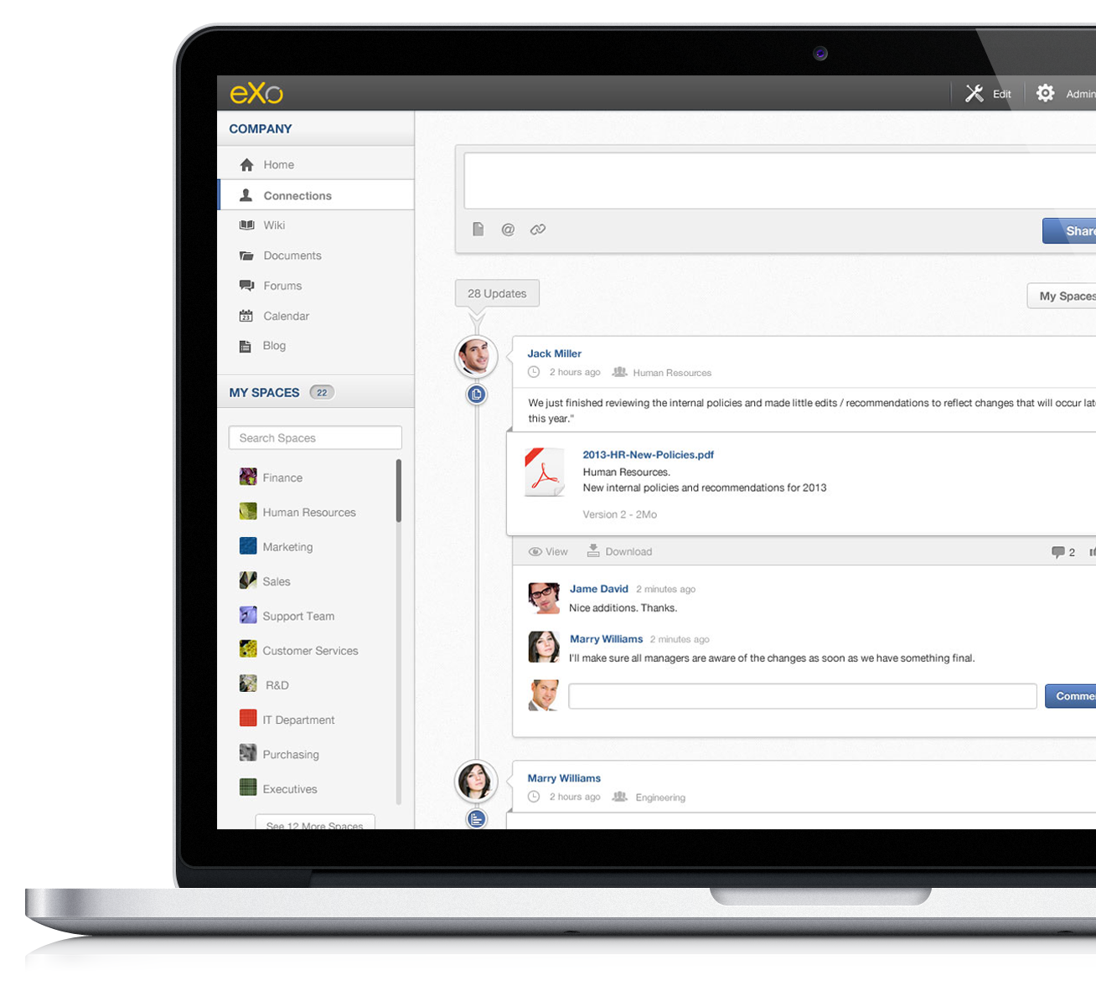
Features
Social Features
User profiles: Profiles let users personalize their avatar picture, their job title, contact details, skills and background. All profiles are searchable through a centralized directory of people.
Connections: Build your network by connecting to other people. You can track their activity through their activity streams. New connections are suggested automatically.
Activity Streams: Follow what your connections are sharing, such as links to documents or just moods. Follow team activities. All built-in apps are nicely integrated to update the activity streams of important things like events, changes to documents, new posts, etc...

Slide 9
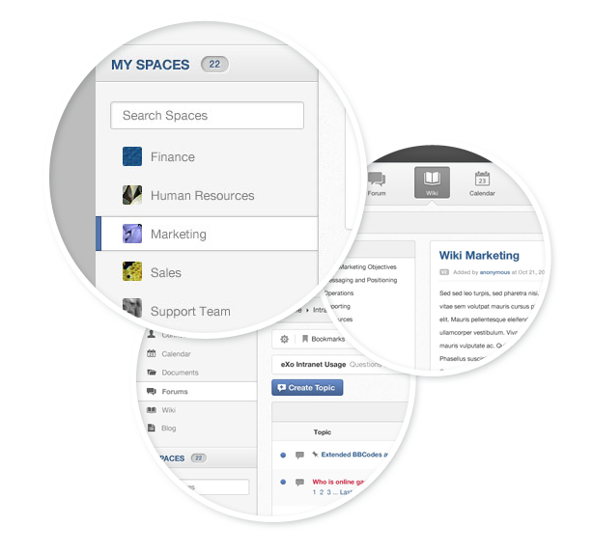
Features
Collaborative
Spaces: Create collaboration workspaces for teams or projects where you can share documents, tasks, events, wikis and more. Spaces can be open or closed, private or public and space administrators can manage members and the applications that are available.
Wikis: Wikis are the most unconstrained way to create content for everybody. Build documentation, a knowledge base or procedures super easily with a powerful enterprise wiki that has templates, WYSIWYG, search, cross-linking and more.
Forums: Bulletin boards are a classic discussion tool, which are very popular with communities. Our full-featured forum app has all you need, such as moderation, permissions, polls, notifications, locking, pruning, bans and search.

Slide 10
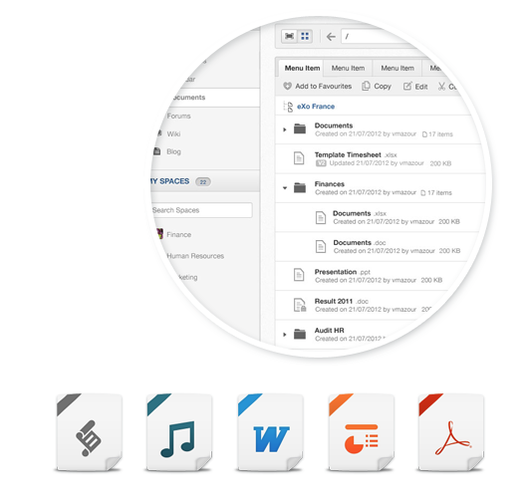
Features
Content
Documents: Upload files easily, preview them, share them and edit them remotely via WEBDAV. Advanced document management capabilities are available such as versioning, metadata, advanced search and digital asset management.
Websites: Build content types and site structure online. A powerful back office lets you classify, search and publish content very easily. You can build an accessible website.
Unified Search (soon): Search any type of content using a single interface, including documents, events, tasks, posts and articles. Any content can be found with the clear and powerful search application. A quick search-ahead helper field shows the most relevant results and a more advanced search with advanced filtering lets you go further.

Slide 11
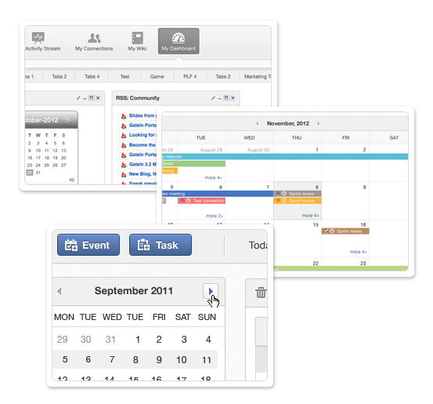
Features
Productivity
Dashboards: Each user has their own customizable dashboard. Gadgets help to track metrics, feeds, status and analytics. The product has a large set of gadgets but you can also install any open social gadget. A large set of gadgets are also available online. The dashboard is available through the mobile applications.
Calendars: Never miss anything with our impressive multi-calendar application. Day, week and month views are available, of course, but it also manages reminders, invitations and free/busy time. Team calendars are managed in spaces and you can also share your calendars individually.
Tasks: Capture work items super easily as tasks. Tasks can be created from anywhere, anytime. They can be scheduled in your calendar and reminders will be sent to you. You can also track other people’s tasks via activity streams.

Slide 12
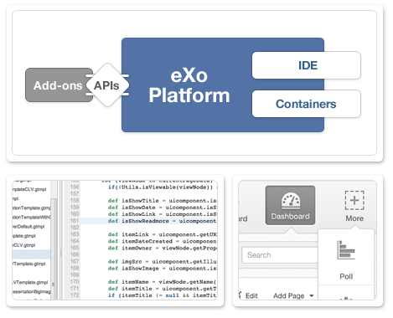
Features
Extensibility
Applications containers: Deploy your own apps besides the built-in ones inside our standardized runtime portlet and gadget containers.
APIs: Standard APIs such as JCR or CMIS are complemented by a set of APIs to program against your organization model, spaces, activity streams, polls, posts, wikis and more.
Web IDE: Develop gadgets and REST services and deploy them in the platform through our powerful development environment.

Slide 13
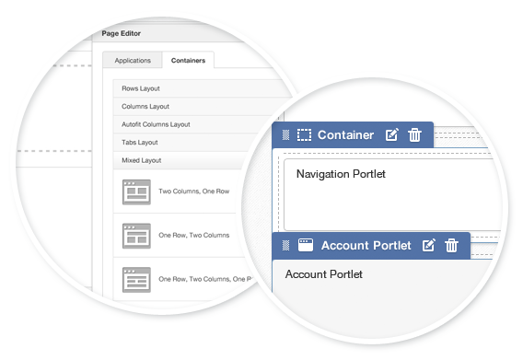
Features
Enterprise Portal
Portal Framework: Based on the open source GateIn portal framework, eXo Platform has all the flexibility of an enterprise portal framework: portlets (JSR 286, WSRP), gadgets (OpenSocial) and content can be aggregated in a secured and customizable way.
UI Composer: A powerful graphical user interface composer that requires no technical skills allows to compose portal pages by picking up a layout and pulling in apps and content.
UXP: eXo Platform is featured in Gartner's Magic Quadrant for Horizontal Portal Products 2012 as a User eXperience Platform.

Slide 14
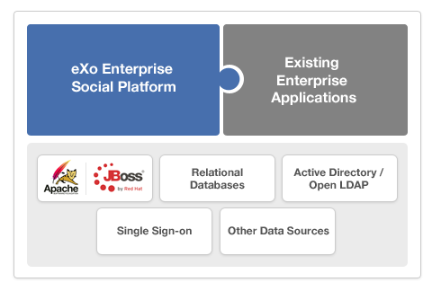
Features
Enterprise Integration
Enterprise directory: If you already manage user accounts in an enterprise directory such as Active Directory or Open LDAP, eXo Platform can integrate with it for authentication or user profile attributes. Advanced capabilities even let you use groups in eXo or leverage several directories at the same time.
Single Sign On: eXo Platform works with your single sign-on system thank to its support of solutions like CAS, JOSSO and OpenSSO, and its support of standards like SAML.
Standards: eXo Platform is built using enterprise-standard tools such as Java EE, WEBDAV, CalDAV, JCR and CMIS to maximize its interoperability within the applications already available within the information system.

Slide 15

Features
Enterprise Portal
Multi-tenancy: Unique multi-tenancy support allows eXo Platform to host several tenants in the same eXo instance. Tenants coexist in the same JVM but are strictly isolated. Each tenant’s data is in its own database.
Elasticity: eXo cloud infrastructure management lets you install eXo in an IaaS such as Amazon or Openstack. The cloud controller constantly monitors the load on your infrastructure and automatically adjusts the number of servers so that you can continue to deliver an optimal service in a cost-effective manner.

Slide 16
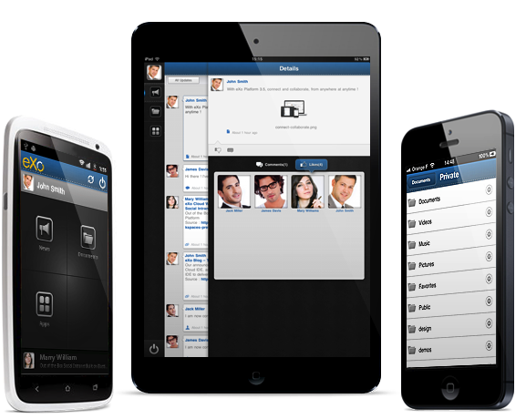

Mobile
v
Connect and collaborate on the go.
Native iPhone, iPad, and Android apps integrate easily and securely with your eXo instance.
Follow the latest updates from your colleagues and groups, interact with your personal dashboards, browse and edit your files, and more – at any time, from anywhere.

Slide 17
Pricing
Express Edition
25 Users Plan
Plan Features
$
4.0
An Annual Subscription of $1200
Ready to use Social Intranet Solution
Website Templates to build your own
✓Access to Customer Portal
✓Bugfix releases
per User
per Month
50 Users Plan
Plan Features
$
3.7
An Annual Subscription of $2200
Ready to use Social Intranet Solution
Website Templates to build your own
✓Certified Production-ready
✓Bugfix releases
per User
per Month
100 Users Plan
Plan Features
$
3.3
An Annual Subscription of $4000
Ready to use Social Intranet Solution
Website Templates to build your own
✓Access to Customer Portal
✓Bugfix releases
per User
per Month
500 Users Plan
Plan Features
$
1.3
An Annual Subscription of $8000
Ready to use Social Intranet Solution
Website Templates to build your own
✓Access to Customer Portal
✓Bugfix releases
per User
per Month

Slide 18
Pricing
Enterprise Edition
Enterprise Plan
Plan Features
Unlimited users
Annual Subscription. Request a Quote.
Ready to use Social Intranet Solution
Website Templates to build your own
Development Environment
Higher Availability and Scalability
Enterprise Integration
✓Access to Customer Portal
✓Bugfix releases
✓Professional Support
✓Security Advisory
✓Emergency Fixes
Contact US

Slide 19

Our Customers

Slide 20
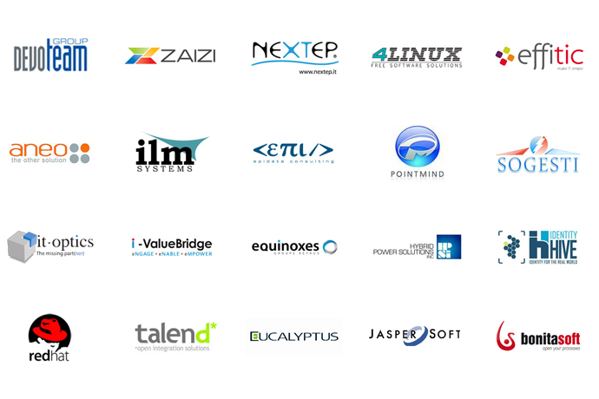
Our Partners
Our global network of resellers and systems integrator partners deliver enterprise-grade services & support to ensure the success of customer projects.
To find a certified eXo partners, visit our partner catalog.
System Integrators
Resellers and Distributors
Service and Cloud Providers
ISV/OEM

Slide 21
Partnership – S.I. Tracks

Slide 22
Partnership – S.I. Tracks

Slide 23
Training Courses
 | Fundamentals (2 days) | Developer (3 days) | Adminstrator (2 days)
Course Objectives | Introduce the key benefits and features of eXo products | Customize eXo to support POCs & deployments | Manage, support & maintain eXo in production
Student Profile | Users, consultants, project managers, portal administrators, webmasters | System engineers with >1 year Java experience | System engineers with >4 years of Java experience
Prerequisite | - | eXo Fundamentals | eXo Developer
Certification |  | ✓ | ✓
Public

Slide 24
Professional Services
Evaluation Programs
Quick Start Program
Training
Curriculum designed for admins, developers & architects
Certification
Consulting
POCs
Custom solutions
Migration

Slide 25
Questions and Answers
www.exoplatform.com

