Slide 1
Customization
Notes:
1

Slide 2
Table of Contents
User ACL
Portal Init Files
Internationalization
Skins
Notes:
2

Slide 3
UserACL
3
Notes:
3
3

Slide 4
UserACL
…\webapps\portal\WEB-INF\conf\portal\portal-configuration.xml
NewPortalConfigListener : Default configuration of new portals
default.portal : Default portal. Cannot be deleted.
Portal configuration :
portal.configuration
group.configuration
site.templates.location
page.templates.location
user.configuration

Slide 5
UserACL
Allows to manage portal functionalities permissions
super.user: The super user has all the rights on the platform, this user is referred to as root.
portal.administrator.groups: Any member of those groups are considered administrators. Default configuration is /platform/administrators.
portal.administrator.mstype: Any user with that membership type would be considered administrator or the associated group. Default configuration is manager.
portal.creator.groups: This list defines all groups that will be able to manage the different portals. Members of this group also have the permission to create new portals. The format is membership:/group/subgroup.

Slide 6
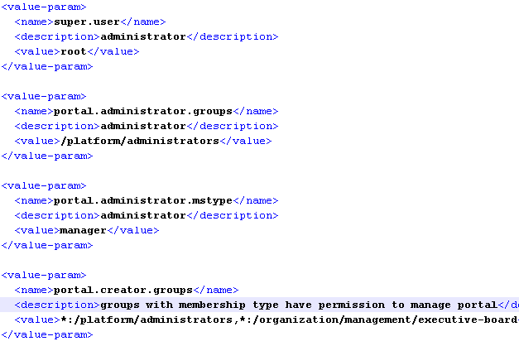
UserACL
…\webapps\portal\WEB-INF\conf\portal\portal-configuration.xml

Slide 7
UserACL
Allows to manage portal functionalities permissions
navigation.creator.membership.type: Defines the membership type of group managers. The group managers have the permission to create and edit group pages and they can modify the group navigation.
guests.group: Any anonymous user automatically becomes a member of this group when they enter the public pages.
mandatory.groups: Groups that can't be deleted.
mandatory.mstypes: Membership types that can't be deleted.
…\webapps\portal\WEB-INF\conf\portal\portal-configuration.xml

Slide 8
Portal Init Files
8
Notes:
8
8

Slide 9
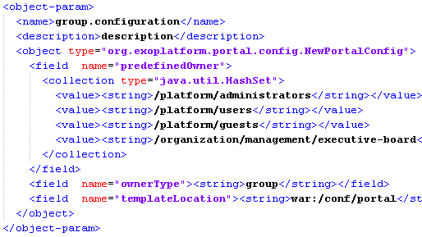
UserPortalConfigService
…\webapps\portal\WEB-INF\conf\portal\portal-configuration.xml

Slide 10
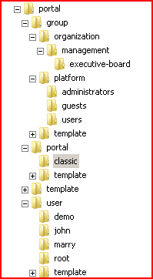
Configuration Types
Hierarchy is under WEB-INF/conf/portal
Portal Elements
portal/${portalName}
group/${groupPath}
user/${username}
Portal, Group and User Templates
portal/template/{templateName}
portal.xml, navigation.xml, pages.xml

Slide 11

portal.xml
Portal layout
portal-name : Portal name
locale : Default portal locale
access-permission : who can see ?
edit-permission : who can edit ?
creator : ‘owner’ user
portal-layout : Portal layout
application : application
page-body : position of the page (cf pages.xml)

Slide 12
navigation.xml
Navigation tree
owner-type : {portal,group,user}
owner-id : owner id
priority: aggregation priority
node : navigation node, can contain children
uri : to identify a page :
/portal/[private|public]/${portalName}/${uri}
name : navigation name
label : navigation label (for navigation menu)
page-reference : see also page-id in pages.xml

Slide 13
pages.xml
Pages list
page-id : $type::$owner::$pageName
owner-type : owner type = {portal,group,user}
owner-id : owner name
name : name (technical) of the page
title : Title of the page
access-permissions : Who can see this page ?
edit-permission : Who can edit this page ?

Slide 14
Application-Registry
Configuration for portlets and gadgets
Ordered by categories
accessPermissions
applicationName
displayName
Exactly the same information, that you enter in the interface
…\webapps\portal\WEB-INF\conf\portal\application-registry-configuration.xml

Slide 15
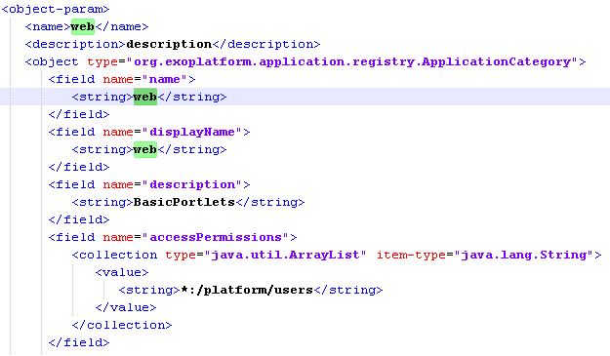
Application-Registry

Slide 16
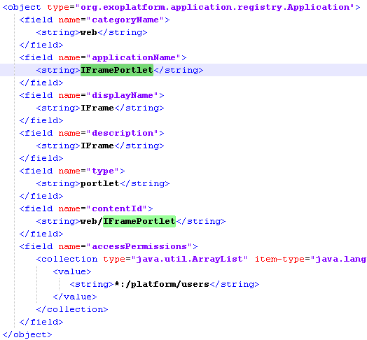
Application-Registry

Slide 17
Exercise – Portal Init Config
Discover
…\webapps\platform-extension\WEB-INF\conf\portal\application-registry-configuration.xml
…webapp\platform-extension\WEB-INF\conf\portal\portal-configuration.xml (userACL, PortalConfiguration)
the structure of sub-folders of …\webapps\platform-extension\WEB-INF\conf\portal :
Discover the files for navigation, pages, portal layout for a portal
Discover the same files for a group
Discover the portal layout for a new group
Discover the initial files for a new user.

Slide 18
Exercise – Custom Portal
Project: …/exercises/site-creation
You find a maven structure to generate an activation jar and a war which is an extension that creates a site, groups, internationalization and templates.
Scrutinize the extension.
Compile, deploy the extension. Restart and test.
Do not forget to add your extension to tomcat\conf\Catalina\localhost

Slide 19
Internationalization Service
19
Notes:
19
19

Slide 20
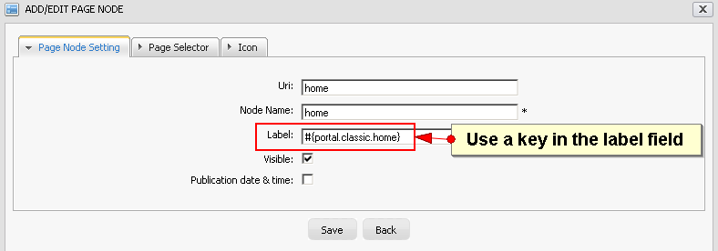
Navigation Internationalisation
Internationalisation
Uses keys in the label fields
Format: #{key}
Notes:
20

Slide 21
Navigation Internationalisation
Internationalisation
The corresponding keys are in properties files.
For example, the keys for Italian for the classic site are in: ...\webapps\portal\WEB-INF\classes\locale\navigation\portal\classic_it.properties
Example Content:
portal.classic.home=Home
portal.classic.sitemap=Mappa del Sito
portal.classic.groupnavigation=Navigazione dei Gruppi
portal.classic.portalnavigation=Navigazione del Portale
portal.classic.register=Registrazione
portal.classic.webexplorer=Web Explorer
UIAddNewApplication.label.AddApplication = Aggiungi Applicazione
Notes:
21

Slide 22

Internationalization
Keywords
Only external – reloaded at each startup
Resources are located in : WEB-INF/conf/classes/locale (These java resources are part of the unified classloader.)
.properties and .xml files
Translation
Portal and group navigation
Common terms in ...\webapps\portal\WEB-INF\classes\locale\portal
Notes:
22
22

Slide 23
Internationalization
Keywords
ResourceBundleService
Definition: ...\webapps\portal\WEB-INF\conf\common\common-configuration.xml
Init.resources: List of all resource files.
portal.resource.names: Theses files are merged into one file, the properties are generally available. Be careful not to create name conflicts.
classpath.resources: deprecated, because now all resources are reloaded
Notes:
23
23

Slide 24
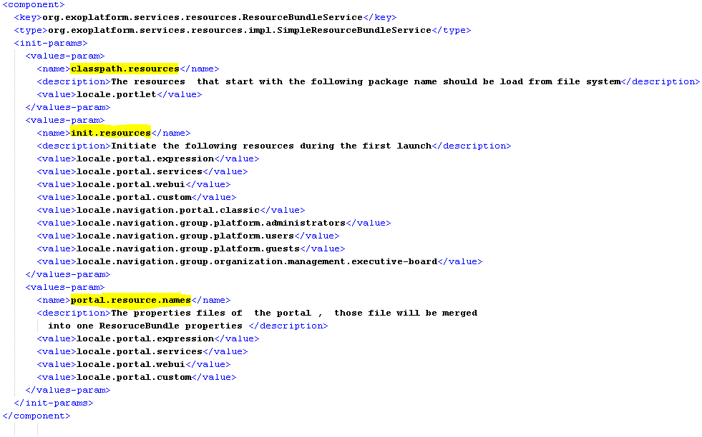
Internationalization
Notes:
24
24

Slide 25

Internationalization
Navigation Properties
Distinguishes portal, group and user navigation.
Special prefix: “locale.navigation”, followed by
Type of navigation (portal, group or user)
An id (portal name, group name)
Notes:
25
25

Slide 26

Internationalization
Portlets and WebUI Components
...\webapps\formgenerator\WEB-INF\classes\locale\portlet\FormGeneratorPortlet
classpath.resources
Notes:
26
26

Slide 27
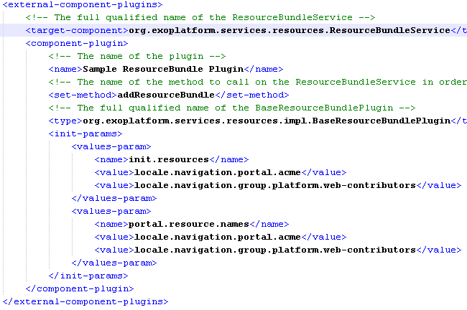
Plugin
Notes:
27
27

Slide 28
Exercise: Internationalization
Copy the empty extension and create from that your custom i18n-extension.
1. Correct wrong translations
In your custom extension, override a *.properties file in order to correct some translations. Override the file …\webapps\acme-website\WEB-INF\classes\locale\navigation\group\platform\web-contributors_en.xml
2. New language
In your custom extension add Swahili. Provide …\webapps\acme-website\WEB-INF\classes\locale\navigation\portal\acme_en.xml for that Swahili.
3. New group (Extra for experts)
For the group “platform/training” create some navigation nodes with some pages. Use a key for the navigation node labels (#myTrainingGroupPage).
Create a properties file for the translations.
Notes:
28
28

Slide 29
Skins
29
Notes:
29
29

Slide 30
Skins
Portal Skin
The portal skin contains the css styles for the portal and its various UI components. This should include all the UI components except for the window decorators and portlet specific styles.
Window Styles – Decoration – only 1% need this
The CSS styles associated with the portlet window decorators. The window decorators contain the control buttons and boarders surrounding each portlet. Individual portlets can have their own window decorator selected, or be rendered without one.
Notes:
30
30

Slide 31
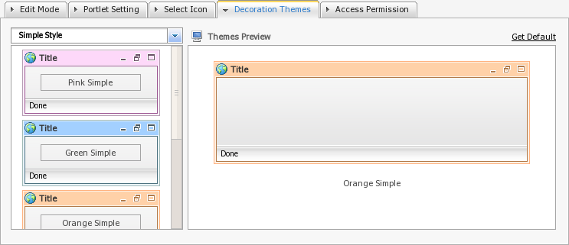
Window Styles - Decorations
Notes:
31
31

Slide 32
Portlet Skins
The portlet skins effect how portlets are rendered on the page. There are two main ways this can be affected:
Portlet Specification CSS Classes
The portlet specification defines a set of css classes that should be available to portlets. GateIn 3.1 provides these classes as part of the portal skin. This allows each portal skin to define its own look and feel for these default values. ../webapps/eXoResources/skin/Portlet/Stylesheet.css
Portlet Skins
GateIn 3.1 provides a means for portlet css files to be loaded based on the current portal skin. This allows a portlet to provide different css styles to better match the current portal look and feel. Portlet skins provide a much more customizable css experience than just using the portlet specification css classes.
Notes:
32
32

Slide 33
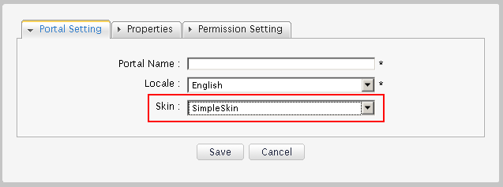
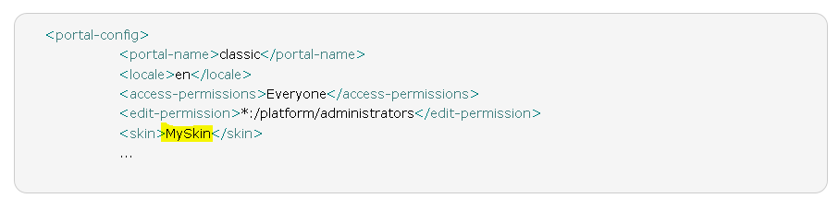
Portal Skin Configuration
Notes:
33
33

Slide 34
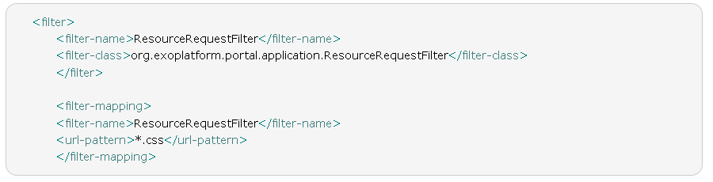
ResourceRequestFilter
If you create your own portal skin, you need
To create an extension
Add a ResourceRequestFilter for css to the web.xml
Notes:
34
34

Slide 35
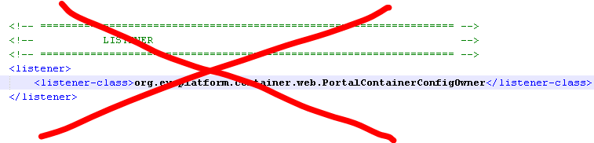
ResourceRequestFilter
Resource webapps need their own URL they are not part of the UnifiedServletContext.
Examples: http://localhost:8080/eXoWCMResources/javascript/eXo/wcm/frontoffice/public/Breadcrumb.js http://localhost:8080/eXoResources/skin/DefaultSkin/portal/webui/component/control/UIWorkspace/Stylesheet-lt.css
You add your webapp to the PortalContainer, but you do not add a PortalContainerConfigOwner listener in web.xml.
Notes:
35
35

Slide 36
CSS Debugging
By default, CSS files are cached and their imports are merged into a single CSS file at the server side.
This reduces the number of HTTP requests from the browser to the server.
The optimization code is quite simple as all the CSS files are parsed at the server startup time and all the @import and url(...) references are rewritten to support a single flat file.
The result is stored in a cache directly used from the ResourceRequestFilter.
Although the optimization is useful for a production environments, it may be easier to deactivate this optimization while debugging stylesheets.
System Property : -Dexo.product.developing=true
This property is used in gatein-dev.sh
Notes:
36
36

Slide 37
Exercise – Skins
Open …/exercise/skin/1-project\war\src\main\webapp\skin\SimpleSkin\UIPortalApplicationSkin.css and add this line: #UIPortalApplication .UIWorkingWorkspace {width:auto !important;}
Build it, copy the config jar and the war file, and restart eXo.
Switch acme to SimpleSkin, logout and login. Do you see the difference?
You can access http://localhost:8080/bike-skin-resources/skin/SimpleSkin/UIPortalApplicationSkin-lt.css
Notes:
37
37

Slide 38
Customization
Notes:
38

