Slide 1
eXo SysAdmin Training
JCR - CRaSH
Notes:
1

Slide 2
Table of Contents
JCR Fundamentals
CRaSH Introduction
CRaSH Configuration
CRaSH Commands
Exercises

Slide 3
JCR Introduction
3
Notes:
3

Slide 4
Introduction
Java Content Repository (JSR 170)‏
Connected to a SQL database
Used like a file system in eXo applications
Hierarchical Structure
Integrity Constraints
Advanced Features: Queries, locks, versioning‏

Slide 5
JCR dans eXo
eXo uses JCR for all persistant data:
Portal Configuration (layout, pages, navigations, preferences...)‏
DMS and CMS data
Other applications (CS, KS, Social...)‏
Custom extensions can also use the JCR

Slide 6

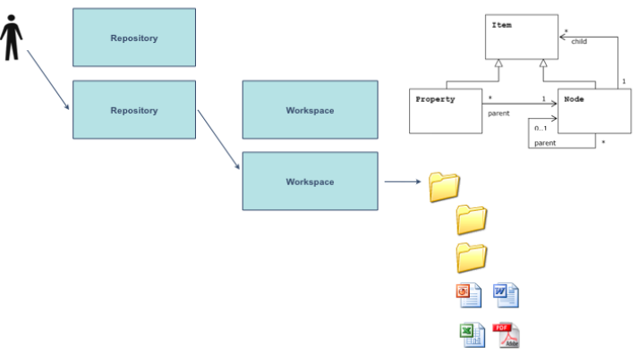
Concepts JCR
One or several repositories (by default 1 repository called “repository”)
Each repository is split in several workspaces
Each workspace has a node tree with a root node, child nodes and leaf nodes. Each node can have properties.

Slide 7
Concepts JCR

Slide 8
Exercise: JCR
Content Explorer
Connect to an eXo instance http://localhost:8080/portal/private/acme/siteExplorer
Login as user john (password gtn)
On the left hand site, open acme/documents and test the pdf document
Test the button “Node Properties” in the “system” tab
Webdav Access
Open a webdav client (or a web browser) and connect to http://localhost:8080/portal/rest/jcr/repository/collaboration/
“collaboration” is the name of the workspace
Go to the node /sites content/live/acme and open the pdf document
Search for node properties (the webdav protocol does not allow to see them)
Notes:
8

Slide 9
CRaSH Introduction
9
Notes:
9

Slide 10
CRaSH
What
A shell for Java Content Repository
Considers the JCR tree as its file system
Basic administration
http://code.google.com/p/crsh
Notes:
10

Slide 11

CRaSH
How
A webapp included in eXo Platform
Written as a Groovy script
Easy to add new commands
Found in WEB-INF/groovy/commands
Annotated with Args4j
Describe switches and arguments
You can extend the language
Notes:
11

Slide 12
CRaSH
Telnet
SSH
Connectors
Shell Engine
JCR
Connector
SCP
Commands
Args4j
Groovy
Notes:
12

Slide 13
Documentation
http://crsh.googlecode.com
http://crsh.googlecode.com/svn/doc/1.0.0-beta18/index.html

Slide 14
CRaSH Configuration
14
Notes:
14

Slide 15
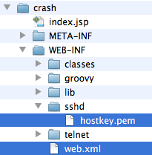
CRaSH Configuration
Configuration
All configuration in /WEB-INF/web.xml
The SSH server key is stored in /WEB-INF/sshd/hostkey.pem
Notes:
15

Slide 16

CRaSH Configuration
Port configuration
Telnet connection is configured for the port 5000, SSH on port 2000
Remove access
To remove the telnet access, remove or comment the listeners from web.xml:
Notes:
16

Slide 17

CRaSH Configuration
SSH server key configuration
The key can be changed by replacing the file WEB-INF/sshd/hostkey.pem.
Alternatively you can configure the server to use an external file by using the ssh.keypath parameter in web.xml. Uncomment the XML section and change the path to the key file.
Notes:
17

Slide 18
CRaSH Commands
18
Notes:
18

Slide 19
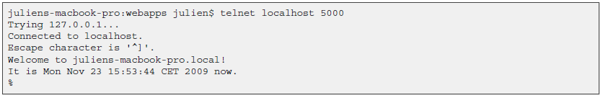
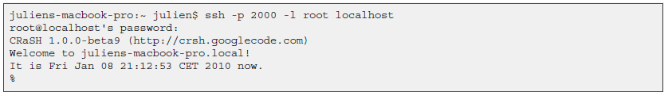
CRaSH How-to
Telnet connection is done on port 5000
SSH connection is done on port 2000 with the password crash :
Notes:
19

Slide 20
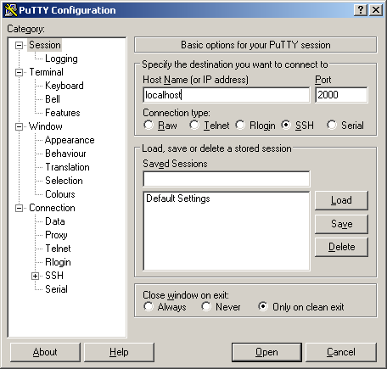
CRaSH How-to
PuTTY:
Notes:
20

Slide 21
Base Commands
Commands
Connect to the container “portal” to the workspace “portal-system”
Like Unix ls, cp, mv, rm
ls list not only folder contents but also details of a single node.
SQL select command for queries on the JCR (-o for offset and -l for length)
“bye” command in order to disconnect
Notes:
21

Slide 22
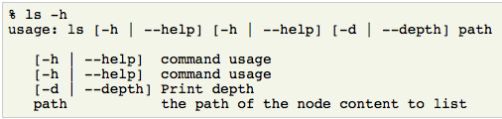
Help Commands
Help and Man
--help -h : Lists the command options. Try “cd -h” or “mv -h”
man : Gives a complete manual. Try “man select”
Notes:
22

Slide 23
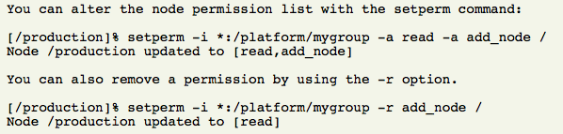
Permission Modification
Permissions
Rights: read, add_node, set_property, remove
Example of permissions, listing role:group and the right : [*:/platform/administrators read,*:/platform/administrators add_node,*:/platform/administrators set_property,*:/platform/administrators remove]
setperm: Modify the permissions for any node
Notes:
23

Slide 24
Session Commands
Commit and rollback
You are working in a CRaSH session, that means that the changes you did in the session are not visible outside of your session!
commit: saves the changes you did in the current session. A node can be provided to save the state of the this nodes and its descendants only. Otherwise they are not visible outside of the current CRaSH session!
rollback: in order to rollback the changes of the current session. A node can be provided to rollback the state of the this nodes and its descendants only.
Notes:
24

Slide 25
Pipe and Distribution Operators
Operators for experts
“|” Pipe Operator: streams a command output stream to a command input stream Example: select * from exo:article | addmixin mix:referenceable
“+” Distributor Operator: Merging(“distributing”) two streams into one stream After the pipe Before the pipe
Be careful when using these operators!
Notes:
25

Slide 26
Telnet Exporting and Importing
Export – Import
It is possible to export a node. The node type is nt:file. The file is in the root folder of the same workspace. Then it is possible to access the file using webdav.
Import, the other way around
Notes:
26

Slide 27
SCP Export and Import
Export
The following command will export the node /gadgets in the repository portal-system of the portal container portal:
scp -P 2000 root@localhost:portal:portal-system:/production/app:gadgets .
pscp -scp -P 2000 root@localhost:portal:portal-system:/production/app:gadgets D:\eXo\export.xml
The node will be exported as app_gadgets.xml.
Note that the portal container name is used: “portal”. If you do omit it, then the root container will be used. The exported file format use the JCR system view.
Import
scp -P 2000 app_gadgets.xml root@localhost:portal:portal-system/production/app:gadgets
Notes:
27

Slide 28
CRaSH Exercises
28
Notes:
28

Slide 29
Exercise 1: CRaSH command
Connect to CRaSH by ssh (port 2000) or telnet (port 5000)
Type in your shell: connect -c portal -u root -p gtn collaboration
Test the commands: ls, cd, mv, rm,
Export and import a node. Is it document or system view? Import the node 5 times. What happens?
Don’t do this: Add a mix:versionable mixin to an existing node. (syntax: addmixin . mix:versionable)
Test 5 different select use cases as seen in http://wiki.exoplatform.org/xwiki/bin/view/JCR/JCR+Query+Usecases.
For experts: Create a new command and test it
Notes:
29

Slide 30
Exercise 2: CRaSH SCP
login as root/gtn
Create a new site called “mysite”
The configuration of your site is in the workspace portal-system at the path: /production/mop:workspace/mop:portalsites/mop:mysite
Make an SCP export of your site and import using SCP it on a different server
Export: scp -P 2000 root@localhost:portal:portal-system:/production/mop:workspace/mop:portalsites/mop:mysite .
Import: scp -P 2000 mop_mysite.xml root@localhost:portal:portal-system:/production/mop:workspace/mop:portalsites
Experts: Also export/import the content of mysite (articles etc.) : workspace collaboration, path /sites content/live/mysite
CRaSH Documentation: http://crsh.googlecode.com/svn/doc/1.0.0-beta18/html/index.html
Notes:
30

Slide 31
eXo SysAdmin Training
Notes:
31

