Slide 1
eXo Knowledge

Slide 2
eXo Forum

Slide 3
eXo Forum
Administrator definition:
Defines who is administrator (of all portlet instances in all sites)
Definition by login, group or membership
RolesRulesPlugin defined in ...webapps\portal\WEB-INF\conf\ks\ks-plugins-configuration.xml, extract:
<value-param>
<name>role</name>
<value>ADMIN</value> <!--only ADMIN is possible here -->
</value-param>
<values-param>
<name>rules</name>
<value>root</value>
<value>*:/platform/administrators</value>
<value>manager:/platform/users</value>
...

Slide 4
eXo Forum
Contact Provider Component:
When opening the user profile, the data can be provided by different ways:
Defined in ...webapps\ks-extension\WEB-INF\ks-extension\ks\profile-configuration.xml
<component>
<key>org.exoplatform.ks.common.user.ContactProvider</key>
<type>org.exoplatform.ks.common.user.DefaultContactProvider</type>
</component>
Alternatives providers:
  CSContactProvider
  PersonalProfileContactProvider
  BusinessProfileContactProvider
  Detailed wiki article: http://wiki.exoplatform.org/xwiki/bin/view/KS/Profile+Provider+Configuration

Slide 5
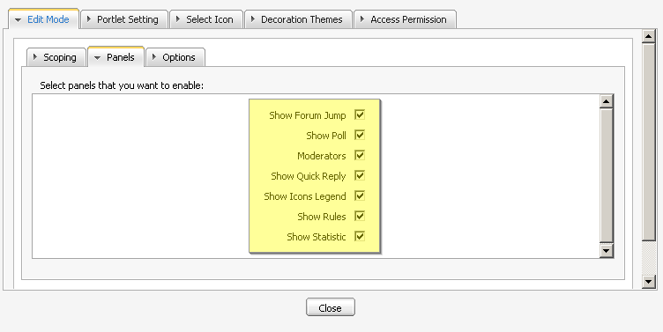
eXo Forum
Composition of the Forum Portlet:
The forum portlet contains smaller portlets, you can choose to show those small interfaces in the forum settings:
Show Forum, Jump, Show Poll, Moderators, Show Quick Reply, Show Icons Legend, Show Rules, Show Statistic
The forum portlet
accesses in fact the
UIComponent of each
portlet.

Slide 6
eXo Forum
Customization
Each panel contains a groovy template (gtmpl).
This template can be replaced by your own implementation.
1. Find the UIComponent‘s groovy template
...\webapps\forum\templates\forum\webui\popup\UIQuickReplyForm.gtmpl
Create your

Slide 7
eXo Forum
Forum real world project:
Get a idea of the goal structure before you start
What categories and which names for theses categories?
Which forums in each category and their names?
Who will be a moderator of each single category?
For each forum, which email addresses shall be notified at new each new topic or new message?
Which forums shall be moderated?
Which groups have write and view access to each forum?
Do you want to have all forums in on portlet instance or in several instances?

Slide 8
eXo FAQ
FAQ:
RolesRulesPlugin
ContactProvider
Modify the template in the portlet’s setting
http://wiki.exoplatform.org/xwiki/bin/view/KS/Initialization+FAQ+Plugin+Configuration

Slide 9
eXo Knowledge Suite
Q & A

