Slide 1
eXo Content for Developers
Notes:
1

Slide 2
Table of Content
Document Template Syntax
Mixins
Interceptors
Content List Portlet Templates
Action Scripts and Dialogs
Notes:
2

Slide 3
Dialog Template
Notes:
3

Slide 4
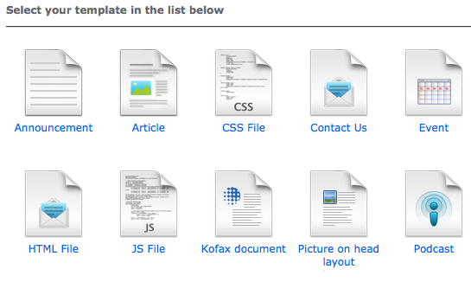
Document Types
Document type are node type which have associated dialog and view templates.
Notes:
4

Slide 5
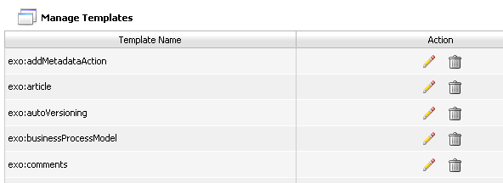
Groovy Templates
Groovy : script language for the JVM
http://groovy.codehaus.org
Java compliant syntax
GTMPL : equivalent of Java with JSP but with Groovy
No taglibs
5

Slide 6
Groovy Templates
Scriptlets :
<%String portalURI = Util.getPortalRequestContext().getPortalURI();%>
<%=variable %> ou $variable
<a href=”<%=portalURI%>”>
<href="$portalURI">
Implicit objects:
uicomponent : UIComponent linked to this template
_ctx : Binding context WebuiBindingContext
6

Slide 7
Groovy Template
Get the label from a resource bundle
<%=_ctx.appRes("key.from.resourcebundle") %>
You can access the public methods of the UIComponent class
GTMPL Documentation :
http://groovy.codehaus.org/Groovy+Templates
7

Slide 8
View Templates
View Template for a specific NodeType
File Explorer = UIDocumentInfo
Content Browser : UIDocumentDetail
ECMViewComponent:
public Node getNode()‏
public List<Node> getRelations()‏
public List<Node> getAttachments()‏
public String getRssLink()‏
public String getLanguage()
public Object getComponentInstanceOfType(String className)
public String getImage(Node node)‏
public String getPortalName()‏
public String getRepository()‏
public String getWorkspaceName()‏
public List<Node> getComments()
public String getDownloadLink(Node node)‏
8

Slide 9
View Templates
<%
def node = uicomponent.getNode() ;
SimpleDateFormat dateFormat = new SimpleDateFormat() ;
%>
<div class="SampleBG">
<label class="text"><%=_ctx.appRes("Sample.view.label.date")%>: </label>
<span class="text">
<%if(node.hasProperty("exo:date")) {
dateFormat.applyPattern("MMMMM dd yyyy") ;
%>
<%=dateFormat.format(node.getProperty("exo:date").getDate().getTime())%>
<%}%>
</span>
</div>
<% if (node.hasNode("exo:image")) {
imgSrc = uicomponent.getImage(node) ;
%>
<div style= "width: 95%; height: 160px ; text-align: center; padding: 5px;">
<image src="$imgSrc" width="250" height="150"/>
</div>
<% } %>
9

Slide 10
Dialog Templates
Form directive (mandatory):
<% uiform.begin() %>
...
<% uiform.end() %>
Form action buttons (mandatory):
<% for(action in uicomponent.getActions()) {
String link = uicomponent.event(action) ;
%>
<a href="$link" >$action</a>
<%}%>
10

Slide 11
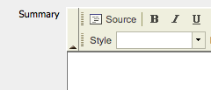
Dialog Templates
Input fields:
Many types : Text, Wysiwyg, Upload, Select,...
1 input = 1 node property
With a common model:
addXYZField(String name, String label, String [] parameters)
Example: addTextField("title", "Titre",["jcrPath=/node/exo:title"])‏
11

Slide 12
Node Input
The node name is mandatory
String nameArgs[] = ["jcrPath=/node", "mixintype=mix:votable", "editable=if-null", "validate=name,empty"];
uicomponent.addTextField("name", nameArgs )
jcrPath : /node represents the target jcr node
mixintype : mixin list to apply on this node
editable : readonly/rw input. Possible values: true, false, if-null
validate : Validators : name, email, number, empty, datetime or customized validators
nodetype : the target node type
12

Slide 13
Text Input
String [ ] titleArgs = ["jcrPath=/node/exo:title", "validate=empty"];
uicomponent.addTextField("title", titleArgs) ;
Possible Arguments:
jcrPath : The target path
editable : true|false|if-not-null
defaultValue : Predefined value
multiValues=true : is it a multi-values input
type=password : for password inputs
13

Slide 14
Common Arguments (Parameters)
With a common model:
addXYZField(String name, String label, String [] arguments)
jcrPath=/node/exo:title – The relative path inside the current node.
mixintype=mix:votable,mix:commentable,mix:i18n – The list of mixin types you want to initialize when creating the content.
multiValues=true – Show a multi-valued component. It only can be used with corresponding multi-valued properties.
visible=true
editable=if-null – The input will be editable only if the value of this parameter is if-null and the value of this input is null or blank.
“options=toolbar:CompleteWCM,height:'410px',noSanitization” – A comma-separated list of field-specific parameters.
14

Slide 15
Validators
A list of validators which are applied to the field. Possible values are: name, email, number, empty, null, datetime, length or a validator classes:
validate=empty,name
validate=org.exoplatform.webui.form.validator.StringLengthValidator
You can create your own validator class. An alternative to validator classes are interceptors.
Validators with parameters:
validate=empty,length(50;int)
The parameter type (“int”) is needed if the type is not String.
15

Slide 16
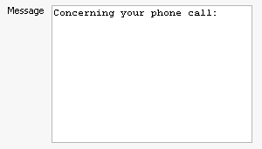
Textarea Input
String [ ] messageArgs = ["jcrPath=/node/exo:message", "validate=empty"];
uicomponent.addTextAreaField(“message", messageArgs) ;
defaultValues : predefined value
16

Slide 17
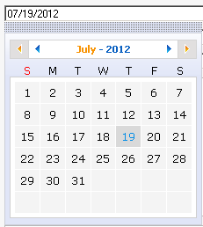
Calendar Input
String [] dateArgs = ["jcrPath=/node/exo:date", "validate=datetime"];
uicomponent.addCalendarField("date", dateArgs) ;
options=displaytime : Manage time
defaultValues : predefined value (MM/dd/yyyy) by default.
17

Slide 18

Upload Input
String [ ] imageArgs = ["jcrPath=/node/exo:image/jcr:data"];
uicomponent.addUploadField("image", imageArgs);
Example : exo:image is a node nt:resource :
<nodeType name="exo:sample"...
<childNodeDefinition name="exo:image" defaultPrimaryType="nt:resource"...
<nodeType name="nt:resource" primaryItemName="jcr:data" ...
<propertyDefinition name="jcr:data" requiredType="Binary"...
<propertyDefinition name="jcr:encoding" requiredType="String"...
<propertyDefinition name="jcr:lastModified" requiredType="Date"...
18

Slide 19

Select Input
String [ ] langArgs = ["jcrPath=/node/exo:language", "options=en,fr,es,de"];
uicomponent.addSelectBoxField(“language", langArgs) ;
options : Value list
script : groovy script to provide the list
scriptParams : groovy script parameters
19

Slide 20
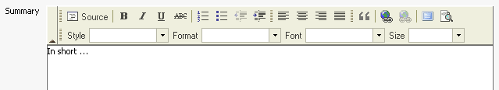
HTML Text Input
String [] summaryArgs = ["jcrPath=/node/exo:summary", "options=basic"];
uicomponent.addWYSIWYGField("summary", summaryArgs);
defaultValues : predefined value
options=basic|full : basic editor or full editor
20

Slide 21
Hidden Input
Often used to create sub nodes
String[ ] resource = ["jcrPath=/node/exo:image", "nodetype=nt:resource", "visible=false"] ;
uicomponent.addHiddenField("resource", resource) ;
mixintype : mixin list
defaultValues : Predefined values.
21

Slide 22

Selector Action 1/2
Text filled with a value selector widget:
String[] fieldPath = ["jcrPath=/node/exo:targetPath”, "selectorClass=org.exoplatform.ecm.webui.tree.selectone.UIOneNodePathSelector", "workspaceField=targetWorkspace", "selectorIcon=SelectPath24x24Icon”];
uicomponent.addActionField("targetPath", fieldPath);
22

Slide 23
Selector Action 2/2
A nodetype selectorClass : FQN ComponentSelector class. Component Widget used for the selector. Examples : UIECMPermissionBrowser, UIJCRBrowser,
org.exoplatform.ecm.webui.selector.UIPermissionSelector
org.exoplatform.ecm.webui.tree.selectone.UIOneNodePathSelector together with “workspaceField=targetWorkspace”
selectorParams : Parameters to pass to the selector
selectorIcon : css style to show the selector icon
23

Slide 24
Exercise – Dialog Template 1/2
Login as john.
Create a selectBox widget “FillSelectBoxByChildNodes”, accepting two parameters : workspace and path, the widget shall fill the selectbox with the child nodes of the path, showing exo:title - if there is, otherwise the name of the child node.
Test out other fields: Create a form (dialog template) using a Calendar (Format dd/MM/YYYY), Child Node Selector Widget, SelectorClass, and upload field and a multivalue input field.
Test your template
24

Slide 25
Exercise – Dialog Template 2/2
Open the Application Registry and import all applications.
Create a new page, open the “content” category and drag the standard content creator portlet to your page. Open the portlet’s settings and choose your form. Path: /sites content/live/acme/web contents/training
Test the StandardContentCreator.
Open the site explorer at /sites content/live/acme/web contents/training and discover how your form is stored.
Open the form’s dialog and analyze the generated code.
25

Slide 26
Mixins
Notes:
26

Slide 27
Mixins
Allows to add properties and/or subnodes to any node.
You have to add code for the mixin in the node‘s dialog template.
Example: The mixin “i18n” defines the “exo:language” property. This property is added to the exo:article dialog:
String[] fieldName = ["jcrPath=/node", "mixintype=mix:i18n"] ;
uicomponent.addTextField("name", fieldName) ;
...
String[] fieldLang = ["jcrPath=/node/exo:language", "options=en,fr,es,de", lang] ;
uicomponent.addSelectBoxField("lang", fieldLang) ;
Remark: You can create a template for a mixin and integrate it in a view template – for an example search for mix:votable in the exo:article view template: <% _ctx.include(uicomponent.getViewTemplate("mix:votable", "view1")); %>
27

Slide 28
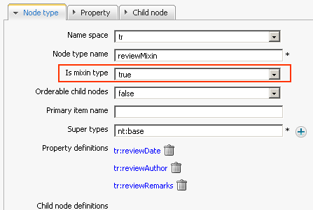
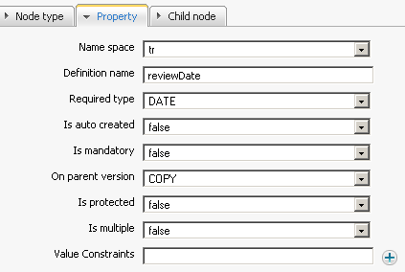
Exercise – Mixins 1/2
Your boss asks you to add three fields to the exo:article form: → reviewDate (Calendar Widget), reviewAuthor (input field)
You cannot modify the exo:article node type anymore. In that moment the mixins come into your mind.
Create the mixin node type “bb:reviewMixin” for these properties. Choose “true” for the “mixin” type.
28

Slide 29
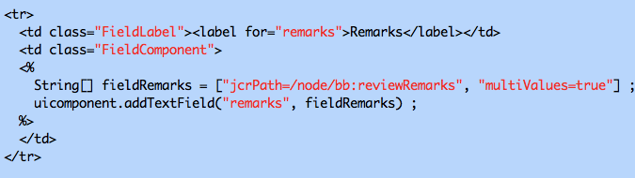
Exercise – Mixins 2/2
Integrate this mixin in your exo:article dialog template.
In the dialog template, add the mixins name in to the list of mixins: ["jcrPath=/node", mixintype=mix:i18n,bb:reviewMixin”).
Add the input elements for the “reviewMixin” properties: reviewDate and reviewAuthor”.
29

Slide 30
Content List Portlet Template
Notes:
30

Slide 31
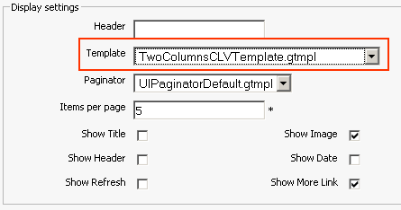
Content List Template
The Content List portlet offers a number of prepared templates.
For projects you can create custom templates, they will then appear in the select box of the portlet settings.
The templates are coded in groovy template (gtmpl) – similar to java.
Notes:
31
31

Slide 32
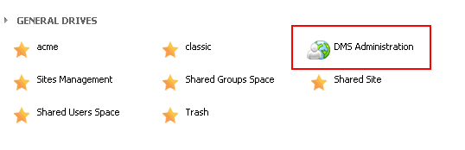
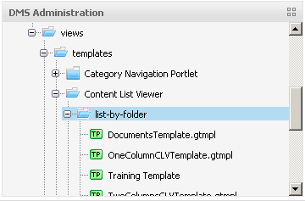
List Template
Access by the site explorer:
Login as john. Open the Acme site.
Open the Site Explorer
Open the DMS Administration drive and then /exo:ecm/views/templates/content-list-viewer/list/list-by-folder
Notes:
32
32

Slide 33
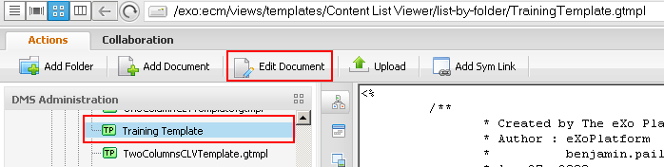
List Template
Modify the new template
Copy the ContentListViewerDefault and call the copy BikeTemplate.gtmpl
Add a test text like “TEEEESSSSTT” behind the first <div> of the BikeTemplate.gtmpl in order to if the modification works.
Notes:
33
33

Slide 34
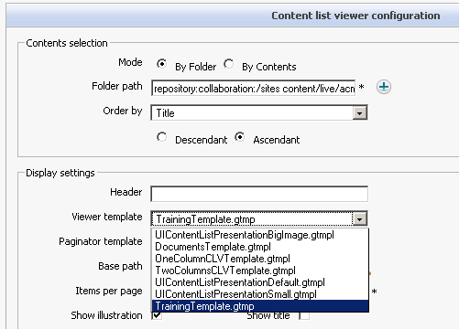
Mini-Exercise: List Template
List Template
Copy and paste the ContentListViewerDefault and rename it to your BikeTemplate
Modify the BikeTemplate
Use the bike template in a Content List portlet
Notes:
34
34

Slide 35
Exercise – Banner Show
Your boss asks you to show the banner in a banner show
Your idea is to create a content list template that takes images of a target folder and show them in a carousel way (every n seconds).
Open the content list folder by webdav: http://localhost:8080/portal/rest/jcr/repository/dms-system/exo:ecm/views/templates/Content%20List%20Viewer/list-by-folder
Add jquery.js and slidebanner.js as gatein ressources to your bike extension.
Rebuild the bike extension, redeploy and restart.
Copy the banner list template from the toolkit (SlideBanner.gtmpl).
Create a banner folder and upload some images.
Add a banner list to the homepage of acme pointing to your banner folder and test it.
35

Slide 36
Interceptors
Notes:
36

Slide 37
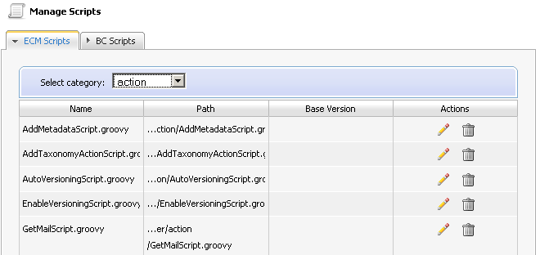
Manage Scripts
Scripts
ECM Scripts
Actions
Interceptors
Widgets
BC Scripts (deprecated)
37

Slide 38
CmsScript Interface
ECM Supports groovy script execution
The script has to implement CmsScript :
import org.exoplatform.services.cms.scripts.CmsScript;
public class PreNodeSaveInterceptor implements CmsScript {
public PreNodeSaveInterceptor() {
}
public void execute(Object context) {
// wrong: String path = (String) context;
println(" Pre Node Save, a good form validator");
}
public void setParams(String[] params) {}
}
Context and params depend on the script type.
38

Slide 39
ECM Script Dependency Injection
Dependency injection (Widget example)
public class FillSelectBoxWithCalendarCategories implements CmsScript {
...
public FillSelectBoxWithCalendarCategories(RepositoryService repositoryService, NodeHierarchyCreator nodeHierarchyCreator) {
repositoryService_ = repositoryService ;
nodeHierarchyCreator_ = nodeHierarchyCreator ;
}
39

Slide 40
Integrate Interceptor Scripts to a dialog template
Executed before node creation:
<% uicomponent.addInterceptor("ecm-explorer/interceptor/MyPreInterceptor.groovy", "prev"); %>
Executed after node creation:
<% uicomponent.addInterceptor("ecm-explorer/interceptor/MyPostInterceptor.groovy”, "post"); %>
Possible Parameters:
context = node.getPath()‏
params[0] = repository
40

Slide 41
Exercise – Interceptor
For the event template you need a validation that the start date is prior to the end date.
Use a prenodesave interceptor that verifies this condition. If negative a message exception has to be triggered and the data has not to be stored.
Upload a the interceptor script from the toolkit.
Assign the interceptor to the dialog template of exo:event. Add this code at the beginning of the template: <% uicomponent.addInterceptor("ecm-explorer/interceptor/DateOrderPreNodeSaveInterceptor.groovy”,"prev");%>
Test it.
41

Slide 42
Action Scripts and Dialogs
Notes:
42

Slide 43
Triggers – Actions
You can link an action to any node.
Action Types:
Business Process: Workflow integration with Bonita or JBPM,
Groovy Script: A java implementation.
The action can be triggered when
A node is added, deleted,
A property is added, deleted or read,
the scheduler triggers the action,
or right-click by the user.
Actions are node types
You can find them in the node type list. Furthermore each action has a dialog template.

Slide 44
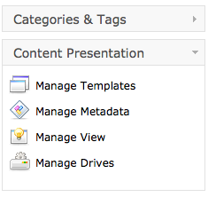
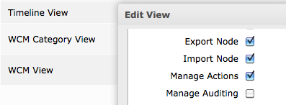


Actions

Slide 45
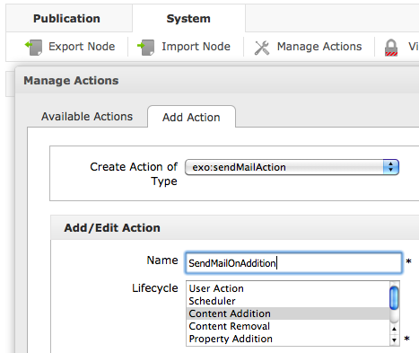
Actions

Slide 46
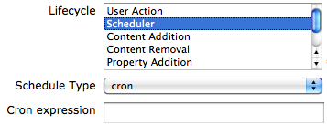
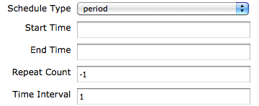
Scheduled Actions
Schedule Types:
Cron: A cron expression can define any period, repetitions, weekdays etc. – a little bit cryptic.
Period: Start and End time, number of repetitions and a time interval.

Slide 47
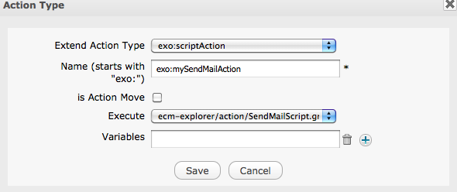
Actions

Slide 48
Actions Scripts
For ECM Actions with the «script» type
Parameters
context : Properties map
params : n/a
Common variables :
Map variables = (Map) context;
String nodePath = (String) variables.get("nodePath") ;
String workspace = (String) variables.get("srcWorkspace");
String actionName = (String) variables.get("actionName");
Node actionNode = (Node) variables.get("actionNode");
48

Slide 49
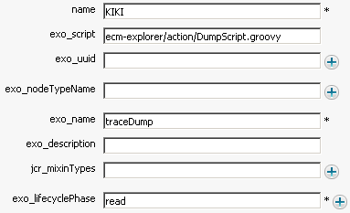
Exercise – Action Dump
Open the Site Administration, then the Manage Scripts Interface.
Create a new action script. Copy the DumpScript code from the toolkit, call the script « DumpScript ».
Create a new Action Type using the DumpScript. Call the action « exo:dumpScriptAction ».
Open the manage template interface and create a dialog for the DumpScript. Do not check the document type checkbox.
The generated template is not nice; you can copy-paste a DumpActionDialog from the toolkit.
Open the site explorer and assign the action to any node, then right click, trigger the action and see the log traces.
49

Slide 50
Exercise – Action Dump Example Output
srcWorkspace = collaboration
exo:script = ecm-explorer/action/DumpScript.groovy
exo:lastModifier = root
nodePath = /sites content/live/acme/documents
actionName = dumpScript
jcr:uuid = a2a68cd7a9fe066b00310525a0b6af4b
exo:name = dumpScript
repository = repository
initiator = root
exo:title = dumpScript
document-type = nt:unstructured
exo:index = 1000
exo:lastModifiedDate = 2010-10-12T18:54:05.539-04:00
actionNode = org.exoplatform.services.jcr.impl.core.NodeImpl@1b0048a
exo:dateModified = 2010-10-12T18:54:05.532-04:00
exo:owner = root
exo:dateCreated = 2010-10-12T18:54:05.531-04:00
srcPath = /sites content/live/acme/documents
action node properties
jcr:primaryType=exo:dumpScriptAction
jcr:mixinTypes=exo:sortable
exo:modify
exo:owneable
exo:datetime
mix:referenceable
exo:rss-enable
jcr:uuid=a2a68cd7a9fe066b00310525a0b6af4b
exo:dateCreated=2010-10-12T18:54:05.531-04:00
exo:dateModified=2010-10-12T18:54:05.532-04:00
exo:index=1000
exo:isDeep=true
exo:lastModifiedDate=2010-10-12T18:54:05.539-04:00
exo:lastModifier=root
exo:lifecyclePhase=read
exo:name=dumpScript
exo:nodeTypeName=exo:owner=root
exo:roles=*:/platform/users
exo:script=ecm-explorer/action/DumpScript.groovy
exo:title=dumpScript
exo:uuid=
50

Slide 51
eXo Content for Developers
Notes:
51

