Slide 1
Content Management
Advanced features

Slide 2
Table Of Contents
Node Types
Documents Types
Locks – Unlocks
Export - Import

Slide 3
Node Types

Slide 4
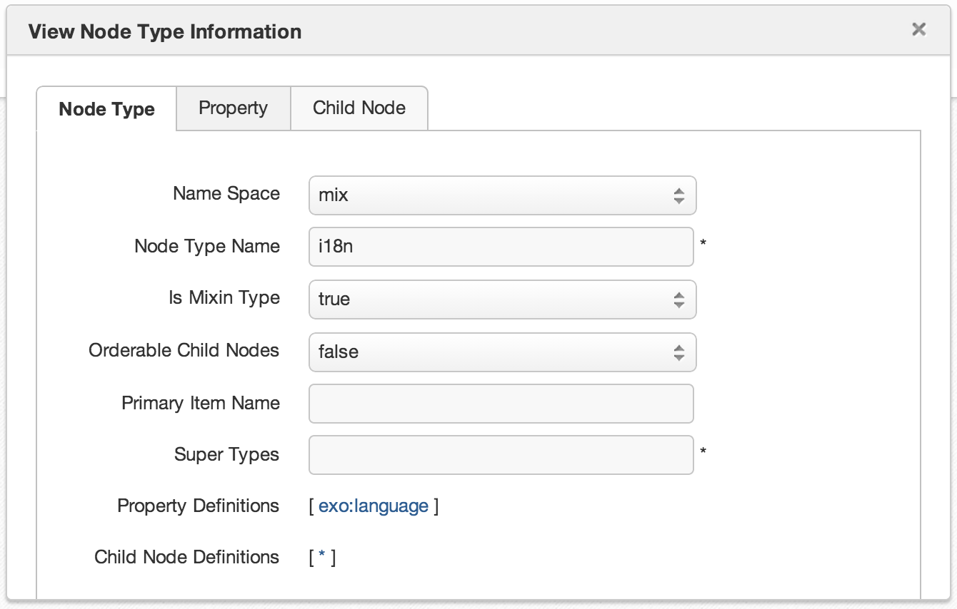
Node Types
A node type defines the properties and the possible child nodes of a nodes.
A node type must be either “primary” or “mixin“.
Primary node type: Each node is defined by exactly one primary node type.
Mixin node type: Each node can integrate properties of 0 or several mixin node types. (For java experts: Mixins are often compared to java interfaces.)

Slide 5
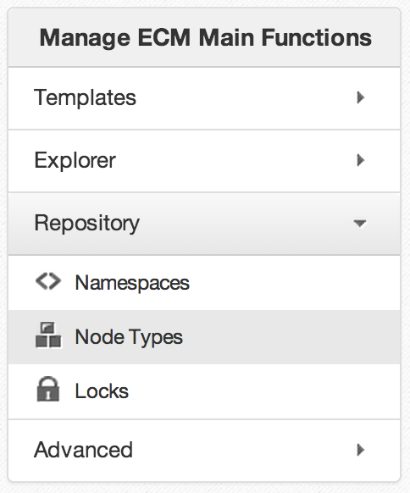
Node Type
Namespace, NodeType and Templates
There are many different nodetypes for a JCR.
A nodetype defines the properties and possible child nodes.
A nodetype can inherit from other nodetypes.
The nodetype then inherits property and child node definitions.

Slide 6
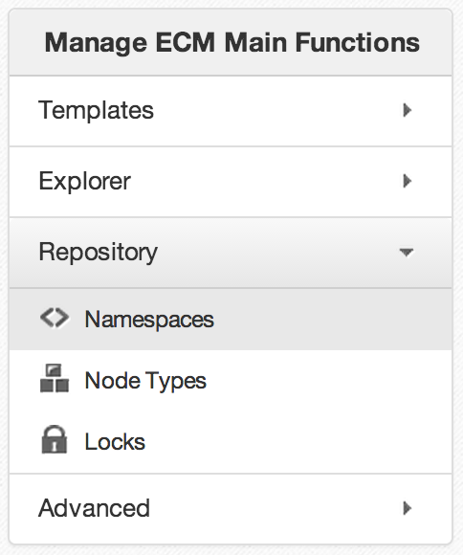
Namespace
Namespace
Each nodetype and property belongs to a namespace.
The namespace helps to avoid name conflicts. (When different organizations uses the same name.)
A namespace is a prefix, defined a URL. (Similar to xml.)
The namespaces are managed in a namespace registry.
Do not hesitate to create your own namespace(s) for your nodetypes and properties.

Slide 7
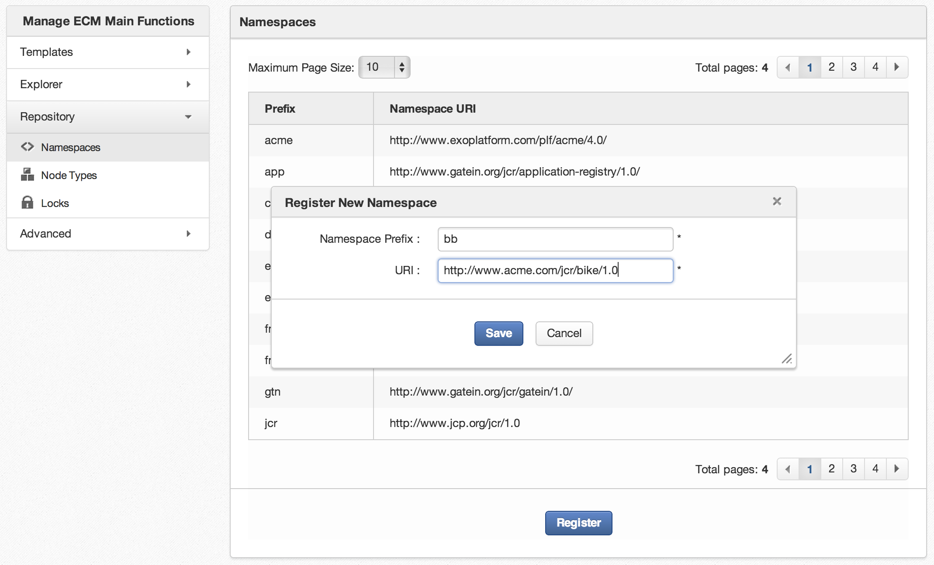
Namespace
You’re encouraged to create your own namespace

Slide 8
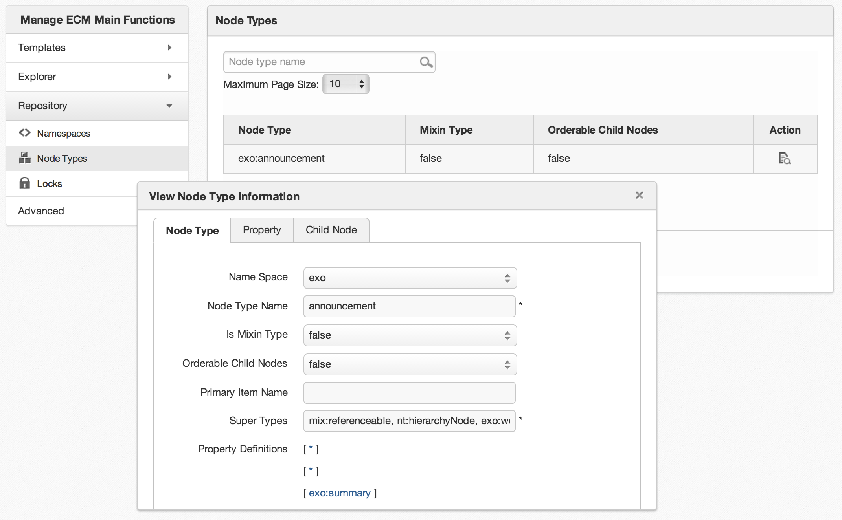
Nodetype

Slide 9
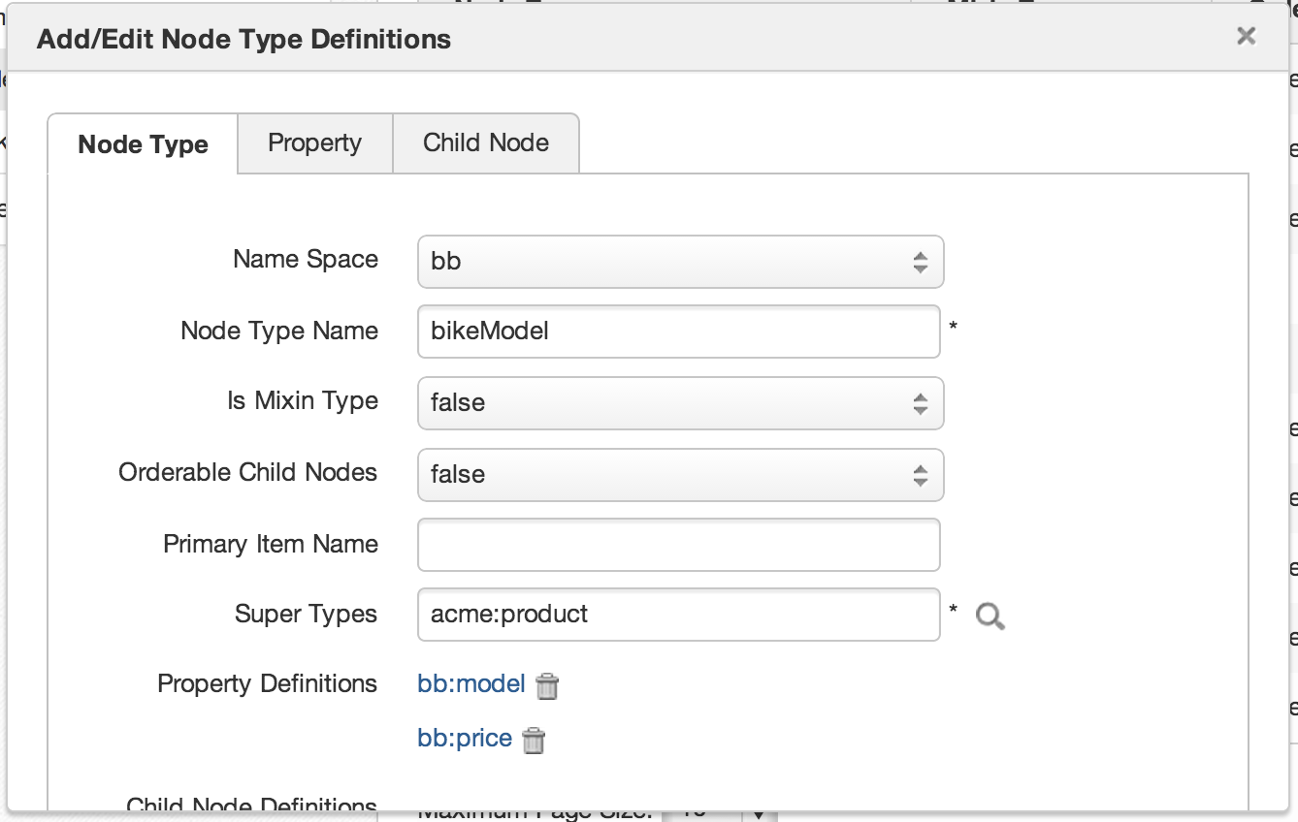
Custom Node Type

Slide 10
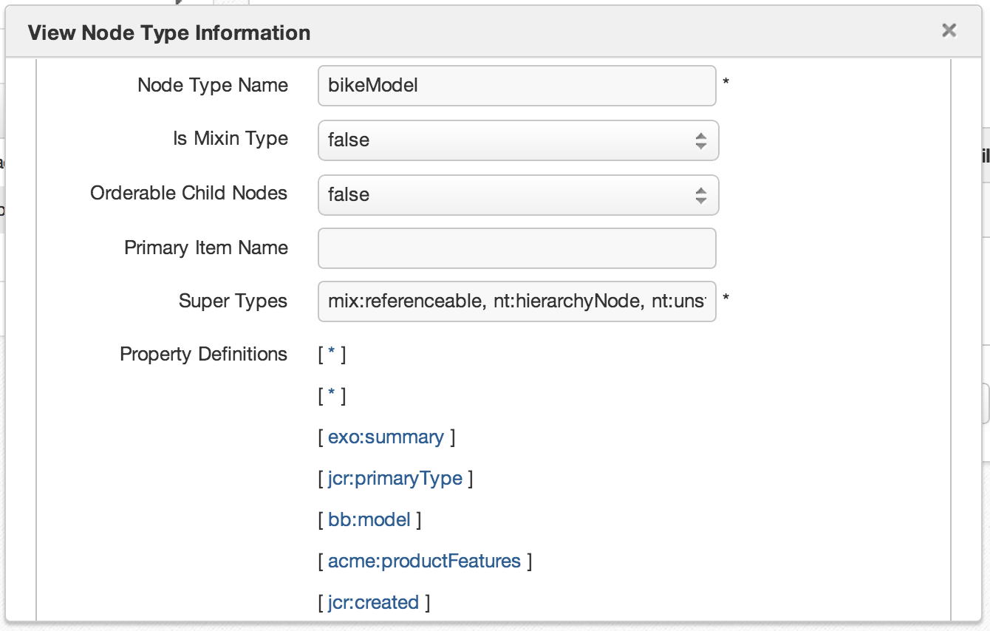
Custom Node Type

Slide 11
Document Types

Slide 12
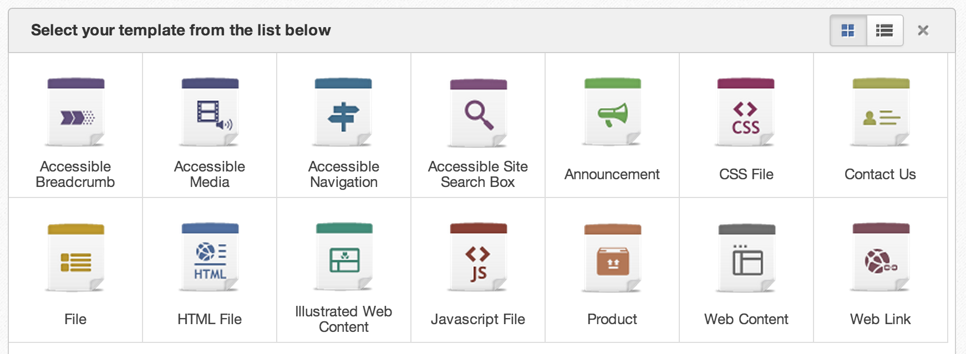
Document Type
Document types are node types for which you created a dialog and a view template.
Document type dialog templates appear in the “Add Content” dialog of the site explorer.

Slide 13
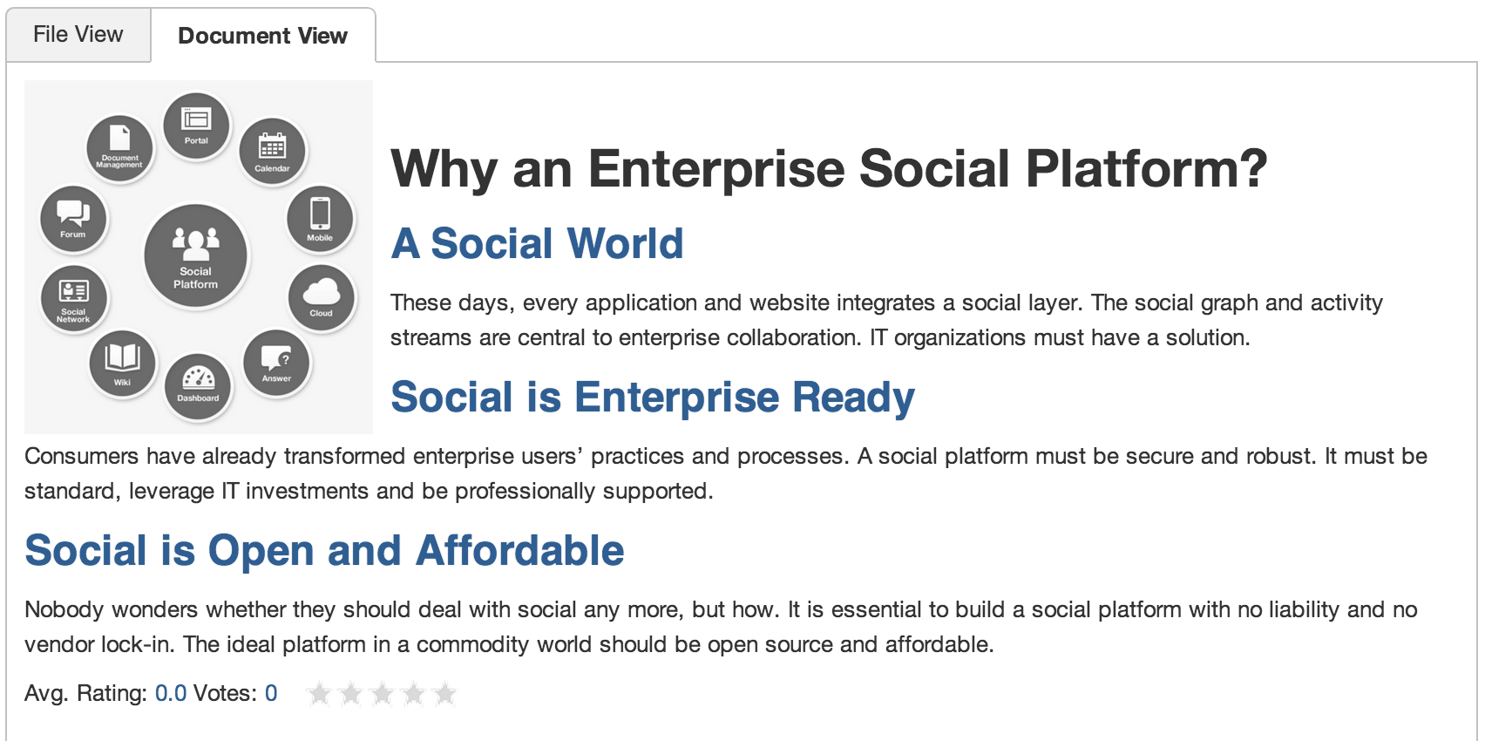
Document Type
The view of a document type is used for showing the content.

Slide 14
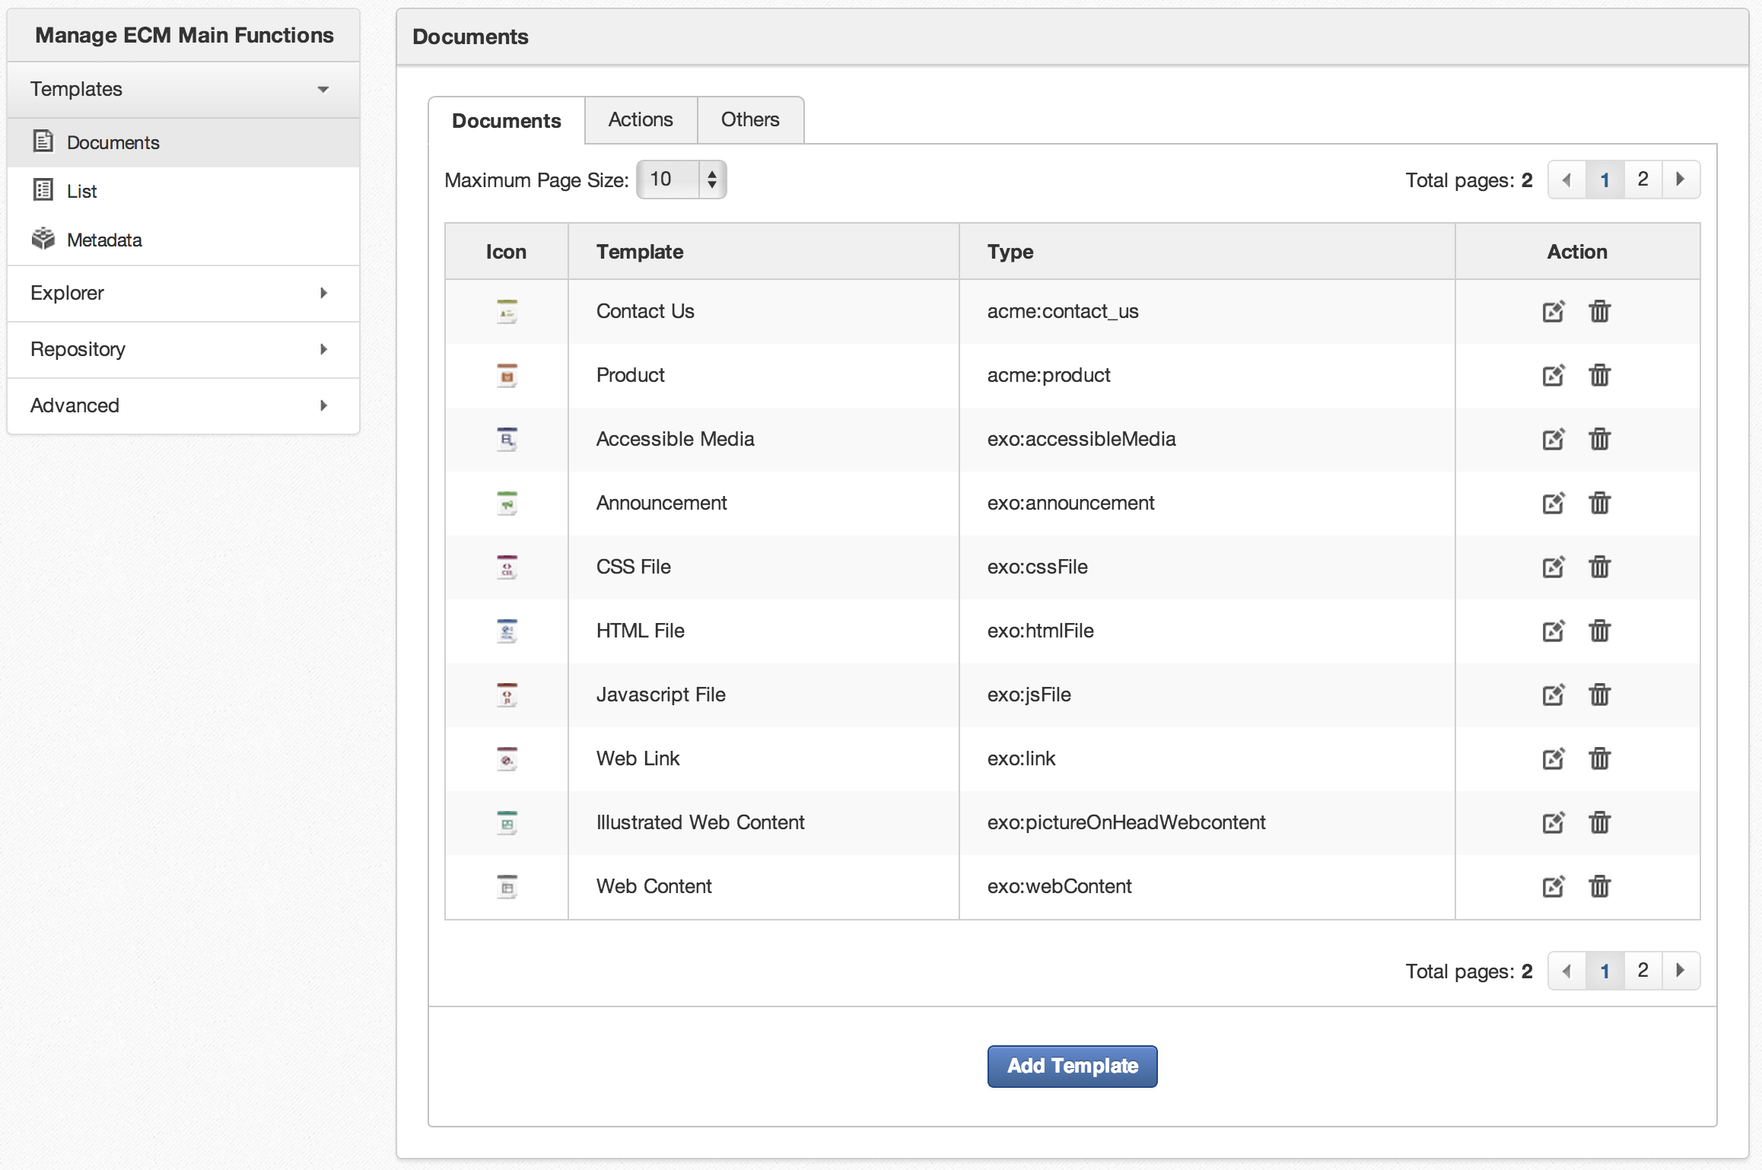
Document Type
Don’t modify Built-in templates (no support possible)
Feel free to copy them and create new templates

Slide 15
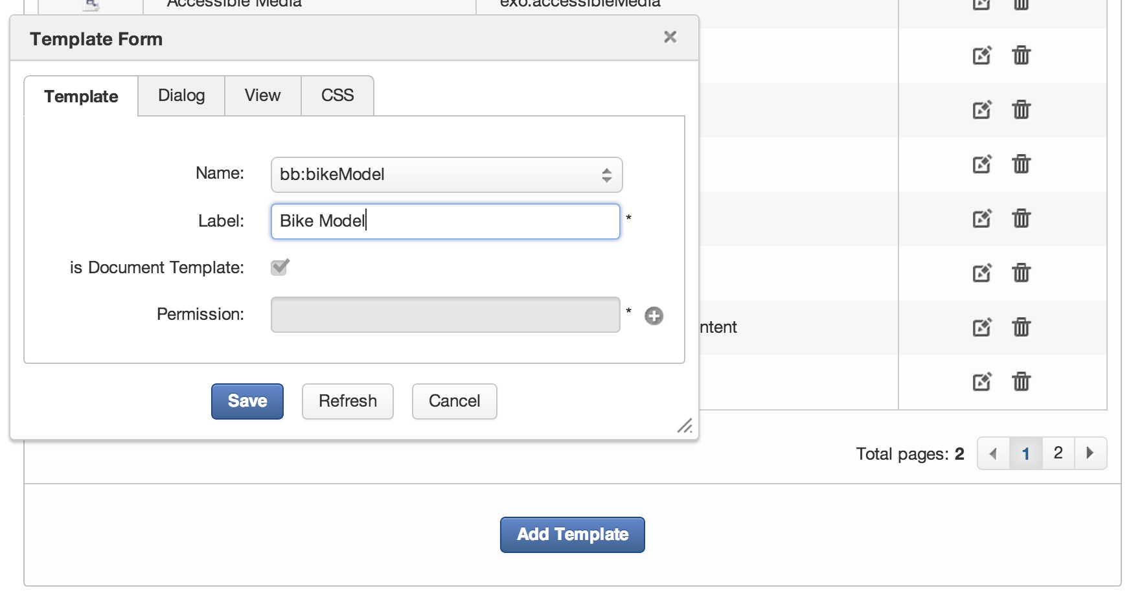
Custom Template
You’re encouraged to create your own templates

Slide 16
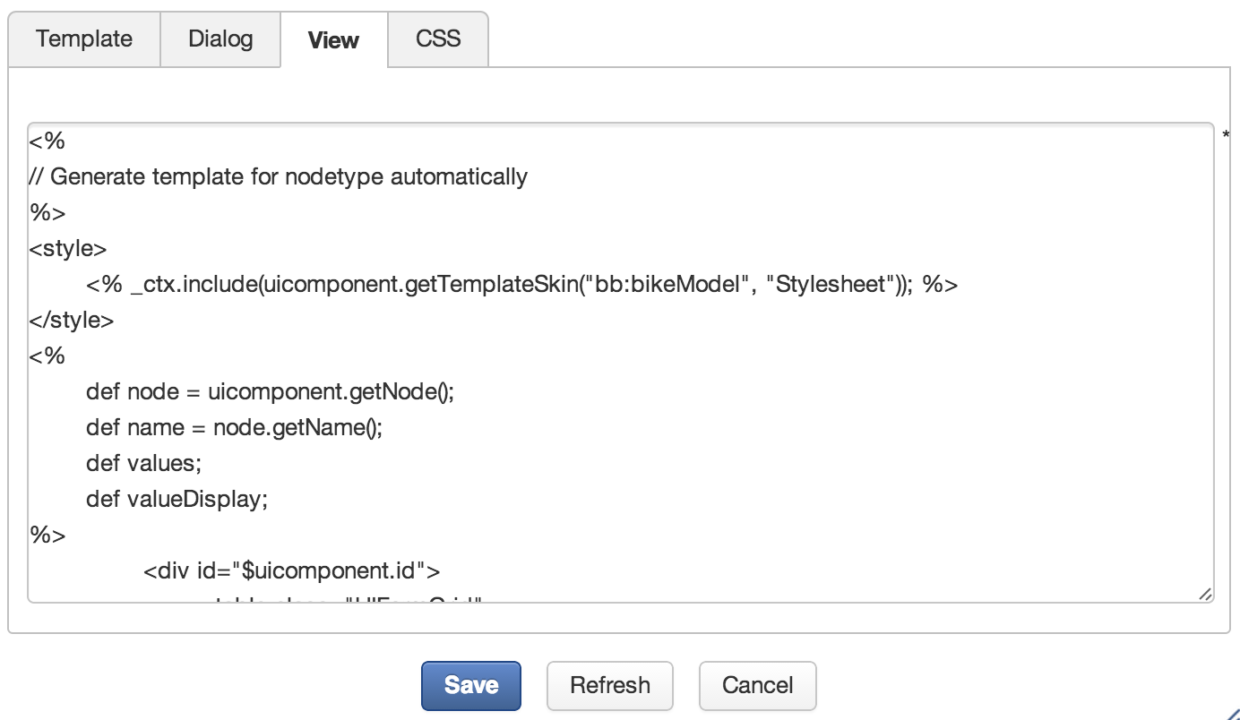
Custom Templates
The dialog and view templates are written in groovy template language.

Slide 17
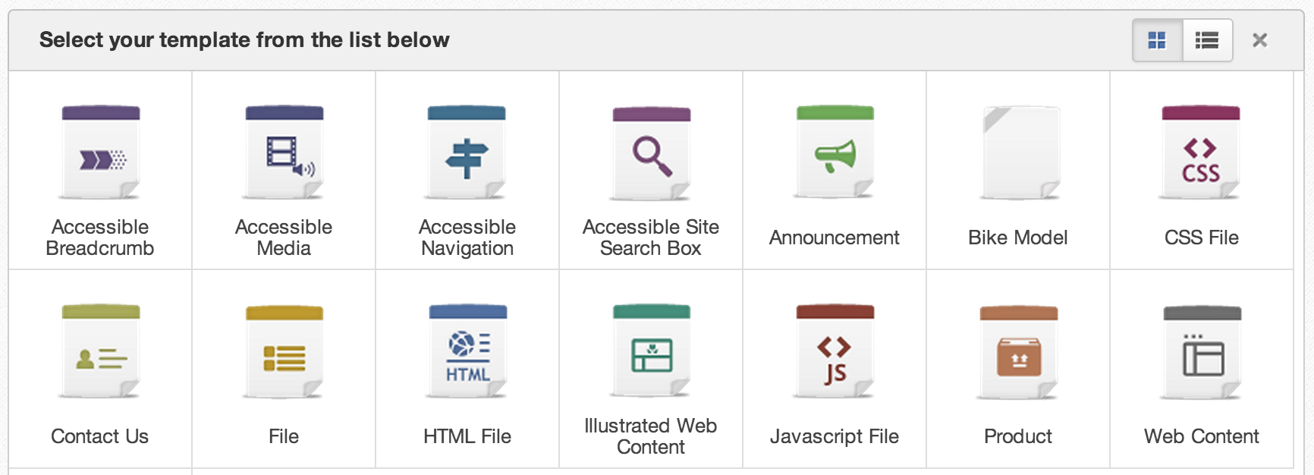
Document Dialogs
« Bike Model » node type is now in the Template list

Slide 18
Exercise

Slide 19
Exercise : Document Type
New node type “bb:bikeModel”
Create a namespace “bb”
Create a node type “bikeModel” that inherits from “acme:product”.
Do not save yet!
Add the string property “model“ and the double property “price” to the bikeModel node type.
Now, save the node type.
After saving you cannot modify the node type anymore!
Open the manage templates interface, Click on “Add”.
Choose the node type “bikeModel”;
The view and a dialog templates will be generated automatically, do not modify the generated templates.
Open the site explorer, drive “Sites Management”
go to any folder like “acme/documents/”
create a new node of your new document type.

Slide 20
Locks – Unlocks

Slide 21
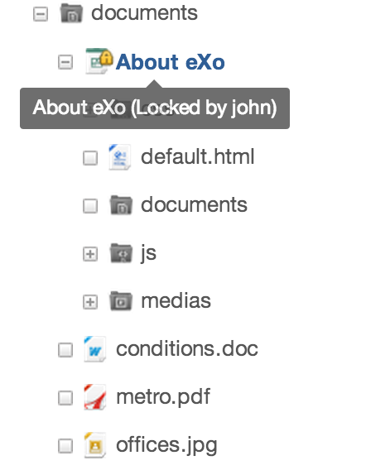
Locks
When modifying a content, then the node is locked for other users automatically by the Content Explorer.
The locked node is marked by a very small lock.
Behind this, there is a locking mechanism. If necessary, an administrator can unlock nodes manually.

Slide 22
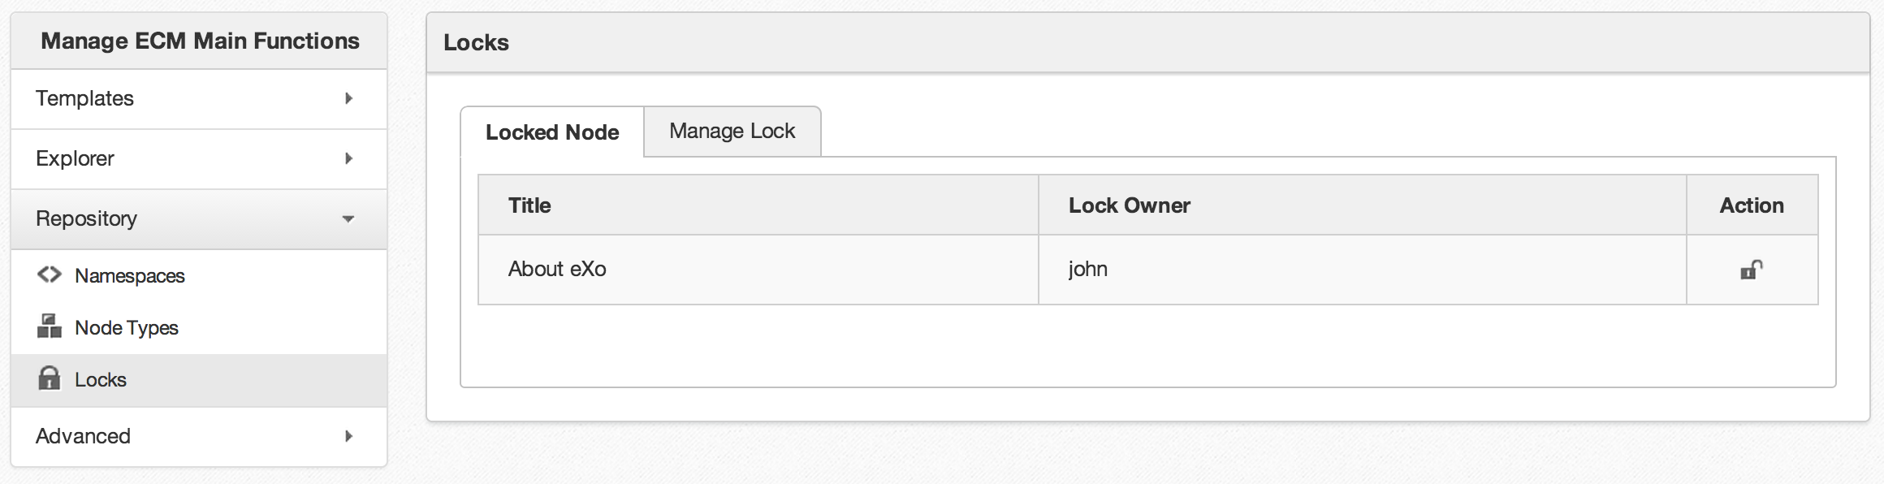
Unlock
Behind this, there is a locking mechanism. If necessary, an administrator can unlock nodes manually.

Slide 23
Export – Import

Slide 24
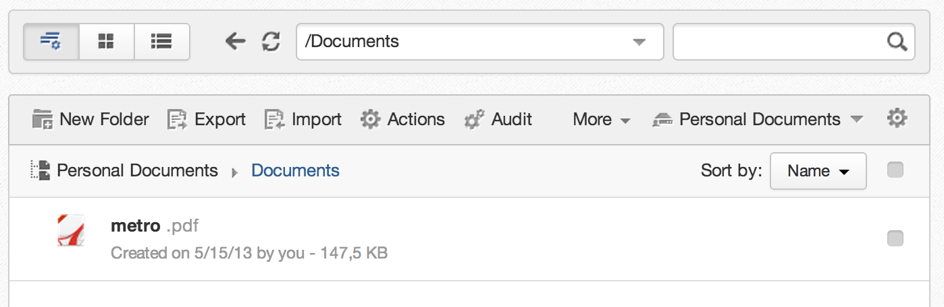
Export / Import
You can export a node. This export the node and all its descendants to an xml file.
You import the exported file to another node or another installation of eXo, also for transferring between from Pre-Prod and Production systems.

Slide 25
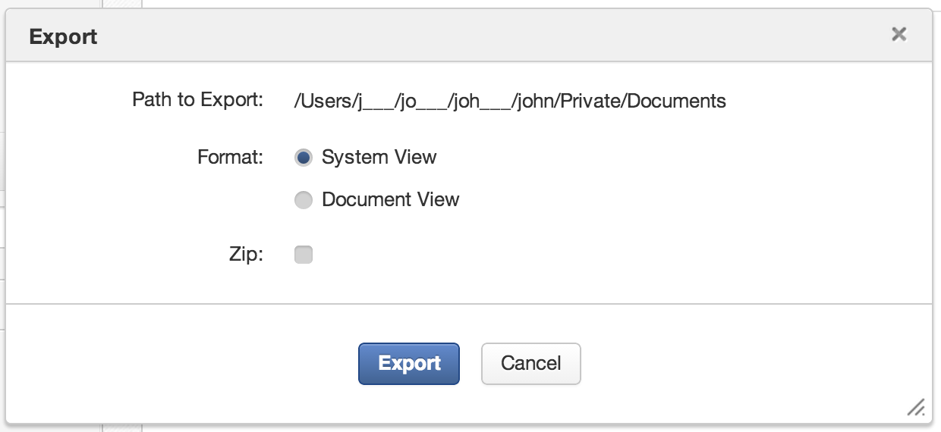
Export
When exporting you can choose between two different xml formats (they are explained in eXo Developer course).

Slide 26
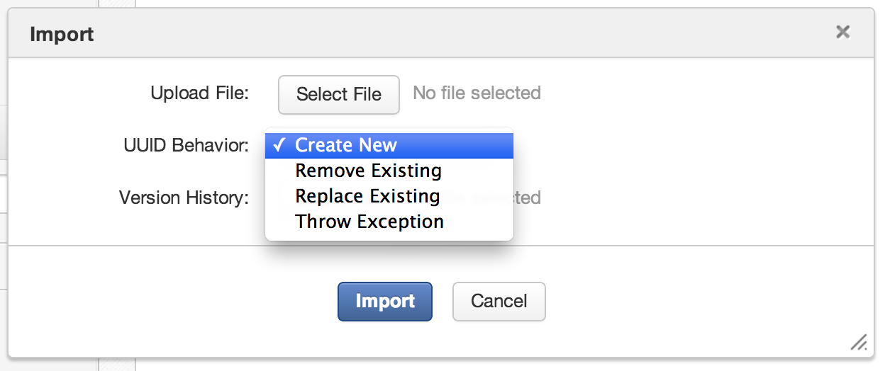
Import
When importing you may have conflicts of UUID which by definition have to be unique. PLF-2970

Slide 27
Exercise

Slide 28
Exercise : Export / Import
Open the folder: /bike/web contents/Events
Export this node.
Scrutinize the exported file.
Delete this node and test it.
Import the node to the same parent node and test again.
Extra: Test UUID conflicts
Extra: Export a node and import it on a different system.

Slide 29
Content Management
Advanced features
Questions and Answers

