Slide 1
eXo Web Content Management

Slide 2
WCM Folder Structure

Slide 3
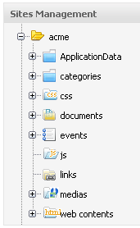
WCM Folder Structure
WCM Folders of a site:
Application Data: Newsletter details. The newsletter depends on the site
Categories: contains the taxonomy tree of the site
CSS: Central CSS documents
A js folder: is to store all shared javascripts for a website
A css folder: is to store all shared css for a website
A document folder: is to store all shared documents
for all webpages

Slide 4
WCM Folder Structure
WCM Folders of a site:
A media folder: is to store all shared media content types (images, sounds, video) for a website
A link folder: is to store all shared links that a webcontent can be referred to.
A webcontent folder: is to store all webcontents that are used in the webpages or nodes.
A site artifacts folder: is to store all site artifacts like banner, footer.. as webcontent. This folder is a child of webcontent folder. Should not be found by the search, only put artifacts!
Create your own folders in “web contents” or create a folder at the root of your site folder.

Slide 5
Portlet 2.0

Slide 6
Portlet 2.0
Push by RenderReponse:
In Portlet 2.0 you can modify any element of the response from any portlet.
Therefore you use the RenderResponse object.
Example of a RenderResponse in a portlet’s form code that adds a javascript to header of the page:
  RenderResponse response = context.getResponse();
  Element elementS = response.createElement("script");
  elementS.setAttribute("type", "text/javascript");
  elementS.setAttribute("src", "/eXoWCMResources/javascript/eXo/wcm/backoffice/public/Components.js");
  response.addProperty(MimeResponse.MARKUP_HEAD_ELEMENT,elementS);
Task: Create a portlet that adds a favicon to the current page, access the favicon by a service rest. Alternatively add Google Analytics.
Hint: <link rel="shortcut icon" href=“/portal-rest-path/name_of_icon.ico">

Slide 7
WCM UI Extension

Slide 8
WCM UI Extension
...
Lowest rank wins
Elements
Java
Filter
Configuration / Internationalization
Put everything in a jar.

Slide 9
WCM UI Extension
Category
GroundContextMenu (Click in the empty space)
Single Item : Only one item selected
Multi Item : several item selected
ItemContextMenu : ??

Slide 10
WCM UI Extension
Filters
Optional, only put a filter if you need it
Example: Paste is only accessible if you can clicked on “copy”.
Accept()
onDeny()

Slide 11
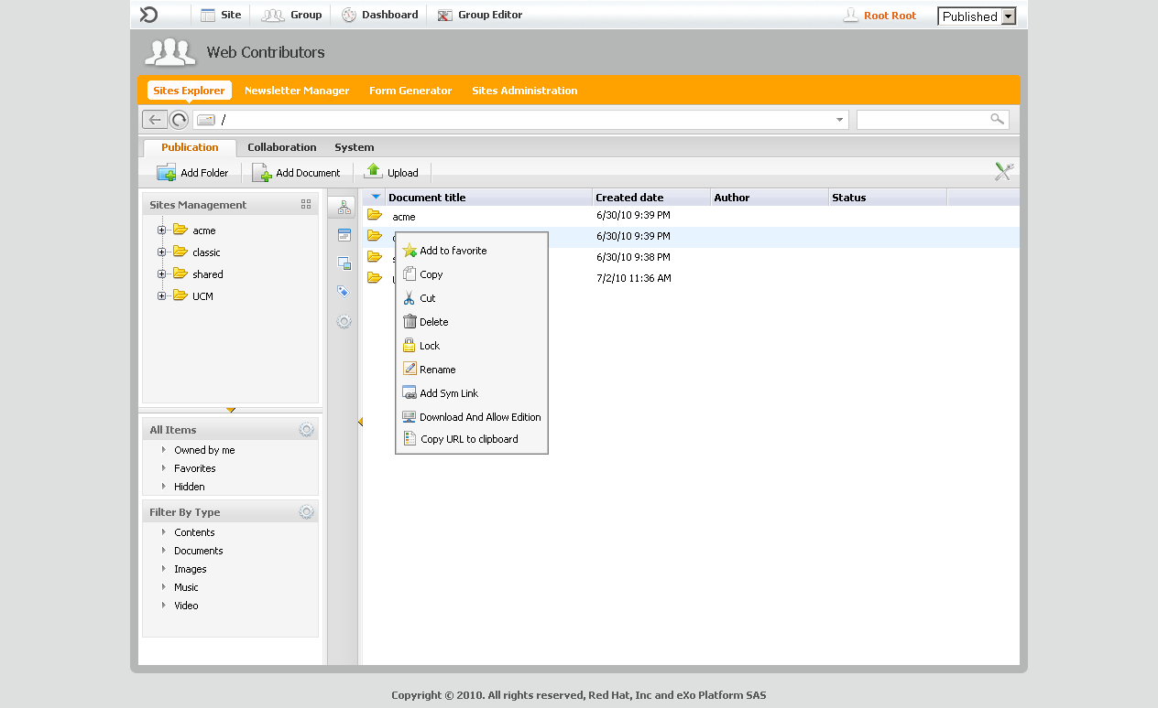
WCM UI Extension
Elements
ActionBar (Icons on the top), simple one: AddTranslation
Right Click (On the folder nodes)
UIWorkingArea (Right click on a node). Example: Paste
FileViewer for viewing different mime types. No filter, but a mime-type list. Example: TextViewer or PDFViewer (PDFViewer: class java, groovy template with the buttons and a rest service, uses pdfbox.)
http://svn.exoplatform.org/projects/ecms/trunk/packaging/wcm/webapp/src/main/webapp/WEB-INF/conf/dms-extension/dms/dms-ext-configuration.xml
Corresponding icons have to be added in an independent css file.

Slide 12
WCM UI Extension
Elements
Show an example of an WorkinArea class.

Slide 13
WCM UI Extension
Internationalization
Properties files for the portlets
For the Acion Bar Elements there are two property files (One for the site administration and another for the file explorer)

Slide 14
WCM UI Extension
Access to document by a filter:
http://wiki-int.exoplatform.org/display/exoMktgCom/WCM+Authoring+Extension
Rest Access: http://localhost:8080/ecmdemo/rest-ecmdemo/authoring/bystate/?fromstate=draft&user=root&lang=en&workspace=collaboration&path=/&json=true
PublicationManager

Slide 15
WCM UI Extension
Content Explorer Update by Ajax
Used UIDashboardForm:
exemple de passage de param en ajax à la portlet explorer pour la positionner sur un noeud donné :
PortalRequestContext context = Util.getPortalRequestContext();
String path = event.getRequestContext().getRequestParameter(OBJECTID);
HashMap<String, String> map = new HashMap<String, String>();
map.put("repository", "repository");
map.put("drive", "collaboration");
map.put("path", path);
context.setAttribute("jcrexplorer-show-document", map);
Utils.updatePortal((PortletRequestContext) event.getRequestContext());

Slide 16
Content Explorer

Slide 17
Web UI

Slide 18
Web UI
Mixin
Allows add subnodes to any node.
You have to add code for the mixin in the node’s dialog template.
Example: The mixin “i18n” defines the “exo:language” property. This property can be added to the exo:article dialog:
String[] fieldName = ["jcrPath=/node", "mixintype=mix:i18n"] ;
uicomponent.addTextField("name", fieldName) ;
...
String[] fieldLang = ["jcrPath=/node/exo:language", "options=en,fr,es,de", lang] ;
uicomponent.addSelectBoxField("lang", fieldLang) ;
Remark: You can create a template for a mixin and integrate it in a view template – for an example search for mix:votable in the exo:article view template:
<% _ctx.include(uicomponent.getViewTemplate("mix:votable", "view1")); %>

Slide 19
Publishing Lifecycle

Slide 20
WCM Publishing Lifecycle
Configuration
E:\java\exo-working\eXo-WCM-2.0.0-community-release3\webapps\ecm-wcm-extension\WEB-INF\conf\content-extended\authoring\configuration.xml

Slide 21
WCM Publishing Lifecycle
AddLifecycle Example
<target-component>org.exoplatform.services.wcm.extensions.publication.PublicationManager</target-component>
<component-plugin>
<name>AddLifecycle</name>
<set-method>addLifecycle</set-method>
<type>org.exoplatform.services.wcm.extensions.publication.lifecycle.StatesLifecyclePlugin</type>
<description>Configures</description>
<priority>1</priority>
<init-params>
<object-param>
<name>lifecycles</name>
<object type="org.exoplatform.services.wcm.extensions.publication.lifecycle.impl.LifecyclesConfig">
<field name="lifecycles">
<collection type="java.util.ArrayList">
<value>
<object type="org.exoplatform.services.wcm.extensions.publication.lifecycle.impl.LifecyclesConfig$Lifecycle">
<field name="name"><string>lifecycle1</string></field>
<field name="publicationPlugin"><string>Authoring publication</string></field>
<field name="states">
<collection type="java.util.ArrayList">
<value>
<object type="org.exoplatform.services.wcm.extensions.publication.lifecycle.impl.LifecyclesConfig$State">
<field name="state"><string>draft</string></field>
<field name="membership"><string>author:/platform/web-contributors</string></field>
</object>
</value>
<value>
<object type="org.exoplatform.services.wcm.extensions.publication.lifecycle.impl.LifecyclesConfig$State">
<field name="state"><string>pending</string></field>
<field name="membership"><string>author:/platform/web-contributors</string></field>
</object>
</value>

Slide 22
WCM Publishing Lifecycle
AddContext
Allows to fine-tune the conditions that have to be fulfilled for a specified lifecycle.
You can add as many contexts as you wish.
Among the contexts that fulfil the conditions the one with the lowest priority is picked.
Possible conditions: site, membership, path or node type.
Site condition: It depends on the site the user has opened (=URL of the browser) and not where the content is stored.
You define the default lifecycle by adding no condition at all.

Slide 23
WCM Publishing Lifecycle
AddContext Example
<component-plugin>
<name>AddContext</name>
<set-method>addContext</set-method>
<type>org.exoplatform.services.wcm.extensions.publication.context.ContextPlugin</type>
<init-params>
...
<value>
<object type="org.exoplatform.services.wcm.extensions.publication.context.impl.ContextConfig$Context">
<field name="name"><string>context4</string></field>
<field name="priority"><string>50</string></field>
<field name="lifecycle"><string>lifecycle2</string></field>
<field name="membership"><string>*:/platform/web-contributors</string></field>
<field name="site"><string>acme</string></field>
<field name="path"><string>repository:collaboration:/documents/company/finances</string></field>
<field name="nodetype"><string>exo:article</string></field>
...
</component-plugin>

Slide 24
WCM Publishing Lifecycle
States
10 different states are defined and can be used in your custom lifecycle. You cannot add other states.
http://svn.exoplatform.org/projects/ecms/trunk/core/publication/src/main/java/org/exoplatform/services/wcm/publication/PublicationDefaultStates.java
The states are:
  archived, obsolete, unpublished, enrolled, draft, pending, approved, inreview, staged, published

Slide 25
WCM Publishing Lifecycle
States Cron job
You can use the scheduler plugin in order to change the state by a cron job.
Use the org.exoplatform.services.wcm.extensions.scheduler.ChangeStateCronJob
Example in ...\webapps\ecm-wcm-extension\WEB-INF\conf\content-extended\authoring\configuration.xml :
<external-component-plugins>
<target-component>org.exoplatform.services.scheduler.JobSchedulerService</target-component>
<component-plugin>
<name>changeStateJobToUnpublished</name>
<set-method>addCronJob</set-method> <type>org.exoplatform.services.wcm.extensions.scheduler.ChangeStateCronJob</type>
<description>add a job to change the state of content</description>

Slide 26
WCM Publishing Lifecycle
<init-params>
<properties-param>
<name>cronjob.info</name>
<description>cron job info</description>
<property name="jobName" value="changeStateJobToUnpublished"/>
<property name="groupName" value="group"/>
<property name="job" value="org.exoplatform.services.wcm.extensions.scheduler
.impl.ChangeStateCronJobImpl"/>
<property name="expression" value="45/120 * * * * ?"/>
</properties-param>
<properties-param>
<name>changeStateCronJob.generalParams</name>
<description>General parameters for job</description>
<property name="fromState" value="published"/>
<property name="toState" value="unpublished"/>
<property name="predefinedPath" value="repository:collaboration:/"/>
</properties-param>
...

Slide 27
WCM Publishing Lifecycle
Exercise
Create a custom extension
Define a lifecycle called “completeCycle”
  Only for the nodetype exo:article
  Containing all 10 states
  Involve three different memberships for the state transition
  With a cron job between two states
Configure and test the lifecycle

Slide 28
eXo Web Content Management
Q & A

