Slide 1
eXo Content Customization
Notes:
1

Slide 2
Table of Contents
Content Explorer Extension
Publication Lifecycle
Notes:
2

Slide 3
Content Explorer Extension
3
Notes:
3
3

Slide 4
WCM UI Extension
Elements
Java
Filter
Configuration / Internationalization
Put everything in a jar
General Principle: Lowest rank wins
Notes:
4
4

Slide 5
Site Explorer Elements
Extendible Elements
ActionBar (Icons on the top), simple one: AddTranslation
Right Click (On the folder nodes or other nodes)
UIWorkingArea (Right click on a node). Example: Paste
FileViewer for viewing different mime types. No filter, but a mime-type list. Example: TextViewer or PDFViewer (PDFViewer: class java, groovy template with the buttons and a rest service, uses pdfbox)
…/ecm-wcm-extension/WEB-INF/conf/dms-extension/dms/dms-ext-configuration.xml
Corresponding icons have to be added in an independent css file.
Notes:
5
5

Slide 6
Element Categories
Category
GroundContextMenu (Click in the empty space)
Single Item : Only one item selected
Multi Item : several item selected
ItemContextMenu : Right-Click
Notes:
6
6

Slide 7
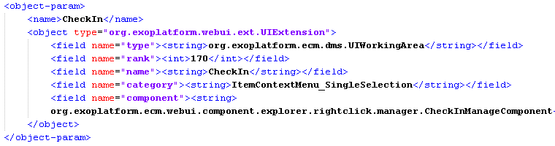
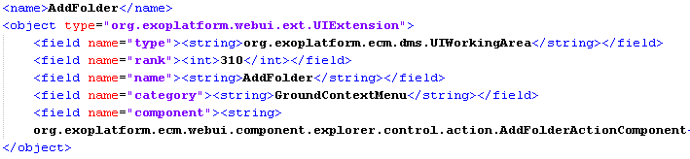
Site Explorer Extension
Notes:
7
7

Slide 8
WCM UI Internationalization
Internationalization
Properties files for the portlets
For the Action Bar Elements, there are two property files (One for the site administration and another for the file explorer)
Notes:
8
8

Slide 9
Site Explorer Ajax Update
Site Explorer Update by Ajax
Used UIDashboardForm:
Example of an ajax call to the site explorer portlet in order to open a specific node:
PortalRequestContext context = Util.getPortalRequestContext();
String path = event.getRequestContext().getRequestParameter(OBJECTID);
HashMap<String, String> map = new HashMap<String, String>();
map.put("repository", "repository");
map.put("drive", "collaboration");
map.put("path", path);
context.setAttribute("jcrexplorer-show-document", map);
Utils.updatePortal((PortletRequestContext) event.getRequestContext());
Notes:
9
9

Slide 10
Example: Overview
It is possible to extend the File Explorer and the ECM Administration thanks to the UI Extension Framework. Indeed, you can add your own action buttons to the File Explorer and/or add your own managers to the ECM Administration.
We will see how to add a new action button to the File Explorer but the logic is exactly the same for the managers in the ECM Administration.

Slide 11
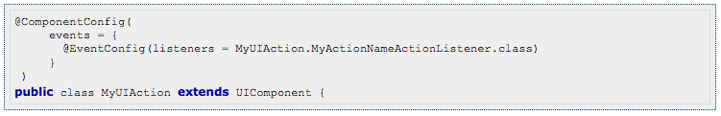
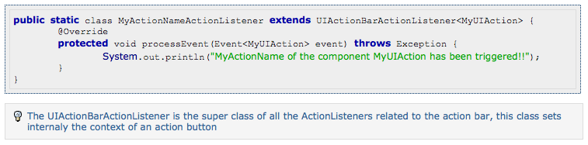
Create your ActionListener

Slide 12
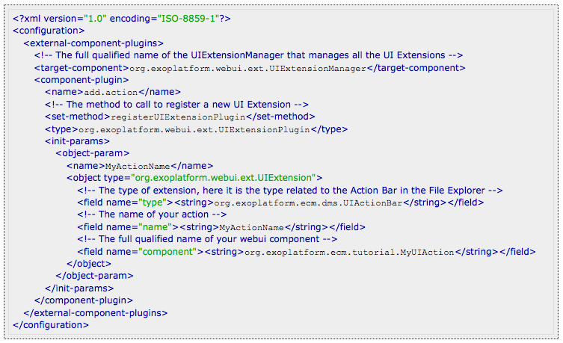
Register your UI Action

Slide 13
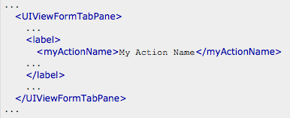
Define a label and an icon
Copy the file ${TOMCAT_HOME}/webapps/ecmadmin/WEB-INF/classes/locale/portlet/administration/ECMAdminPortlet_en.xml to your extension and add “MyActionName” to the file.

Slide 14
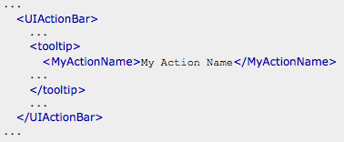
Define a label and an icon
Copy the file ${TOMCAT_HOME}/webapps/ecmexplorer/WEB-INF/classes/locale/portlet/explorer/JCRExplorerPortlet_en.xml to your extension and add your “myActionName” to the file.

Slide 15

Define a label and an icon
Copy the file ${TOMCAT_HOME}/webapps/ecm/skin/icons/24x24/DefaultStylesheet.css to your extension and add the rule for MyActionNameIcon to the file.

Slide 16
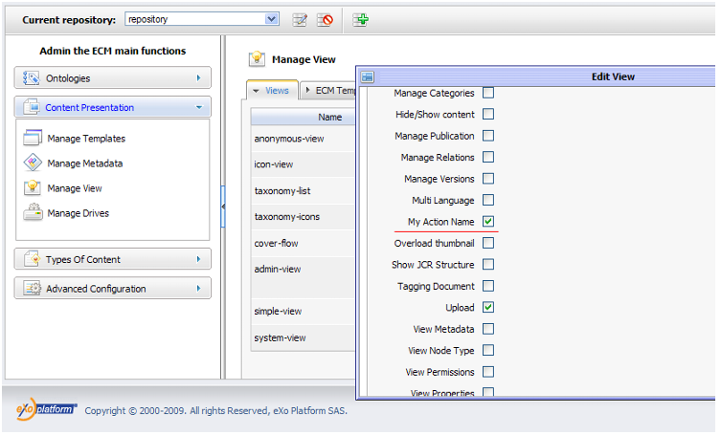
Test your Action

Slide 17
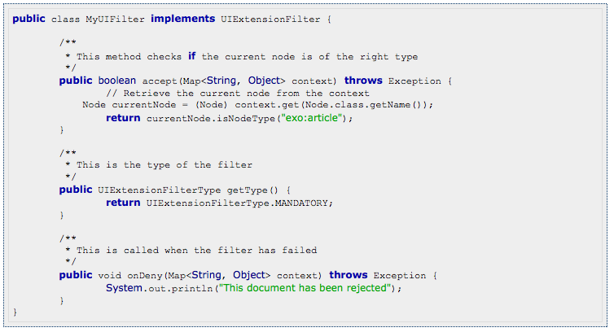
Add an internal Filter

Slide 18
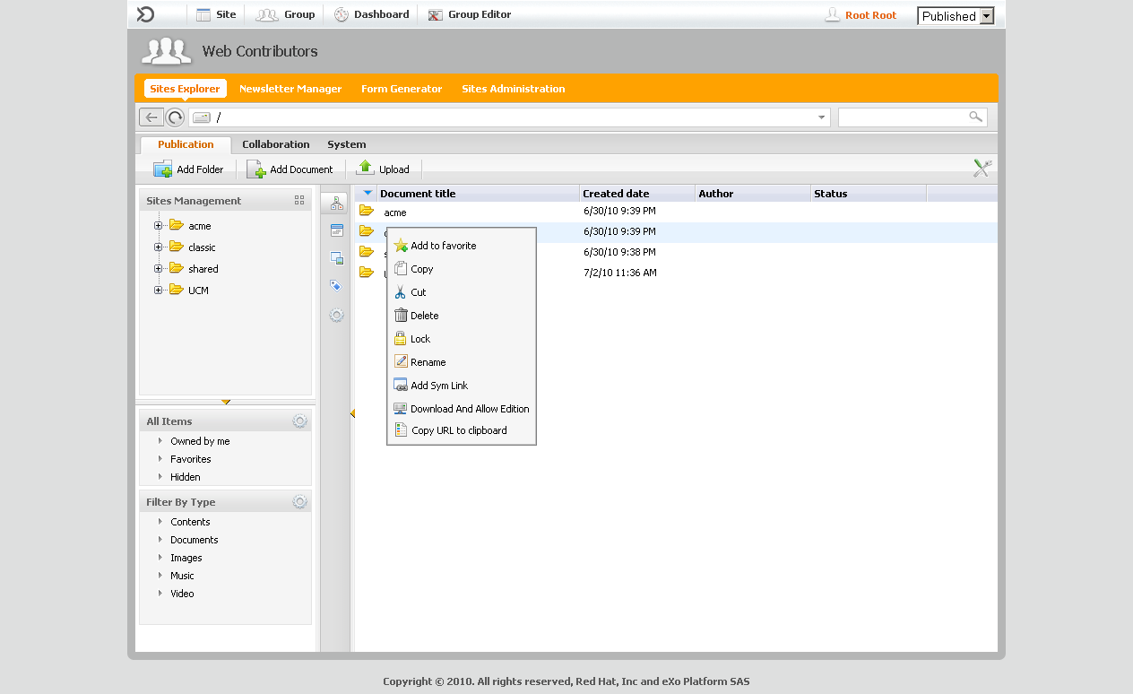
Filters
Filters
Filters are optional, only put a filter if you need it
Example: Paste is only accessible if you have clicked on “copy”.
Implement the filter methods:
accept()
onDeny()
Notes:
18
18

Slide 19
Add an internal Filter
private static final List<UIExtensionFilter> FILTERS = Arrays.asList(new UIExtensionFilter[] {new MyUIFilter()});

Slide 20
Publishing Lifecycle
20
Notes:
20
20

Slide 21
WCM Publishing Lifecycle
Three Plugins:
Simple
StatesAndVersion (Legacy from WCM 1.2)
Authoring Plugin (High flexibility)
Configuration Example: …\webapps\ecm-wcm-extension\WEB-INF\conf\content-extended\authoring\configuration.xml
Notes:
21
21

Slide 22
Authoring Lifecycle States
10 different states are defined and can be used in your custom lifecycle. You cannot add other states.
The states are:
draft (Author) : Content is in editing phase
pending (Author) : Author validates the content
approved (Approver) : Content is approved by the Manager
staged (Publisher) : Content is ready for publication (multi-server mode)
published (Publisher or Automatic) : Content is published and visible in Live mode
unpublished (Publisher or Automatic) : Content is not visible in Live mode
archived (Automatic) : Content is archived and ready to be moved in archive workspace if enabled.
Notes:
22
22

Slide 23
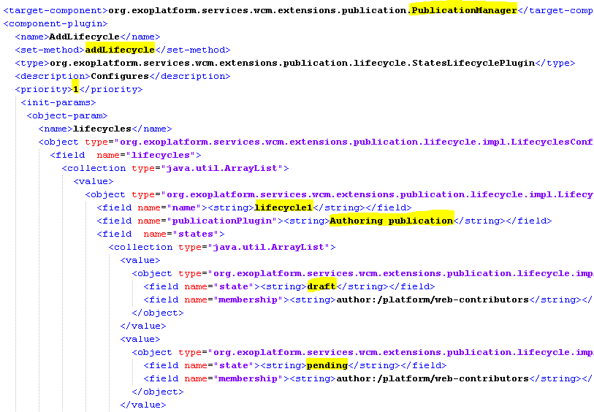
Authoring Lifecyles
Notes:
23
23

Slide 24
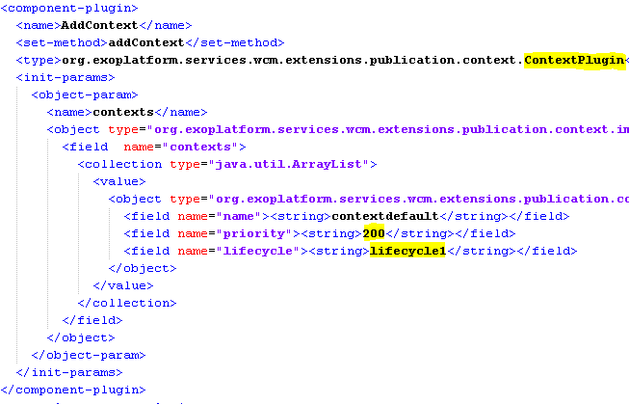
Authoring Lifecycles
Notes:
24
24

Slide 25
Default Lifecycle Configuration
4 states:
Draft: author:/platform/web-contributors
Pending: author:/platform/web-contributors
Published: publisher:/platform/web-contributors
Unpublished: publisher:/platform/web-contributors
Notes:
25
25

Slide 26
WCM Publishing Lifecycle
AddContext
Allows to fine-tune the conditions that have to be fulfilled for a specified lifecycle.
You can add as many contexts as you wish.
Among the contexts that fulfil the conditions the one with the lowest priority is picked.
Possible conditions: site, membership, path or node type.
Note: It depends on the site the user has opened (=URL of the browser) and not where the content is stored.
You define the default lifecycle by adding no condition at all.
Notes:
26
26

Slide 27
WCM Publishing Lifecycle
AddContext using all conditions:
<component-plugin>
<name>AddContext</name>
<set-method>addContext</set-method>
<type>org.exoplatform.services.wcm.extensions.publication.context.ContextPlugin</type>
<init-params>
...
<value>
<object type="org.exoplatform.services.wcm.extensions.publication.context.impl.ContextConfig$Context">
<field name="name"><string>context4</string></field>
<field name="priority"><string>50</string></field>
<field name="lifecycle"><string>lifecycle2</string></field>
<field name="membership"><string>*:/platform/web-contributors</string></field>
<field name="site"><string>acme</string></field>
<field name="path"><string>repository:collaboration:/documents/company/finances</string></field>
<field name="nodetype"><string>exo:article</string></field>
...
</component-plugin>
Notes:
27
27

Slide 28
Publication Dates
Start and End Dates
Customers don't want to publish directly a content but at a defined date and they also want to unpublish automatically the content after that.
In the authoring publication plugin, we add new properties to manage this :
publication:startPublishedDate
publication:endPublishedDate
staged : in multi-server mode, publisher can only put the content to staged and wait for auto-publication (“staged” means “ready to be published”)
published : in single-server mode, publisher can directly publish a content (with or without publication dates).
Notes:
28
28

Slide 29
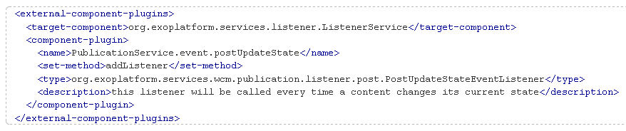
Lifecycle Listener
When we change state, we broadcast an event in order for partners to add features if they want to.
Notes:
29
29

Slide 30
Authoring Rest Exposition
Access to document by a filter:
Rest Access: http://localhost:8080/portal/rest/authoring/bystate/?fromstate=draft&user=root&lang=en&workspace=collaboration&path=/&json=true
Used in the authoring portlet
Notes:
30
30

Slide 31
ChangeStateCronJob
States Cron job
You can use the scheduler plugin in order to change the state by a cron job.
Use the org.exoplatform.services.wcm.extensions.scheduler.ChangeStateCronJob
Example in ...\webapps\ecm-wcm-extension\WEB-INF\conf\content-extended\authoring\configuration.xml
Notes:
31
31

Slide 32
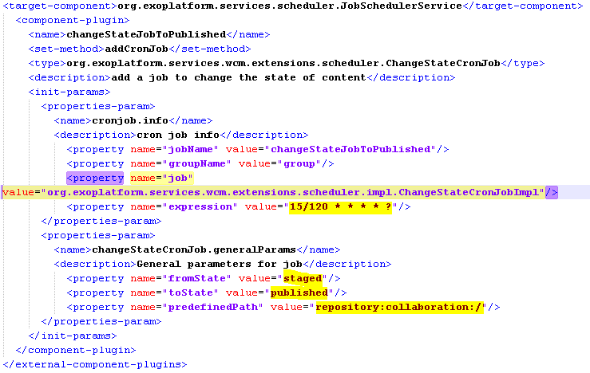
ChangeStateCronJob
Notes:
32
32

Slide 33
WCM Publishing Lifecycle
Exercise
Create a custom extension
Define a lifecycle called “completeCycle”
Only for the nodetype exo:article
Containing 5 different states, including “published”
Involve two different memberships for the state transition
With a cron job between two states
Configure and test the lifecycle
Notes:
33
33

Slide 34
eXo Content Customization
Q & A
Notes:
34
34

