Slide 1
eXo SysAdmin Training
Directory Service
Notes:
1

Slide 2
Table of Contents
Overview of the Organizational Model
Predefined User Configuration
Ldap Connection Settings
Organization Service Configuration
Active Directory configuration
PicketLink Intégration configuration
SSO - Single Sign On

Slide 3
Overview of the Organizational Model
3
Notes:
3

Slide 4
Overview of the Organizational Model
User
- Username used as the identified Profile (identity and preferences)
Group
- Gather a set of users, applicative or business users
- Tree structure, No inheritance
Expressed as /group/subgroup/subsubgroup
Membership / Role
- Qualifies the role in a group
- "Member of group as XXX »
Expressed as : manager:/organization/hr, *:/partners

Slide 5
Overview of the Organizational Model
Basis of eXo personalization and authorizations in eXo
Used to all over the platform.
The model is abstract and does not rely on any specific storage.
Multiple implementations exist in eXo :
Hibernate : for storage into a RDBMS
JNDI: for storage into a directory such as an LDAP or MS Active Directory

Slide 6
Predefined User Configuration
6
Notes:
6

Slide 7
Predefined User Configuration
Used to specify the initial Organization configuration
Configuration file : portal/portal/conf/organization/organization-configuration.xml
Several configuration plugins :
org.exoplatform.services.organization.OrganizationDatabaseInitializer is used to specify a list of membership types, a list of groups, and a list of users to be created
org.exoplatform.services.organization.impl.NewUserEventListener specifies which groups all the newly created users should become members of.
GroupEventListener, MembershipEventListener and more ….

Slide 8
Predefined User Configuration (OrganizationDatabaseInitializer)
Memberships Configuration:
<field name="membershipType"> <collection type="java.util.ArrayList"> <value> <object type="org.exoplatform.services.organization.OrganizationConfig$MembershipType"> <field name="type"> <string>member</string> </field> <field name="description"> <string>member membership type</string> </field> </object> </value> </collection>
….
</field>

Slide 9
Predefined User Configuration (OrganizationDatabaseInitializer)
Groups Configuration:
<field name="group"> <collection type="java.util.ArrayList"> <value> <object type="org.exoplatform.services.organization.OrganizationConfig$Group"> <field name="name"> <string>portal</string> </field> <field name="parentId"> <string></string> </field> <field name="type"> <string>hierachy</string> </field> <field name="description"> <string>the /portal group</string> </field> </object> </value> … </collection>

Slide 10
Predefined User Configuration (OrganizationDatabaseInitializer)
Users Configuration:
<field name="user"> <collection type="java.util.ArrayList"> <value> <object type="org.exoplatform.services.organization.OrganizationConfig$User"> <field name="userName"><string>root</string></field> <field name="password"><string>exo</string></field> <field name="firstName"><string>root</string></field> <field name="lastName"><string>root</string></field> <field name="email"><string>exoadmin@localhost</string></field> <field name="groups"><string>member:/admin,member:/user,owner:/portal/admin</string></field> </object> </value> <value> <object type="org.exoplatform.services.organization.OrganizationConfig$User"> <field name="userName"><string>exo</string></field> <field name="password"><string>exo</string></field> <field name="firstName"><string>site</string></field> <field name="lastName"><string>site</string></field> <field name="email"><string>exo@localhost</string></field> <field name="groups"><string>member:/user</string></field> </object> </value> ... </collection> </field>

Slide 11
Predefined User Configuration (NewUserEventListener)
<component-plugin> <name>new.user.event.listener</name> <set-method>addListenerPlugin</set-method> <type>org.exoplatform.services.organization.impl.NewUserEventListener</type> <description>this listener assign group and membership to a new created user</description> <init-params> <object-param> <name>configuration</name> <description>description</description> <object type="org.exoplatform.services.organization.impl.NewUserConfig"> <field name="group"> <collection type="java.util.ArrayList"> <value> <object type="org.exoplatform.services.organization.impl.NewUserConfig$JoinGroup"> <field name="groupId"><string>/user</string></field> <field name="membership"><string>member</string></field> </object> </value> </collection> </field> <field name="ignoredUser"> <collection type="java.util.HashSet"> <value><string>root</string></value> </collection> </field> </object> </object-param> </init-params>

Slide 12
Ldap Connection settings
12
Notes:
12

Slide 13
Ldap connection settings
You may decide that you want eXo users to be mapped to an existing directory
eXo provides a flexible implementation of its OrganizationService on top of LDAP
By default, eXo store Organization Model to RDBMS (using Picketlink configuration)
To switch to ldap storage, in portal/portal/conf/configuration.xml, replace:
<import>portal/portal/conf/organization/idm-configuration.xml</import>
By
<import>portal/portal/conf/organization/ldap-configuration.xml</import>
But you have to add the declaration <key>org.exoplatform.services.database.HibernateService</key> etc. into ldap-configuration.xml

Slide 14
Ldap connection settings
Start by connection settings which will tell eXo how to connect to your directory server
ldap configuration file :
portal/portal/conf/organization/exo/ldap-configuration.xml
<component>
<key>org.exoplatform.services.ldap.LDAPService</key>
<type>org.exoplatform.services.ldap.impl.LDAPServiceImpl</type>
<init-params>
<object-param>
<name>ldap.config</name>
<description>Default ldap config</description>
<object type="org.exoplatform.services.ldap.impl.LDAPConnectionConfig">
<field name="providerURL"><string>ldap://127.0.0.1:389,10.0.0.1:389</string></field>
<field name="rootdn"><string>CN=Manager,DC=exoplatform,DC=org</string></field>
<field name="password"><string>secret</string></field>
<field name="version"><string>3</string></field>
<field name="referralMode"><string>follow</string></field> <!– fallow, ignore, throw →
<field name="serverName"><string>default</string></field> <!– default, active.directory,open.ldap, netscape.directory,redhat.directory; -->
</object>
</object-param>
</init-params>
</component>

Slide 15
Ldap connection settings
providerURL: LDAP server URL. For multiple ldap servers, use comma separated list of host:port (Ex. ldap://127.0.0.1:389,10.0.0.1:389).
rootdn: dn of user that will be used by the service to authenticate on the server.
password: password for user rootdn.
authenticationType: type of authentication to be. Use one of none, simple, strong. Default is simple.
version: LDAP protocol version. Set to 3 if your server supports LDAP V3.
referalMode: one of follow, ignore,throw.
serverName: you will need to set this to active.directory in order to work with Active Directory servers. Any other value will be ignore and the service will act as on a standard LDAP.

Slide 16
Organization Service Configuration
16
Notes:
16

Slide 17
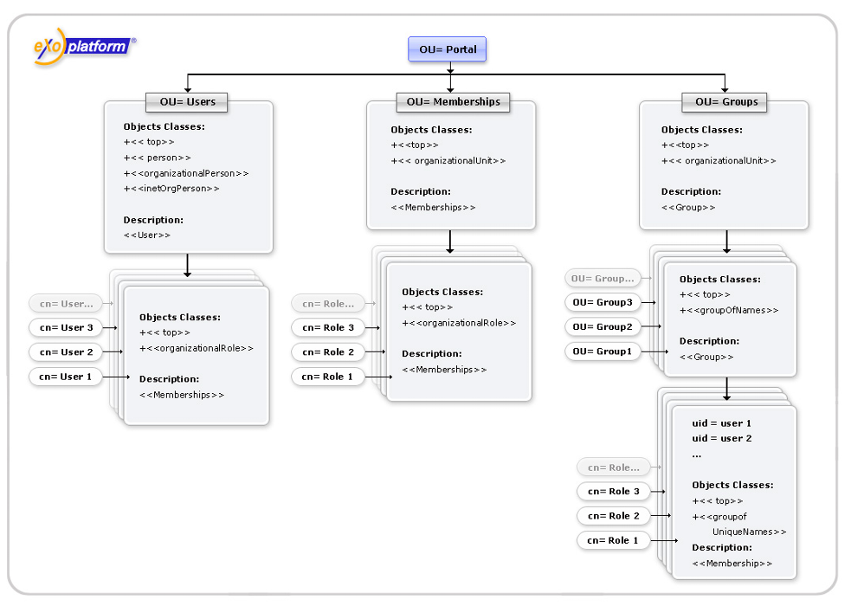
Organization Service Configuration
Need to configure OrganizationService to tell him how the directory is structured and how to interact with.

Slide 18
Organization Service Configuration
Configuration file : portal/portal/conf/organization/exo/ldap-configuration.xml
ldap.attribute.mapping maps your ldap to eXo.
Two main parameters to configure in it:
<field name="baseURL"><string>dc=exoplatform,dc=org</string></field>
Root dn for eXo organizational entities. This entry can't be created by eXo and must preexist in directory.
<field name="ldapDescriptionAttr"><string>description</string></field>
Name of a common attribute that will be used as description for groups and membership types.

Slide 19
Organization Service Configuration
Main parameters to map eXo users to your directory :
<field name="userURL">
<string>ou=users,ou=portal,dc=exoplatform,dc=org</string></field>
Base dn for users. Users are created in a flat structure under this base with a dn of the form: ldap.userDN.key=username,userURL
<field name="userObjectClassFilter">
<string>objectClass=person</string></field>
Filter used under userURL branch to distinguish eXo user entries from others.
<field name="userLDAPClasses">
<string>top,person,organizationalPerson,inetOrgPerson</string></field>
Comma separated list of classes used for user creation

Slide 20
Organization Service Configuration
The following parameters maps ldap attributes to eXo User java objects attributes.
<field name="userUsernameAttr »><string>uid</string></field>
=> username (login)
<field name="userPassword"><string>userPassword</string></field>
=> password
<field name="userFirstNameAttr"><string>givenName</string></field>
=> Firstname
<field name="userLastNameAttr"><string>sn</string></field>
=> Lastname
<field name="userDisplayNameAttr"><string>displayName</string></field>
=> Display name
<field name="userMailAttr"><string>mail</string></field>
=> e-mail address

Slide 21
Organization Service Configuration
eXo groups can be mapped to organizational or applicative groups defined in your directory:
<field name="groupsURL">
<string>ou=groups,ou=portal,dc=exoplatform,dc=org</string></field>
Base dn for eXo groups. Groups can be structured hierarchically under groupsURL.
<field name="groupLDAPClasses"><string>top,organizationalUnit</string></field>
Comma separated list of classes used for group creation.When creating a new group, an entry will be created with the given objectClass attributes.
<field name="groupObjectClassFilter"><string>objectClass=organizationalUnit</string></field>
Filter used under groupsURL branch to distinguish eXo groups from other entries. You can also use a complex filter if you need.

Slide 22
Organization Service Configuration
eXo Membership types are the possible roles that can be assigned to users in groups.
<field name="membershipTypeURL">
<string>ou=memberships,ou=portal,dc=exoplatform,dc=org</string></field>
Base dn for membership types storage. eXo stores membership types in a flat structure undermembershipTypeURL.
<field name="membershipTypeLDAPClasses "><string>top,organizationalRole</string></field>
membershipTypeLDAPClasses: comma separated list of classes for membership types creation. When creating a new membership type, an entry will be created with the given objectClass attributes. The classes must define the required attributes : description, cn
<field name="membershipTypeNameAttr"><string>cn</string></field>
Attribute that will be used as the name of the role

Slide 23
Organization Service Configuration
eXo Memberships are used to assign a role within a group. They are entries that are placed under the group entry of their scope group. Users in this role are defined as attributes of the membership entry.
<field name="membershipLDAPClasses"><string>top,groupOfNames</string></field>
Comma separated list of classes used to create memberships.
<field name="membershipTypeMemberValue"><string>member</string></field>
Multivalued attribute used in memberships to reference users that have the role in the group.Values should be a user dn.
<field name="membershipTypeRoleNameAttr"><string>cn</string></field>
Attribute of the membership entry whose value references the membership type.
<field name="membershipTypeObjectClassFilter"><string>objectClass=organizationalRole</string></field>
Filter used to distinguish membership entries under groups..

Slide 24
Exercise 1a : Configuration ldap - Orgservice
Unzip the OpenDJ-2.4.3
Run the OpenDJ-2.4.3/quickSetup (linux or osx) or the OpenDJ-2.4.3/setup.bat on windows
Keep the default ldap port 389 or 1389 (on osx port 389 is already in use)
Change the user dn to cn=admin and password=admin
Click next, next, next, finish then close the wizard.
Run OpenDJ-2.4.3 via OpenDJ-2.4.3/bin/control-panel on linux or osx, via OpenDJ-2.4.3/bat/control-panel.bat on windows
Choose « local server» as the server to administrate, enter cn=admin and password=admin
Check if the OpenDJ-2.4.3 server is started
Create a new « dn » to store eXo platform organisation model (new base dn on left panel) : ou=portal,dc=exoplatform,dc=org

Slide 25
Exercise 1b : Configuration ldap – Orgservice
Copy the portal folder in tomcat_home/gatein/conf directory
Edit the main portal configuration file to enable the organisation service ldap configuration instead of the PicketLink hibernate (default configuration) : portal/portal/configuration.xml
- Comment the Picketlink import :
<import>war:/conf/organization/idm-configuration.xml</import>
- Uncomment the ldap configuration :
<import>organization/exo/ldap-configuration.xml</import>
Edit the ldap configuration file :
portal/portal/organization/exo/ldap-configuration.xml
Change the ldap port, dn, password to fit with your configuration
Check if the organisation model are in ldap (left panel, manage entry, select the ou=portal,dc=exoplatform,dc=org dn.)

Slide 26
Active Directory configuration
26
Notes:
26

Slide 27
Active Directory configuration
Alternative configuration for active directory :
portal/portal/conf/organization/exo/activedirectory-configuration.xml
There is a microsoft limitation: password can't be set in AD via unsecured connection
You have to use the ldaps protocol, to use LDAPS protocol with Active Directory:
Add Active Directory Certificate Services role
install right certificate for DC machine 2 enable Java VM to use certificate from AD
Import root CA used in AD, to keystore,
set java options JAVA_OPTS="${JAVA_OPTS}
-Djavax.net.ssl.trustStorePassword=changeit
-Djavax.net.ssl.trustStore=cacerts_path"

Slide 28
PicketLink configuration
28
Notes:
28

Slide 29
PicketLink
PicketLink is an umbrella project that aims to address different Identity Management needs.
PicketLink IDM
provides a common identity model for Identity Management operations.
includes easy management of identities like Users/Groups/Roles and their attributes.
provides usage of different identity stores like LDAP or RDBMS.
eXo uses only PicketLink IDM

Slide 30
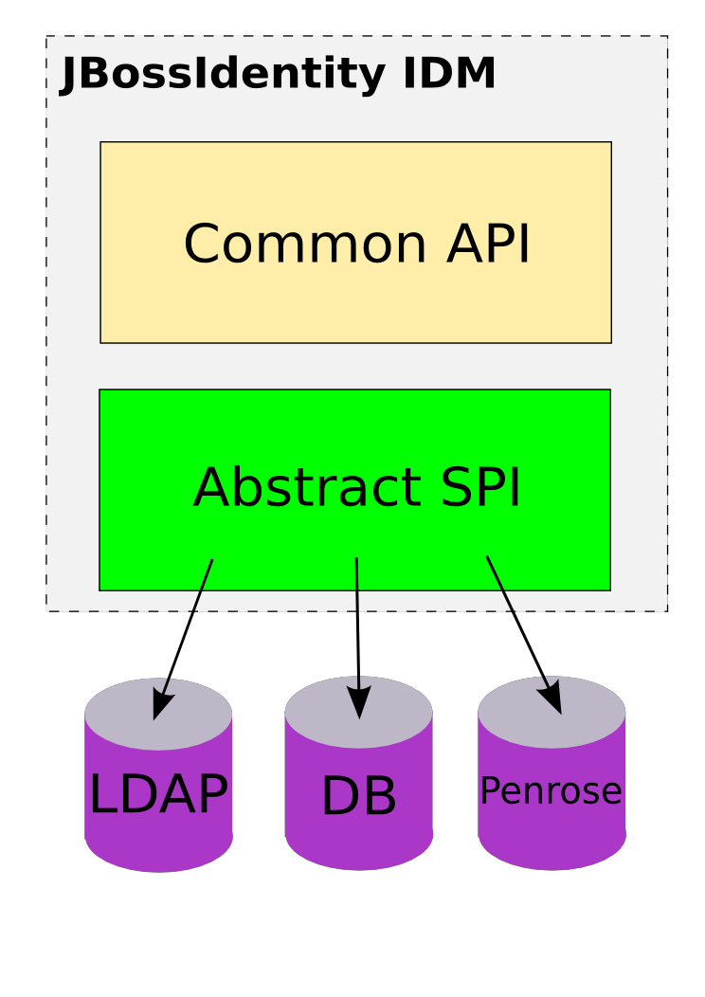
PicketLink

Slide 31
PicketLink Integration configuration
GateIn 3.1 uses PicketLink IDM component to keep the necessary identity information (users, groups, memberships, etc.)
Legacy interfaces are still used (org.exoplatform.services.organization) for identity management
The identity model represented in 'org.exoplatform.services.organization' interfaces and the one used in PicketLink IDM have some major differences.
The main configuration file is :
portal/portal/conf/organization/idm-configuration.xml

Slide 32
PicketLink Integration configuration
By setting the config parameter of the org.exoplatform.services.organization.idm.PicketLinkIDMService, you can specify which configuration to use
<component>
<key>org.exoplatform.services.organization.idm.PicketLinkIDMService</key>
<type>org.exoplatform.services.organization.idm.PicketLinkIDMServiceImpl</type>
<init-params>
<value-param>
<name>config</name>
<value>war:/conf/organization/picketlink-idm/picketlink-idm-config.xml</value>
portal/portal/conf/organization/picketlink-idm/examples/picketlink-idm-ldap-config.xml is the template to use for standard ldap configuration
To understand all the options it contains, please refer to the PicketLink IDM Reference Guide : http://www.jboss.org/picketlink/IDM.html

Slide 33
Exercise 2a : Configuration Picketlink
Configure Picketlink to use ldap-readonly configuration :
- Copy the portal folder in tomcat_home/gatein/conf directory
Edit the idm configuration file to use the picketlink ldap configuration : portal/portal/organization/idm-configuration.xml, in this file do :
- Comment the default Picketlink configuration
<value>portal/portal/organization/picketlink-idm/picketlink-idm-config.xml</value>
- Uncomment the ldap configuration (readonly is already « true ») :
<value>portal/portal/organization/picketlink-idm/examples/picketlink-idm-ldap-acme-config.xml</value>
- Uncomment the lines for ACME LDAP example
Edit the ldap configuration file :
portal/portal/organization/picketlink-idm/examples/picketlink-idm-ldap-acme-config.xml
Change the providerURL, adminDN, adminPassword

Slide 34
Exercise 2b: Configuration Picketlink
Enable the readonly configuration (in picketlink-idm-ldap-acme-config.xml) :
<option>
<name>allowCreateEntry</name>
<value>false</value>
</option>
Clean the jcr data in /tomcat_home/gatein/data
Create a new DN « dc=exoplatform,dc=com » (via the control panel) and import the data in the ldap :
portal/portal/organization/picketlink-idm/examples/gatein-sample.ldif
Start eXo
Go into "Users and groups management »
Under root create group "acme"
Create two subgroups under "acme" - "roles" and "organization_units »

Slide 35
Exercise 2c: Configuration Picketlink
At the moment users defined in LDAP should be visible in "Users and groups management" and groups from LDAP should be present as children of /acme/roles and /acme/organization_units
Create a New User via the interface.
Is the User created on the ldap? Why?
How does it work?
- groupTypeMappings option defines that all groups under /acme/roles should be stored in PicketLink IDM with the acme_roles_type group type name (same for /acme/organization_units and acme_ou_type). (idm_configuration.xml)
- In PicketLink IDM configuration file repository maps users and those two group types (acme_roles_type and acme_ou_type) to be stored in LDAP. An additional option defines that nothing should be written (except password update) from eXo, so that this is readonly. (picketlink-idm-ldap-acme-config.xml)

Slide 36
SSO - Single Sign On
36
Notes:
36

Slide 37
SSO - Single Sign On
The portal users gain access to many systems through portlets using a single identity
However, the portal infrastructure must be integrated with other SSO enabled systems
eXo platform provides some form of Single Sign On (SSO) as an integration and aggregation platform.
Many different Identity Management solutions available :
CAS - Central Authentication Service
JOSSO
OpenSSO - The Open Web SSO project
SPNEGO
In most cases each SSO framework provides a unique way to plug into a Java EE application

Slide 38
Exercise 3a: SSO CAS
The integration consists of two parts :
1. installing or configuring a CAS server
2. setting up the eXo (CAS Client).
CAS Server Setup
To install the CAS server, copy the prepared cas.war in into tomcat/webapps (in the toolkit)
For the exercise, we will deploy the CAS on the same tomcat as eXo, on production environnement, a CAS server runs on a standalone server.
cas.war has been pre-configured to work with eXo, you can find more information here: http://docs.jboss.com/gatein/portal/3.1.0-FINAL/reference-guide/en-US/html_single/index.html#sect-Reference_Guide-Single_Sign_On-CAS_Central_Authentication_Service

Slide 39
Exercise 3b: SSO CAS
Edit the tomcat/conf/server.xml file in the CAS server and uncomment the SSL section to open up port 8443.
<!-- Define a SSL HTTP/1.1 Connector on port 8443 -->
<Connector port="8443" maxHttpHeaderSize="8192"
maxThreads="150" minSpareThreads="25" maxSpareThreads="75"
enableLookups="false" disableUploadTimeout="true" acceptCount="100" scheme="https"
secure="true" clientAuth="false" sslProtocol="TLS" />
CAS Client Setup
Generate the SSL cert with Java keytool. Answer the questions: your firstname and lastname MUST be the hostname (localhost for testing) of your server and cannot be an IP address:
keytool -genkey -alias tomcat -keypass changeit -keyalg RSA
Export it : keytool -export -alias tomcat -keypass changeit -file %FILE_NAME%
Finally import the cert into Java's keystore : keytool -import -alias tomcat -file %FILE_NAME% -keypass %PASSWORD% -keystore %JAVA_HOME%/jre/lib/security/cacerts

Slide 40
Exercise 3c: SSO CAS
Copy all libraries from the %CAS_toolkit%gatein_sso/cas/gatein.ear/lib into tomcat_home/lib)
Edit tomcat/conf/jaas.conf, comment the default configuration and uncomment this section:
org.gatein.sso.agent.login.SSOLoginModule required org.exoplatform.services.security.j2ee.TomcatLoginModule required portalContainerName=portal realmName=gatein-domain
Start the tomcat and test if the CAS server is up & running:
https://127.0.0.1:8443/cas
Login with the username root and the password gtn (or any account created through the portal)
To use the Central Authentication Service, eXo needs to redirect all user authentications to the CAS server.

Slide 41
Exercise 3d: SSO CAS
Information about where the CAS is hosted must be properly configured within the eXo instance. The required configuration is done by modifying:
- tomcat_home/webapps/platform-extension/login/jsp/login.jsp
- Replace the InitiateLoginServlet declaration in tomcat_home/webapps/portal/WEB-INF/web.xml by:
<servlet> <servlet-name>InitiateLoginServlet</servlet-name>
<servlet-class>org.gatein.sso.agent.GenericSSOAgent</servlet-class>
<init-param>
<param-name>ssoServerUrl</param-name>
<param-value>https://localhost:8443/cas</param-value> </init-param>
<init-param> <param-name>casRenewTicket</param-name>
<param-value>false</param-value>
</init-param>
</servlet>
Try to access to eXo

Slide 42
eXo SysAdmin Training
Notes:
42

