Slide 1
eXo SysAdmin Training
JMX Remote Monitoring
Notes:
1

Slide 2
Table of Contents
Introduction JMX & VisualVM
JMX remote configuration
Connecting VisualVM to remote JVM
Using VisualVM
Exercises : VisualVM

Slide 3
Introduction JMX & VisualVM
3
Notes:
3

Slide 4
Introduction JMX & VisualVM
JMX is a generic interface created by Sun for retrieving statistics on Java applications.
There are pre-built JMX client applications that exist for gathering these statistics and also APIs for creating custom applications
VisualVM is a GUI application designed for monitoring Java applications. It acts as a client to the JMX interface and can monitory statistics locally or remotely.
By default VisualVM will monitor the VM from which it's launched (locally)
JMX service does not incur any significant overhead

Slide 5
JMX Remote Configuration
5
Notes:
5

Slide 6
JMX remote configuration (JBoss)
For JBoss, you can set Java environment variables in $JBOSS/bin/run.conf with the shell environment variable $JAVA_OPTS :
- Define a variable REMOTE_DEBUG
# Enable JMX Remote
REMOTE_DEBUG= "-Dcom.sun.management.jmxremote
-Dcom.sun.management.jmxremote.port=9999
-Dcom.sun.management.jmxremote.authenticate=false
- Dcom.sun.management.jmxremote.ssl=false -Djava.rmi.server.hostname=localhost"
- Set $JAVA_OPTS: JAVA_OPTS="$JAVA_OPTS $REMOTE_DEBUG"
The property com.sun.management.jmxremote indicates that JMX should be activated.
The property com.sun.management.jmxremote.port indicates that remote access is allowed and it should occur on the given port (in the example 9999).

Slide 7
JMX remote configuration (JBoss)
The next two properties, com.sun.management.jmxremote.ssl=false and com.sun.management.jmxremote.authenticate=false disable SSL and authentication respectively.
The final property java.rmi.server.hostname indicates the name of the host on which jboss is running
Authentication should be used in production environments, this configuration should only be used for testing (see JMX remote tomcat configuration for a example of authentication)

Slide 8
JMX Remote Configuration (Tomcat)
During start up sequence tomcat calls the file TOMCAT_HOME/bin/setenv.bat (or TOMCAT_HOME/bin/setenv.sh depending on your environment) which sets up any extra environment variables or Java VM command line options.
In some of the Tomcat distributions this file does not exist, so you must create it yourself
Tomcat’s servlet container is called Catalina so inside TOMCAT_HOME/bin/setenv.bat we must set our JMX options in the environment variable CATALINA_OPTS.
All the arguments must go on the same line.
set CATALINA_OPTS=-Dcom.sun.management.jmxremote
-Dcom.sun.management.jmxremote.port=9999
-Dcom.sun.management.jmxremote.authenticate=false
-Dcom.sun.management.jmxremote.ssl=false
-Djava.rmi.server.hostname=localhost

Slide 9
JMX Remote Configuration (Tomcat)
The property com.sun.management.jmxremote indicates that JMX should be activated.
The property com.sun.management.jmxremote.port indicates that remote access is allowed and it should occur on the given port (in the example 9999).
The next two properties, com.sun.management.jmxremote.ssl=false and com.sun.management.jmxremote.authenticate=false disable SSL and authentication respectively.
The final property java.rmi.server.hostname indicates the name of the host on which jboss is running
Authentication should be used in production environments, this configuration should only be used for testing

Slide 10
JMX Remote Configuration
The first thing you need to do is create a password file ($CATALINA_HOME/conf/jmxremote.password) with the user accounts that can access the monitoring information :
guest password admin password
The file above create two users, guest and admin. The »guest" account has a password "password" and the admin account has the password "password ».
The next step is to assign permissions to each account. This is done in another text file that I named $CATALINA_HOME/conf/jmxremote.access:
guest readonly admin readwrite

Slide 11
JMX Remote Configuration
After creating these two file you need to set the file permissions such that only the owner can read them
The final step is to add properties to CATALINA_OPTS that initialize JMX (in setenv.bat or setenv.sh) and point to the given files :
-Dcom.sun.management.jmxremote.ssl=false
-Dcom.sun.management.jmxremote.authenticate=true
-Djava.rmi.server.hostname=localhost
-Dcom.sun.management.jmxremote.password.file=$CATALINA_HOME/conf/jmxremote.password
-Dcom.sun.management.jmxremote.access.file=$CATALINA_HOME/conf/jmxremote.access";

Slide 12
Connecting VisualVM to remote JVM
12
Notes:
12

Slide 13
Connecting VisualVM to remote JVM
Download VisualVm from : http://visualvm.java.net/download.html
VisualVM will monitor the VM from which it's launched (locally)
First create a remote host (via File-> add remote host), by default localhost is already define as « local »
Add a JMX connection to remote eXo platform server (via File ->add JMX connection)
Add a name and specify the port (9999 for example) used by the JMX
Add a username/password if you are using the authentication
You have now remote JMX access.

Slide 14
Using VisualVM
14
Notes:
14

Slide 15
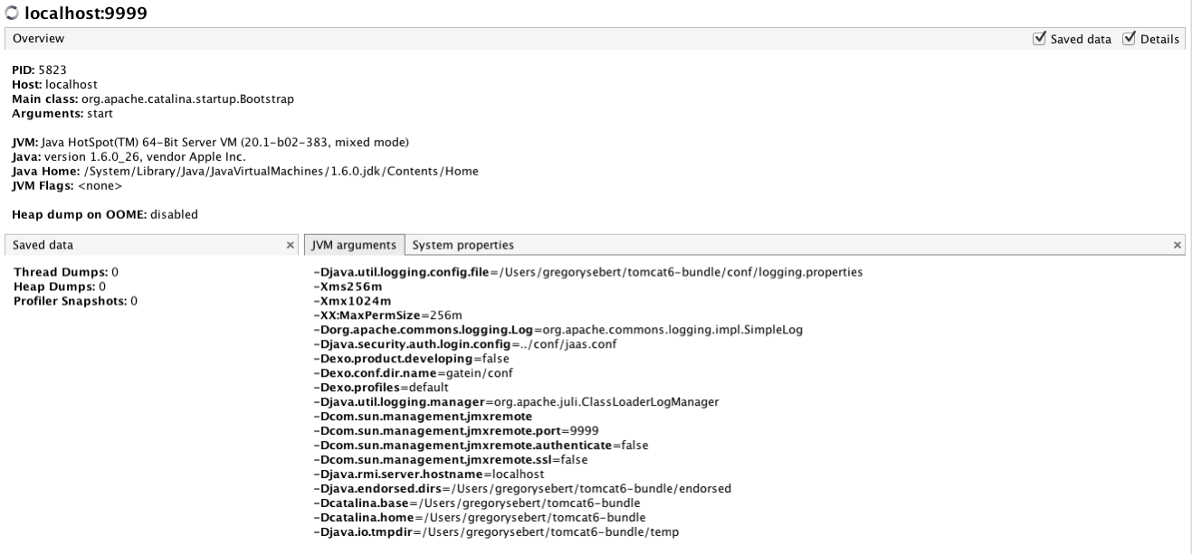
Using VisualVM (Overview tab)
The Overview tab display shows high-level information about the application: its process ID, Java version used to run it, the name of the main class, etc..

Slide 16
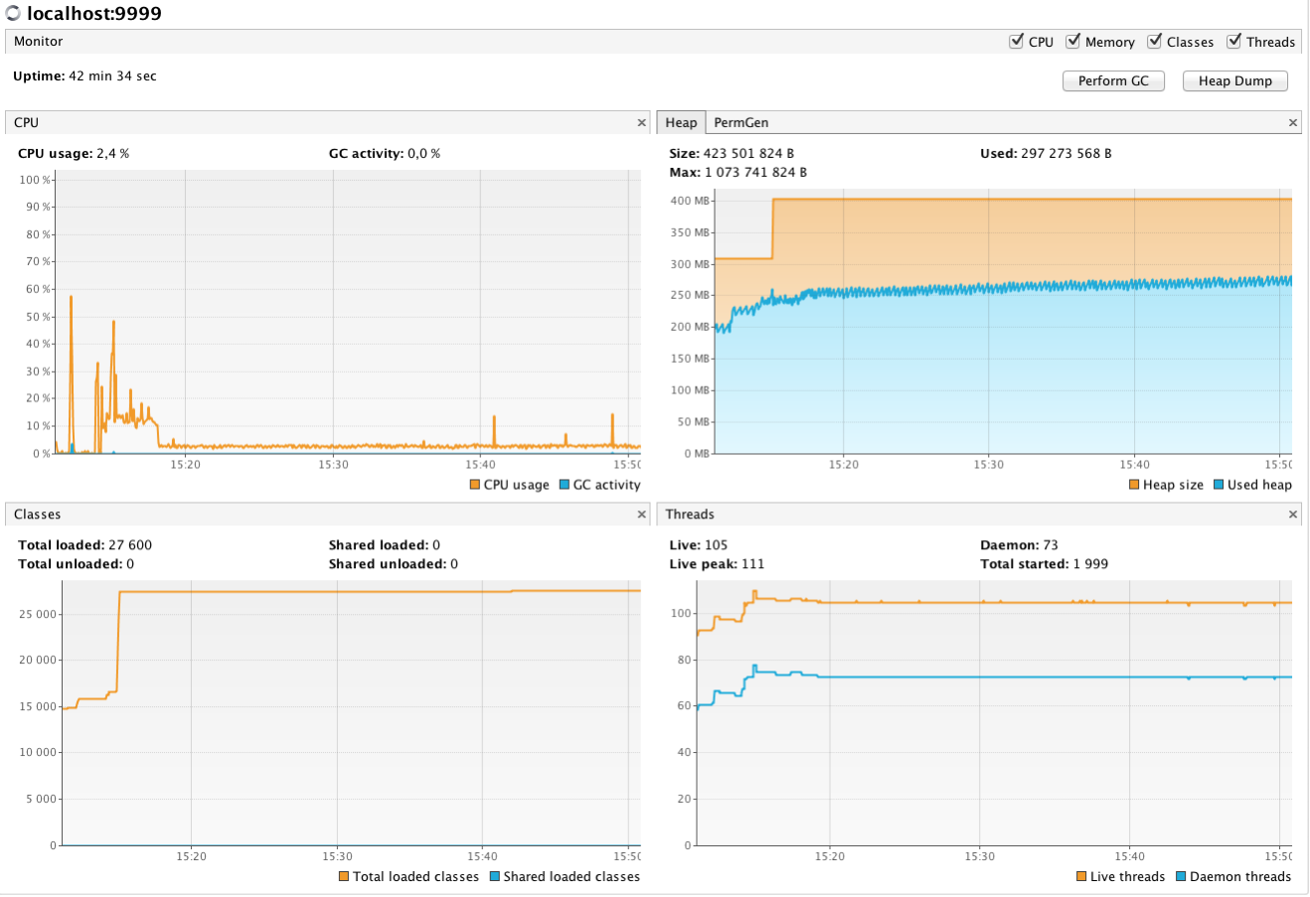
Using VisualVM (Monitor tab)
The Monitor display use full graphs about : CPU, Heap, Permanent Generation, Threads, and Classes
You can also perform GC (garbage collector) or Heap Dump directly from the interface.

Slide 17
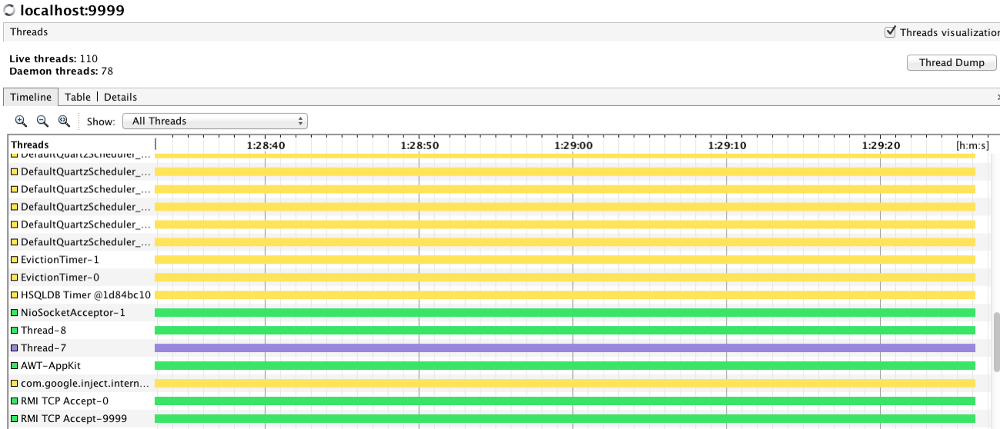
Using VisualVM (Threads tab)
This tab displays a timeline with real-time thread states. Use the buttons in the Timeline toolbar to zoom in/out on the current view
The drop-down list enables you to select which threads are displayed. You can choose to view all threads, live threads or finished threads.
You can also select a single thread or multiple threads to display a subset of the threads. You can double-click on a thread timeline to open that thread in the Details tab

Slide 18
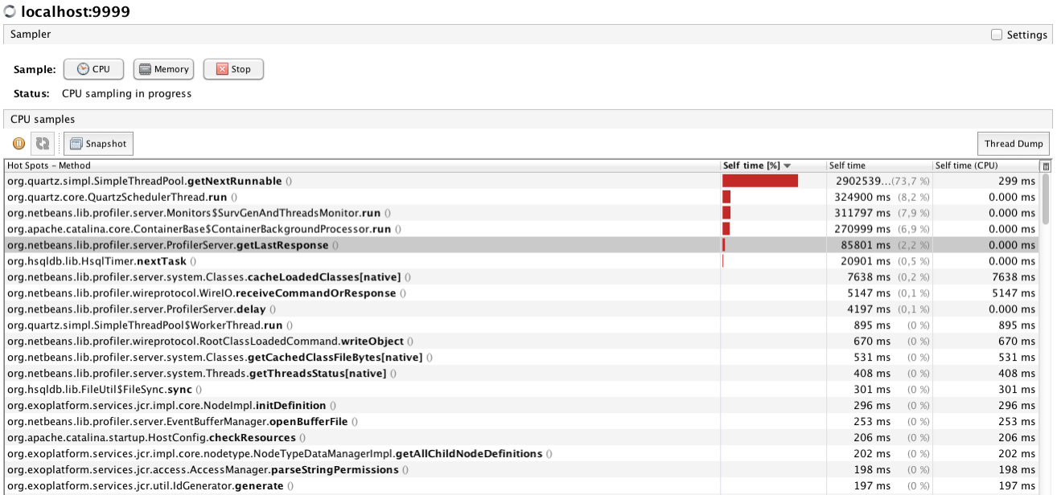
Using VisualVM (Sampler(profiler) tab)
The Sampler tab provides a powerful performance and memory profiler which uses sampling, a technique that allows performance and memory data to be gathered with zero setup and virtually no overhead.

Slide 19
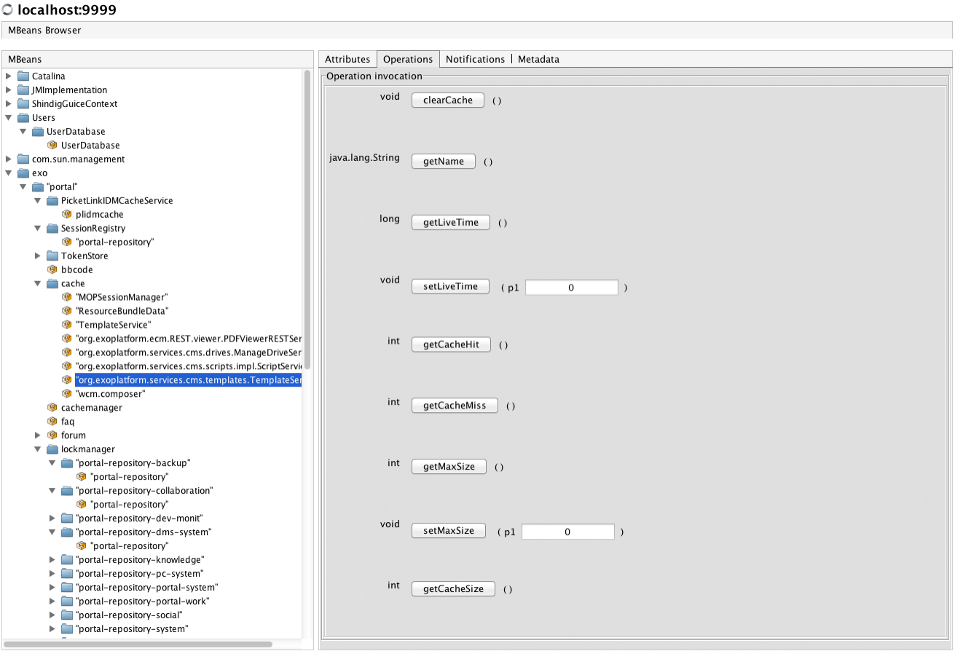
Using VisualVM (Mbeans tab)
The MBeans tab displays information about all the MBeans registered with the platform MBean server.
Exo expose various attributes, operations, notifications, and metadata are
For example, Mbeans tab can be used to manage eXo cache or to retieve eXo keys attributes :

Slide 20
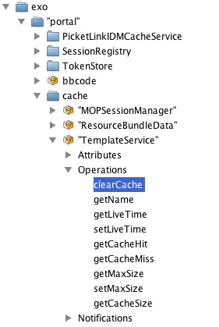
Using VisualVM (Mbeans tab)
Clearing a cache (of groovy templates):

Slide 21
Exercises : VisualVM
21
Notes:
21

Slide 22
Exercises : 80a Connection to JMX
Download VisualVM from : http://visualvm.java.net/download.html
Setup eXo to accept remote conection on port 9999 without authentitication (all the information are in JMX remote configuration (Tomcat) slides)
Start VisualVM
Add a JMX connection to remote eXo platform server (via File ->add JMX connection)
Add a name and specify the port 9999 used by the JMX
You have now remote JMX access.

Slide 23
Exercises : 80b Connection to JMX with authentitication
Setup eXo to use remote JMX with authentification (All information are in the JMX remote configuration (tomcat - Password Authentication slides).
Create a user adminjmx password adminjmx with read write permission
Create a user guestjmx password guestjmx with read only permission
Restart eXo
Launch VisualVM
Try to connect to jmx, what happens?
Connect to jmx with user guestjmx, go to Mbeans, go to catalina->engine, and try to stop the engine via the operation tab. What happens?
Connect to jmx with user guestjmx, go to Mbeans, go to catalina->engine, and try to stop the engine via the operation tab. What happens?
Restart tomcat

Slide 24
Exercises : 80c Using VisualVM
Go to overview tab, retrieve the JVM argument and system properties
In the monitor tab, perform a Heap Dump & save it to your machine.
Open this Heap Dump with VisualVM, you can find information about classes, instances etc ....
In the sampler tab, perform a cpu & memory sampling
With the sampler profiler, you can easily identifiy the top cpu & memory consumer.
With the MBeans tab, explore the MBeans exposed by eXo :
Retrieve the portal configuration (in exo->portal->portal->portal.getConfigrationXML())
In the forum MBeans, check if john & root has admin role:
(in exo->portal->forum->hasAdminForumRole(« john »)
Clear the eXo template cache (in exo->portal->cache->TemplateService.clearCache())

Slide 25
eXo SysAdmin Training
Notes:
25

