Slide 1
Portlets

Slide 2
Concepts

Slide 3

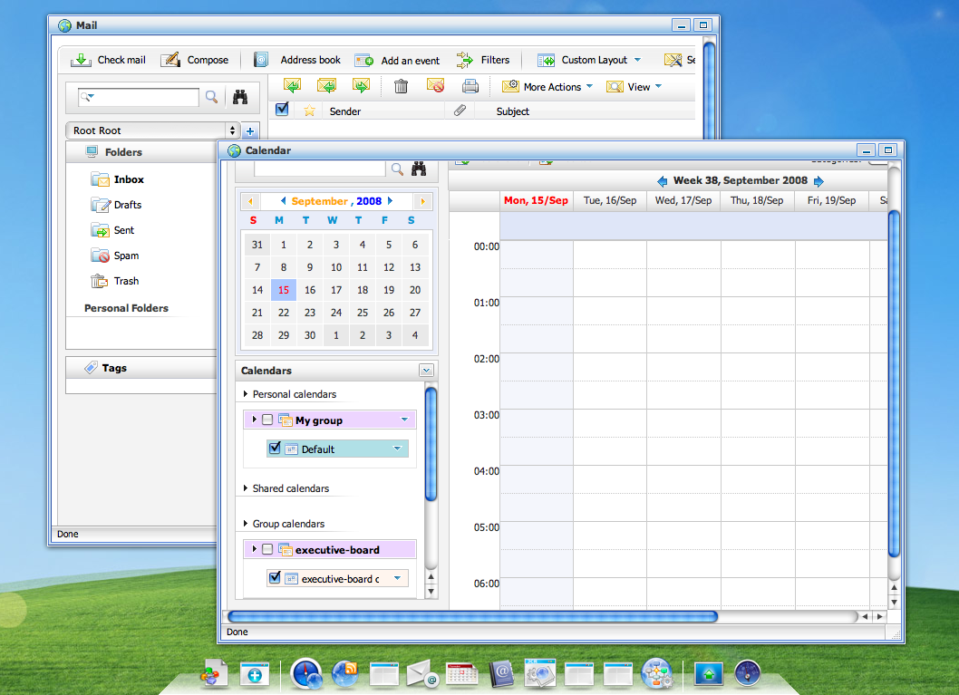



Portlets
Enterprise portals aggregate your applications, contents and services
Calendar
Portlet
Portal
Sales
Gadget
Java EE

Slide 4
Definitions
Portlet : A portlet is an application that provides a specific piece of content (information or service) to be included as part of a portal page.
Portlet Container : A portlet container contains portlets and manages their lifecycle.
JSR-286

Slide 5

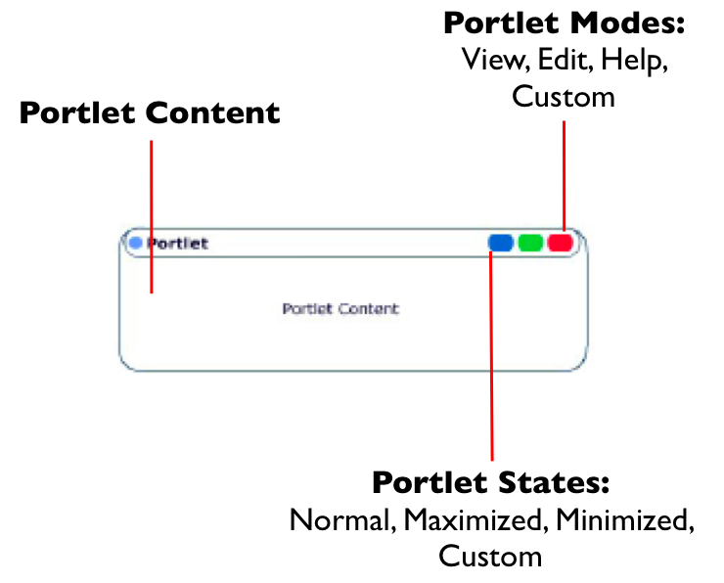
Concepts

Slide 6
Portlets
Portlets are server components
  Similar to servlets
  Designed for aggregation and personalization
  Portlet 2.0 standard
  Designed to integrate with the Java EE ecosystem but not part of it

Slide 7

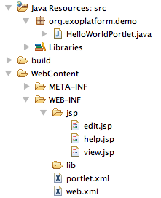
Portlet
JSR 168 et JSR 286
Based on a Web Container (Servlets/JSP)
Extends the class javax.portlet.GenericPortlet
Configuration:
  ./WEB-INF/portlet.xml
Notes:
- le warfile contient un des portlets. Une portlet s’occupe de la gestion

Slide 8
MVC Phases

Slide 9
The MVC paradigm
Portlets interactions are divided into three phases:
  action phase updates state and acts as controller
  event (Portlet 2.0+) phase coordinates portlets, it is an extension of the action phase to other portlets on the same page
  render phase retrieves markup to update the view

Slide 10
Portlets lifecycle
init()
  Initialization of the portlet
processAction()
  Valid the form and commit changes in the database
processEvent()
  Event management
render()
  Render the content of the portlet and read in the database
destroy()
  Destroy the portlet

Slide 11
Portal http GET
Renders a portal page
  The render phase reads the state and create markup

Slide 12
Portal http POST
Triggered by a portlet to trigger the execution of its action phase
  The action updates the state
    Database
    Session
    Preferences
    Parameter
  The optional event phase signals other portlet that something happened
  Finally page rendering occurs again

Slide 13
Phase sequence
Portal
Portlet
Portlet
Portlet
Action
Event
Render

Slide 14
Portlet vs Gadget vs Servlet

Slide 15
Gadgets
Gadgets are browser components
  An embeddable chunk of Javascript using web standards
  Many implementations, many names: widgets, badge, module, webjit, capsule, snippet, …
  eXo uses the de facto standard “Google Gadget”

Slide 16
Portlets vs Gadgets
Portlet | Gadget
Portlets use the javax.portlet interfaces and classes | Google Gadget API
Requires a build (compile/package/deploy) | No development process required
Supports Browser Back Button (BBB) | No support for BBB
Supports bookmarkability | No support for bookmarkability

Slide 17
Portlets vs Gadgets
Portlet | Gadget
Request/response server interactions | Live user interface
State is shared between the portal and the portlet container | State is shared between the browser DOM and the portal No development process required
Use container services (Database, EJB, ESB) | Use Programmable Web, usually REST Web Services
Standardized coordination | De facto standard by Google

Slide 18
Portlet vs Servlet
Portlet Extras
Decorations
  Portlet mode: view, edit, help, admin
  Window state: minimized, normal, maximized
Personalization
Specified support for internationalization
Categorization

Slide 19
Portlet / Servlet similarities
PortletRequest | ServletRequest
PortletResponse | ServletResponse
PortletSession | ServletSession
PortletContext | ServletContext
PortletFilter | ServletFilter
PortletRequestDispatcher | RequestDispatcher

Slide 20
Architecture

Slide 21
Request / Response Objects
Each phase defines his own objects
Similar to the Servlet API
PortletRequest
PortletResponse
ActionRequest
RenderRequest
ActionResponse
RenderResponse
EventRequest
ResourceRequest
EventResponse
ResourceResponse

Slide 22

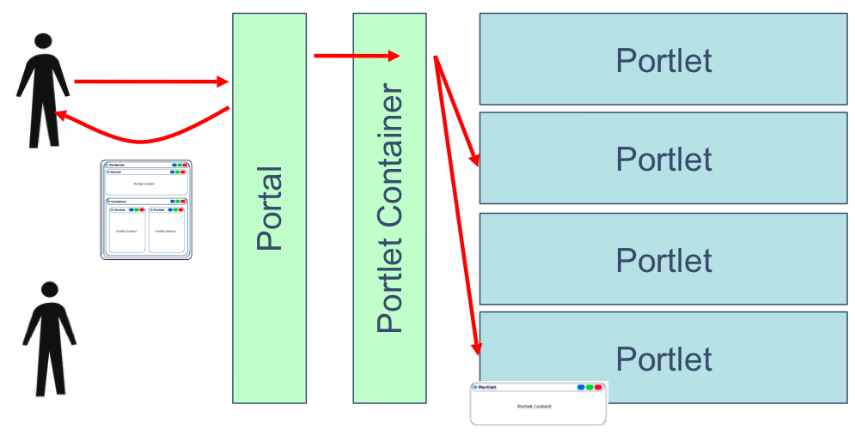
Architecture

Slide 23
Portlet application packaging
Portlets are packaged in a war file and the portlet container discovers them
The portlet.xml deployment descriptor configures and describes the portlets

Slide 24
Configuration
<?xml version="1.0" encoding="UTF-8"?>
<portlet-app
xmlns="..." version="2.0"xmlns:xsi="..."
xsi:schemaLocation="http://java.sun.com/xml/ns/portlet/portlet-app_2_0.xsd">
<portlet>
<description xml:lang="EN">HelloWorld Portlet</description>
<portlet-name>HelloWorld</portlet-name>
<display-name xml:lang="EN">Hello World Portlet</display-name>
<portlet-class>org.exoplatform.demo.HelloWorldPortlet</portlet-class>
<expiration-cache>0</expiration-cache>
<supports>
<mime-type>text/html</mime-type>
<portlet-mode>help</portlet-mode>
<portlet-mode>edit</portlet-mode>
</supports>
<supported-locale>en</supported-locale>
<supported-locale>fr</supported-locale>
<portlet-info>
<title>HelloWorld</title>
<short-title>Hello</short-title>
</portlet-info>
</portlet>
</portlet-app>

Slide 25
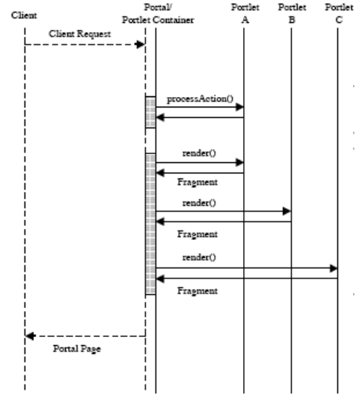
Architecture
The portal calls the processAction() method on one single portlet of the page in the portal.
The render() method of all the portlets on the page is called
The processAction() method allows to change the state of an object shared by many portlets of the page.

Slide 26
Architecture

Slide 27
JSP Code Snippets

Slide 28
PortletRequestDispatcher
Delegate rendering to a jsp page
private static final String VIEW_PAGE = "/WEB-INF/jsp/view.jsp";
public void doView(RenderRequest pRequest, RenderResponse pResponse)
throws PortletException, IOException {
  pResponse.setContentType("text/html");
  PortletContext context = getPortletContext();
  portletRequestDispatcher rd = context.getRequestDispatcher(VIEW_PAGE);
rd.include(pRequest, pResponse);
}

Slide 29
Portlets URL
Portlets URL are managed by the portal
The PortletURL object is available during rendering phase and allows to create an URL to the action phase or rendering phase of the portlet
...
PortletURL renderURL = response.createRenderURL();
renderURL.setParameter(“a”, “b”);
renderURL.setPortletMode(PortletMode.EDIT”);
renderURL.setWindowState(WindowState.MAXIMIZED);
String url = portletURL.toString();
PortletURL actionURL = response.createActionURL();
...

Slide 30
Portlet Taglib for JSP
...
<%@taglib uri="http://java.sun.com/portlet_2_0" prefix="portlet"%>
<!-- Mandatory !!! -->
<portlet:defineObjects /> <br/>
...
<!-- une autre manière de créer des URLs -->
<portlet:renderURL var="renderURL"/> <br/>
Render Link: <a href="<%=renderURL %>"
...
WindowState and PortletMode <br/>
<%= renderRequest.getWindowState().toString()%> <br/>
<%= renderRequest.getPortletMode().toString()%> <br/>

Slide 31
Portlet Preferences

Slide 32
PortletPreferences
Classes and methods to manage personalization of portlets
Generally used in the «edit» mode
Preferences can be editable (action) or read only (render)

Slide 33
PortletPreferences
...
<portlet-preferences>
<preference>
<name>message</name>
<value>Message par defaut</value>
<read-only>false</read-only>
</preference>
</portlet-preferences>
...
...
PortletPreferences prefs = actionRequest.getPreferences();
prefs.setValue("message", "Nouveau Message");
prefs.store();
...
...
String message = prefs.getValue("message", “");
...

Slide 34
Save Preferences
Input form
...
<portlet:actionURL var="action"/>
<form action="<%=action %>" method="post">
<label for="messageinput">Message:</label>
<input type="text" name="message" id="messageinput" value="<%= message %>"/>
<input type="submit" label="Save" />
</form>
...
ProcessAction() call
...
if (request.getPortletMode().equals(PortletMode.EDIT) ) {
String message = request.getParameter("message");
PortletPreferences prefs = request.getPreferences();
prefs.setValue("message", message);
prefs.store();
response.setPortletMode(PortletMode.VIEW);
}
...

Slide 35
Simple Portlet Example

Slide 36
Portlet Example
Simple Hello World: package
|-- SimplestHelloWorld-0.0.1.war
| `-- WEB-INF
| |-- classes
| | `-- org
| | `-- gatein
| | `-- portal
| | `-- examples
| | `-- portlets
| | `-- SimplestHelloWorldPortlet.class
| |-- portlet.xml
| `-- web.xml

Slide 37
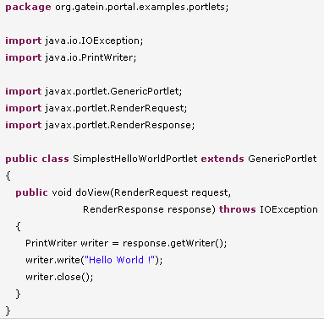
Portlet Example – Portlet Class

Slide 38
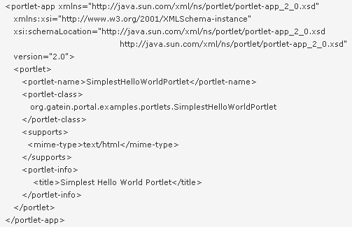
Portlet Example – portlet.xml

Slide 39
Exercises – Simple Portlets
Simple Portlets
There are four examples of portlet bridges
Analyse, build and test these examples
  Simple hello world (java only)
  JSP: hello user (all phases)
If time: Take the JSP example, modify it depending on your experience: modify the rendering jsp files, access to eXo services, add a form and react to different parameters

Slide 40
Exercise – Portlet 2.0
Push by RenderReponse:
In Portlet 2.0 you can modify any element of the response from any portlet.
Therefore you use the RenderResponse object.
An example of a RenderResponse is in a portlet’s form code that adds a javascript to header of the page:
  RenderResponse response = context.getResponse();
  Element elementS = response.createElement("script");
  elementS.setAttribute("type", "text/javascript");
  elementS.setAttribute("src", "/eXoWCMResources/javascript/eXo/wcm/backoffice/public/Components.js");
  response.addProperty(MimeResponse.MARKUP_HEAD_ELEMENT,elementS);
Exercise: Create a portlet that adds a favicon to the current page, access the favicon by a rest service. Or alternatively add Google Analytics.
Favicon hint: <link rel="shortcut icon" href=“/portal-rest-path/name_of_icon.ico">

Slide 41
Portlet Bridges

Slide 42
Bridges
Bridges are portlet implementations which adapt web framework to the portlet world and allows you to execute native applications
  JSF Portlet Bridge / JSR 301
  Struts 1 bridge deprecrated
  Struts 2 portlet
  SpringMVC portlet
  Grails portlet
  Tapestry portlet

Slide 43
The web framework reality check
Gives you productivity
You should not develop an application with the Portlet API
  low level
  not productive

Slide 44
Web framework for portals
The Portlet Bridge
  An adapter for a web framework to the portlet container runtime
  Works ideally with framework that does not expose the servlet container
  Limited support for the full portlet API
The Portlet Framework
  The web framework approach to the portlet world
  Leverage your knowledge of a framework
  The full portlet API can be leveraged

Slide 45
Portlet Bridges
Modern web frameworks have an abstraction (SPI) over the servlet API
  The bridge implements the SPI by delegating to portlet container
Legacy web frameworks relies on the servlet API
  The bridge executes the target framework in its servlet container context
Notes:
SPI : System Programmer Interface

Slide 46
Modern Portlet Bridges
The framework action is executed during the portlet action phase
The framework rendering is executed during the portlet render phase
The best example is JavaServer Faces
  The JSR 301 specifies the semantics of the bridge

Slide 47
Legacy Portlet Bridges
Provides a servlet container context
  The bridge emulates the Servlet API
  or
  The bridge performs a request dispatch to the web framework servlet
Markup must be filtered for aggregation
URLs must be rewritten to work with the portlet container and the portal

Slide 48
JSF Bridge Specification
Portlet Bridge Specification for JavaServer Faces (JSR 301)
  The main goal is to define how a JSF application executes in a portlet environment
  Additionally it specifies how advanced portlet features can be used
  Split into two specifications
    Portlet 1.0 Bridge Specification for JavaServer Faces 1.2
    Portlet 2.0 Bridge Specification for JavaServer Faces 1.2
At least three open source implementations
  Apache MyFaces Portlet (RI)
  JBoss PortletBridge
  OpenPortal JSF PortletBridge

Slide 49
JSF Bridge Lifecycle
Restore
View
Apply
Request
Values
Process
Validations
Action
Save Context
Invoke
Application
Update
Model
Values
Render
Load
Context
Restore
View
Render

Slide 50
JSF Bridge Features
Clean room specification
Maintain action request attributes
Handle identifier namespacing
Handle redirects during the render phase
Supports portlet mode changes
  Manage a view per mode
  Navigation between modes
    /edit.jspx?javax.portlet.faces.PortletMode=edit
    #{sessionScope['javax.portlet.faces.viewIdHistory.view']}

Slide 51
JSF Bridge known issues
The bridge extends JSF and there can be conflicts or ordering issues with other JSF extensions

Slide 52
Apache Struts 2
A Struts 2 plugin provides support for Portlet 1.0
Struts 2 is a clean MVC implementation and does not require much configuration as opposed to Struts 1.x
No specific support for portlet features

Slide 53
Spring Portlet MVC
Leverages the Spring Framework for Portlets
  Part of the core framework since Spring 2.0
  Apply concepts of Spring Web MVC
  File upload support
  Annotation support since Spring 2.5
  No support for Portlet 2.0

Slide 54
Spring Portlet MVC dispatching
The portlets distinct phases are mapped to the controller and the view
The DispatcherPortlet orchestrates the controller and the view
  The action phase is mapped to a specific controller
  The render phase emulates a servlet container and allow the reuse of the view technologies of Spring Web MVC (ViewRendererServlet)

Slide 55
Apache Wicket Bridge
Wicket is a component based web framework
The bridge is available since Wicket 1.3
It requires the Portlet 2.0 API as it relies on the resource serving feature
There is no support for advanced portlet features

Slide 56
Tapestry Bridge
Tapestry has been rearchitected in version 4 to support portlets natively
It provides support for portal features such as
  Map window state and portlet mode to specific pages
  Map user attributes to page properties

Slide 57
Grails Portlet
Grails aims to bring “coding by convention” paradigm to Groovy
  Heavily based on Spring and Hibernate
The Grails Portlet is a plugin for Grails
  The plugin is an extension of the Spring DispatcherPortlet
  View rendering is delegated to a Groovy ServerPage (gsp)
  Transparent Portlet reloading
Warning
  No release of the plugin at the moment
  Need to obtain trunk from SVN

Slide 58
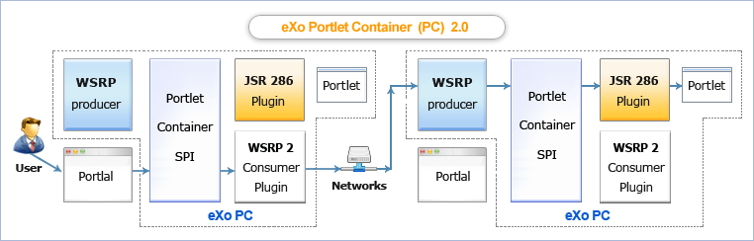
WSRP: Remote Portlets

Slide 59
JBoss Portlet Bridges
JBoss Portlet Bridge
Implementation of the JSR-329 specification which supports the JSF 1.2 runtime within a JSR 286 portlet
Supports JSF, Seam and RichFaces
The developer no longer needs to worry about the underlying portlet development, portlet concepts, or the API.

Slide 60
JBoss Portlet Bridges
Understanding how JSF works with Portal
The portlet bridge isn't a portlet. It's the mediator between the two environments and allows JSF and Portal to be completely unaware of each other.
The bridge is used to execute Faces requests on behalf of the portlet.
During each request, the Faces environment is setup and handled by the bridge.
Part of this implementation acts as a Faces controller much as the FacesServlet does in the direct client request world.

Slide 61
Exercises – JBoss Portlet Bridges
Portlet Bridges
There are four examples of portlet bridges
Analyse, build and test these examples
  JSF: hello user
  Struts: jpetstore
Customize the JSF example

Slide 62
Portlets

