Slide 1
eXo Fundamentals Training
Introduction
Sören Schmidt
soren.schmidt@exoplatform.com
Notes:
1

Slide 2

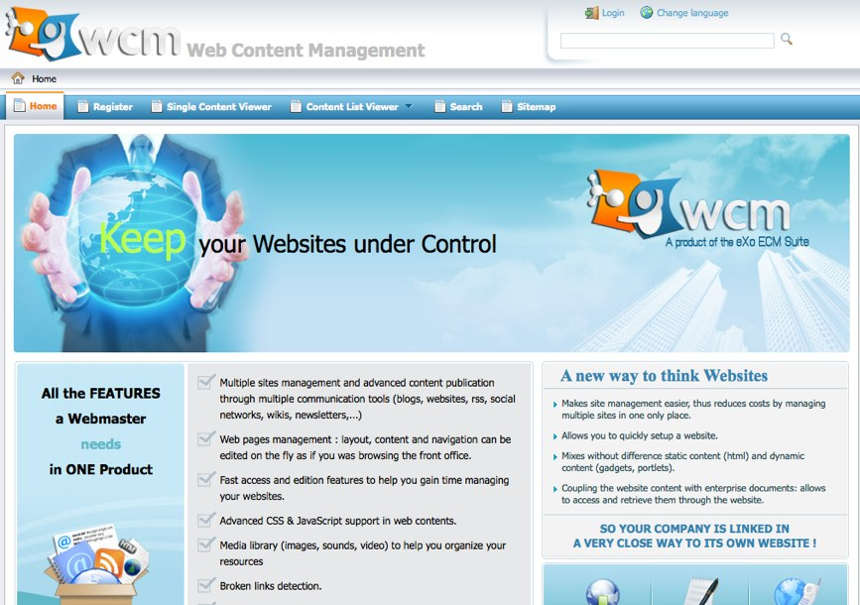
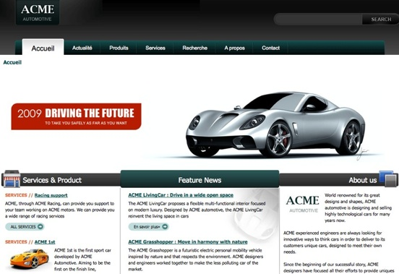
Enterprise Portals
Notes:
2

Slide 3
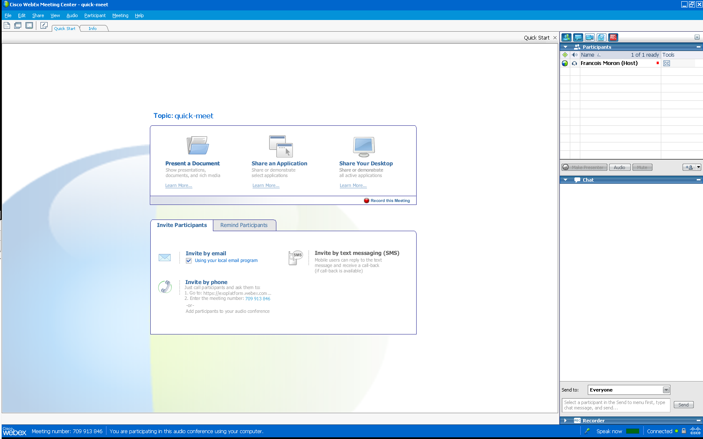
Welcome to eXo Webinar
Our names
Audio
Here you can mute your microphone
Our chat

Slide 4
Objectives
At the end of the eXo Fundamentals Training you should know :
What’s GateIn, eXo Content, eXo Knowledge, eXo Collaboration?
All functional knowledge about these tools
Use, administrate and configure these tools
No programming!

Slide 5
Agenda
Day 1 | Introduction, eXo Portal/GateIn presentation, GateIn Front Office and Backoffice, eXo Content Front Office and Back Office
Day 2 | eXo Content Features, eXo Content Customization, eXo Collaboration, eXo Knowledge, eXo Social, Q & A

Slide 6
Training Toolkit
eXo Platform 3.0
Eclipse
Maven
Maven Repository
Slides
Other Resources:
http://www.exoplatform.com/
http://www.jboss.org/gatein/documentation.html

