Slide 1

UNSEEN VICTIMS: Exploring Male Experience of Domestic Violence and Legal gaps
A Presentation by:
Anirban Das
Arkadwip Dutta
Gourab Mukherjee
Asit Panja
Arijit Chatterjee
Kusal Ranjan Samaddar
.

Slide 2
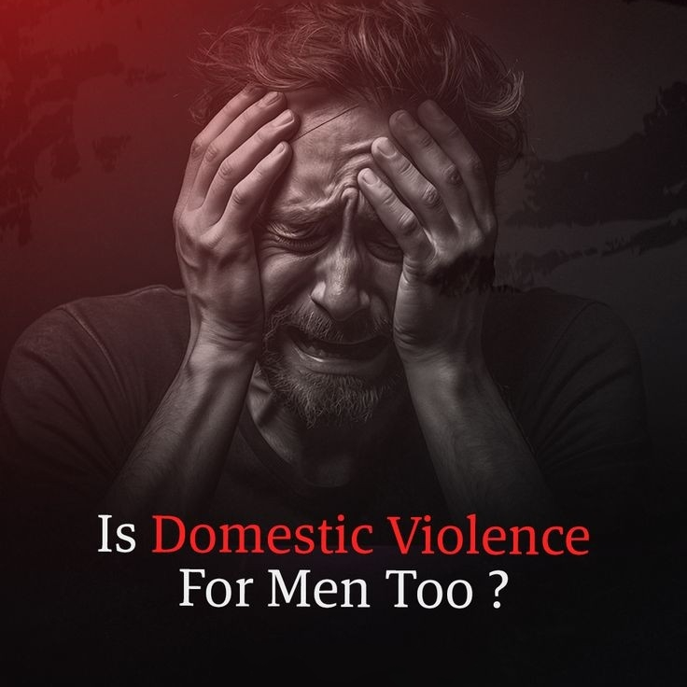
Understanding Domestic violence
Prevalence: Domestic violence against men is more common than often believed. While statistics vary, research suggests that around 1 in 10 men experience some form of intimate partner violence during their lifetime.
Types of Abuse: Like women, men can experience various forms of abuse in domestic settings, including physical, emotional, sexual, and financial abuse. These can range from physical assaults to psychological manipulation and control tactics.
Underreporting: Men are less likely to report domestic violence due to societal stereotypes that suggest men should be strong and invulnerable. Fear of not being taken seriously or being ridiculed can also contribute to underreporting.
Stigma and Shame: There is a significant stigma attached to being a male victim of domestic violence. Many men feel ashamed or emasculated by their experiences and may struggle to seek help or support.

Slide 3
Societal Perceptions and Stereotypes
Belief in Male Invulnerability: One pervasive stereotype is the belief that men are inherently strong and invulnerable, both physically and emotionally. This stereotype can lead to disbelief or minimization of men's experiences of abuse, as it contradicts the idea of men as capable of being victimized.
Perception of Female Harmlessness: There's a widespread assumption that women are less capable of causing harm, especially physical harm, compared to men. This perception can lead to disbelief or trivialization of men's experiences of abuse perpetrated by female partners.
Portrayal in Media and Culture: Mainstream media and cultural narratives often depict men as perpetrators of violence and women as victims. This can reinforce the misconception that domestic violence is primarily a problem faced by women, overshadowing the experiences of male victims.
Changing Perceptions: Challenging these stereotypes and perceptions is essential for raising awareness about domestic violence against men and ensuring that all victims receive the support and resources they need. It involves promoting a more inclusive understanding of gender and masculinity, as well as acknowledging that anyone can be a victim or perpetrator of abuse regardless of gender

Slide 4

Legal Frameworks and Gaps
Protection Orders: Legal mechanisms such as restraining orders or protection orders are available to victims of domestic violence in many jurisdictions. However, male victims may face challenges in obtaining these orders, as they may be less likely to be taken seriously or believed by authorities.
Criminal Justice System Response: Male victims of domestic violence may encounter skepticism or disbelief from law enforcement and the criminal justice system when reporting abuse. There may be a perception that men cannot be victims or that they should be able to defend themselves, leading to a lack of investigation or prosecution of cases involving male victims.
Addressing these gaps in legal frameworks is essential for ensuring that male victims of domestic violence receive the protection, support, and justice they deserve. This includes recognizing their experiences, providing accessible and gender-inclusive services, and challenging stereotypes and biases that may hinder their ability to seek help.

Slide 5
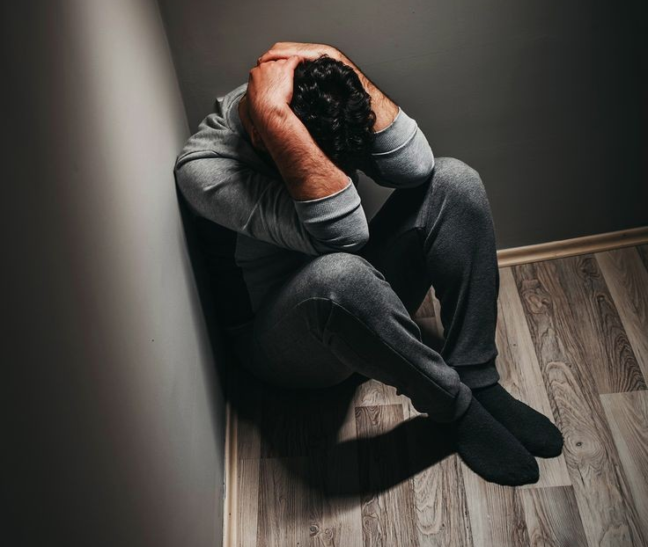
Barriers to Seeking Help
Stigma and Shame: Societal norms and stereotypes around masculinity can lead male victims to feel ashamed or emasculated by their experiences of abuse. They may worry about how seeking help will impact their perceived masculinity or fear being judged by others.
Lack of Awareness and Understanding: Many people, including victims themselves, may not recognize the signs of domestic violence in male victims or may believe that men cannot be victims of abuse. This lack of awareness can prevent victims from identifying their experiences as abuse and seeking help.
Fear of Not Being Taken Seriously: Male victims may fear that their experiences will not be believed or taken seriously by law enforcement, healthcare professionals, or support services. This fear can be exacerbated by stereotypes that suggest men should be able to defend themselves or that domestic violence is primarily a women's issue.
Lack of Support Services: Many support services for victims of domestic violence are designed with women in mind and may not be accessible or appropriate for male victims. This can include shelters, counseling services, and legal assistance. Male victims may struggle to find resources that cater to their needs.

Slide 6

Impact on Male Victims
Emotional and Psychological Trauma: Domestic violence can cause significant emotional and psychological trauma for male victims. They may experience feelings of fear, anxiety, depression, and helplessness as a result of the abuse. This trauma can affect their self-esteem, confidence, and ability to trust others.
Post-Traumatic Stress Disorder (PTSD): Male victims of domestic violence are at risk of developing PTSD, a mental health condition that can occur after experiencing or witnessing a traumatic event. Symptoms of PTSD can include flashbacks, nightmares, hypervigilance, and avoidance of reminders of the trauma.
Physical Injuries: Male victims of domestic violence can sustain physical injuries ranging from bruises, cuts, and broken bones to more severe injuries requiring medical attention. These injuries can have long-term health consequences and may require ongoing medical treatment.
Impact on Children: Male victims who have children with their abuser may worry about the impact of the abuse on their children's well-being.

Slide 7
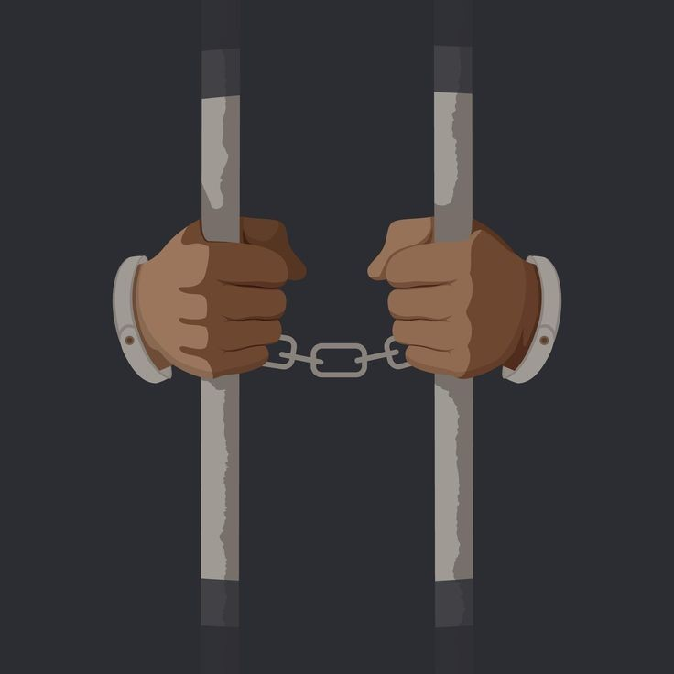
Support Service Available
Counseling and Therapy: Counseling and therapy can be crucial for male victims of domestic violence to process their experiences, manage trauma symptoms, and develop coping strategies. Some therapists specialize in working with male victims of domestic violence and can provide a supportive and nonjudgmental space for healing.
Legal Assistance: Legal assistance is essential for male victims who are navigating the legal system, seeking protection orders, or pursuing custody or divorce proceedings. Legal advocacy organizations may provide free or low-cost legal services to victims of domestic violence, including representation in court.
Helplines and Hotlines: Many countries have helplines or hotlines specifically dedicated to providing support and information to male victims of domestic violence. These helplines are often staffed by trained professionals who can offer advice, safety planning, and referrals to local resources.
Healthcare Services: Healthcare providers can play a critical role in identifying and responding to domestic violence in male victims. They can provide medical treatment for injuries, screen for mental health concerns, and offer referrals to support services. Some healthcare facilities may have specialized programs or protocols for addressing domestic violence.
Community Resources: Community-based organizations, faith-based groups, and social service agencies may offer a range of support services for male victims of domestic violence, including emergency assistance, financial support, and practical assistance with housing, employment, or childcare.
.

Slide 8

Challenges In Prosecution
Gender Bias: There may be a societal bias or misconception that domestic violence is primarily perpetrated by men against women. This bias can influence how law enforcement, prosecutors, judges, and jurors perceive cases involving male victims, leading to disbelief or minimization of their experiences.
Stereotypes of Masculinity: Stereotypes about masculinity may influence how male victims are perceived and treated within the criminal justice system. Male victims may be expected to be physically strong and capable of defending themselves, leading to skepticism about their vulnerability or credibility.
Lack of Legal Protections: In some jurisdictions, legal protections and resources for male victims of domestic violence may be limited or nonexistent. This can hinder prosecutors' ability to pursue charges and provide support to victims throughout the legal process.
Cultural and Social Barriers: Cultural or social norms regarding gender roles, family dynamics, and relationships may influence how domestic violence cases involving male victims are perceived and handled within the legal system. Prosecutors may need to navigate these cultural nuances sensitively while ensuring victims' rights and safety are prioritized.
.

Slide 9

Policy Recommendations
Gender-Inclusive Legislation: Ensure that laws and policies related to domestic violence are gender-neutral and inclusive of male victims. This can help combat gender bias and ensure that all victims receive equal protection under the law.
Specialized Units and Protocols: Establish specialized units within law enforcement agencies and prosecutor's offices to handle cases of domestic violence, including those involving male victims. Develop protocols and best practices for investigating and prosecuting these cases, with a focus on victim-centered approaches and sensitivity to the unique needs of male victims.
Victim Support Services: Ensure that male victims of domestic violence have access to a range of support services, including counseling, advocacy, housing assistance, legal aid, and financial support. These services should be gender-inclusive and tailored to the specific needs of male victims.
Community Outreach and Education: Implement public awareness campaigns and community outreach initiatives to raise awareness about domestic violence against male victims, challenge stereotypes and stigma, and encourage reporting of abuse. Provide education and resources to schools, workplaces, healthcare providers, and other community organizations.
.

Slide 10
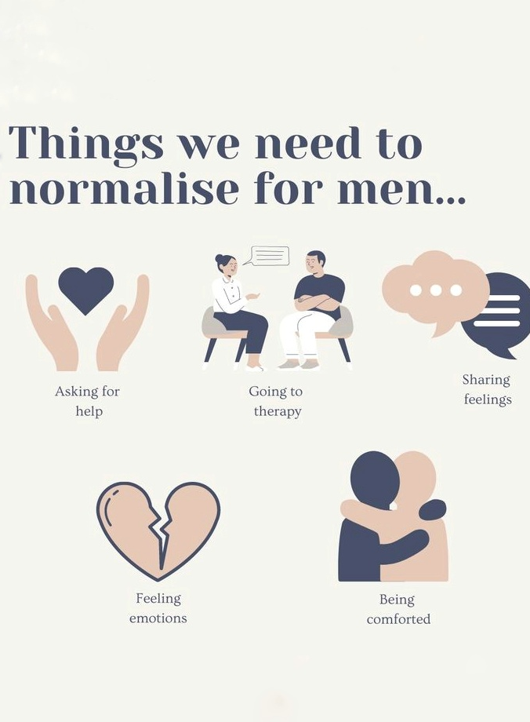
Educational Campaigns
Training and Education: Offer training sessions and educational workshops for professionals working with male survivors, including law enforcement officers, healthcare providers, educators, and social service providers. Provide guidance on recognizing signs of abuse, responding sensitively to disclosures, and connecting survivors with appropriate support resources.
Public Events and Workshops: Organize public events, workshops, and panel discussions to facilitate conversations about domestic violence against male victims. Invite survivors, advocates, and experts to share their insights and experiences, and provide opportunities for participants to ask questions and engage in dialogue.
Social Media: Create a social media campaign using the campaign hashtag (#BreakTheSilence, #SupportMaleSurvivors, etc.) to share statistics, survivor stories, educational resources, and information about support services. Encourage followers to share their own experiences and show solidarity with male survivors.
Public Awareness Materials: Develop posters, flyers, and informational brochures to distribute in community centers, workplaces, schools, healthcare facilities, and other public spaces. Include helpline numbers, local resources, and tips for recognizing and responding to domestic violence.
.

Slide 11

Conclusion
In conclusion, addressing domestic violence against male victims requires a multifaceted approach that involves raising awareness, challenging stereotypes, providing support services, and advocating for policy changes. Despite societal misconceptions and barriers, it's essential to recognize that men can be victims of domestic violence and that their experiences are valid and deserving of support.
Education campaigns play a crucial role in breaking the silence surrounding domestic violence against male victims. By raising awareness about the prevalence and impact of abuse, challenging harmful stereotypes about masculinity and victimhood, and providing information about available resources and support services, we can empower male survivors to seek help and support.
Furthermore, collaboration among government agencies, non-profit organizations, healthcare providers, and community stakeholders is essential for creating a coordinated response to domestic violence and ensuring that male victims have access to the resources and assistance they need to escape abuse and rebuild their lives.
Ultimately, by working together to raise awareness, challenge stigma, and provide support, we can create a society where all survivors of domestic violence, regardless of gender, are believed, supported, and able to access the help they need to heal and thrive.
.

Slide 12

Thankyou!
.
.

