Slide 1
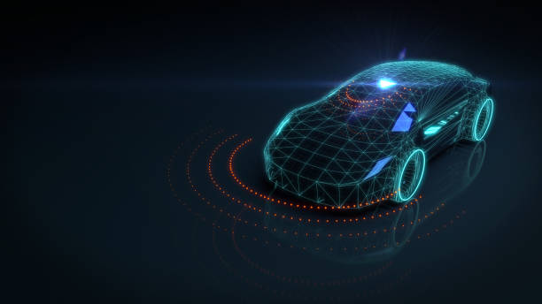
HPC APPLICATIONS
Driverless cars

Slide 2
BATCH - E1
Roll No | Name | PRN no
PE04 | Aniruddha Shende | 1032190079
PE06 | Hrishikesh Vaze | 1032190087
PE11 | Vartika Katiyar | 1032190212
PE13 | Shreya Ramteke | 1032190661

Slide 3
Introduction
Autonomous vehicles will generate and use a large variety of data to permanently analyse their geographical position, condition of the road, state of the vehicle, passenger comfort and safety.
To manage all this data, we need High Performance Computing.
Driverless cars will be equipped with a large number of sensors, embedded cameras, in-car computers, high precision GPS and satellite receivers, short-range wireless network and 5G interfaces to connect to the Internet.

Slide 4
Working
These vehicles will permanently exchange data with management and supervising systems and will sync up with large data-bases that are constantly feeding them with real-time information about the local environment, traffic situation, emergency alerts and weather conditions.
The transmitted information will be used by predictive driving functions to avoid road hazards and increase passenger safety.

Slide 5
When this type of vehicles will go mainstream, the amount of data generated will grow exponentially. According to Intel, driverless vehicles will send more than four terabytes of data (approximately 1000 DVDs) in about an hour and a half of driving to the cloud.
In the future, cars will create significantly more data than today the entire Internet community.
Only next generation exascale High Performance Computing (HPC) and Big Data capabilities can deliver the required computing power to implement predictive decision support systems based on Artificial Intelligence to evaluate this enormous amount of data.

Slide 6
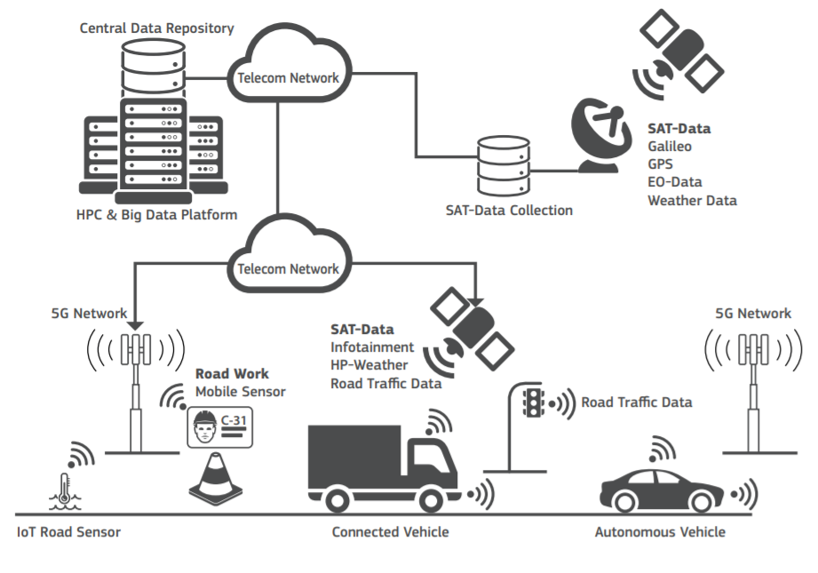
Block Diagram

Slide 7
Impact of HPC
The “Smart Space - Mobility Application” is a new collaboration with the countries involved in the IPCEI: Italy France and Spain.
It will combine “Connected Car” and “Big Data” technologies through the application of data cross-fertilization techniques to gain new insights required for innovative Intelligent Transportation Solutions.
Multiple data streams comes from
Earth Observation and Galileo satellites
Car and road sensors
Weather models
Traffic management
With HPC, It will be possible to processed and converted them into meaningful information that can be delivered to people, vehicles and roadside infrastructures to improve on-road interactions, transport safety and travel comfort.

Slide 8
THANKYOU !

