Slide 1
Introduction to Node.js®

Slide 2
Why node.js ?
“Node's goal is to provide an easy way to build scalable Network programs”

Slide 3
About Node.js……
Created by Ryan Dahl in 2009
• Development & maintenance sponsored by Joyent
• Licence MIT
• Last release : 0.10.31
• Based on Google V8 Engine
• +99 000 packages

Slide 4
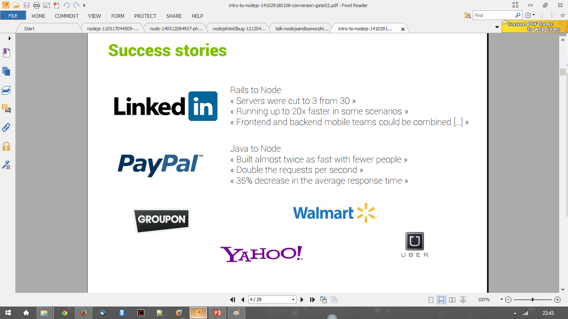
Success Stories…..

Slide 5
Other projects like Node.js….
Vert.x => Polygot programming
Akka => Scala and Java
Tornado => Python
Libevent => C
EventMachine => Ruby

Slide 6
Node.js is not……
Another Web framework
For beginner
Multi-thread

Slide 7
Development for the Web….
Traditional desktop applications have a user interface wired up with background logic
user interfaces are based on Windows Forms, Jswing, WPF, Gtk, Qt, etc. and dependent on operating system
On the web user interfaces are standardized
HTML for markup
CSS for style
JavaScript for dynamic content
In the past proprietary technologies existed on the web, e.g. Adobe Flash, ActiveX
They are slowly dying
Data is generated on the server, transferred to the client and displayed by the browser
Server Side technologies include PHP, JSP, ASP.net, Rails, Django, and yes, also node.js

Slide 8
HTTP Method……
GET
POST
PUT
DELETE

Slide 9
HTTP Method with CRUD…..
POST => Create
GET => Read
PUT => Update
DELETE => Delete

Slide 10
Why node.js ?
Non Blocking I/O
V8 Javascript Engine
Single Thread with Event Loop
40,025 modules
Windows, Linux, Mac
1 Language for Frontend and Backend
Active community

Slide 11
What we can’t do with Node?
Node is a platform for writing JavaScript applications outside web browsers. This is not the JavaScript we are familiar with in web browsers. There is no DOM built into Node, nor any other browser capability.
Node can’t run on GUI, but run on terminal

Slide 12
Threads VS Event-driven
Threads | Asynchronous Event-driven
Lock application / request with listener-workers threads | only one thread, which repeatedly fetches an event
Using incoming-request model | Using queue and then processes it
multithreaded server might block the request which might involve multiple events | manually saves state and then goes on to process the next event
Using context switching | no contention and no context switches
Using multithreading environments where listener and workers threads are used frequently to take an incoming-request lock | Using asynchronous I/O facilities (callbacks, not poll/select or O_NONBLOCK) environments

Slide 13
What is node.js?
Asynchronous i/o framework
Core in c++ on top of v8
Rest of it in javascript
Swiss army knife for network Related stuffs
Can handle thousands of Concurrent connections with Minimal overhead (cpu/memory) on a single process
It’s NOT a web framework, and it’s also NOT a language
« A platform built on Chrome's JavaScript runtime for easily building fast, scalable network applications. » http://nodejs.org/

Slide 14
Why javascript ?!!!
Friendly callbacks
Ubiquitous
No I/O Primitives
One language to RULE them all
JavaScript is well known for client-side scripts running inside the browser
node.js is JavaScript running on the server-side
SSJS -> Server-Side JavaScript
Use a language you know
Use the same language for client side and server side

Slide 15
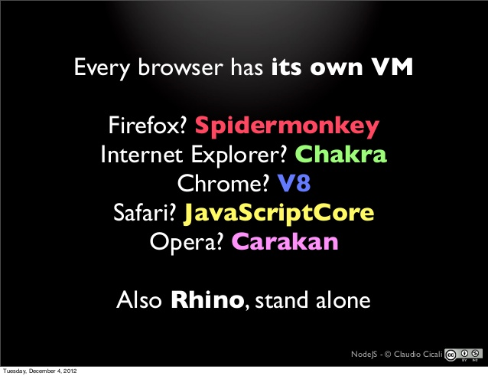
JavaScript Engines……

Slide 16
The idea behind node.js….
Perform asynchronous processing on single thread instead of classical multithreaded processing, minimize overhead & latency, maximize scalability
Scale horizontally instead of vertically
Ideal for applications that serve a lot of requests but do not use/need lots of computational power per request
Not so ideal for heavy calculations, e.g. massive parallel computing
Also: Less problems with concurrency

Slide 17
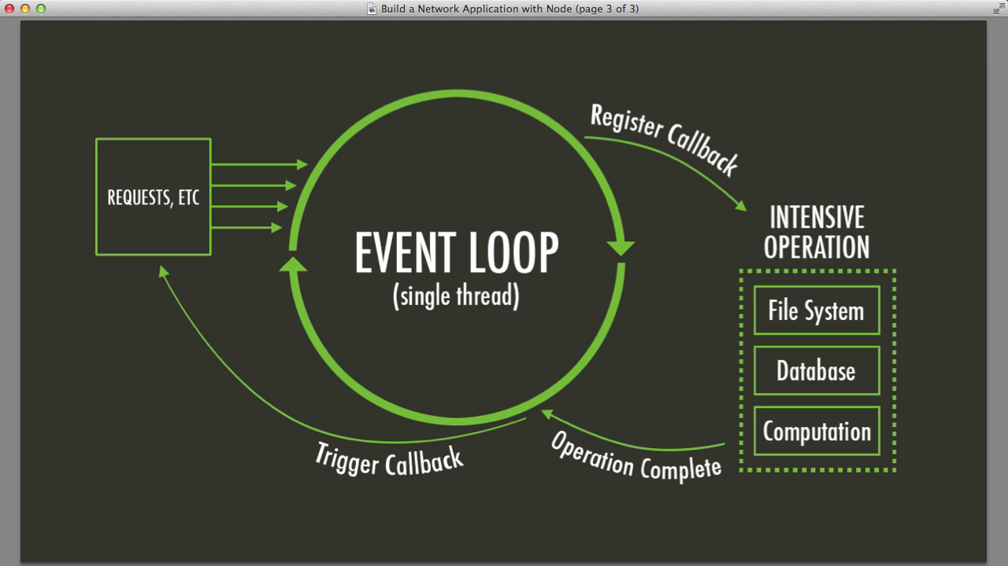
Node.js Event Loop
There are a couple of implications of this apparently very simple and basic model
Avoid synchronous code at all costs because it blocks the event loop
Which means: callbacks, callbacks, and more callbacks

Slide 18
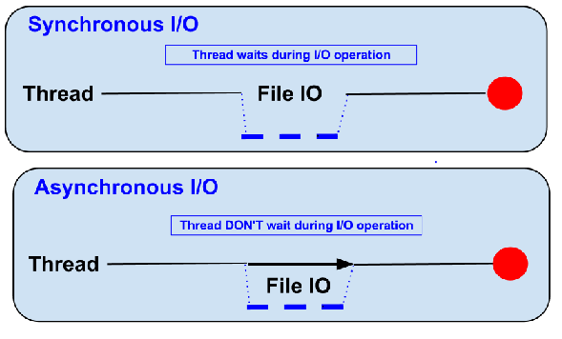
Blocking vs Non-Blocking……
Example :: Read data from file and show data

Slide 19
Blocking…..
Read data from file
Show data
Do other tasks
var data = fs.readFileSync( “test.txt” );
console.log( data );
console.log( “Do other tasks” );

Slide 20
Non-Blocking……
Callback
● Read data from file
When read data completed, show data
● Do other tasks
fs.readFile( “test.txt”, function( err, data ) {
console.log(data);
});

Slide 21
Node.js VS Apache
It's fast
It can handle tons of concurrent requests
It's written in JavaScript (which means you can use the same code server side and client side)
Platform | Number of request per second
PHP ( via Apache) | 3187,27
Static ( via Apache ) | 2966,51
Node.js | 5569,30

Slide 22
When to use it ?
Chat/Messaging
Real-time Applications
Intelligent Proxies
High Concurrency Applications
Communication Hubs
Coordinators

Slide 23
Node.js for….
Web application
Websocket server
Ad server
Proxy server
Streaming server
Fast file upload client
Any Real-time data apps
Anything with high I/O

Slide 24
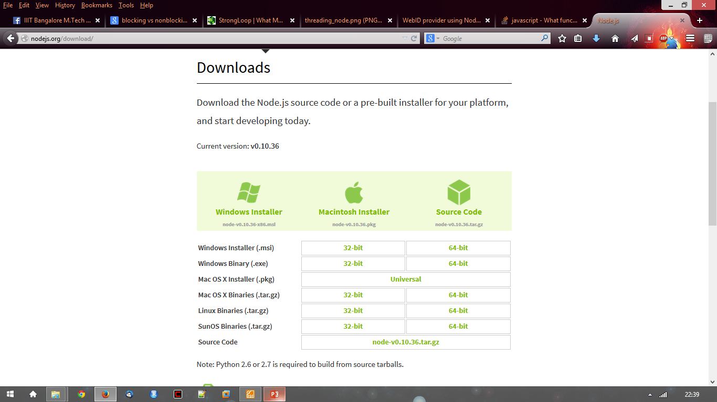
Getting Started…..
http://nodejs.org/ and Download tar.gz
Extract to any directory
$ ./configure && make install

Slide 25
File package.json…..
{
"name": "node-js-getting-started",
"version": "0.2.5",
"description": "A sample Node.js app using Express 4",
"engines": {
"node": "5.9.1"
},
"main": "index.js",
"scripts": {
"start": "node index.js"
},
"dependencies": {
"body-parser": "^1.16.1",
"cookie-parser": "^1.4.3",
"cool-ascii-faces": "1.3.4",
"ejs": "2.4.1",
"express": "^4.13.3",
"express-session": "^1.15.1",
"mongodb": "^2.2.24",
"multer": "^1.3.0",
"pg": "4.x",
"pug": "^2.0.0-beta11"
},
"repository": {
"type": "git",
"url": "https://github.com/heroku/node-js-getting-started"
},
"keywords": [
"node",
"heroku",
"express"
],
"license": "MIT"
}
Project informations
Name
Version
Dependencies
Licence
Main file
Etc...

Slide 26
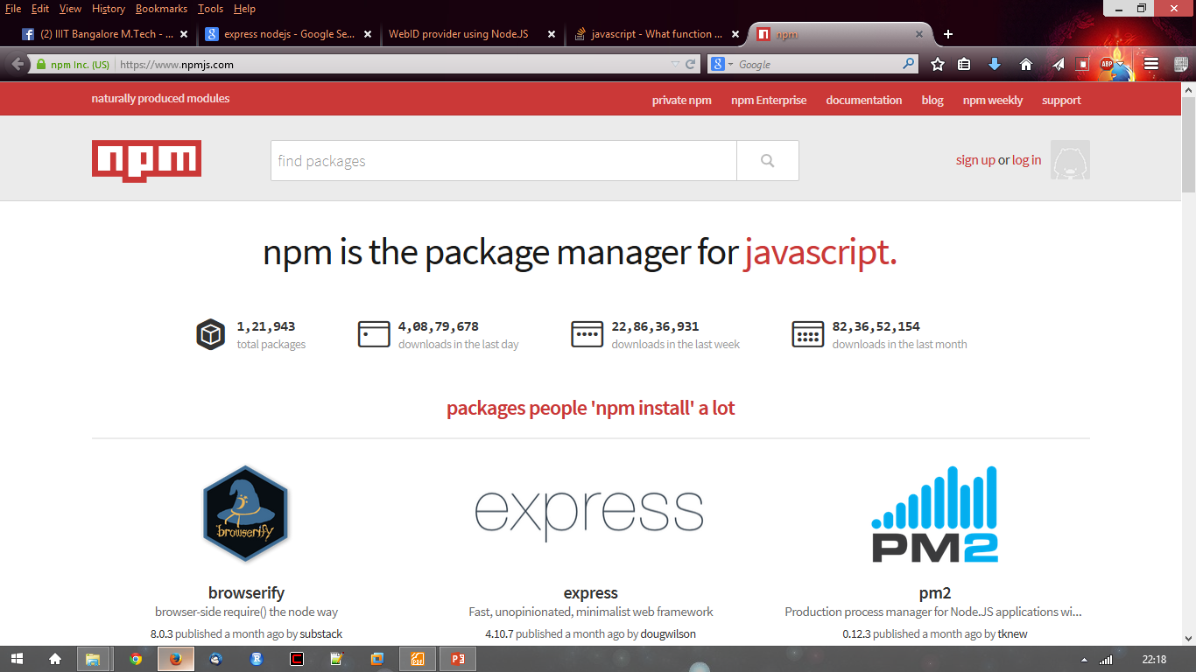
Node.js Modules…..
https://npmjs.org/
# of modules = 1,21,943

Slide 27
Install module…..
$npm install <module name>

Slide 28
Using module…..
var http = require(‘http’);
var fs = require(‘fs’);
var express = require(‘express’);

Slide 29
Hello World Example
STEP 1: create directory and call npm install and follow instructions
>mkdir myapp
>cd myapp
Use the npm init command to create a package.json file for your application. For more information, see Specifics of npm’s package.json handling.
> $ npm init
prompts you for a number of things, such as the name and version of your application. For now, you can simply hit RETURN to accept the defaults

Slide 30
Hello World example
Create file index.js with the following code:
http.createServer(function (request, response) {
// Send the HTTP header
// HTTP Status: 200 : OK
// Content Type: text/plain
response.writeHead(200, {'Content-Type': 'text/plain'});
// Send the response body as "Hello World“
response.end('Hello World\n'); }).listen(8081);
// Console will print the message
console.log('Server running at http://127.0.0.1:8081/');

Slide 31
Hello World example –package.json – describes application
{
"name": "helloworld", "version": "1.0.0", "description": "simple hello world app", "main": "index.js", "scripts": { "test": "echo \"Error: no test specified\" && exit 1" }, "author": "L. Grewe", "license": "ISC", "dependencies": { "express": "^4.14.1"
}
}

Slide 32

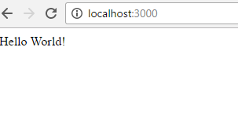
Run your hello world application
Run the app with the following command:
$ node app.js
Then, load http://localhost:3000/ in a browser to see the output.

Slide 33
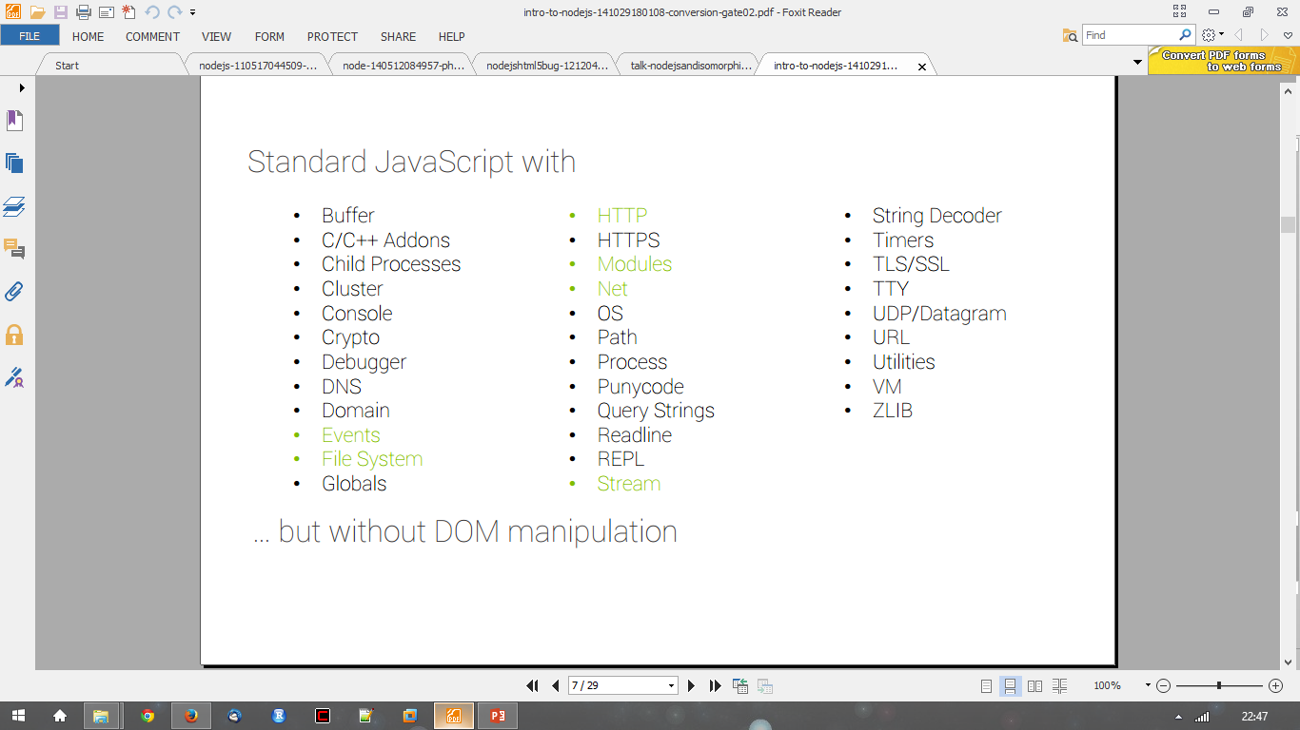
In NodeJS

Slide 34
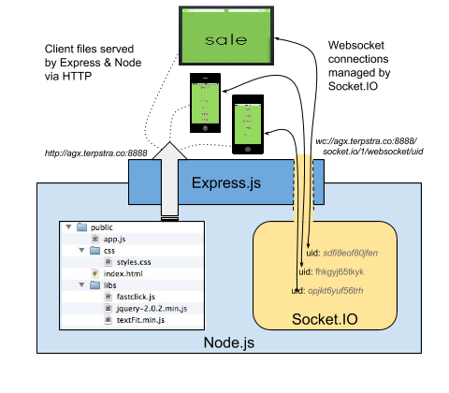
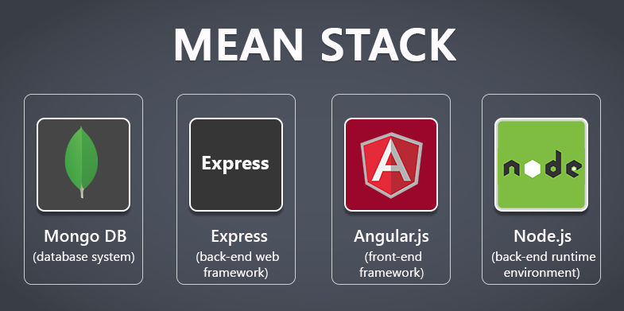
Express
minimal and flexible Node.js web application framework that provides a robust set of features for web and mobile applications.

Slide 35
Express gives ease of functionality
Routing
Delivery of Static Files
“Middleware” – some ease in development (functionality)
Form Processing
Simple forms of Authentication
Cookies and Session Manipulation
A lot of this you can do in NodeJS but, you may write more code to do it than if you use the framework Express.
There are other alternatives than Express (the E in MEAN) like Sail, Meteor

Slide 36
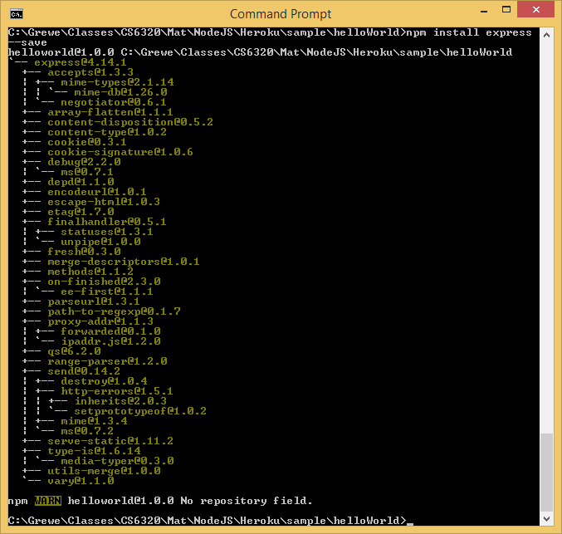
Install express
install Express (if you want it, most will)and any other dependencies needed
Now install Express in the myapp directory and save it in the dependencies list. For example:
>$ npm install express --save

Slide 37
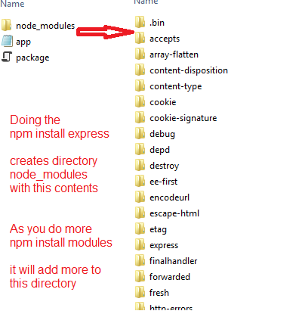
Install Express
Will add files to the node_modules directory
If this is the first module you have installed for current application IT will create the node_modules directory first.

Slide 38
Express – hello world Program
index.js have the code
var express = require('express')
var app = express()
app.get('/', function (req, res) {
res.send('Hello World!')
})
app.listen(3000, function () {
console.log('Example app listening on port 3000!')
})
This says requires module express
Calls function express to initialize object app
App object has various methods like get that responds to HTTP get request.
This code will be call the function specified when a GET for the URI / is invoked
Sets up the HTTP server for listening port 3000

Slide 39
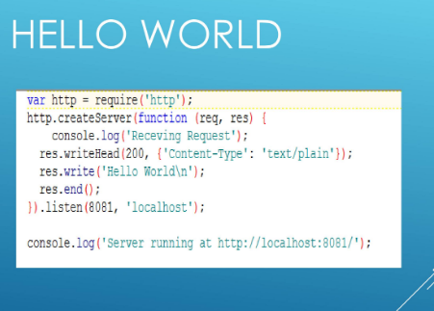
Node as HTTP server

Slide 40
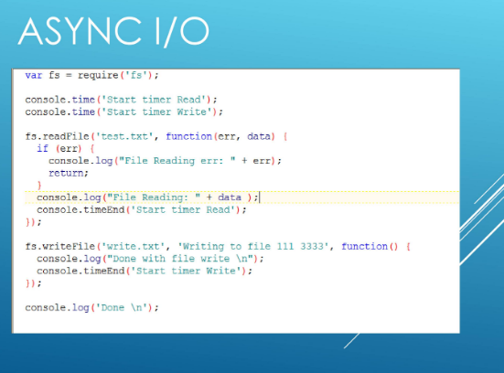
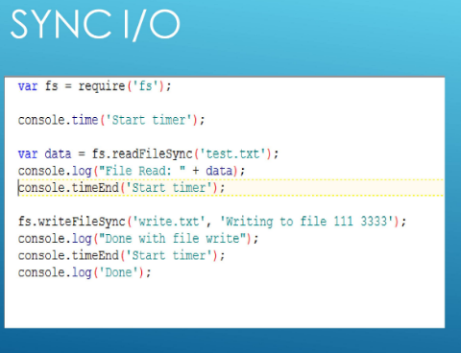
Node as File Server

Slide 41
What is a REST API
The term REST stands for REpresentational State Transfer. It is an architectural style that defines a set of rules in order to create Web Services.
In a client-server communication, REST suggests to create an object of the data requested by the client and send the values of the object in response to the user.
The architectural style of REST helps in leveraging the lesser use of bandwidth to make an application more suitable for the internet.
REST considered to be a set of principles that assign how HTTP and URLs Web standards are used.

Slide 42
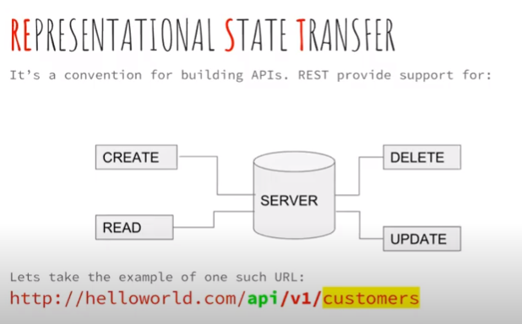
What is REST API
In the url, api tells the user that this is REST API
v1 is version of APIs
customers is end-point and resource

Slide 43
Why use REST API?
Technologies as SOAP, JMS or XML-RPC requires a plenty amount of data and big computer capacity which is not suitable for the limited mobile apps’ resources.
REST allows to pass a minimum amount of data through the same well-defined mechanism that the web determines, avoiding a lot of difficulties provided by fatter protocols.
It enables developers to create programs that access data via APIs in a proper way to make them work in environments with variable network speed and limited computing capacity.

Slide 44
Principles of REST API
Stateless
Client-Server
Uniform Interface
Cacheable
Layered system
Code on demand

Slide 45
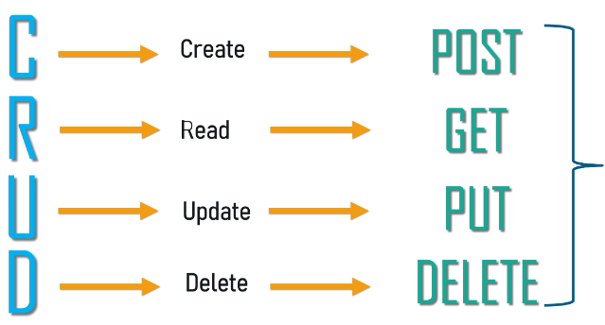
Methods of REST API
HTTP Methods

Slide 46
CRUD Operations in Node JS
MySQL Database
To be able to experiment with the code examples, you should have MySQL installed on your computer.
You can download a free MySQL database at https://www.mysql.com/downloads/. or use MySQL from Xampp Server.
Install MySQL Driver
To access a MySQL database with Node.js, you need a MySQL driver. This tutorial will use the "mysql" module, downloaded from NPM.
To download and install the "mysql" module, open the Command Terminal and execute the following:
C:\Users\User1\ npm install mysql
Node.js can use this module to manipulate the MySQL database:
var mysql = require('mysql');

Slide 47
Create DB connection
Create Connection
Use the username and password from your MySQL database.
demo_db_connection.js
-----------------------------------------------------------------------------------------------------
var mysql = require('mysql'); var con = mysql.createConnection({ host: "localhost", user: "yourusername", password: "yourpassword" }); con.connect(function(err) { if (err) throw err; console.log("Connected!"); });
Save the code above in a file called "demo_db_connection.js" and run the file:

Slide 48
Creating a Database
Creating a Database
----------------------------------------------------------------------------------------
var mysql = require('mysql'); var con = mysql.createConnection({ host: "localhost", user: "yourusername", password: "yourpassword" }); con.connect(function(err) { if (err) throw err; console.log("Connected!"); con.query("CREATE DATABASE mydb", function (err, result) { if (err) throw err; console.log("Database created"); }); });

Slide 49
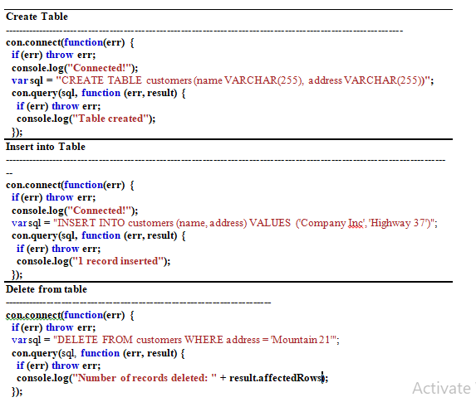
DB Queries

Slide 50
Angular JS
AngularJS extends HTML with new attributes. AngularJS is perfect for Single Page Applications (SPAs). AngularJS is easy to learn.
AngularJS is a JavaScript framework. It can be added to an HTML page with a <script> tag.
<script src="https://ajax.googleapis.com/ajax/libs/angularjs/1.6.9/angular.min.js"></script>
AngularJS extends HTML attributes with Directives, and binds data to HTML with Expressions.

Slide 51
AngularJS Extends HTML
AngularJS extends HTML with ng-directives.
The ng-app directive defines an AngularJS application.
The ng-model directive binds the value of HTML controls (input, select, textarea) to application data.
The ng-bind directive binds application data to the HTML view.
The ng-controller directive defines the application controller.

Slide 52
AngularJS Example
<div ng-app="myApp" ng-controller="myCtrl"> First Name: <input type="text" ng-model="firstName"><br> Last Name: <input type="text" ng-model="lastName"><br> Full Name: {{firstName + " " + lastName}} </div> <script> var app = angular.module('myApp', []); app.controller('myCtrl', function($scope) { $scope.firstName = "John"; $scope.lastName = "Doe"; }); </script>

Slide 53
AngularJS Example
The AngularJS application is defined by ng-app="myApp". The application runs inside the <div>.
The ng-controller="myCtrl" attribute is an AngularJS directive. It defines a controller.
The myCtrl function is a JavaScript function.
AngularJS will invoke the controller with a $scope object.
In AngularJS, $scope is the application object (the owner of application variables and functions).
The controller creates two properties (variables) in the scope (firstName and lastName).
The ng-model directives bind the input fields to the controller properties (firstName and lastName).

Slide 54
Web Scrapping
Web scraping is extracting data from websites in an automated manner.
It is automated because it uses bots to scrape the information or content from websites.
It’s a programmatic analysis of a web page to download information from it.
Example of Web Scraping
Web scraping would involve scraping specific information from a particular web page or pages.
For example, you want to work on price intelligence. You would extract the price of various/specific products from Amazon or any other e-commerce site.
This would qualify as web scraping. Likewise, you can extract data and use it for business leads, stock market data, real estate listings.

Slide 55
Steps to perform web scrapping
1. Request-Response
The first step is to request the target website for the contents of a specific URL.
In return, the scraper gets the requested information in HTML format.
2. Parse and Extract
When it comes to Parsing, it usually applies to any computer language. It is the process of taking the code as text and producing a structure in memory that the computer can understand and work with.
To put it simply, HTML parsing is basically taking in HTML code and extracting relevant information like the title of the page, paragraphs in the page, headings in the page, links, bold text, etc.
3. Download Data
The final part is where you download and save the data in a CSV, JSON or in a database so that it can be retrieved and used manually or employed in any other program.

Slide 56
Modules to perform web scrapping in Node js
By sending HTTP request to a particular URL and then by extracting HTML of that web page for getting useful information is known as crawling or web scraping.
request: For sending HTTP request to the URL
cheerio: For parsing DOM and extracting HTML of web page

Slide 57
Problem Statement
Use Node as File Server and perform file read/ write operations synchronously and asynchronously.
Use Node as HTTP Server and create file upload functionality to upload file/s.
Use Node JS to perform web scrapping by create an application using node package manager
Create single page scalable web application using node JS at server side to perform CRUD operations. (Choose MongoDB, MySQL or any other Database)

Slide 58
NodeJS Resources

Slide 59
References
http://nodejs.org/
http://nodejs.org/cinco_de_node.pdf
http://ajaxian.com/archives/google-chrome-chromium-and-v8
http://blog.chromium.org/2010/12/new-crankshaft-for-v8.html
http://news.softpedia.com/news/IE9-RC-vs-Chrome-10-9-vs-Opera-11-vs-Firefox-11-Performance-Comparison-183973.shtml

