Slide 1
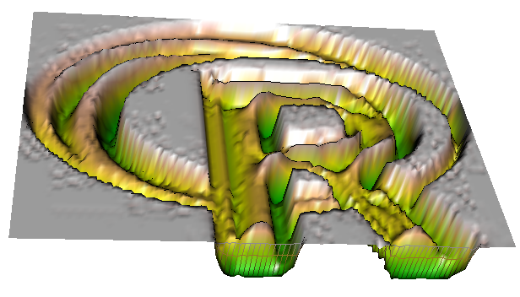
raster data

Slide 2

Raster data
(X-min, Y-max)
col 1
col 5
row 1
1
2
3
4
5
6
7
dimY
24
25
row 6
26
27
28
29
30
dimX
(X-max, Y-min)

Slide 3
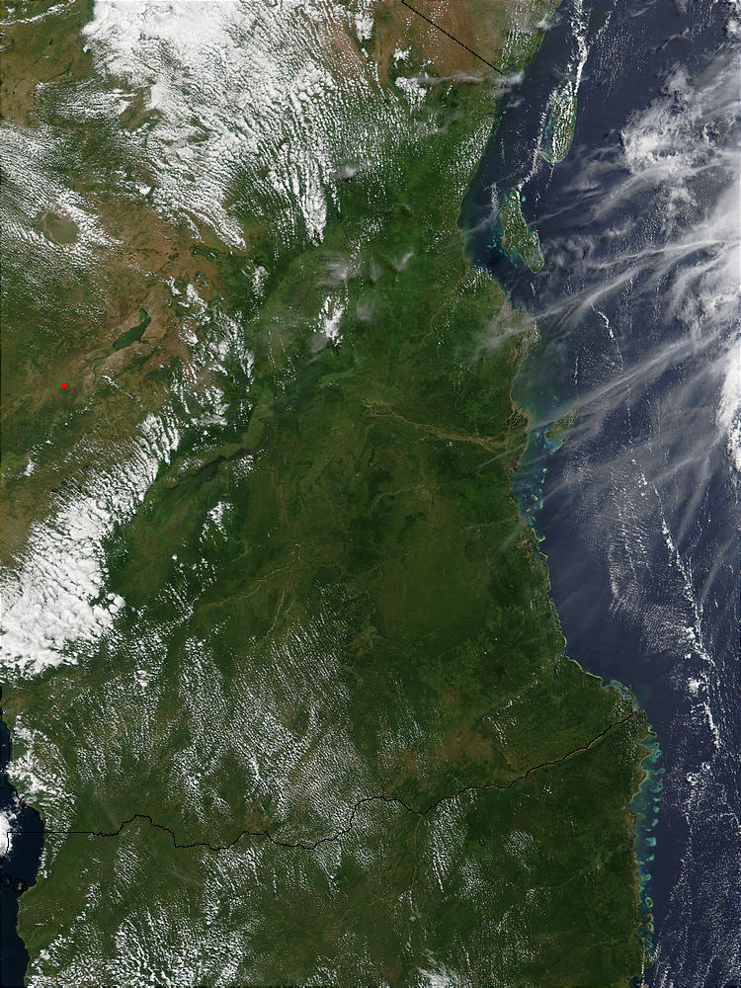
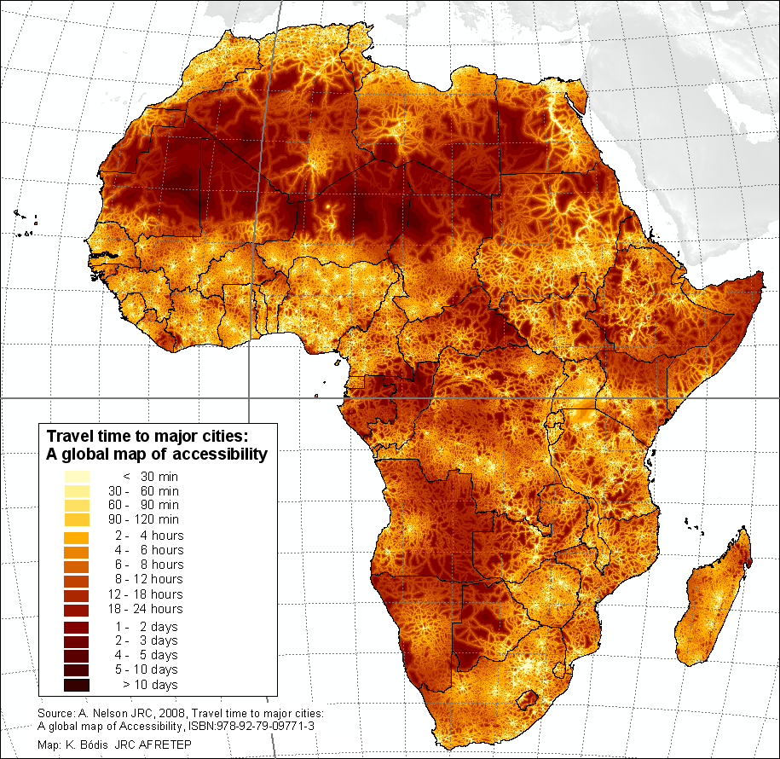

Slide 4
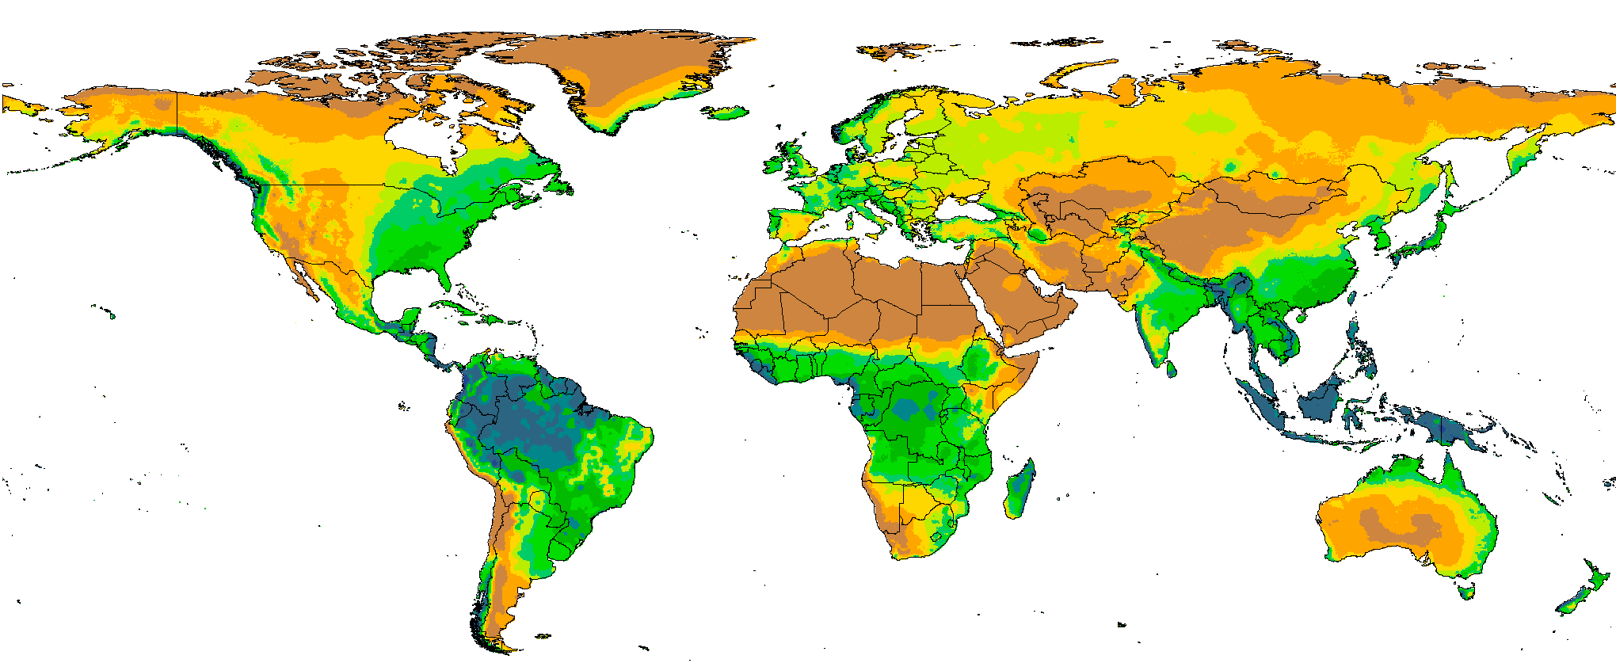
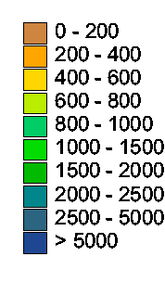
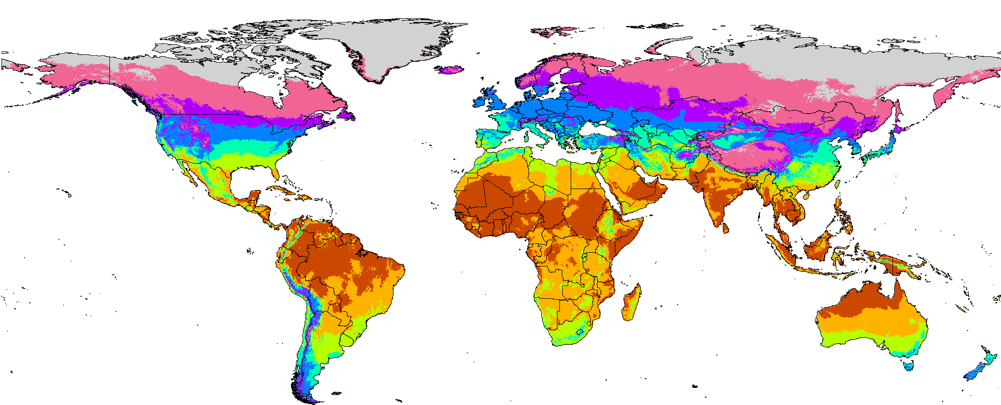
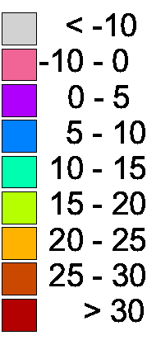
Precipitation (mm)
Temperature (°C)

Slide 5
raster package
Classes for raster data
no file size (or format) restrictions
> 200 functions

Slide 6
RasterLayer
> library(raster) > > x <- raster()
>
> x <- raster('volcano.tif')
>
> x
class : RasterLayer
dimensions : 87, 61, 5307 (nrow, ncol, ncell)
resolution : 10, 10 (x, y)
extent : 2667400, 2668010, 6478700, 6479570 (xmin,
coord. ref. : +proj=nzmg +lat_0=-41 +lon_0=173 +x_0=251 values : d:\data\volcano.tif
min value : 94
max value : 195

Slide 7
Multiple layers
RasterStack - many files
RasterBrick - single files

Slide 8
Basic functions
ncell(x)
xyFromCell(x, 10)
getValues(x, row)
writeRaster(x, filename, …)

Slide 9
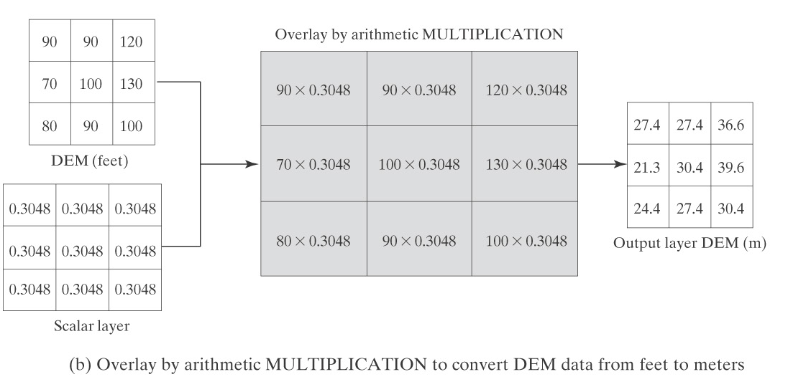
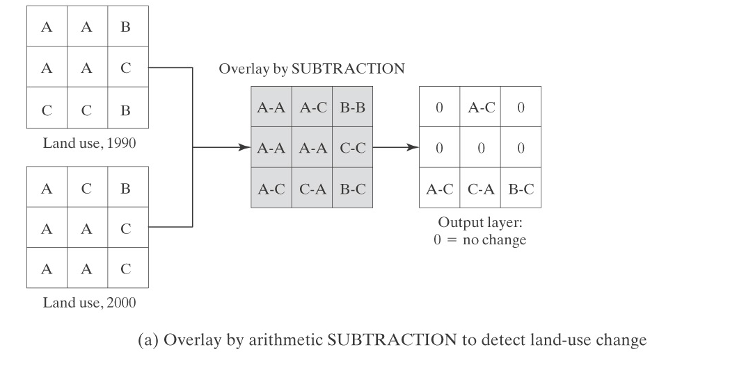
Raster algebra
multiplication
subtraction

Slide 10
Raster algebra
r <- raster(nc=10, nr=10)
values(r) <- 1:ncell(r)
q <- sqrt(r)
x <- (q + r) * 2
s <- stack(r, q, x)
ss <- s * r

Slide 11
Raster manipulation
merge, crop,
project, aggregate,
reclassifcy, resample,
rasterize, …

Slide 12
Raster analysis
distance,
focal,
predict,
…
and other R functions
and external models

