Slide 1
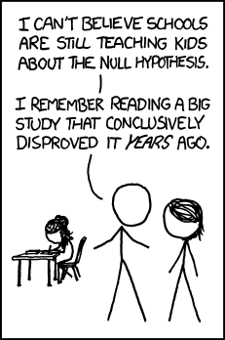
Spatial
Prediction

Slide 2

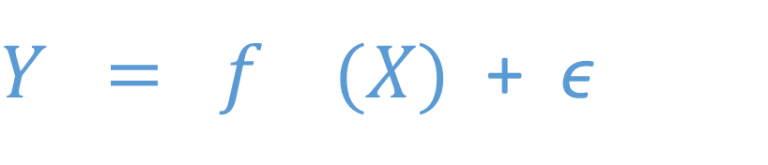


Supervised statistical learning (regression and classification)
quantity of interest
function
predictors
error
Assume:
$Y = f (X)$ + ϵ
Estimate:
$$f$$
to get:
$$\hat{f}$$
Such that:
$$\hat{Y} = \hat{f} (X)$$
For prediction and/or inference

Slide 3
Spatial Interpolation
Y = f (L)
^
^
Observations
Prediction
model
f estimated with
Inv. Dist. Weighting
Universal Kriging
Thin Plate Spline
….
presence
absence
Notes:
realized vs fundamental niche

Slide 4
Image classification
Y = f ( E )
^
^
L
Forest
Water
Urban
Observations
Prediction
f estimated with
Max likelihood
Random Forest
Support Vector Machine
….
model
B
a
n
d
s
Notes:
realized vs fundamental niche

Slide 5
Spatial Distribution Models
Y = f ( E )
^
^
L
Observations
presence
absence
Prediction
f estimated with
Maxent
Random Forest
Logistic regression
….
model
P
r
e
d
i
c
t
o
r
s
Notes:
realized vs fundamental niche

Slide 6
Hybrid Models
Y = f ( L + E )
^
^
presence
absence
L
Observations
Prediction
f estimated with
RandomForest
Thin plate spline
Regression kriging
….
model
P
r
e
d
i
c
t
o
r
s
Notes:
realized vs fundamental niche

Slide 7
Spatial modeling
Get training locations (sites with field observations)
Get environmental data a locations
Fit models to data
Evaluate models/data combinations
Select and/or combine
Predict

Slide 8
Rule based models
Y = f ( E )
^
^
Environment
Prediction
f estimated with
Experimental data and/or
fundamental knowledge
or assumptions
model
Notes:
realized vs fundamental niche

Slide 9
Regression model examples ?dismo::predict

Slide 10
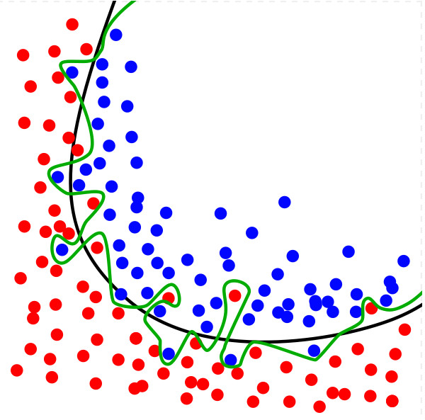
How to pick the modeling method? - keep it simple - try multiple - trade-off between underfitting and overfitting

Slide 11
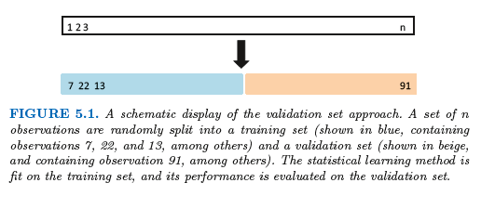
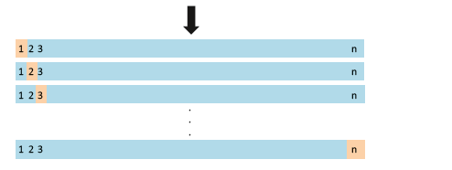
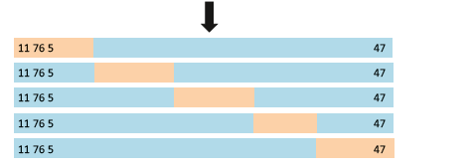
Cross-validation
for model
evaluation
All data
Validation set
LOOCV
k-fold CV (k=5)

Slide 12
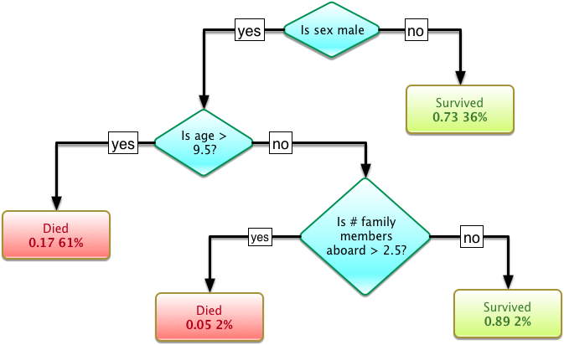
Decision trees "come closest to meeting the requirements for serving as an off-the-shelf procedure for data mining, because it is invariant under scaling and various other transformations of feature values, is robust to inclusion of irrelevant features, and produces inspectable models.
However, they are seldom accurate” (Hastie et al.)
In particular, trees that are grown very deep tend to learn highly irregular patterns: they overfit their training sets, i.e. have low bias, but very high variance.
(Wikipedia)

Slide 13
Random Forests
Random forests are an ensemble learning
The constructing a multitude of decision trees
The prediction is the mode of the classes (classification) or mean prediction (regression) of the individual trees.
Random forests correct for decision trees' habit of overfitting to their training set.
It uses
Bagging (Bootstrap aggregation)
Random variable selection at each node
Variable importance through permutation
An ensemble of many weak learners can make a strong predictor

Slide 14

ISLR
Book website
http://www-bcf.usc.edu/~gareth/ISL/
Answers to the ISLR questions
https://github.com/asadoughi/stat-learning
Lectures by Hastie and Friedman
http://www.r-bloggers.com/in-depth-introduction-to- machine-learning-in-15-hours-of-expert-videos/
Slides and R videos by Abbass Al Sharif
http://www.alsharif.info/#!iom530/c21o7

