Slide 1
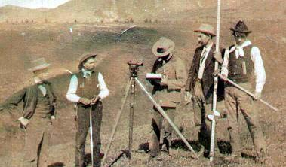
Introduction
From Cartography and Agriculture to Data Science

Slide 2
Background
Spatial data scientist at University of California, Davis (https://biogeo.ucdavis.edu/people.html)
Mostly worked with USAID Feed the Future programs
Contact anighosh@ucdavis.edu, A.Ghosh@cgiar.org

Slide 3

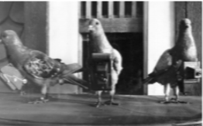
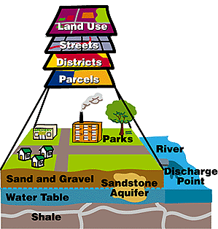
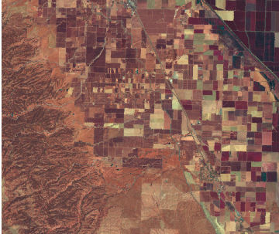
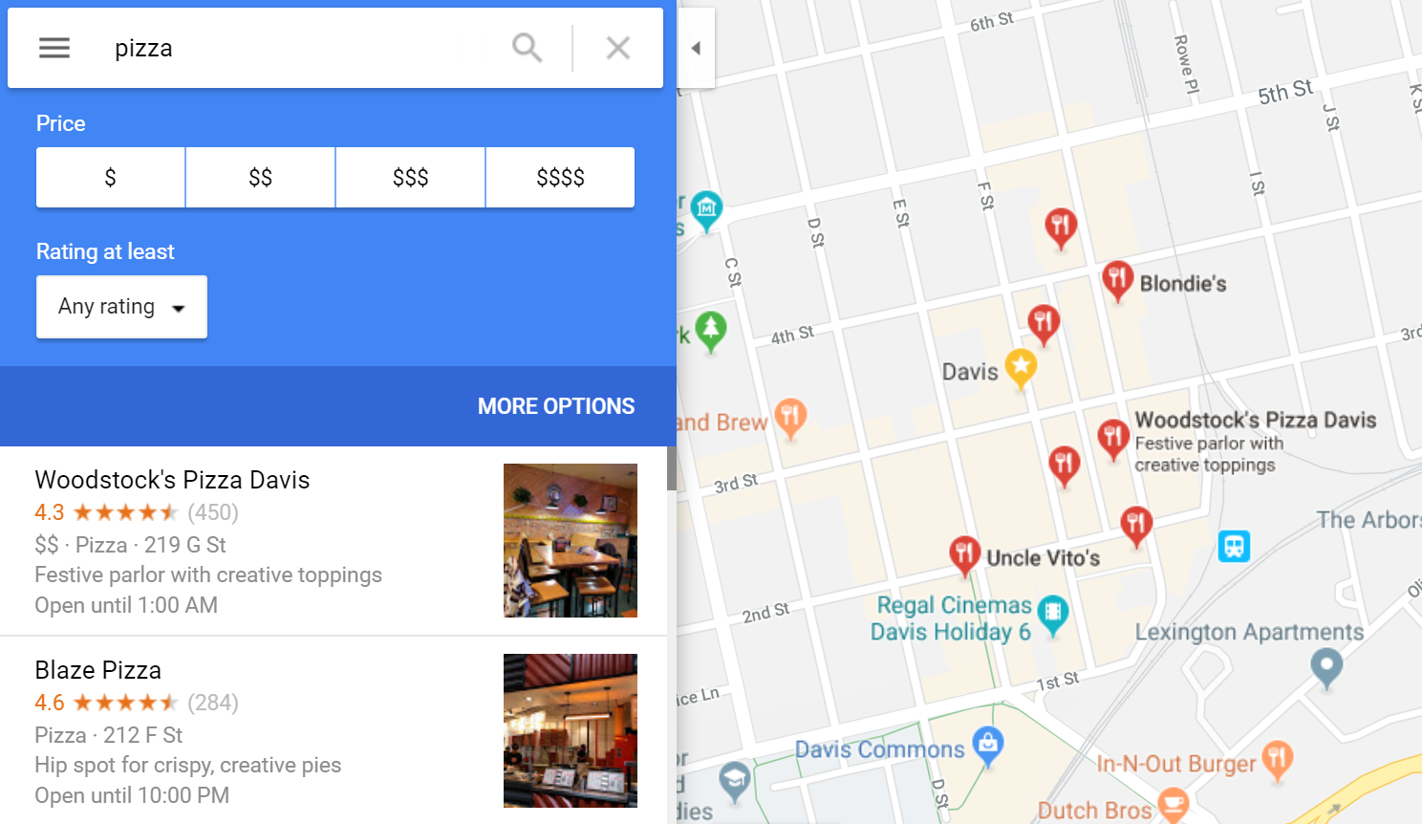


– 1970
The classical era
Land surveying, air-photos, traditional cartography
government
1970 – 2004
Spatial is special
research government
Geographic Information Systems (GIS), LANDSAT
2005 – 2013
Coming out
Google general public
Neo-geography. Open data & software
2014 –
Spatial data everywhere
Spatial data science & big data high spatial and temporal resolution imaging
industry

Slide 4
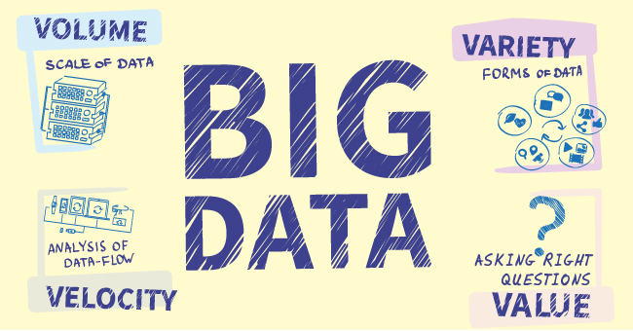
Spatial
AND ANSWERING

Slide 5
Data science
Is about processes to extract information from data
(building on statistics, data mining, computer science, as well as domain specific knowledge, e.g. agronomy)

Slide 6
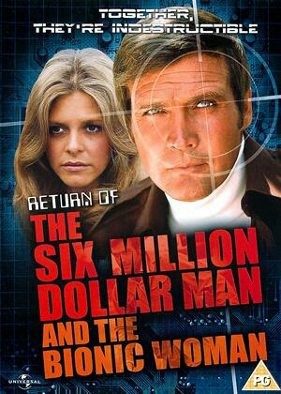
Data Scientists
Are better, stronger, faster …..
…. In processing of data to extract information
Find, manage, improve, merge, explore, model, interpret data
Rapid iteration, communicate current values (live, on line)

Slide 7
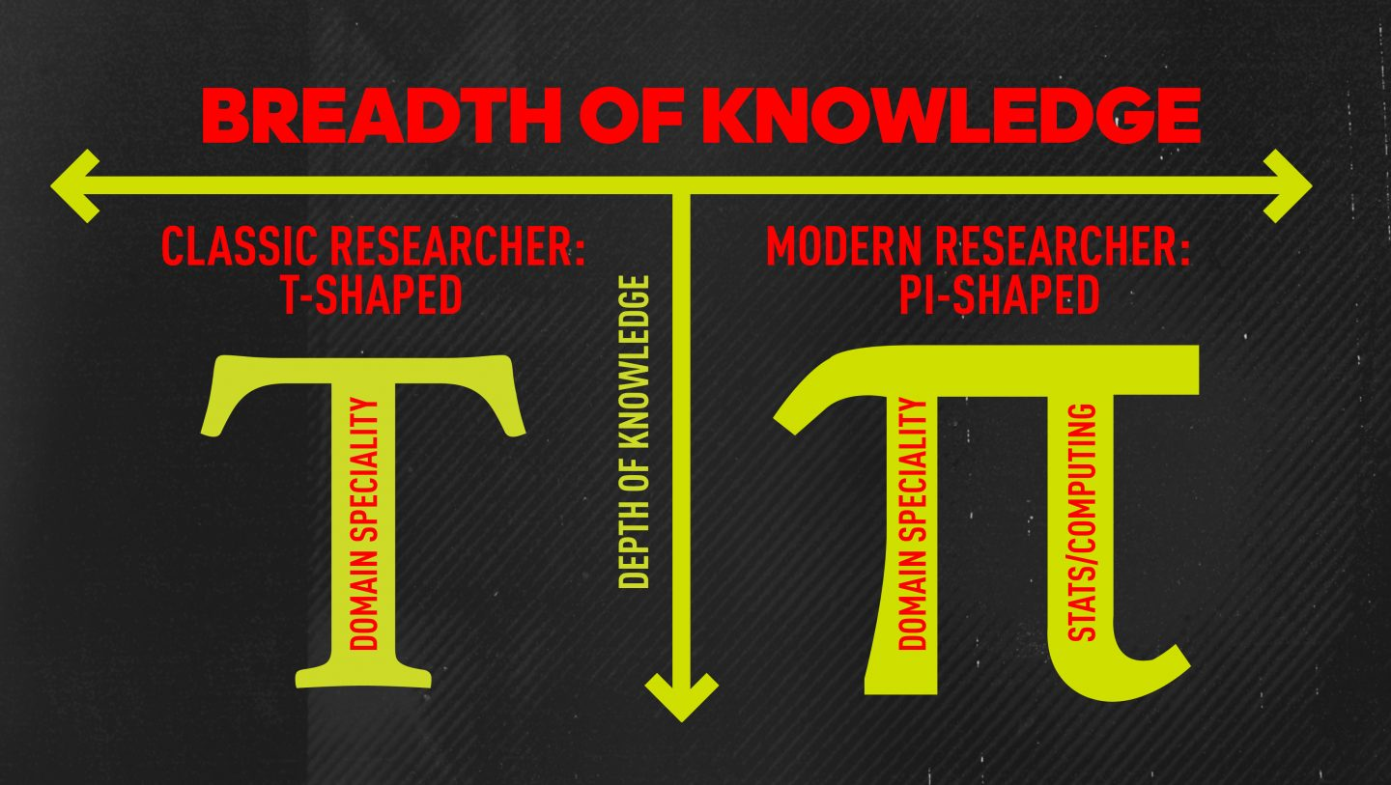

Slide 8
Workshop objectives
Introduction to spatial data science with R
Big data analytics in the cloud: Google Earth Engine

Slide 9

Introduction to

Slide 10

Language
Computer program
For data analysis and graphics
Free and Open-Source
Builds upon existing software (C, Java, …)
Contributions by many (researchers)
Cutting-edge and pervasive
Expanding & improving

Slide 11
(Most) computer languages (including R) have
Defined basic data types (including numbers)
Arithmetic (add, subtract, multiply, divide)
Conditional loop (for / while)
Branch (if / else)
Reuse code (functions)
File input/output
Library of functions
Allow for creation of complex data types

Slide 12
Primitive data types (are vectors)
> x <- 32.0
> x
[1] 32
> class(x)
[1] "numeric"
> x <- as.integer(x)
> x
[1] 32
> class(x)
[1] "integer"
> x <- '32'
> class(x)
[1] "character "
> x <- as.factor(x)
> x
[1] 32
Levels: 32
> class(x)
[1] "factor"

Slide 13
Calculator
>
> 3 * 3
[1] 9
>
> sqrt(9)
[1] 3
>
>
> a <- 4
> b <- 6
> a * b
[1] 24
>

Slide 14
Vectors
> a <- c(1, 2, 3, 4, 5)
> a
[1] 1 2 3 4 5
> b <- c(2, 2, 2, 2, 2)
> a * b
[1] 2 4 6 8 10
> A
Error: object 'A' not found
>
> a <- 1:5
> b <- rep(2, times=5)
> a * b
[1] 2 4 6 8 10
> sum(a*b)
[1] 30
>

Slide 15
Matrix
> a <- 1:5
> b <- rep(2, times=5)
> m <- cbind(a, b, x=a*b)
> m
a b x
[1,] 1 2 2
[2,] 2 2 4
[3,] 3 2 6
[4,] 4 2 8
[5,] 5 2 10
> class(m)
[1] "matrix"

Slide 16
Matrix Indexing
> m <- matrix(1:12, ncol=4)
> m
[,1] [,2] [,3] [,4]
[1,] 1 4 7 10
[2,] 2 5 8 11
[3,] 3 6 9 12
>
> nrow(m)
> ncol(m)
> colnames(m)
> m[2,2]
[1] 5
> m[2,]
[1] 2 5 8 11
> m[,2]
[1] 4 5 6
> m[2, c(1, 3:4)]
[1] 2 8 11
>

Slide 17
data.frame
> x <- c(21,13,5)
> y <- c('a', 'b', 'c')
> d <- data.frame(x, y)
> d
x y
1 21 a
2 13 b
3 5 c

Slide 18
list
> x <- c(21,13,5)
> y <- c('a', 'b', 'c')
> d <- list(x, y)
> d
[[1]]
[1] 21 13 5
[[2]]
[1] "a" "b" "c"

Slide 19
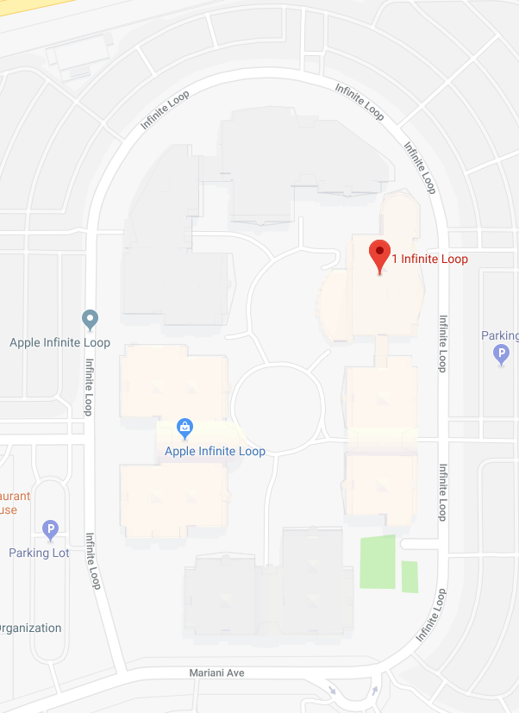
Be loopy if you must
# we can do:
x <- 1:10
n <- length(x)
for (i in 1:n) {
x[i] <- x[i] * 2
}
x
[1] 2 4 6 8 10
12 14 16 18 20
# better:
x <- 1:10
x * 2

Slide 20
Vectory math
x <- 1:10
y <- 0
for (v in x) {
y <- y + v
}
y
[1] 55
x <- 1:10
sum(x)

Slide 21
Vectory math
x <- 1:10
y <- 0
for (v in x) {
y <- y + v
}
y
[1] 55
x <- 1:10
sum(x)

Slide 22
If, else
x <- 1:10
for (i in 1:length(x)) {
if (x[i] < 4) {
x[i] <- 0
} else if (x[i] < 8) {
x[i] <- 1
} else {
x[i] <- 2
}
}
x
[1] 0 0 0 1 1 1 1 2 2 2
x <- 1:10
ifelse(x < 4, 0, ifelse(x >= 8, 2, 1))

Slide 23
Apply your functions
x <- cbind(a=1:5, b=5:1, c=1:5)
x
a b c
[1,] 1 5 1
[2,] 2 4 2
[3,] 3 3 3
[4,] 4 2 4
[5,] 5 1 5
apply(x, 1, sum)
[1] 7 8 9 10 11
apply(x, 2, sum)
a b c
15 15 15
>

Slide 24
Apply more
tapply (aggregate)
lapply, sapply
x <- list(1:10)
lapply(x, function(x) x + 5)
[[1]]
[1] 6 7 8 9 10 11 12 13 14 15

Slide 25
Functionality
f <- function() {
print("I like you!")
}
f()
[1] "I like you!"
> f()
[1] "I like you!"
> f()
[1] "I like you!"

Slide 26
Functionality
doit <- function(a, b) {
x <- a + b
return(x)
}
> doit(1, 2)
[1] 3
> doit(1:10, 2)
[1] 3 4 5 6 7 8 9 10 11 12
>

Slide 27

tidyverse
a <- 1:10
b <- sum(a)
d <- sqrt(b)
e <- log(d)
e <- log(sqrt(sum(a)))
library(magrittr)
e <- a %>% sum %>% sqrt %>% log
tidyverse

Slide 28
Read and write
x <- read.csv(“c:/data/observations.csv”)
readxl::read_excel (“c:/data/observations.xlsx”)
foreign::read.dbf
foreign::read.dta for Stata files
foreign::read.spss for SPSS files
foreign::read.ssd for SAS files
write.csv(x, file=“c:/data/results.csv”)
saveRDS(x, “file.rds”)
y <- readRDS(“file.rds”)

Slide 29
