Slide 1

Spatial data with

Slide 2
Spatial is special
Complex: geometry and attributes
The earth is not flat (coordinate reference systems)
Size: lots and lots of it, multivariate, time series
Special plots: maps
First Law of Geography: nearby things are similar
Statistical assumptions: violated
Interpolation: possible

Slide 3
Don't we have GIS for that?
GIS* –
● Visual interaction –
Data management –
Geometric operations –
Standard workflows –
Single map production –
Click, click, click & click –
Speed of execution –
Cumbersome –
R
– Data & model focused ●
– Analysis ●
– Attributes as important ●
– Creativity & innovation ●
– Many (simpler) maps ●
– Repeatability (single script) ●
– Speed of development ●
– Easy & powerful (& free) ●
* there are many different GISs and they evolve

Slide 4
Spatial is NOT special
Spatial data is just an extension of “base” data --- the same data science principles apply
Collection, organization, cleaning, exploring, summarizing, analyzing, modeling, predicting, storage, big data...

Slide 5
Representation of space
Objects
Discrete entities, defined by coordinates
points, lines, areas
typically represented as vector data
Fields
Continuously varying properties
typically represented as raster data

Slide 6
Vector data
(x, y)
part 1
part 2

Slide 7
The ‘sp’ package defines classes to represent spatial data.
SpatialPoints
SpatialPointsDataFrame
SpatialLines
SpatialLinesDataFrame
Spatial
SpatialPolygons
SpatialPolygonsDataFrame

Slide 8
> str(new('SpatialPolygonsDataFrame'))
Formal class 'SpatialPolygonsDataFrame' [package "sp"] with 5 slots
..@ data :'data.frame': 0 obs. of 0 variables
Formal class 'data.frame' [package "methods"] with 4 slots
.. .. ..@ .Data : list()
.. .. ..@ names : chr(0)
.. .. ..@ row.names: int(0)
.. .. ..@ .S3Class : chr "data.frame"
..@ polygons : list()
..@ plotOrder : int(0)
..@ bbox : num[0 , 0 ]
..@ proj4string:Formal class 'CRS' [package "sp"] with 1 slot
.. .. ..@ projargs: chr ""
>

Slide 9
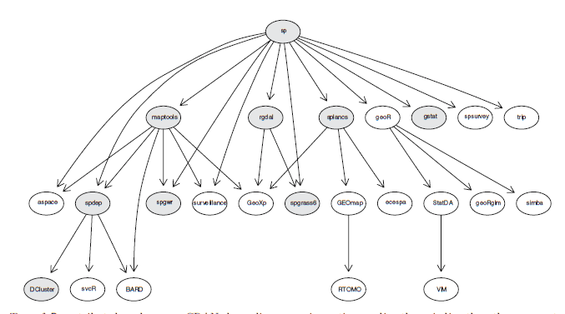
sp is not designed to do much
To provide classes that can be used by other packages
Mostly house-keeping (creation and coercion of objects)
Yet, it has functions for other things (overlay, sample, plot)

Slide 10
SpatialPoints
x <- c(4,7,3,8)
y <- c(9,6,12,11)
xy <- data.frame(x, y)
library(raster)
sp <- SpatialPoints(xy)
crs(sp) <- "+proj=longlat +datum=WGS84"
sp <- SpatialPoints(xy, proj4string=
CRS("+proj=longlat +datum=WGS84"))
coordinates(xy) <- ~ x + y

Slide 11
sp
class : SpatialPoints
features : 4
extent : 3, 8, 6, 12 (xmin, xmax, ymin, ymax)
coord. ref. : +proj=longlat +datum=WGS84
d <- data.frame(v1=1:4, v2=LETTERS[1:4])
SpatialPointsDataFrame(sp, d)
class : SpatialPointsDataFrame
features : 4
extent : 3, 8, 6, 12 (xmin, xmax, ymin, ymax)
coord. ref. : +proj=longlat +datum=WGS84
variables : 2
names : v1, v2
min values : 1, A
max values : 4, D

Slide 12
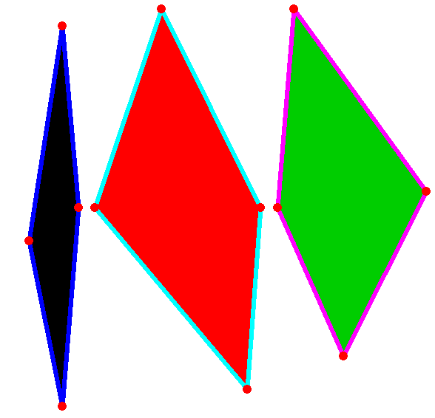
x1 <- rbind(c(-80,-10), c(-70,55), c(-65, 0), c(-70,-60))
x2 <- rbind(c(-10,0), c(-40,60), c(-60,0), c(-14,-55))
x3 <- rbind(c(-5,0), c(0,60), c(40,5), c(15,-45))
p <- spPolygons(x1, x2, x3)
plot(p, col=1:3, border=4:6, lwd=5)
points(x1, col='red', pch=20, cex=2)

Slide 13
library(raster)
f <- "C:/data/lux.shp"
p <- shapefile(f)
p
class : SpatialPolygonsDataFrame
features : 12
extent : 5.74, 6.53, 49.45, 50.18 (xmin, xmax, ymin, ymax)
coord. ref. : +proj=longlat +datum=WGS84
variables : 5
names : ID_1, NAME_1, ID_2, NAME_2, AREA
min values : 1, Diekirch, 1, Capellen, 76
max values : 3, Luxembourg, 12, Wiltz, 312
Equivalent to
library(rgdal)
readOGR(readOGR("C:/data", "lux"))

Slide 14
“overlay” functions (in raster package)
bind append combine Spatial* objects of the same (vector) type
erase or "-" erase parts of a SpatialPolygons* object
intersect or "*" intersect SpatialPolygons* objects
union or "+" union SpatialPolygons* objects
cover update and identity a SpatialPolygons object with another one
symdif symmetrical difference of two SpatialPolygons* objects
aggregate dissolve smaller polygons into larger ones
disaggregate explode: turn polygon parts into separate polygons (in the sp package)
crop clip a Spatial* object using a rectangle (Extent object)
select select - interactively select spatial features
click identify attributes by clicking on a map
merge Join table (in the sp package)
over spatial queries between Spatial* objects
extract spatial queries between Spatial* and Raster* objects
as.data.frame coerce coordinates of SpatialLines or SpatialPolygons into a data.frame

Slide 15
sf package
New package to replace ‘sp’
New object structure (data.frame with geometry column)
Fast reading and writing
Includes “overlay” functions
https://r-spatial.github.io/sf/

