Slide 1
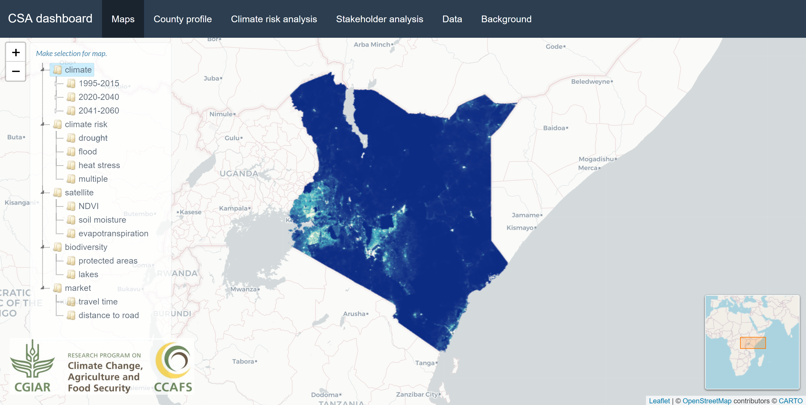

Slide 2
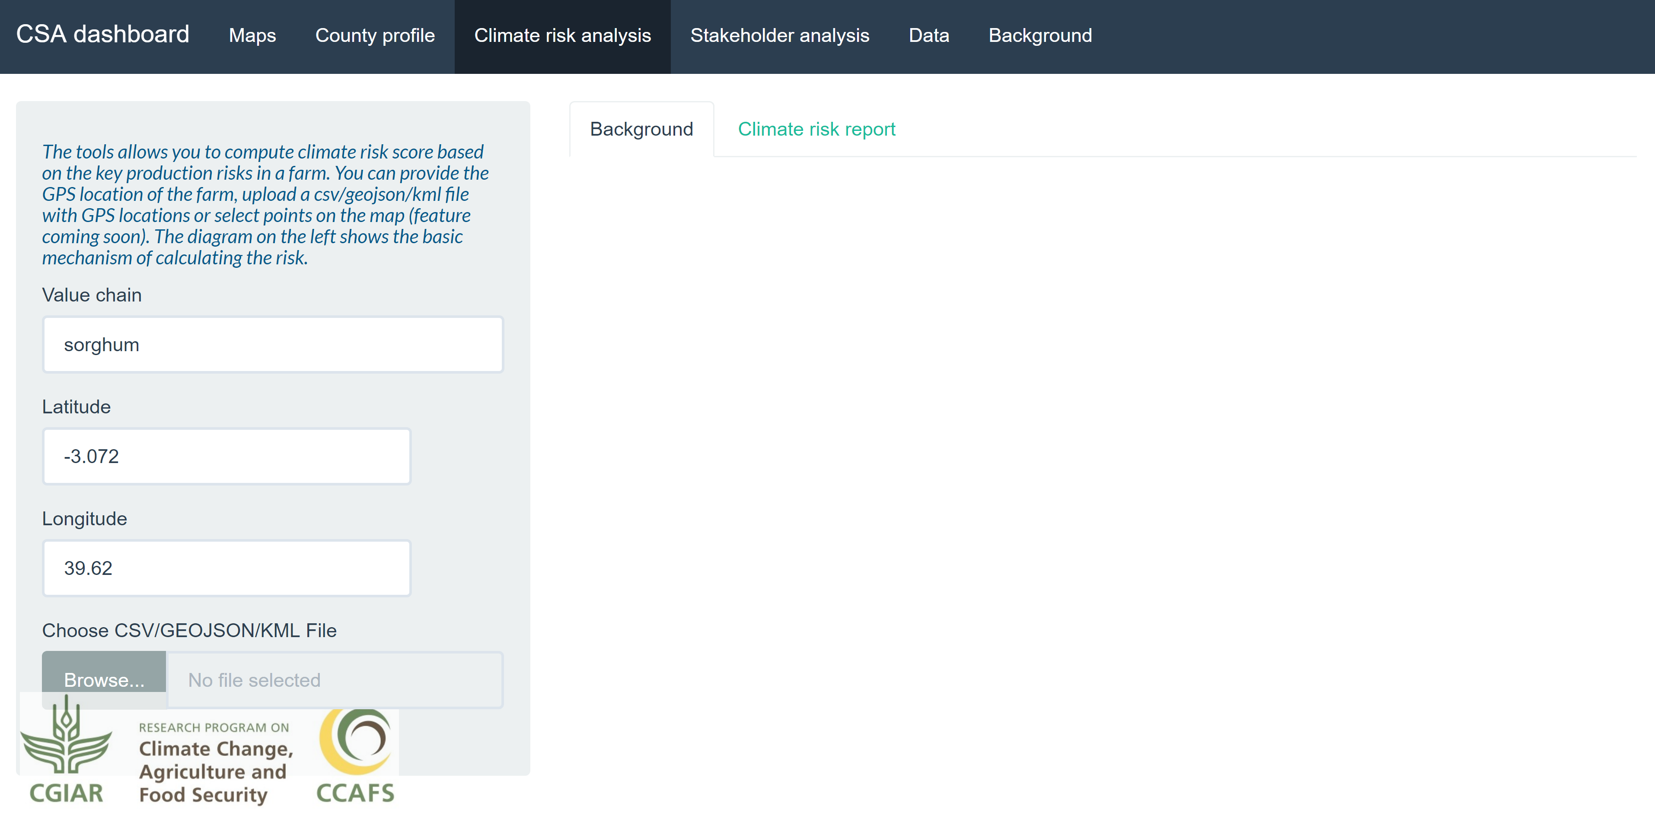
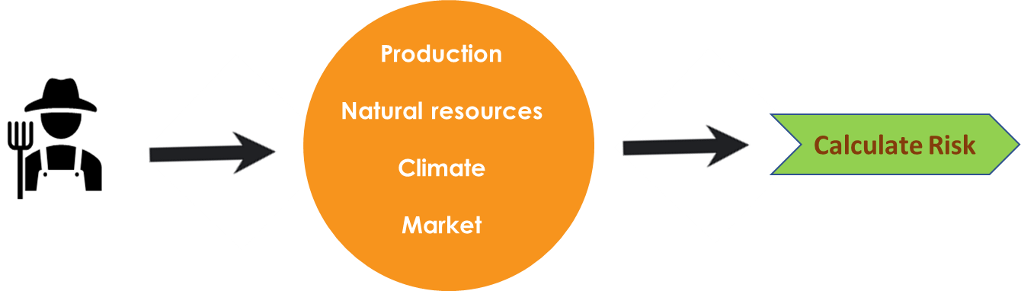

Slide 3
Risk categories | Risk indicators | Value | Comment
Production | NDVI | 0.4-0.85 | Variable
 | Suitability | >60% | High
Natural resources | Water access | ~2km | Mod
 | Soil pH | 6.1 | Close to optimum
 | Soil organic matter | 14 | On the lower side
 | Biodiversity | Med-Low | Med-Low
Climate | Precipitation | 600mm/year | Variable
 | Drought | < -2 | High
 | Flood | 0 | Low
Market/ Input | Market access | ~10 mins | Good connectivity
 | Pop density | 2/km² | Sparsely populated
Final decision
Based on the analysis, the location is found to be low risk investment for sorghum production

