Slide 1

PES College of Engineering
Department of Computer Science & Engineering
Ecommerce Website using MERN Stack
Anuvansh Khatri | Animesh Randhawa | Anisha Singh | Aditya Kumar Sah

Slide 2
Introduction
• Abstract
• Software & Hardware Requirements
• Existing System
• Proposed System
• Modules
• Tasks
• Screenshots
• Conclusion

Slide 3
Abstract
• A full-stack e-commerce platform is a robust digital solution built using modern web technologies to facilitate the seamless buying and selling of goods and services
• This platform leverages:
Front-End
Back-End
Database
• The platform incorporates user authentication, secure payment gateways, inventory management, and order tracking. React ensures a fast and smooth user experience, while MongoDB provides scalable data storage. By combining these technologies, the platform delivers a complete, responsive, and modern e-commerce experience tailored for global and local markets.

Slide 4
Software & Hardware Requirement
• Software Requirement
Front End/GUI Tool : HTML/CSS/JavaScript
Operating System : Windows Family
Language : NodeJS
Application : Web Application
Back End : MongoDB
• Hardware Requirement
Processor : Nvidia 3050 GE Force
RAM : 16 GB
Hard Disk Drive : 1 TB

Slide 5
Existing System
• The existing e-commerce platforms are built on traditional or monolithic architectures that often lack flexibility and scalability. Key characteristics include:
Features
Limited customization for user experience and design.
Basic inventory management and static product catalogs.
Minimal use of advanced technologies like AI for recommendations.
Challenges
Scalability issues during high traffic periods.
Inefficient handling of real-time updates and complex workflows.
Limited support for omnichannel experiences and personalization.
Data storage and retrieval inefficiencies due to rigid database structures.
Tech Stack
Backend: Legacy frameworks or older technologies.
Frontend: Static HTML and CSS with limited interactivity.
Database: Relational databases (e.g., MySQL) with rigid schemas.

Slide 6
Proposed System
• The proposed e-commerce platform addresses the limitations of the existing system by adopting a modern, full-stack architecture with advanced features and technologies.
Features:-
Fully customizable and dynamic user interface using React.
Scalable and efficient backend powered by Node.js and Express.js.
Secure and scalable MongoDB, for flexible data management.
Support for mobile-first design and omnichannel integration.
Improvements :-
High scalability to handle large user traffic and transactions.
Enhanced user experience through responsive and interactive designs.
Improved performance with asynchronous operations and efficient APIs.
Tech Stack :-
Frontend: React, HTML, CSS, JavaScript (ES6+).
Backend: Node.js, Express.js.
Database: MongoDB.
Additional Tools: Payment gateways (e.g., Stripe, PayPal).

Slide 7
Modules
• User Authentication and Profile Management
The User Authentication and Profile Management module ensures a secure and personalized user experience. It involves implementing a system where users can register, log in, and manage their profiles. Using JSON Web Tokens (JWT), secure authentication tokens are generated for session management, enabling role-based access control for different user types such as administrators and customers. Passwords are encrypted ensuring data security. Profile management features include updating personal information such as contact details, addresses, and preferences.
• Product Catalogue and Inventory
The Product Catalog and Inventory module is the backbone of the e-commerce platform. It provides functionality for managing and displaying product details, including names, descriptions, images, prices, and stock availability. Admins can add, update, or delete products through intuitive interfaces powered by REST APIs. Inventory management ensures stock levels are tracked and alerts are triggered when products need replenishment, ensuring smooth operations and customer satisfaction.
• Cart and Checkout Integration
The Cart and Checkout Integration module facilitates the shopping process by enabling users to add, update, or remove items in their cart. The cart dynamically calculates subtotals, taxes, and applicable discounts. Logged-in users benefit from saved cart states, ensuring continuity even after logging out. The checkout process collects shipping information and prepares the order for payment, offering a seamless transition from browsing to buying.
• Payment Gateway and Order History
The Payment Gateway and Order History module handles the final stage of the transaction. Secure integration with payment APIs like Stripe allows users to complete purchases with confidence. The system stores transaction details and ensures users can view their order history for tracking and future reference. Additional features such as refunds and cancellations enhance the user experience and provide a comprehensive solution for order management

Slide 8
Tasks
• Set up Authentication using JWT
The first task involves setting up authentication using JWT to enable secure user access. Upon successful login, the backend generates a JWT token that is sent to the client for use in subsequent requests. Middleware on protected routes verifies the token, ensuring only authenticated users can access sensitive information
• Create REST APIs for Product Management
Creating REST APIs for product management is another critical task. These APIs allow administrators to perform CRUD operations on products, such as adding new items to the catalog, updating details like pricing and descriptions, retrieving product lists, and deleting outdated entries. This flexibility empowers the platform to maintain an up-to-date and comprehensive product catalog.
• Implement Cart Management and Order Processing
The cart management and order processing task focuses on implementing APIs and logic to manage the shopping cart and process orders. Users can interact with the cart dynamically, adjusting item quantities and viewing real-time updates on pricing. The order processing system validates the cart and inventory, finalizes the order, and stores it in the database. This task ensures a seamless shopping experience from cart to checkout.
• Integrate Payment APIs (e.g., Stripe)
To handle payments securely, the payment gateway and order history module integrates APIs like Stripe . These gateways ensure secure transaction processing, with successful payments generating order confirmations stored in the database. The system maintains a detailed order history, enabling users to review their past purchases and administrators to track transactions. Support for refunds and cancellations ensures flexibility for users and operational ease for administrators.

Slide 9
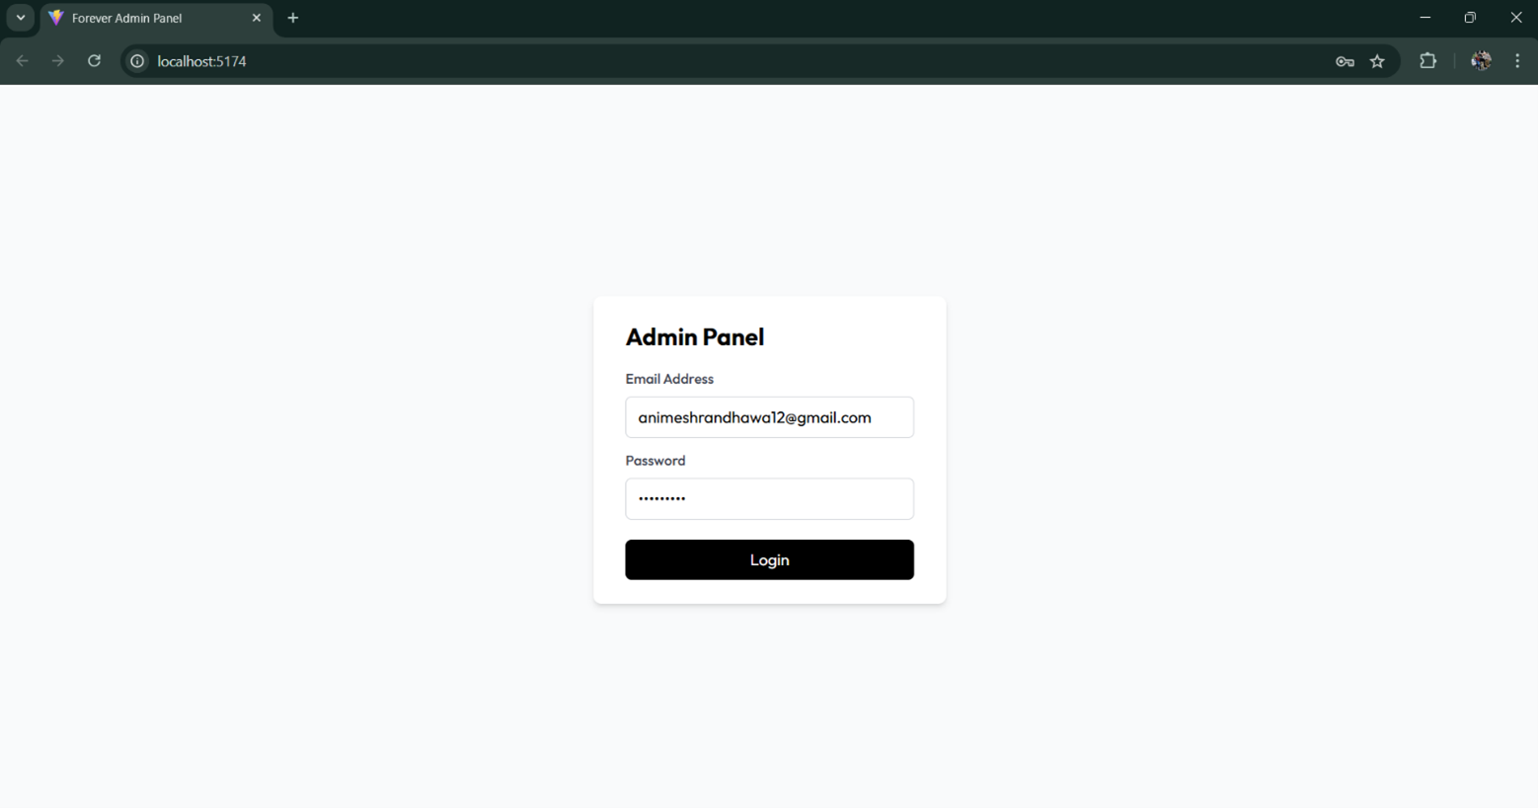
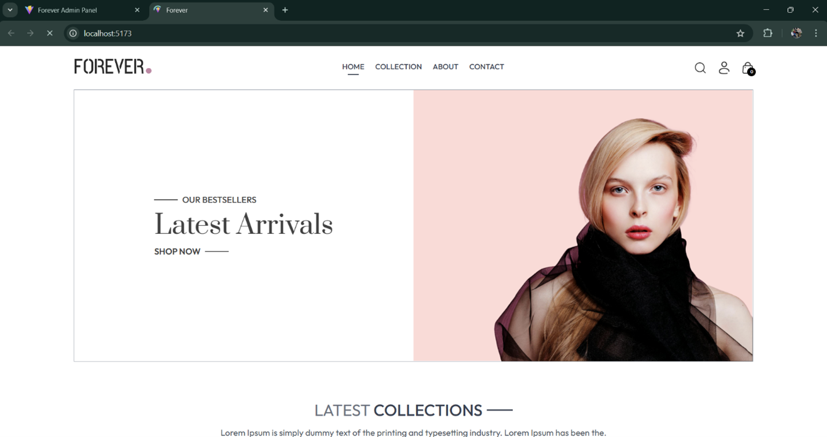
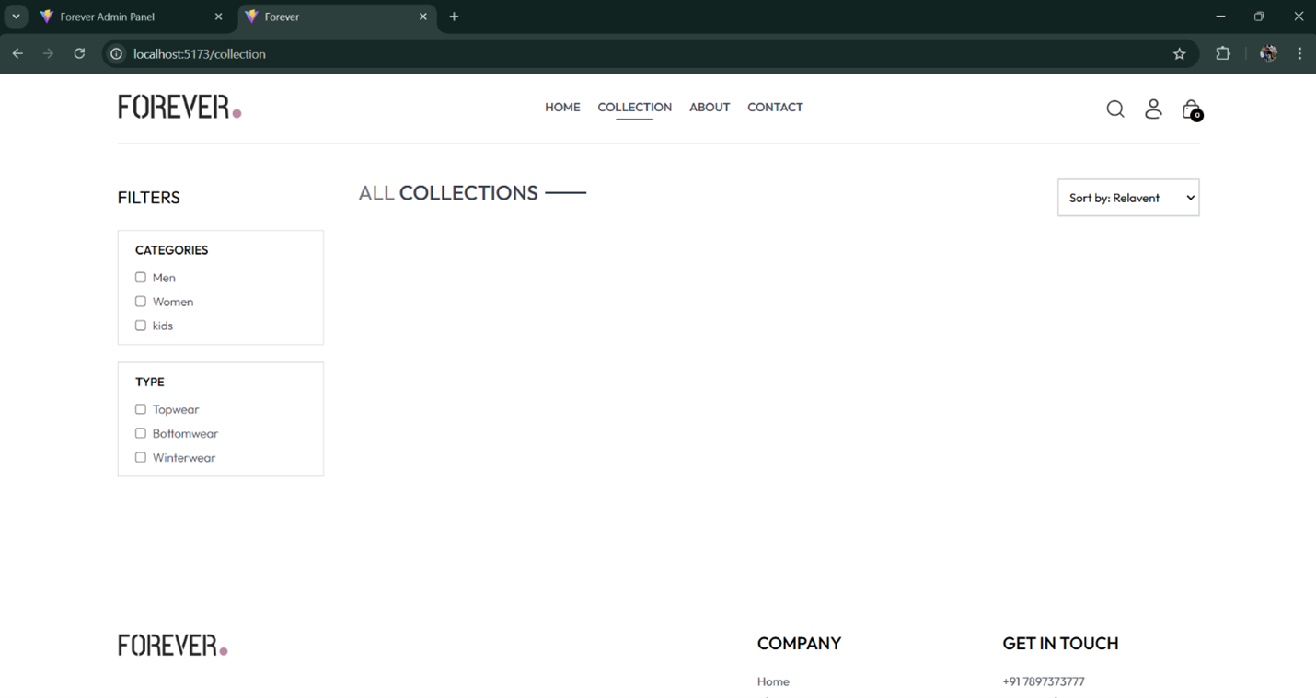
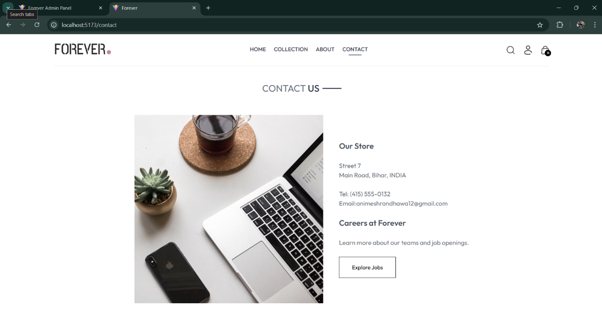
Screenshots

Slide 10
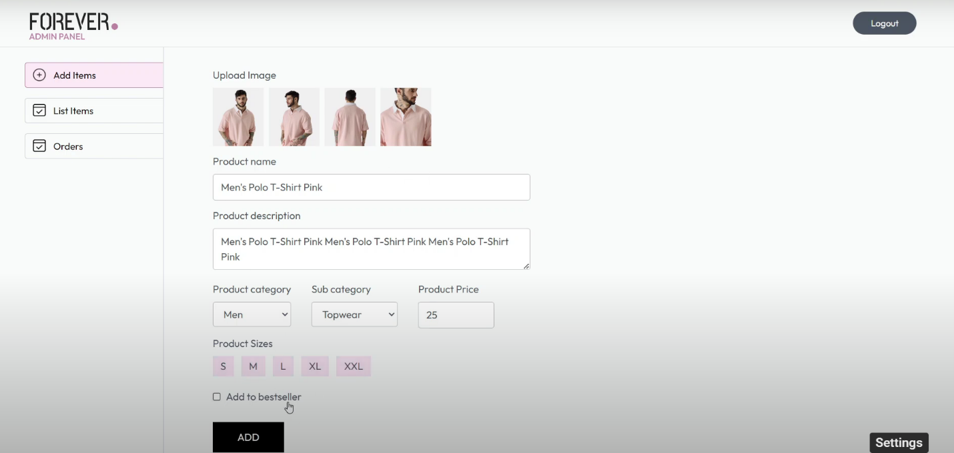
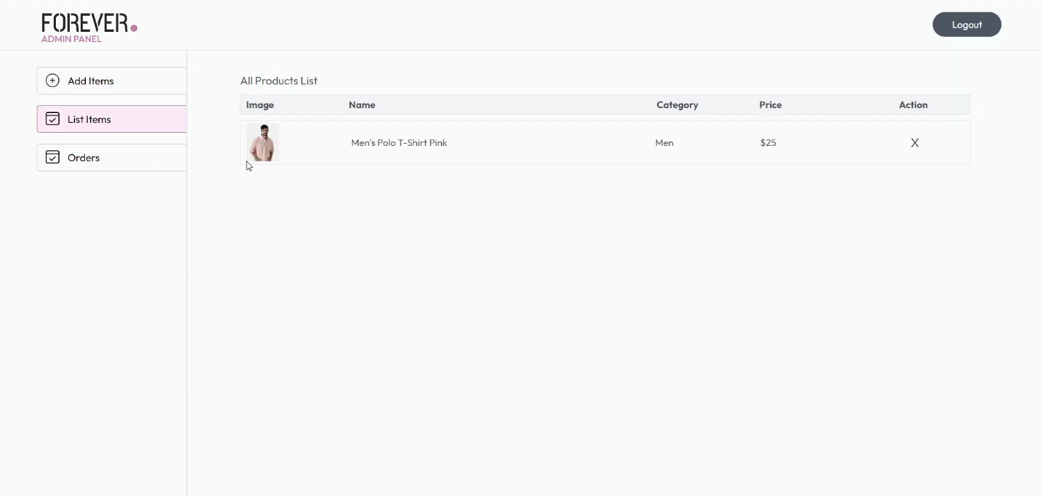
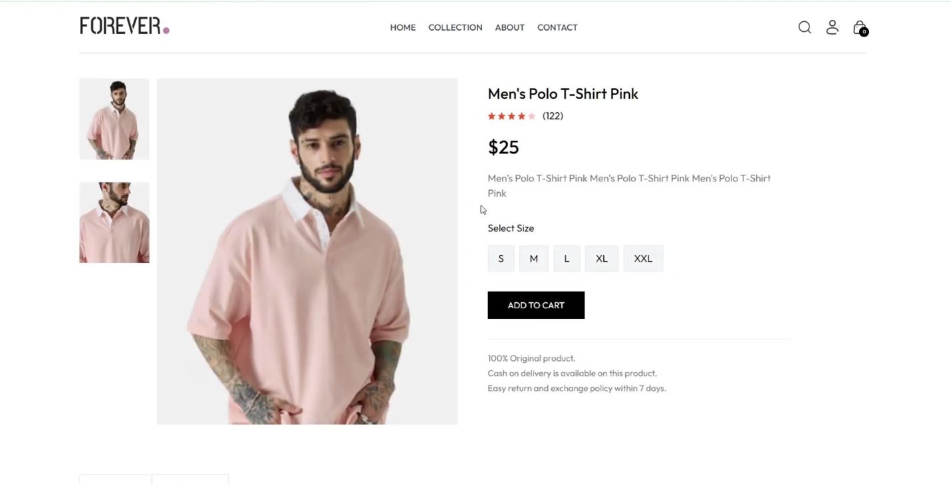
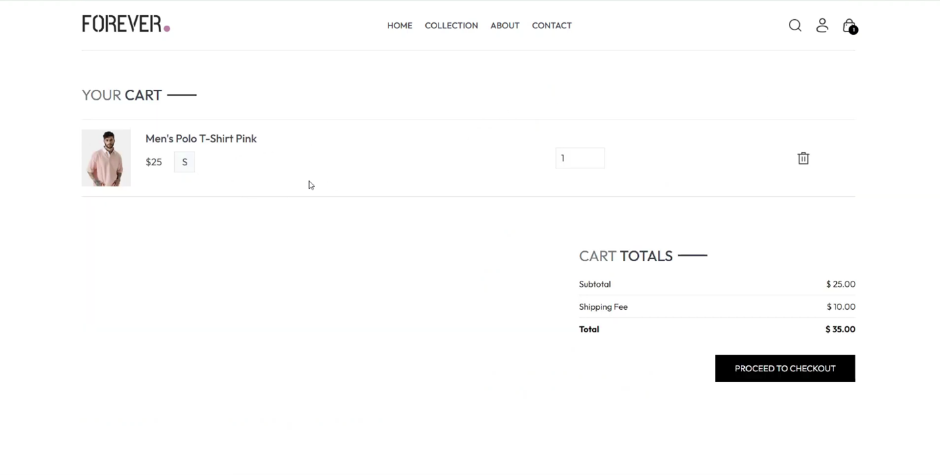
Screenshots

