Slide 1
NEOMd : a Graph DB approach to recommendations
By:
L. Aniruth Naraayanan
Prathamesh Madiwale
Siddhesh Kokane

Slide 2
Introduction
In this project, we are experimenting with an approach to combine recommendation system to graph databases.
Recommendation Systems : are a subclass of information filtering system that seeks to predict the "rating" or "preference" a user would give to an item.
Examples : YouTube, Netflix, Amazon’s ‘People also Bought & many more.
Graph Databases are No-SQL databases which is based on graph theory. The data is stored as a collection of nodes and relationships.
Examples : Neo4j(used for this project), ArangoDB.
This is also a comparative study on Rel.Db & GraphDb.

Slide 3
NEOMd
NEOMd is a Movie Recommendation Web Application.
Dataset : OpenMovie dataset – based on IMDb
Technology Stack:
Front End – Bootstrap + Pug
Server Side – Express-js(Node js framework)
Back-end – Neo4j
IDE: VS-Code, Neo4j Browser
Algorithm used: Content Based Weighted Similarity, Collaborative Filtering
Design Pattern : Model – View - Controller

Slide 4
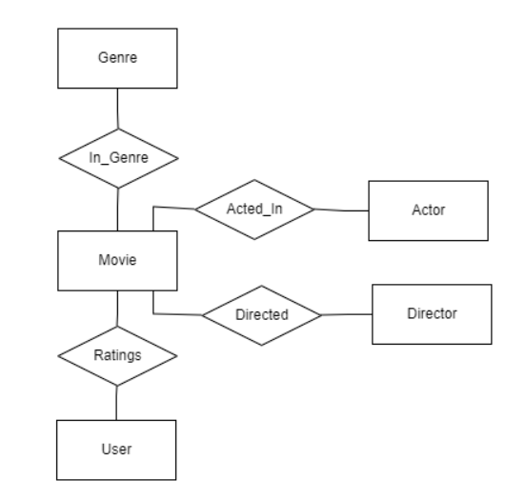
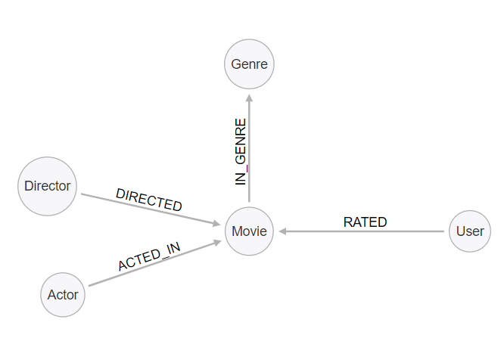
Data Model:
E-R Diagram: (RDBMS)
Property Graph Model:(GraphDb)

Slide 5
Addressing Cold Start Issue.
One of the most common problems associated with recommendation system is Cold Start
Cold Start happens when a new user enters a recommender system, and there is no items to recommend because he/she has no behavior (ratings, purchases etc..).
To address this issue we start of our application with a list of the most relevant/popular items, in this case movies.
Once the users rates these movies we can then start giving personalized recommendations.

Slide 6
Relevance Algorithm:
Select movies rated by users.
Aggregate the movies by the users who rated them, to get the relevance parameter of each movie.
Sort movies by relevance to get desired result.

Slide 7
Relevance Algorithm Listing Movies by Popularity:
SQL
SELECT movie_id FROM ratings
GROUP BY movie_id
ORDER BY COUNT (*) DESC
Neo4j
MATCH(m:Movie)<-[:RATED](u:User)
WITH m.id AS id, COUNT(*) as rel
ORDER BY rel RETURN id

Slide 8
Similar Genres Approach: Recommending Movies with matching genres
One easy approach for movie recommendation is to return relevant movies in matching genres.
Algorithm:
Select genres of given movie
Select other movies along with genres matching given movies genre
Aggregate movies over genre to get similarity
Sort by similar
Simple approach, very similar to jaccard index, but can be improved by using other fields like directors, cast, ratings, etc..

Slide 9
Matching Genres: Get Movies with matching genres for a given movie
PGSQL:
SELECT movie_id, COUNT(*) AS common_genre FROM in_genre WHERE genre_id IN (
SELECT genre_id FROM in_genre
WHERE movie_id = 1375666
) AND movie_id != 1375666
GROUP BY movie_id
ORDER BY common_genre DESC
Neo4j
MATCH(m:Movie{imdbId: "1375666"})-[:IN_GENRE]→(g:Genre)<-[:IN_GENRE]-(sim:Movie)
WITH sim.imdbId as movie_id, COUNT(*) AS common_genres
ORDER BY common_genres DESC RETURN movie_id, common_genres

Slide 10
Weighted Similarity Algorithm: Recommending movies by several similar fields and assigned weights
This approach is very similar to genre similarity technique, in-fact its an improvement.
Instead of just considering matching genres, we also consider directors, actors, and relevance.
Working:
Select movies, with matching genres and aggregate matching genres to get genre similarity parameter
From the above movies optionally select those with matching directors and actors, and aggregate to get person similarity parameter
Assign weights to each parameter and sum them to get final similarity parameter
Sort by similarity to get desired results.
We found this algorithm to be much superior to the previous one.

Slide 11
Weighted Similarity (Only PostgreSQL)
// match common genres
WITH
cg AS
(
SELECT movie_id, COUNT(*) AS common_genre
FROM in_genre
WHERE gen_id
IN (SELECT gen_id FROM in_genre WHERE movie_id = 1375666)
AND movie_id != 1375666
),
// match common directors
cd AS
(
SELECT mov_id, COUNT(*) AS common_directors
FROM directed
WHERE dir_id
IN (SELECT dir_id FROM directed WHERE mov_id =1375666)
AND movie_id != 1375666
),
// match common actors
ca AS
(
SELECT movie_id, COUNT(*) AS common_actors
FROM acted_in
WHERE actor_id
IN (SELECT act_id FROM acted_in WHERE movie_id = 1375666)
AND movie_id != 1375666
),
// assign weights
t1 AS
(
SELECT cg.movie_id, common_genre, COALESCE(common_directors, 0) AS common_directors
FROM cg LEFT JOIN cd ON cg.movie_id = cd.movie_id
),
t2 AS
(
SELECT t1.movie_id, common_genre, common_directors, COALESCE(common_actors, 0) AS common_actors
FROM t1 LEFT JOIN ca ON t1.movie_id = ca.movie_id
)
SELECT movie_id, (3*common_genre + 5*common_directors + 2*common_actors) AS similarity FROM t2
ORDER BY similarity DESC

Slide 12
Neo4j vs PostgreSQL: Weighted Similarity (Only Neo4j)(~100-150ms)
// match common genres
MATCH (curr :Movie {id:$id})-[:IN_GENRE]->(g:Genre)<-[:IN_GENRE]-(sim :Movie)
// match common directors
WITH curr, sim, COUNT(*) AS cg
OPTIONAL MATCH(curr)<-[: DIRECTED]-(d:Director)-[:DIRECTED]-> (sim)
// match common actors
WITH curr, sim, cg, COUNT(d) AS cd
OPTIONAL MATCH(curr)<-[: ACTED_IN]-(a: Actor)-[:ACTED_IN]->(sim)
// assign weights
WITH curr, sim, cg, cd, COUNT(a) AS ca
WITH sim.id AS id, (3 * cg) + (5 * cd) + (2 * ca) AS Similarity
ORDER BY Similarity DESC RETURN id

Slide 13
Collaborative Filtering:
Very simple and commonly used technique in most recommendation systems.
It works by taking into consideration other users ratings/preference for the given item for recommendation.
Popular example : Amazon’s ‘People also bought’ recommendations.
Working:
Select users who liked movie under consideration.
Select others movies liked by these users and aggregate these movies over users to get similarity index.
Sort by similarity.
Biggest problem with this technique is that it depends heavily on the users and works very poorly when the number of users are quite low, but can be a very efficient technique for systems with lots of users already available, like facebook, linkedin..
For our movie recommendation app however, it isn't good enough, as it gives repeated and inappropriate results frequently.

Slide 14
Collaborative Filtering:
MATCH(m:Movie{id:$id})<-[r:RATED]-(u:User) WHERE r.rating >= 3
MATCH (u)-[x:RATED]->(sim) WHERE sim.imdbId <> m.imdbId AND x.rating >= 3
WITH sim.id AS id, COUNT(*) as relevance RETURN id

Slide 15
Neo4j vs PostgreSQL: Conclusion
Performance of both databases, neo4j and sql is asymptotically the same.
The biggest difference, however, is the ease with which queries are formulated especially when query deals with a lot of associations
Query can be designed quite easily in neo4j, but in the sql version, when the query involves several tables, formulating a query can be quite tedious.
The designed query is also a lot more concise and expressive in Neo4j when compared to SQL.

Slide 16
DEMO

