Slide 1
Web Components
Download workshop pack:
Includes:
Code files for workshop
Course Workbook
Slides

Slide 2
WP REST API & AJAX
Craig West
Feel free to contact me: craig@wpjs.co.uk
RESOURCE PACK with course files, handbook, slides:
https://github.com/iwswordpress/rest
https://wpjs.co.uk/rest.zip
Live site: https://49plus.co.uk/udemy/
https://49plus.co.uk/udemy/login
user: demo pwd: demo

Slide 3


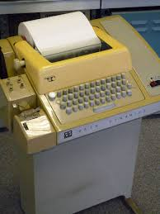



My start in computing at school in 1979
58 in human years – 243 in tech years
Where/what were you in 1979?
Brighton, UK
Source:Wikimedia Commons
Source:Wikimedia Commons
1980: At University, I studied Chemistry and used MS-DOS, client/server main frame systems.
ZX-Spectrum computer and Jupiter Ace.
15 min walk
The English Channel
Source:Wikimedia Commons
Source:Wikimedia Commons

Slide 4
In and out of tech over the years
Microsoft Certified Systems Engineer (2000-2003)
Microsoft Certified Database Administrator (SQL2000)
Business Information Architect at a UK Recycling Company
WordPress 2017
Currently PWAs(offline/instant websites), Web Components, WordPress-HTML and Mobile Web Optimisation.
1-3 hour training seminars for companies and groups.
Still just as ‘student’! Still overwhelmed!
Volounteer Coach at Codebar.io (Brighton)

Slide 5
PREVIOUS TALKS
What is the WP REST API and how can I use it to make forms and pages that don’t need to do be reloaded? - WordUp Brighton May 2020.
WORKSHOP: WordPress REST API and AJAX Forms - WordCamp Geneva March 2020 [EVENT CANCELLED due to virus concerns :( ]
TALK - WP-HTML: The marriage of WP and JS Frameworks for expansion, ubiquity and profit - WordCamp Vienna February 2020.
WORKSHOP: WordPress REST API - WordCamp Vienna February 2020.
Progressive Web Apps - Brighton WordUp November 2019.
Decoupled WordPress (code along style) - WordCamp Dublin October 2019.
JWT and Authentication – WPHooked London September 2019.
Decoupled WordPress and WP Components - WordCamp Brighton August 2019.

Slide 6
Purpose of workshop
To give an overview of all aspects of Web Components.
Prepare you to use all the workshop resources after the workshop.
Demonstrate with examples how to create highly functional Web Components.

Slide 7
What is a Web Component?
<my-component></my-component>
<script src=“file.js”></script>
Must contain at least one hyphen.
Part of the browser specifications so can be used just like regular HTML tags. They extend HTMLElements class.
https://www.webcomponents.org/
https://custom-elements-everywhere.com/ (Making sure frameworks and custom elements can be BFFs )

Slide 8
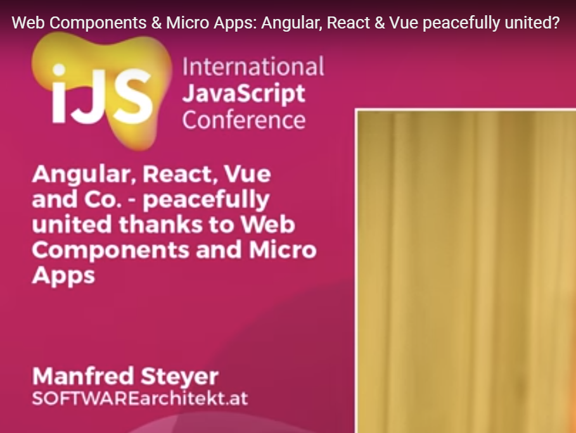
International JS Conference London 2018 – Key Note Speech

Slide 9

<script src=“bundle.js”></script>
<div id=“app”>
HTML
WordPress
Framework 1
Framework 2
Framework ...n

Slide 10

WordPress
HTML
WEB COMPONENTS
Web Components
WP PHP PAGES
Gutenberg Blocks
Framework 1
Framework 2
Framework ...n

Slide 11
Why do I use them?
I use them to convert a large monolithic application that is PHP and WP specific into an HTML decoupled site cross domain.
Enable WP to be a micro front end service to other sites.
We will look at a demo shortly…

Slide 12
Why use them?
Why use HTML? (<dialog>, <video>…)
Create HTML plugins/widgets/.
Code modularity/design.
Be a component maker rather than a specific framework developer.
Engage in cross framework apps.
Use components in any framework, PHP pages and in WP Gutenberg blocks.

Slide 13
BUILD TOOLS
JS compilers (not frameworks):
Stencil JS
Lit Element/Lit HTML
Hybrids
Wrappers:
Svelte (?), Vue, Angular etc have builds that add a web component wrapper.

Slide 14
TYPES OF COMPONENTS
These are only limited by JS.
We will look at couple of UI components and many more highly functional components that have built in:
Fetch requests.
Lazy loading and dynamic loading (scripts/components).
Storing JSON in IndexedDB and rendering it via templates.
Authentication and storage of JSON Web Tokens.
Added offline capability and ‘instant’ pages.
Let’s see an example: https://wp-html.co.uk/semantic
(Vanilla JS)

Slide 15
DEPLOYMENT
How to deploy Web Components as a third party:
In HTML pages as we have seen.
NPM
In Angular, Vue, React etc. There are well documented procedures.

Slide 16
SUMMARY
Craig West
wpjs.co.uk
craig@wpjs.co.uk

