Slide 1
UNDERGRAD
STRESS + SLEEP
AT BU
Ania Shaheed, Riya Parikh, Adhya Hoskote
DS 110 Final Presentation

Slide 2
01
The Project
What did we want to achieve?

Slide 3
Problem statement
Do different majors experience different amounts of stress?
Do STEM students sleep more than, less than, or the same amount as non-STEM students?
Notes:
Stress isn't always bad–there is eustress, which, in small amounts, can help motivate people under pressure. Some academic majors are bound to be more demanding than others.
STEM courses are notoriously difficult. While school is not the only factor in a how much sleep a student gets, amount of homework definitely contributes.

Slide 4
Backstory
Our friends in humanities majors seem to be less stressed, have a lighter workload, and get more sleep
Testing the validity of stereotypes about STEM students
Stress is prevalent issue
Notes:
This statistic is from a journal article published by the Texas A&M https://web-p-ebscohost-com.ezproxy.bu.edu/ehost/pdfviewer/pdfviewer?vid=0&sid=2d8bc0db-2418-4116-8fd7-777da66093f7%40redis
This shows the stress scale of American College students compared to students in International Universities – this infers that on average American students in college are more stressed than students studying internationally (for all 4 years)
RESULTS Statistical Analysis
“Confirmatory factor analyses were conducted on the 51 items measuring academic stress to examine the factorial structure of constructs of academic stressors and reactions to stressors for American and international student participants. Univariate analysis was done to investigate differences between the American and international students for all five academic stressors and four reactions to stressors. Effect sizes, as determined by Cohen’s (1988) d, were calculated to determine the magnitude of the difference.”

Slide 5


Hypotheses
Tests
H₀:
Perceived stress levels are not correlated to one’s major at BU.
H_{A}:
Perceived stress levels are correlated to one’s major at BU.
H₀:
Amount of sleep is not correlated to STEM/Non-STEM at BU.
H_{A}:
Amount of sleep is correlated to STEM/Non-STEM at BU.

Slide 6
02
Methods
What did we do?

Slide 7




Our Process
Survey
Chi-Square Tests
Clean data
Analysis

Slide 8



Collecting Data
Survey
1
3
Grade
School
Major
Major type
# credits
Time spent HW, studying, free time
Overall grades
Daily stress (1-10)
Stress effects
Biggest causes of stress
Hours of sleep on weekday/end
2
4
Collection method: Google Forms
Min # of Responses: 100
Source population: full-time, undergrad students at BU

Slide 9

Cleaning Data
1
3
2
4

Slide 10
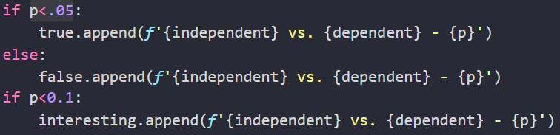
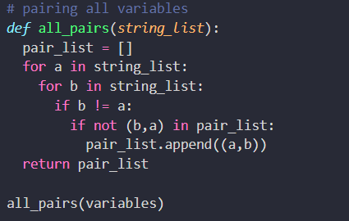

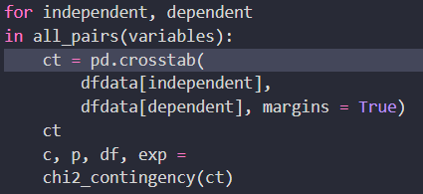
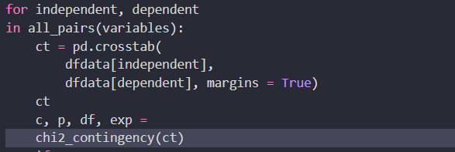
Statistical Tests
1
3
2
4
Pairing and test all survey variables
chi2_contingency from scipy.stats
crosstab from pandas

Slide 11
Analysis
1
3
2
4

Slide 12
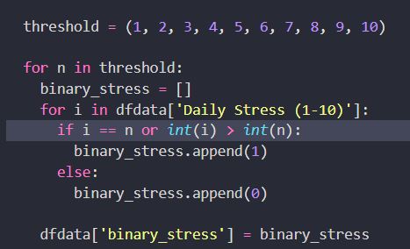
Unexpected Challenge
Insufficient overlaps between certain categories → unacceptable to use chi-square test → introduce threshold

Slide 13
The Outcome
04
What did we find?

Slide 14
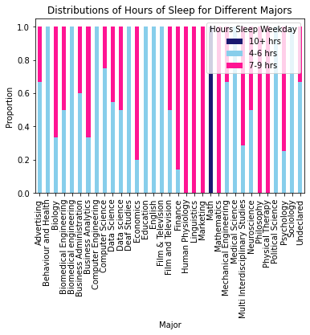
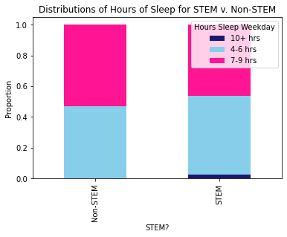
Interesting Result

Slide 15
Conclusions
Stress v. Major
p = 0.579
Failed to reject H₀, inconclusive results
Sleep v. STEM
p = 0.918
Failed to reject H₀, inconclusive results

Slide 16
Fun
A Random Discovery
Fact

Slide 17
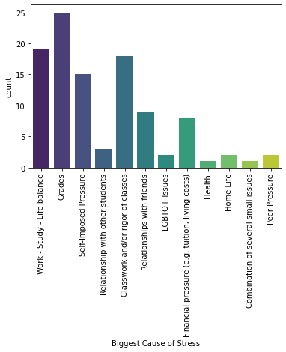
Fun Fact
We were quite surprised that financial pressure was not one of the biggest stressors - it didn’t even place in the top 5!

Slide 18
The
End

