Slide 1

Safe Shopper
By KiwiBanan

Slide 2
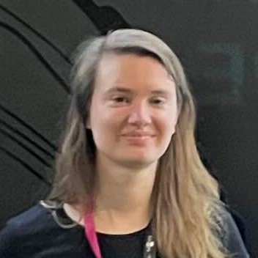
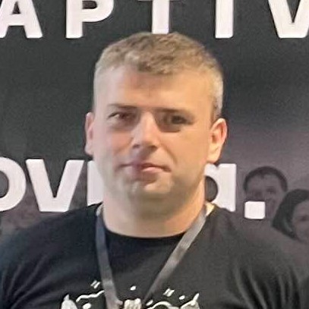
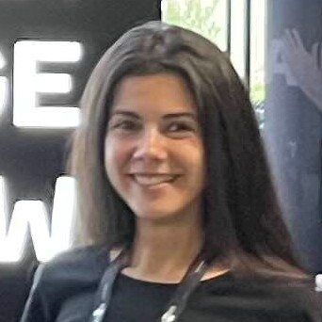
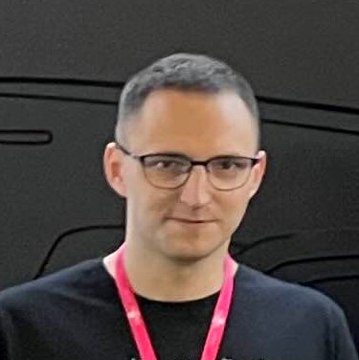
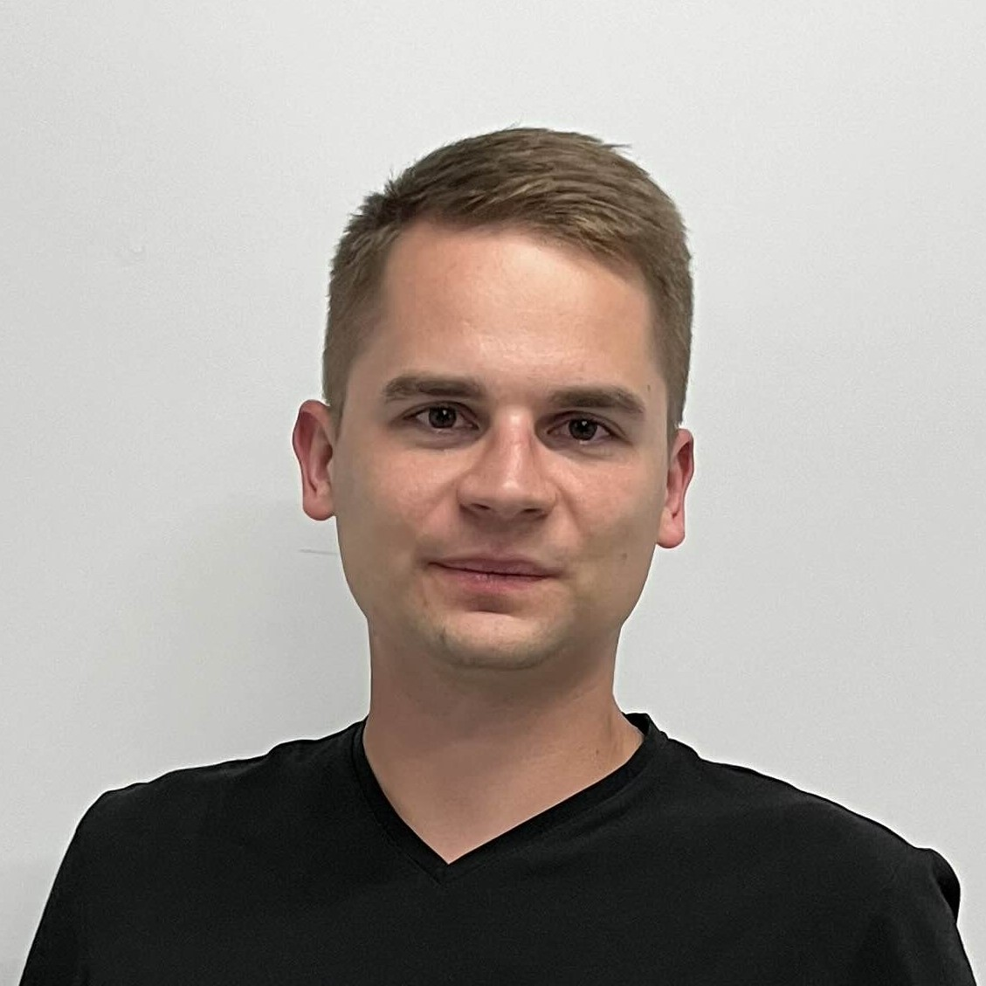
The Team
Anna Metz
Full-Stack
Piotr Weszka
Back-End, DevOps
Diana Melikian
Front-End
Pawel Wojtala
Back-End
Filip
ML

Slide 3
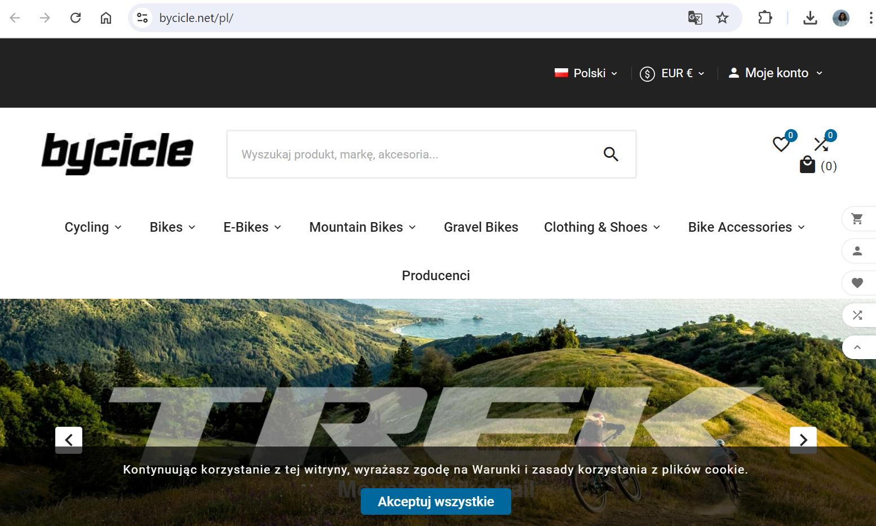
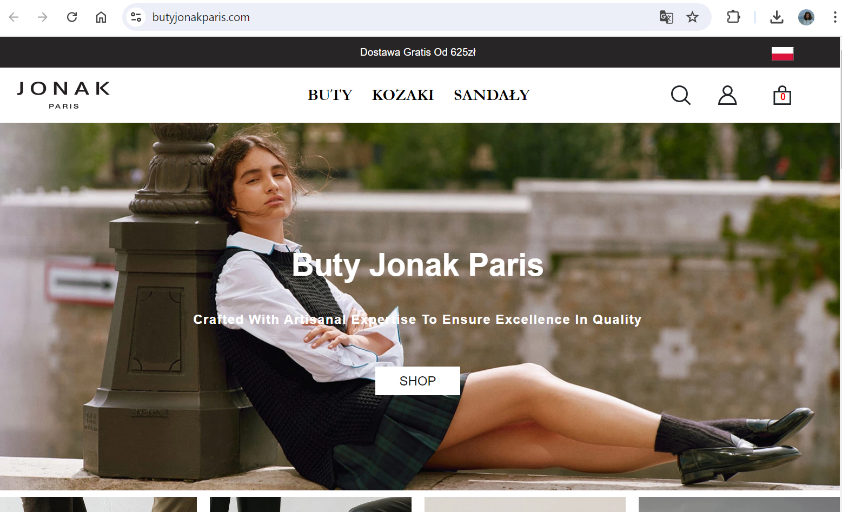
Do these websites seem legit?
https://www.bycicle.net/pl/
https://www.butyjonakparis.com/

Slide 4
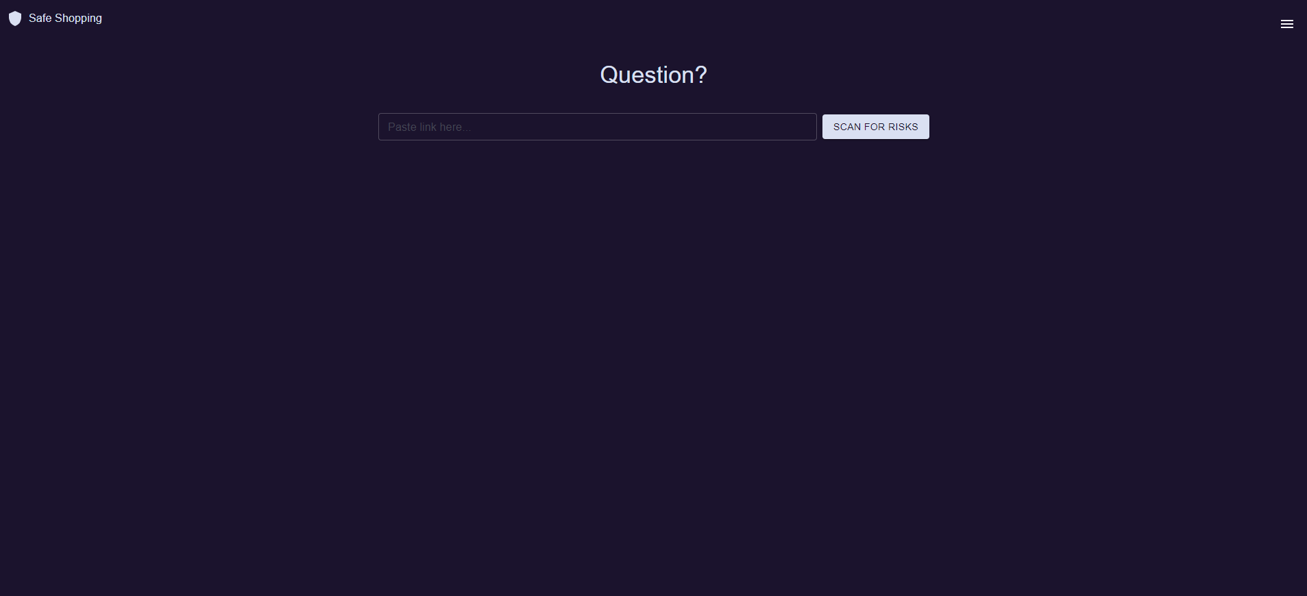

Slide 8
Tech Stack
Python
Flask
SQL
AWS
TypeScript
React

Slide 9

Happy shopping!

