Slide 1

Developing a Nose for Code-Smells
Anibal Velarde
Sr. Solutions Architect @ Aon

Slide 2
My Feelings Towards Code Reviews
I don’t do them as often as I should
I want to get better at it
Could not find the time
Everyone does it their way
I don’t want to insult you but…
I have no idea what this code is doing
I’ve never used that C# keyword

Slide 3
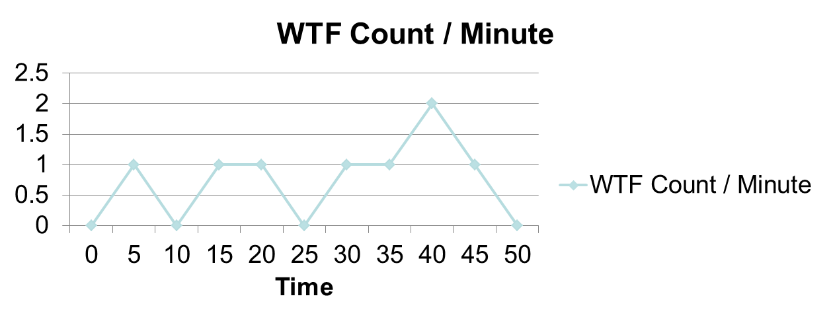
Characteristics of Good Code
What is the best way to measure code quality during a code review?
Good Code!

Slide 4
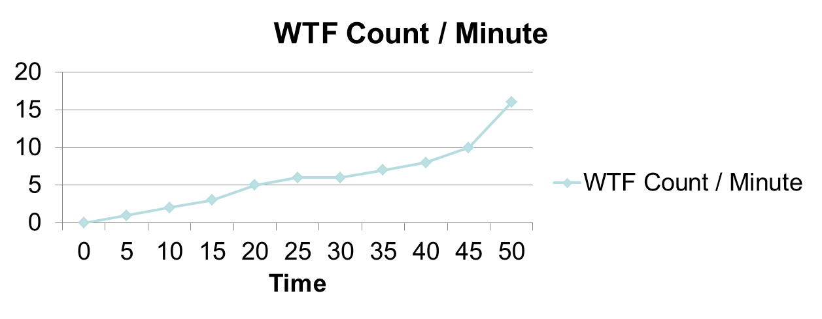
Characteristics of Good Code
What is the best way to measure code quality during a code review?
Bad Code!

Slide 5
Dealing with Toxic Levels of Smelly Code
One approach
  Ridicule the offender to the point that they would not want to use any keyboard ever again (not recommended)
Another approach
  Build and edify your team (even if it is one person at a time)

Slide 6
Tour of Refactoring Guru
It is free
It is informative
It is useful
It can be shared with the code-offender in question
From the site:
  Refactoring.Guru is a shiny website where you can find tons of information on refactoring, design patterns, SOLID principles and other smart programming topics.

Slide 7
Switch to RG for walk-thru of some scenarios
https://www.refactoring.guru

Slide 8
Thanks for Watching!
Questions?
Comments?
Do you use other tools?
How do you deal with smelly code?
Please, share your thoughts

